Slide 1
ACIDS AND BASES

Slide 2
DEFINING ACIDS AND BASES
Acids produce H⁺ ions.
Bases produce OH⁻ ions.
When something is neutral, it has equal amounts of H⁺ and OH⁻.
Usually, acids and bases are dissolved in water; water provides both H⁺ and OH⁻ ions.
Sometimes you will see H₃O⁺ (hydronium ion) instead of H⁺ (hydrogen ion).

Slide 3
DEFINING ACIDS AND BASES
Acids and bases can be understood in terms of the ions they release when they dissolve in water.
An acid is a substance that dissociates in water to produce hydrogen ions (H⁺).
A base is a substance that dissociates in water to produce hydroxide ions (OH⁻).
HCl + NaOH → NaCl + H₂O
H⁺ + Cl⁻ + Na⁺ + OH⁻ → Na⁺ + Cl⁻ + H₂O (HOH)

Slide 4
pH SCALE
The pH scale is the measure of hydrogen ion concentration and acidity.
It measures from 0 to 14.
pH of an acid = 0 up to but not including 7
pH of a base = 14 down to but not including 7
pH of neutral = 7

Slide 5
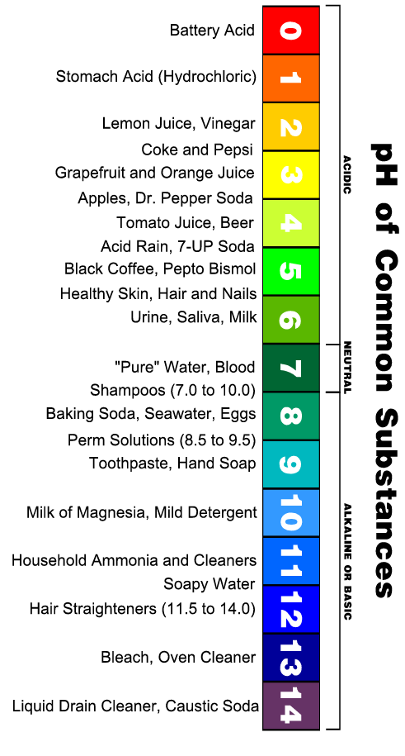
pH SCALE

Slide 6
pH SCALE
The smaller the pH, the more acidic the solution.
Three methods to measure pH:
Litmus paper, indicators - usually measure a range and are not as accurate.
pH paper – measures within a number or two and more accurate than litmus.
pH meter – electronically measures pH

Slide 7

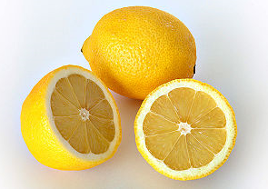
ACIDS AND BASES PROPERTIES
A. Taste
Acids taste sour or tart.
Bases taste bitter.

Slide 8
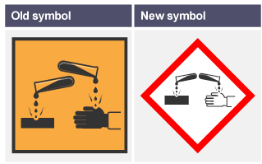
ACIDS AND BASES PROPERTIES
B. Touch
Dilute acids feel like water. Stronger acids are corrosive.
Mild bases feel smooth and slippery. Strong bases are corrosive.

Slide 9
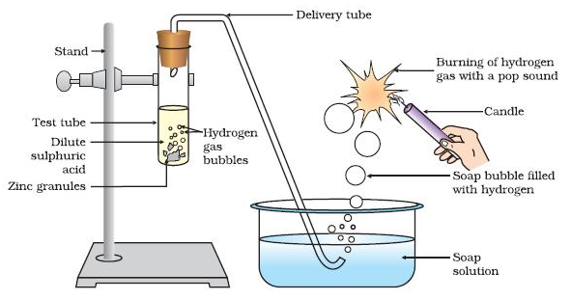
ACIDS AND BASES PROPERTIES
C. Reaction with metals
Acids react vigorously with metals, sometimes producing a gas. Mg + HCl → MgCl₂ + H_{2 (g)}

Slide 10
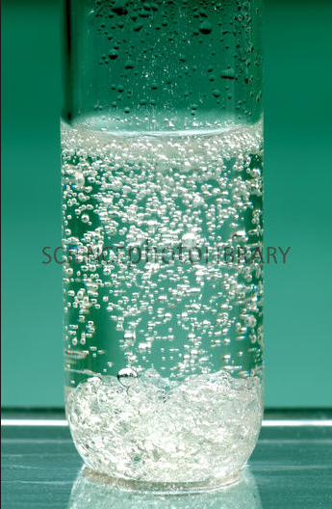
ACIDS AND BASES PROPERTIES
D. Reaction with Carbonates/Hydrogen Carbonates
Acids react vigorously with carbonates or hydrogen carbonates, producing a gas.
NaHCO₃ + HC₂H₃O₂ → NaC₂H₃O₂ + H₂O + CO₂

Slide 11
ACIDS AND BASES PROPERTIES
E. Electrical conductivity
Pure water is an extremely poor conductor of electricity.
An aqueous solution of a strong acid or base conducts electricity well.
Acids and bases are examples of electrolytes.
Electrolytes ionize when they dissolve in water.
A solution containing electrolytes conducts electricity.

Slide 12
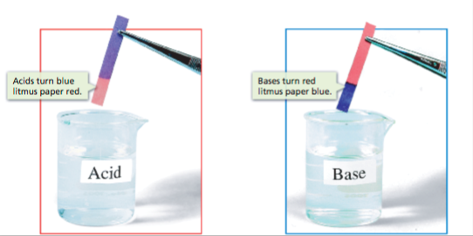
ACIDS AND BASES PROPERTIES
F. Indicators
An acid-base indicator is a substance that turns one color in an acidic solution and another color in a basic solution.
Examples:
    Litmus - acid is red and base is blue
    Phenolphthalein – acid is colorless or white, base is pink

Slide 13
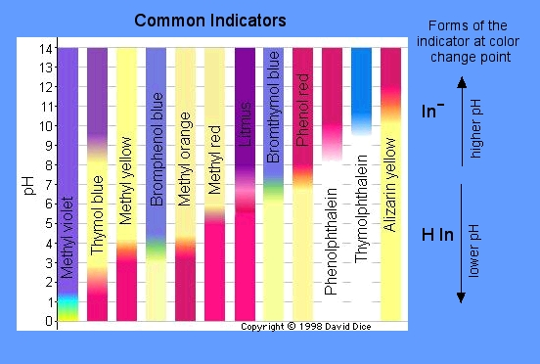
indicators

Slide 14
ACIDS AND BASES PROPERTIES
G. pH
Acids: pH 0 – 7
Examples:
      Stomach acid – pH 2
      (known as hydrochloric acid)
      Vinegar – pH 3
      (known as acetic acid)
      Soft Drink – pH 4
      (known as carbonic acid)
Bases: pH 7-14
Examples:
      Baking Soda – pH 9
      Ammonia – pH 11
      Bleach – pH 13

