Slide 1
ACIDS AND BASES
Chapter 18

Slide 2
STRENGTHS OF ACIDS
DEMO: HCl and Acetic acid
1. What happens when the concentration of hydrochloric acid and acetic acid (vinegar)goes down?
2. Why does hydrochloric acid have a brighter glow than acetic acid?

Slide 3
STRENGTHS OF ACIDS
Ions can carry electricity through a solution and HCl forms more ions than acetic acid does.
A strong acid readily gives up H⁺ ions.
Strong acids react completely to form ions and are therefore, strong electrolytes. These acids produce the maximum amount of ions.
HCl _{(aq)} + H₂O_{(aq)} → H₃O⁺_{(aq)} + Cl⁻_{(aq)}
strong acid - one way arrow

Slide 4
STRENGTHS OF ACIDS
A weak acid transfers only some of its H⁺ ions to water.
Weak acids, because so many fewer ions are formed, are weak electrolytes.
The ions only partially ionize.
HC₂H₃O_{2(aq)} + H₂O_{(aq)} ↔ H₃O⁺_{(aq)} + C₂H₃O₂⁻_{(aq)}
weak acid - reversible arrow

Slide 5
Strength of acids
Strong Acids
Hydrochloric (HCl) – stomach acid
Sulfuric (H₂SO₄)
Nitric acid (HNO₃) – battery acid
Weak Acids
Acetic acid (HC₂H₃O₂) – vinegar
Citric acid (H₃C₆H₅O₇) – fruit acid

Slide 6
STRENGTH OF BASES
Strong bases are also strong electrolytes because they completely ionize in water.
Weak bases only partially ionize and are considered weak electrolytes.
Strong Bases:
  sodium hydroxide (NaOH)
  calcium hydroxide (Ca(OH)₂)
Weak Bases:
ammonia (NH₃)

Slide 7
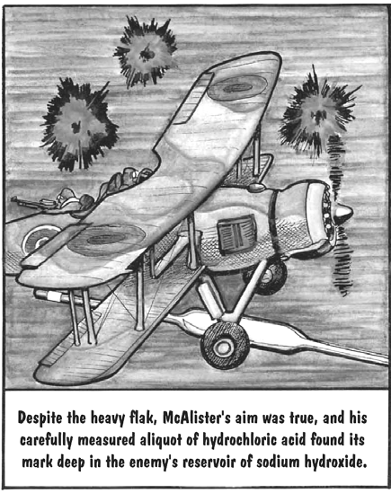
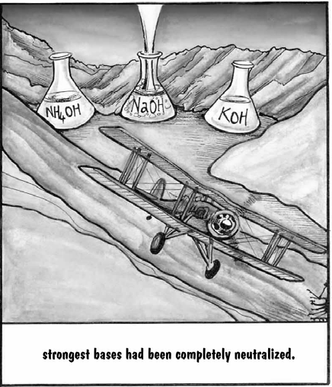

Slide 8
NEUTralization reactions
Chemical reaction that occurs when H₃O⁺ ions from an acid react with OH⁻ ions from a base to produce water molecules.
The reaction of an acid and a base to form a salt and water.
If an acid and a base are mixed together, two new compounds are formed.
It is usually a double replacement reaction.
HClO_{3(aq)} + NaOH_{(aq)} → H₂O_{(l)} + NaClO_{3(aq)}
acid base water salt

Slide 9
NEUTralization reactions
The properties of the acid and base are destroyed; the acid and base are neutralized. Meaning, their pH is much closer to neutral, pH = 7.
One of the products formed is always an ionic compound and is called a salt.
HClO_{3(aq)} + NaOH_{(aq)} → H₂O_{(l)} + NaClO_{3(aq)}
acid base water salt

Slide 10
BUFFERS
pH must, at times, be controlled within very narrow limits. One way to do this is with a buffer.
A BUFFER is a solution containing ions that react with added acids or bases and minimize their effects on pH.
It resists a change in pH.
The mixture of ions and molecules in a buffer solution resists change in pH by reacting with any H⁺ or OH⁻ added to the solution.

Slide 11
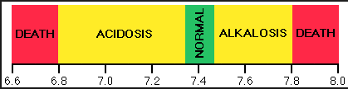
buffers
You have buffers in your blood to help regulate the pH of your blood.
A pH of 7.4 must be maintained in the bloodstream.
It can deviate only within narrow limits – 0.3 pH units up or down.
Acidosis occurs if the blood pH falls below 7.1.
Alkalosis occurs when the blood pH rises above 7.7. Some experience cramping due to lactic acid build-up in muscles.

