Slide 1

KINGDOM ANIMALIA
KINGDOM ANIMALIA

Slide 2
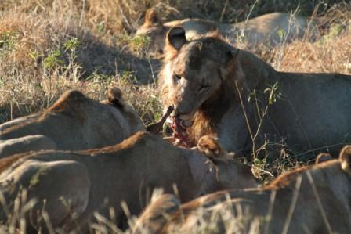
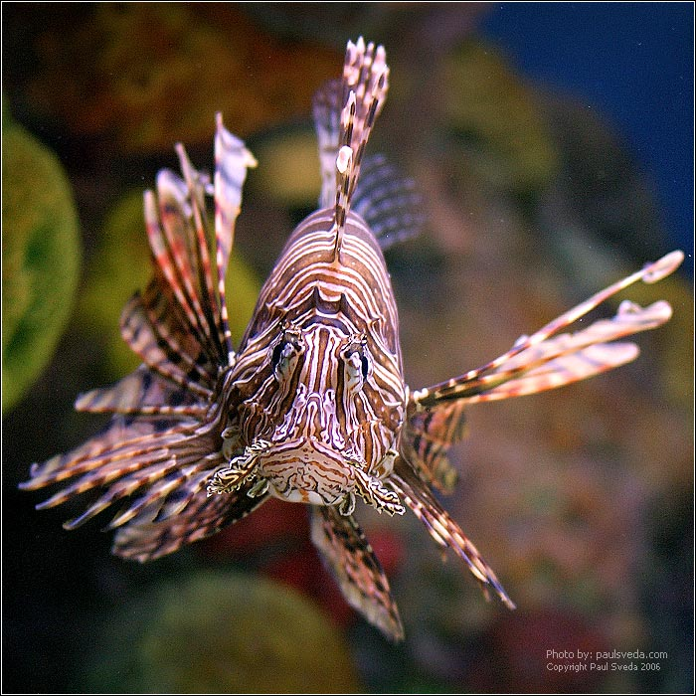
KINGDOM ANIMALIA
Multicellular
Eukaryotes
Most have tissue, organs, and organ systems.
NO Cell wall
Aerobic Heterotrophs – ingest other organisms or withdraw nutrients from them.
Notes:
Growth, with increases in size and number of cells, is part of development.
Development involves many stages from conception until death.

Slide 3
KINGDOM ANIMALIA
Reproduce sexually. Many also reproduce asexually.
Embryos develop through a series of stages.
Most animals are motile; they actively move about during all or part of the life cycle.
Notes:
Growth, with increases in size and number of cells, is part of development.
Development involves many stages from conception until death.

Slide 4
KINGDOM ANIMALIA
Domains | EUKARYA
Kingdoms | ANIMALIA
Cell Type – Prokaryote or Eukaryote | EUKARYOTE
# of cells – Unicellular or Multicellular or Both | MULTICELLULAR
Cell Structure – Cell wall composition | NO CELL WALL
Nutrition – Autotroph or Heterotroph or Both | HETEROTROPHS

Slide 5
LEVELS OF ORGANIZATION
Sponges are the ONLY animals that have just the cellular level.
All other animals show these levels – cell, tissue, organ, and system.
Cells may specialize (take own different shapes and functions).
Cells are held together by cell junctions to form tissues.

Slide 6
Atom
Molecule or compound
Organelle
LEVELS OF ORGANIZATION
CELL
Tissue
Life begins
Organ
Organ system
Organism

Slide 7
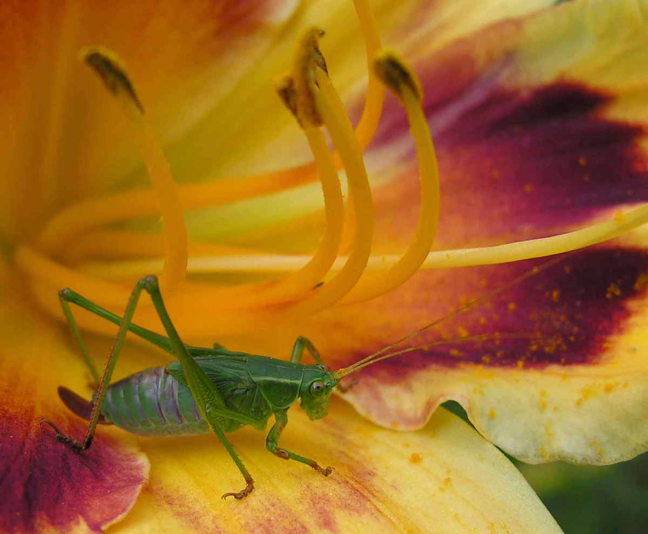
INVERTEBRATE GROUPS

Slide 8
CHARACTERISTICS OF INVERTEBRATES
Simplest animals
Contain the greatest number of different species
Most are aquatic (found in water)
Do NOT have a backbone
Includes sponges, cnidarians, flatworms, roundworms, annelids, mollusks, arthropods, and echinoderms

Slide 9
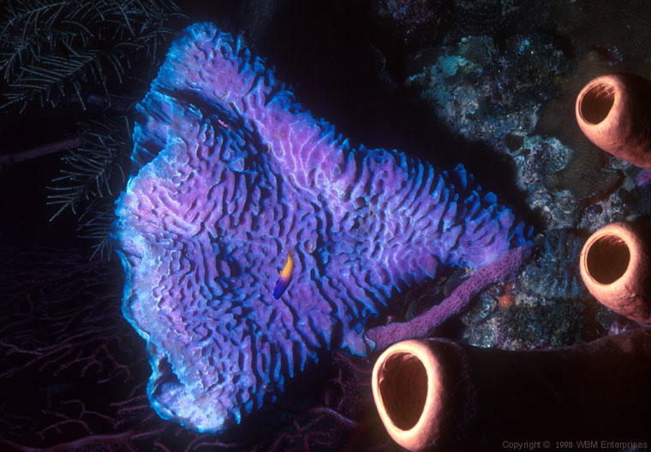
PHYLUM PORIFERA – Sponge
Osculum of Sponge

Slide 10
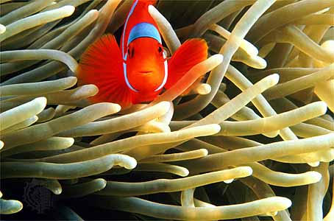
PHYLUM CNIDARIA – Sea Anemone
Tentacles of Sea Anemone

Slide 11
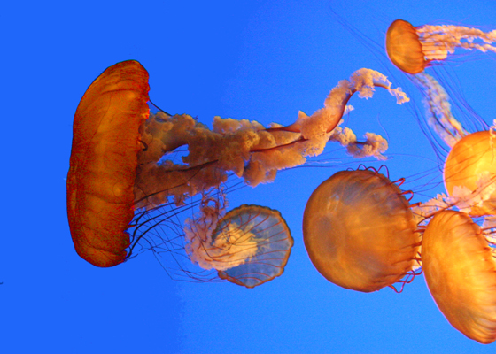
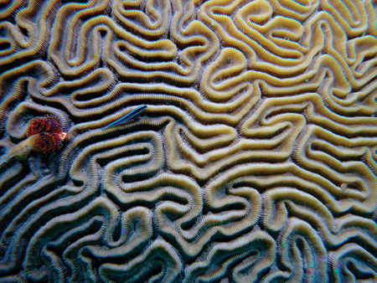
MORE CNIDARIANS
Brain Coral
Red jellyfish

Slide 12
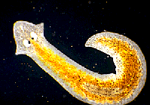
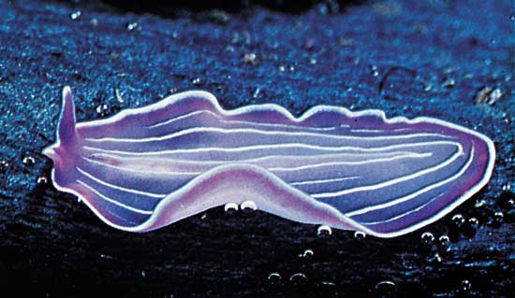
PHYLUM PLATYHELMINTHES – FLATWORMS
Marine Flatworm
Planarian

Slide 13
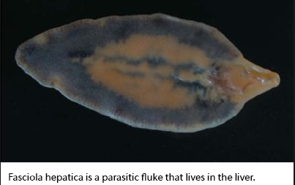
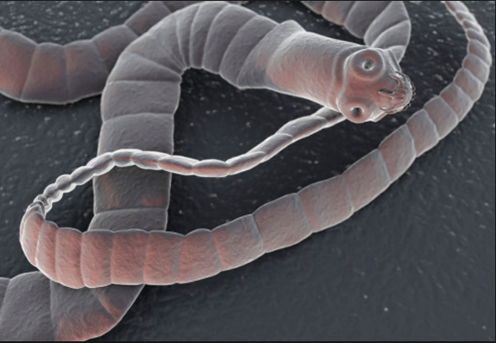
MORE PLATYHELMINTHES
TAPEWORM

Slide 14
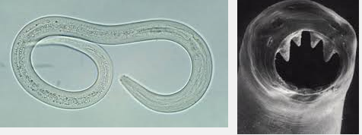
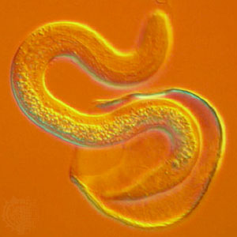
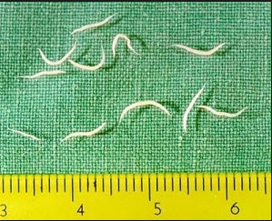
PHYLUM NEMATODA - roundworms
Hook worm
Pin worm
Nematode

Slide 15
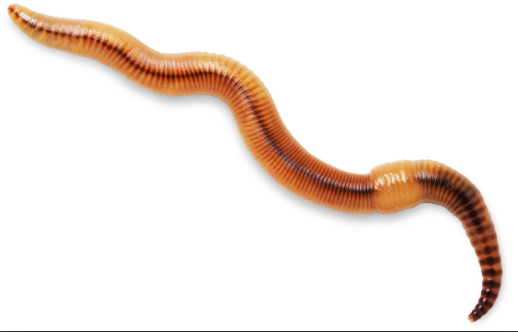
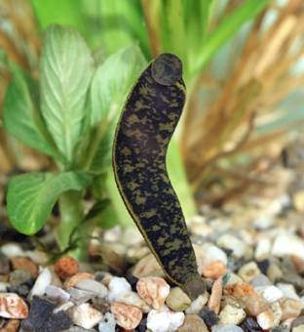
PHYLUM ANNELIDA - Segmented Worms
Leech
Earthworm

Slide 16
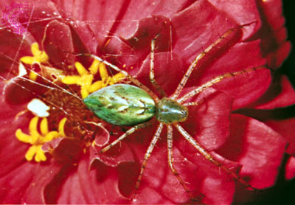
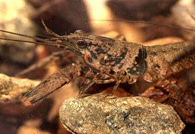
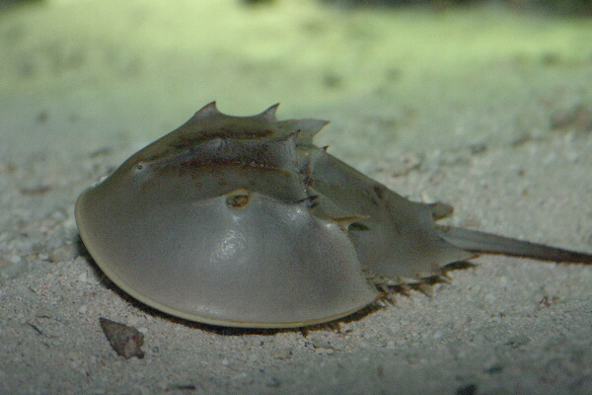
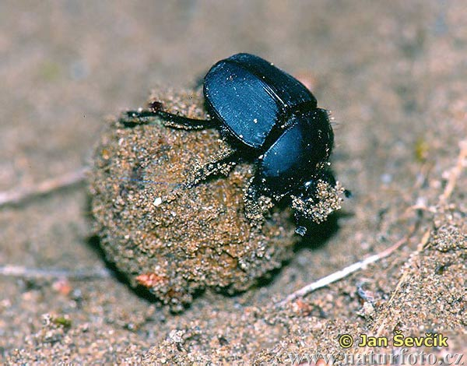
PHYLUM ARTHROPODA (crustaceans, spiders, insects)
spider
crayfish
Horseshoe crab
Dung beetle

Slide 17
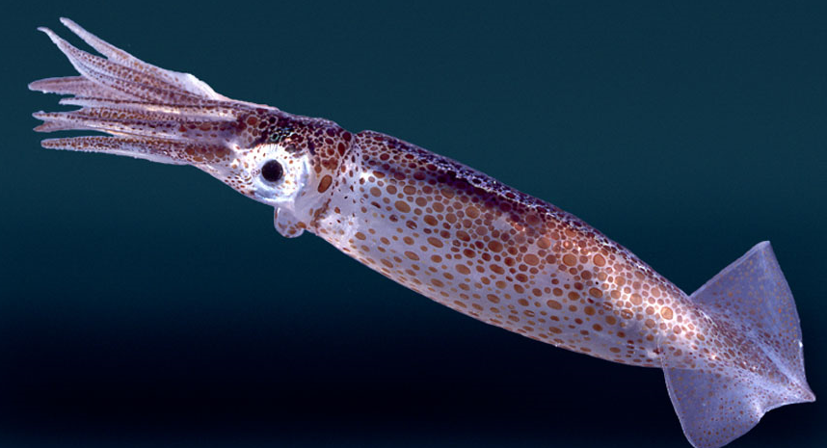
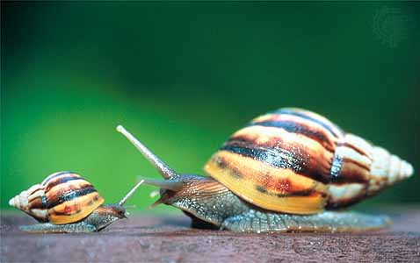
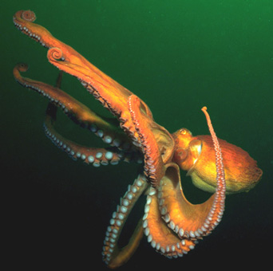
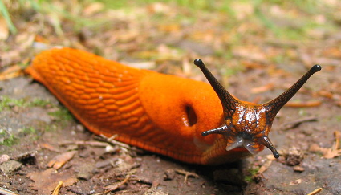
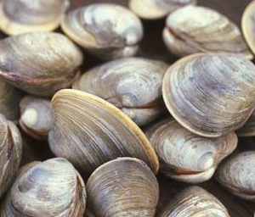
PHYLYM MOLLUSCA
squid
snail
octopus
slug
clams

Slide 18
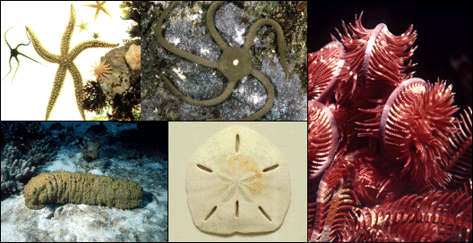
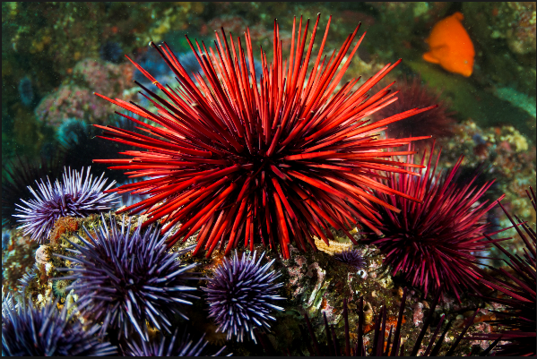
PHYLUM ECHINODERMS
starfish
Sea fan (crinoid)
Brittle star
Sea urchin
Sand dollar

Slide 19
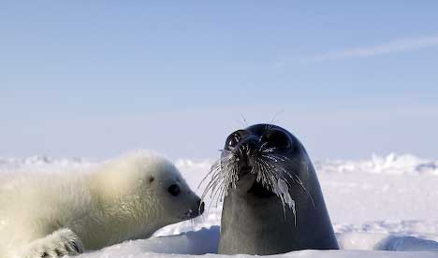
VERTEBRATE GROUPS

Slide 20
PHYLUM CHORDATA
More complex animals
Most have a backbone made up of individual bones called vertebrae
Invertebrates: tunicates, lancelets
Vertebrates: fish, amphibians, reptiles, birds, mammals

Slide 21
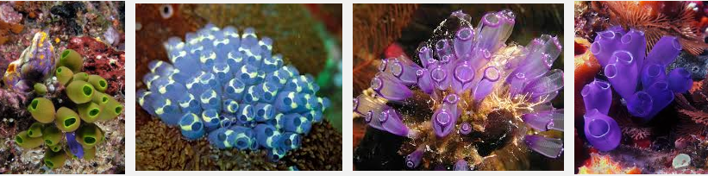
TUNICATES

Slide 22
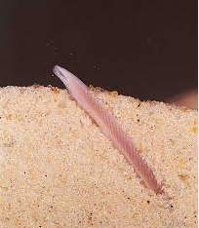
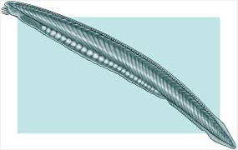
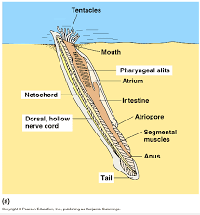
LANCELETS

Slide 23
SUBPHYLUM VERTEBRATA
Vertebrates have endoskeletons (internal)
Some vertebrates have skeletons of cartilage (sharks, rays, and skates)
Other vertebrates have skeletons of bone and cartilage (reptiles, birds, & mammals)

Slide 24
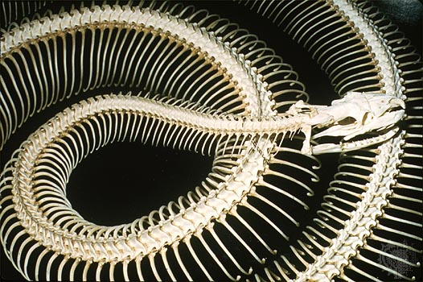
VERTEBRATE BACKBONE

Slide 25
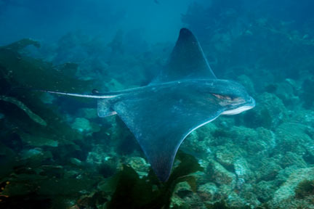
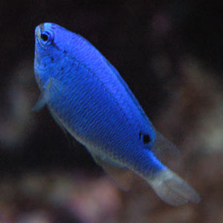
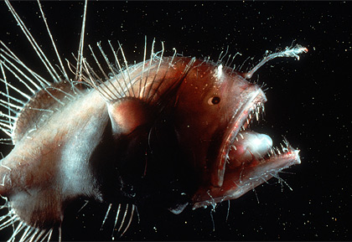
FISH
ray
damselfish
anglerfish

Slide 26
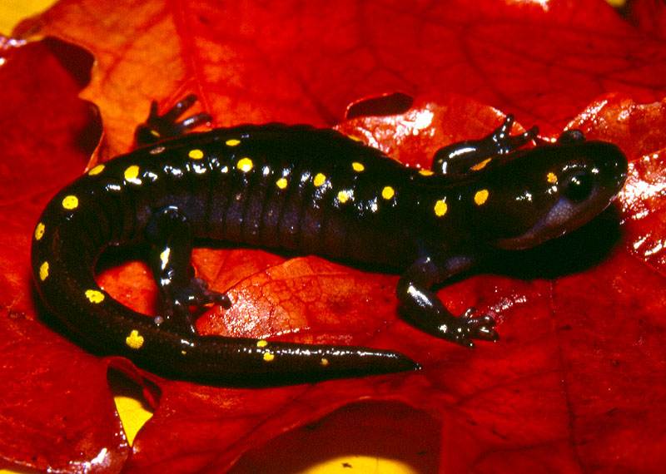
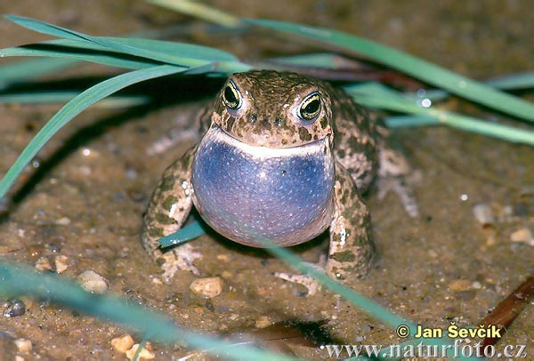
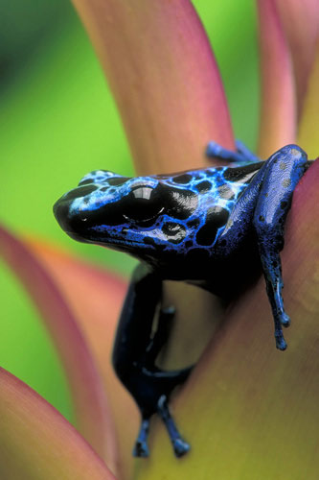
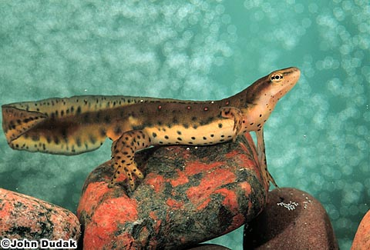
AMPHIBIA
salamander
toad
frog
newt

Slide 27
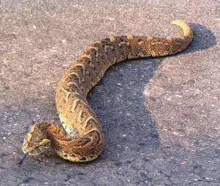
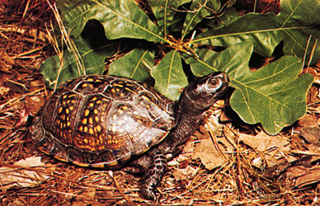
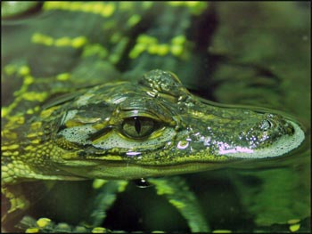
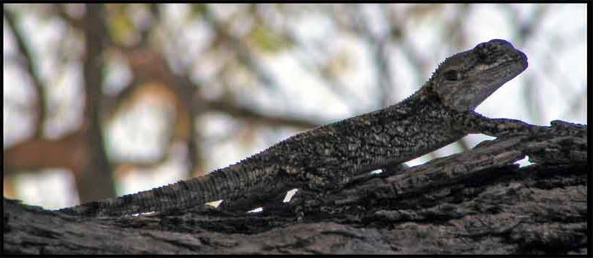
REPTILIA
Turtle
Snake
Lizard
Alligator

Slide 28
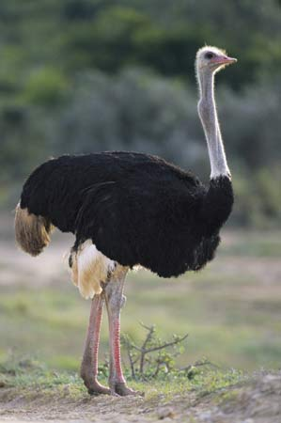
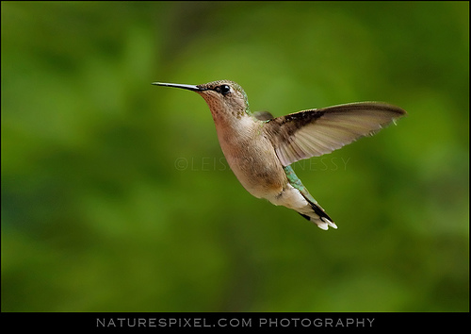
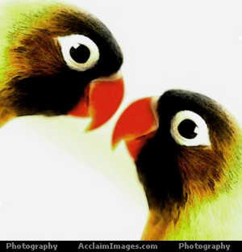
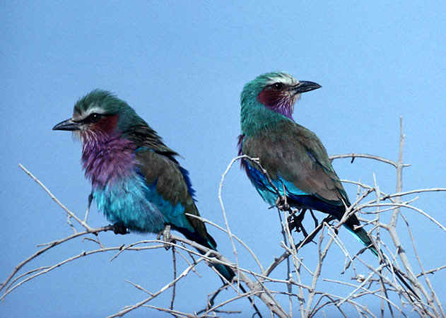
BIRDS - AVES
hummingbird
ostrich
lovebirds

Slide 29
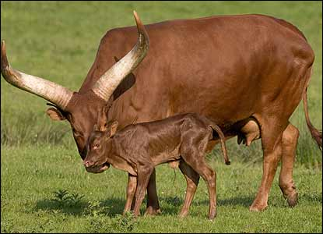
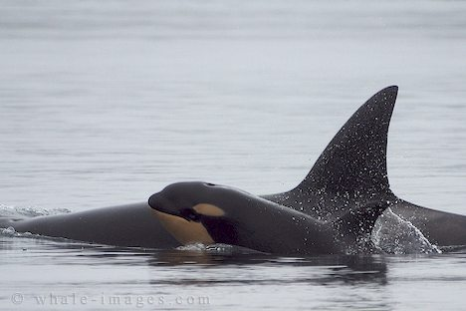


MAMMALIA

Slide 30
ANIMAL BEHAVIORS
Behavior – anything an organism does in response to a stimulus in its environment.
Behaviors develop through interactions between genes and environmental inputs.
Behavior is ADAPTIVE – adapting allows animals to survive!!!

Slide 31



BEHAVIORS
What are some things you are NOT born knowing?
These are learned behaviors.
  Wolves have instincts to eat prey animals, but they must learn from the pack leaders how to become successful hunters.
Notes:
Students at times get learned behaviors and instincts confused. Let them relate behaviors to themselves and then relate the talk to animals as well.
Wolves have instincts to eat prey animals, but they must learn from the pack leaders how to become successful hunters!!

Slide 32


TYPES OF BEHAVIORS
Innate Behavior
Learned Behavior

Slide 33


INNATE BEHAVIOR
From Latin: innatus meaning “inborn”.
Inherited or inborn behavior
Something an animal is born knowing how to do.
Includes both automatic and instinctive behaviors.

Slide 34

INNATE BEHAVIOR
Reflexes
Automatic response that requires no thinking at all.
a simple, inborn, automatic response by a part of the body to a stimulus.
Reflexes help animals respond quickly to a stimulus, thus protecting them from harm.

Slide 35

INNATE BEHAVIOR
Instincts
something which is engrained into that animal when it is still developing and hasn't even been born yet.
Instinct is thought to be hereditary, passed on from the parents.

Slide 36

INNATE BEHAVIOR
Territoriality
Animals that have territories will defend their space against others in their species or (sometimes) against other species.

Slide 37

INNATE BEHAVIOR
Aggression
A threatening behavior that one animal uses to gain control over another.
Used to fend off predators and competitors
Used to protect young and food sources.

Slide 38
INNATE BEHAVIOR
Submission
The weaker animal
involves an individual indicating by an act or posture that it will not challenge a dominant individual in a social group.
Helps maintain a social group hierarchy.

Slide 39

INNATE BEHAVIOR
Courtship
To find a mate
Courtship behavior helps many animals identify healthy mates.
Animal sends out stimuli in order to attract a member of the opposite sex.

Slide 40
INNATE BEHAVIOR
Behavior Cycles
Many animals respond to periodic changes in the environment with daily or seasonal cycles of behavior.
circadian rhythm – occur in daily patterns; uses external cues; important in the feeding and sleeping patterns of all animals

Slide 41


INNATE BEHAVIOR
Circadian rhythm

Slide 42
INNATE BEHAVIOR
Migration
– periodic movement from one place to another and then back again.
Uses geographical clues
Uses the Earth’s magnetic field
Can be triggered by hormones

Slide 43

MIGRATION

Slide 44

INNATE BEHAVIOR
Behavior Cycles
Hibernation
dormancy during winter;
characterized by low body temperature, slow breathing and heart rate, and low metabolic rate;
reducing the need for food
Can be caused by temperature change or day length change.

Slide 45


INNATE BEHAVIOR
Behavior Cycles
Estivation
dormancy during summer;
animals slow their activity for the hot, dry summer months.

Slide 46


LEARNED BEHAVIOR
Allows animals to adapt!
these behaviors are acquired or learned over time.
Organisms can alter their behaviors as a result of experience.
A result of previous experiences.

Slide 47

LEARNED BEHAVIOR
  Habituation
  organism decreases or stops its response to a repetitive stimulus that neither rewards nor harms the animal
  The simplest type of learning.
  By ignoring the stimulus, animals can spend their time and energy more efficiently.

Slide 48
LEARNED BEHAVIOR
Imprinting
when an organism forms an attachment to an object or other organism after birth and copies it.
For example, sparrows have an innate ability to recognize their own species’ song. To sing the complete version, the young birds must first hear it sung by the adults.

Slide 49


LEARNED BEHAVIOR

Slide 50
ADAPTATIONS FOR DEFENSE
Mechanical defense
occurs when an animal uses its physical structures such as claws, tusks, stingers and shells.
Is incorporated into the physical structure of the organism.
Other examples of mechanical defense include camouflage, cryptic coloration, disruptive coloration, counter shading, etc.

Slide 51

ADAPTATIONS FOR DEFENSE - camouflage

Slide 52
ADAPTATIONS FOR DEFENSE
Chemical defense occurs when the animal produces stinging sensations, paralysis, poisoning, or just a bad taste
Most common in insects, but the skunk is a particularly dramatic mammalian example. Another example includes the bombardier beetle which can accurately shoot a predator with a stream of boiling poison.
The most poisonous animal on earth is the 2 inch long (5cm) golden poison dart frog. It has enough venom to kill 10 adult humans or 20,000 mice.

Slide 53

ADAPTATIONS FOR DEFENSE - chemicals

Slide 54
TO DO
25 Animals with Insane Survival Adaptations

