Slide 1
SAT VOCABULARY
analogous (adj.) similar to, so that an analogy can be drawn
dynamic (adj.) actively changing; powerful
paradox (n.) an apparently contradictory statement that is perhaps true
verdant (adj.) green in tint or color

Slide 2
SAT VOCABULARY
Coming back to school after a two week break is hard! It is _____________ to having to get out of bed after two hours of sleep – you just don’t want to do it. The _______________ is that we have to go back to school so that we can be done with it in May. You can only hope that your teachers and classes are ________________ so that the time will seem to go by fast. Before you know it, it will be spring and the grass with be ___________________ and the temperatures will be warm.

Slide 3
WATCH
How small is an atom?

Slide 4
The Development of the Theory on the Atom
Democritus to Bohr

Slide 5
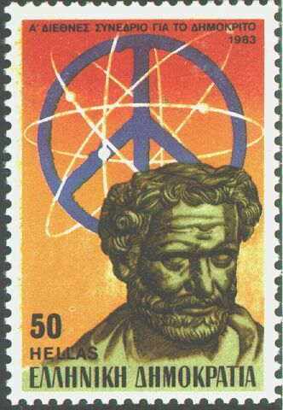
450 BC
Greek - Democritus
Atom was indivisible
Theorized the existence of the atom
Also, theorized that there were just four 'elements' - fire, water, air, earth

Slide 6
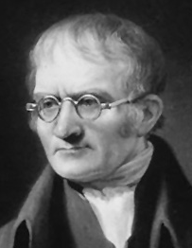
1803
John Dalton
Atom was indivisible.
All elements are composed of atoms.
The same atoms for one element are exactly alike.
Atoms are neither created nor destroyed in a chemical reaction.
In a chemical reaction, atoms are separated, combined, or rearranged.

Slide 7
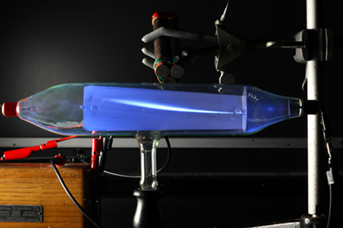
1897
J. J. Thomson
discovered the electron using the cathode ray tube.
determined that the electron was smaller than a hydrogen atom.
Knew the atom was neutral and the electron was negative, so there must be positive material with a lot more mass.

Slide 8
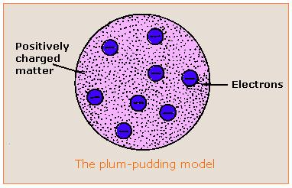
J. J. THOMSON
Said the atom was a positive pudding-like material throughout which negatively charged electrons were scattered - Plum Pudding or Chocolate Chip Cookie Model

Slide 9
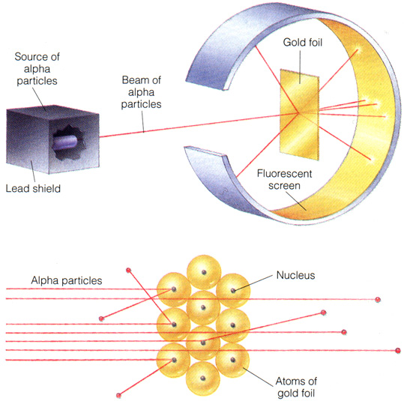
LASERDISC:

Slide 10
1909
Ernest Rutherford
Did a famous gold foil experiment (the alpha scattering experiment).
Calculated that the atom was mostly empty space through which electrons move.
Concluded that the atom has a small, dense, positively charged, centrally-located nucleus surrounded by negatively charged electrons.

Slide 11
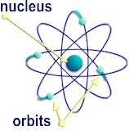
1919
Ernest Rutherford
Called the positive particles protons.

Slide 12
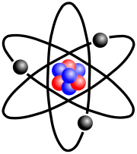
1932
Rutherford and James Chadwick
showed the nucleus also had neutrons.
The neutron was basically equal in mass to the proton but had no electrical charge.

Slide 13
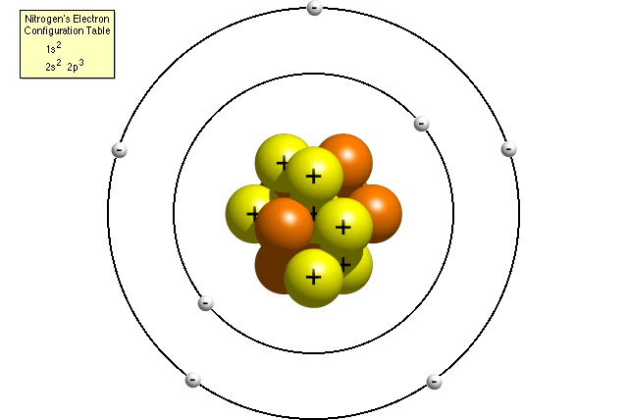
1914
Neils Bohr
Concluded that electrons moved around the nucleus in definite orbits or energy levels.

Slide 14
THE DIVISIBLE ATOM – REVISITING DALTON
Atom was indivisible. FALSE
All elements are composed of atoms. TRUE
The same atoms for one element are exactly alike. FALSE
Atoms are neither created or destroyed in a chemical reaction. TRUE
In a chemical reaction, atoms are separated, combined, or rearranged. TRUE

Slide 15
ATOMIC THEORY
THE ATOM IS
is spherically shaped .
with a dense, centrally located, positive nucleus containing protons and neutrons.
surrounded by one or more negatively charged electrons in an electron cloud.
Most of the atom’s volume consists of fast moving electrons traveling through the empty space that surrounds the nucleus.

Slide 16
ATOMIC THEORY
Electrons are held within the atom by an attraction to the positive nucleus.
The nucleus has neutral neutrons and positive protons and 99.9% of the mass.
Since atoms are electrically neutral, the number of protons must equal the number of electrons.

Slide 17
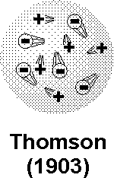
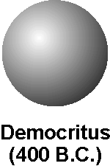

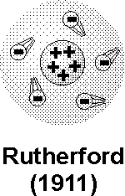

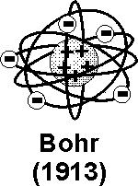
THE THEORIES THROUGH TIME

