Slide 1
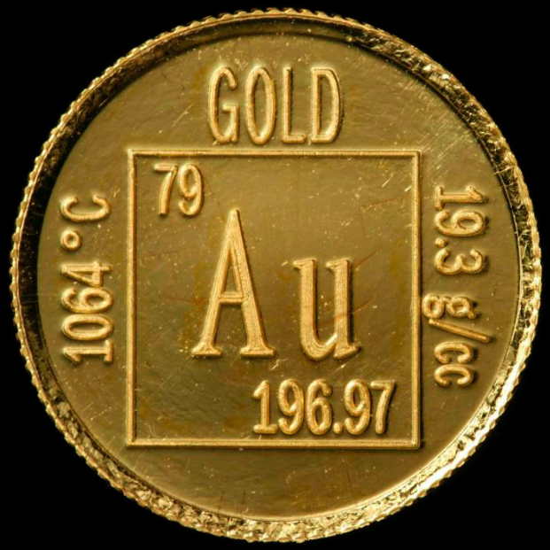
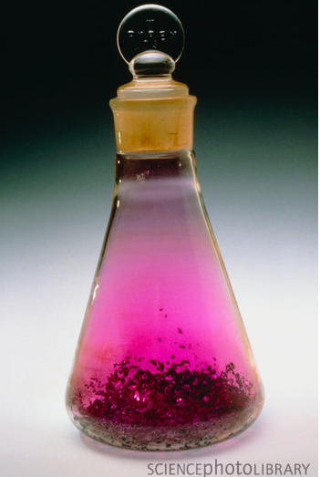
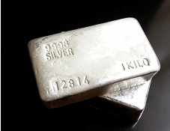
ELEMENT
One of the 114 known “pure” substances.
Listed on the periodic table.
Substance with all atoms that are alike.

Slide 2
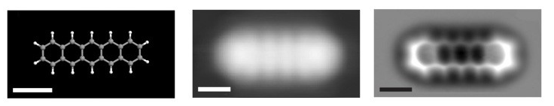
ATOM
Smallest piece of matter that still retains the properties of that matter.
Everything in the world is made of atoms.

Slide 3
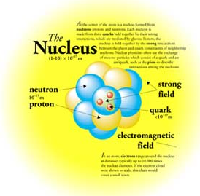
NUCLEUS
Center of the atom.
99.9% of the mass.
Contains two particle types.
Has a positive charge.

Slide 4
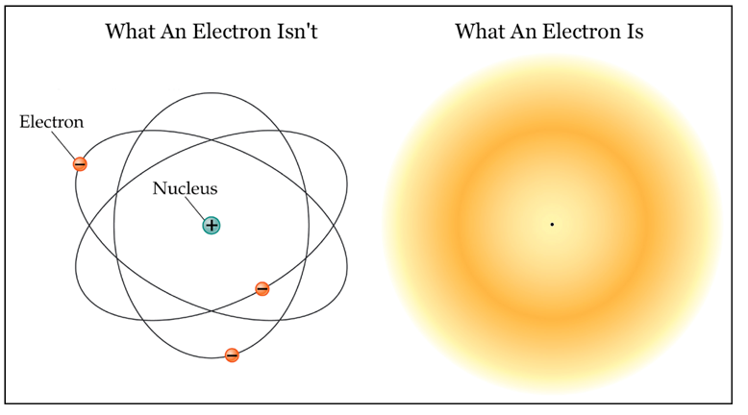
ELECTRON CLOUD
Surrounds the nucleus.
Contains one particle type.
Has a negative charge.

Slide 5
SUBATOMIC PARTICLES
PROTON
All are identical, regardless of the element.
Location: NUCLEUS
Charge: POSITIVE, p+
Relative Mass: 1 amu

Slide 6
SUBATOMIC PARTICLES
NEUTRON
All are identical, regardless of the element.
Location: NUCLEUS
Charge: NEUTRAL, n°
Relative Mass: 1 amu

Slide 7
SUBATOMIC PARTICLES
ELECTRON
Location: ELECTRON CLOUD
Charge: NEGATIVE, e-
Relative Mass: 1/1840 amu
Number in an atom:
number of electrons = number of protons (neutral atom)

Slide 8
WATCH
Structure of the Atom

Slide 9
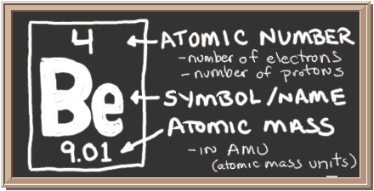
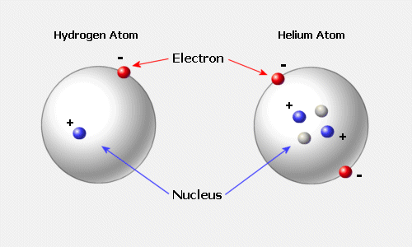
What makes one element different from another element?
Number of protons.

Slide 10

IMPORTANT NUMBERS
Each periodic table gives the same information.

Slide 11
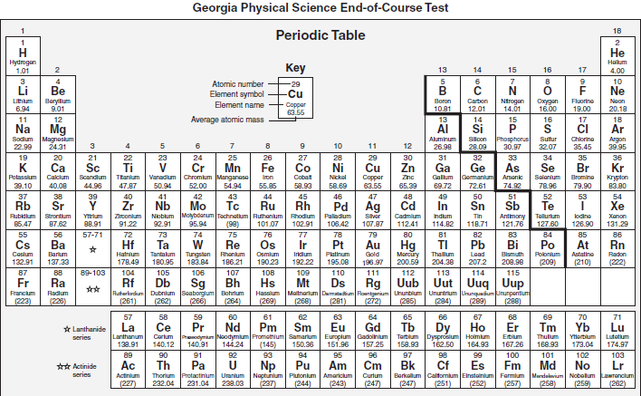

Slide 12

IMPORTANT NUMBERS
ATOMIC NUMBER, Z
Equals the number of protons (and number of electrons).
Determines the identity of the element.
On the periodic table, starts at one and goes up in order.
It is the “5” in the symbol below.

Slide 13
IMPORTANT NUMBERS
ATOMIC MASS
the average of the masses of the isotopes of an atom.
the mass on the periodic table.
IT IS NOT the masses of the protons, neutrons, and electrons added together!

Slide 14
IMPORTANT NUMBERS
MASS NUMBER, A
the number of neutrons and protons (nucleons) added together.
take the whole number (round!) of the atomic mass to get the mass number.
It is the “11” in the symbol below.
Also can be written after the element’s name: Boron-11.

Slide 15
HOW DO YOU DETERMINE THE NUMBER OF…
Protons:
  The atomic number
  Same as the number of electrons in a neutral atom.
Neutrons:
  Mass number – atomic number
Electrons:
  Same as the number of protons in a neutral atom

Slide 16
REMEMBER
The atomic number of an element NEVER changes.
The number of protons (in an element) is ALWAYS the same.
The number of neutrons and electrons can change and the element is still the same element.

Slide 17
PRACTICE
How many protons and electrons are present in a vanadium atom (V)?
How many protons and electrons are present in a nitrogen atom (N)?
How many protons and electrons are present in an argon atom (Ar)?
What is the name of the element that has atoms that contain 5 protons?

Slide 18
PRACTICE
How many protons, neutrons, and electrons are present in zirconium-91?
How many protons, neutrons, and electrons are present in cesium-140?
What is the atomic number and the mass number for the element with 27 protons and 32 neutrons?
What is the atomic number and mass number for the element with 84 protons and 125 neutrons?

