Slide 1
REMINDER
ELECTRON CLOUD
Surrounds the nucleus
Contains one particle type.
Has a negative charge.
It is the electrons that determine how elements will interact with each other.

Slide 2
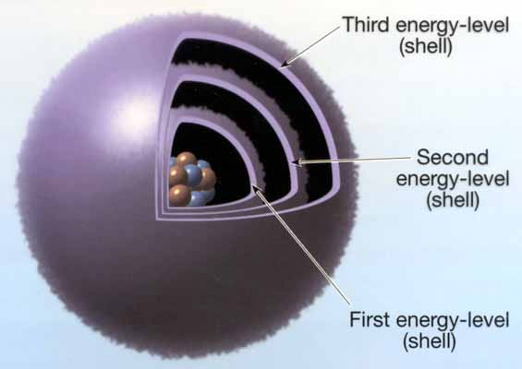
ELECTRON CLOUD

Slide 3
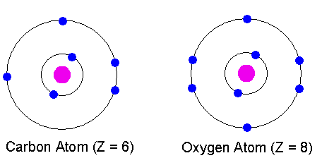
ELECTRON CLOUD
Each energy level can hold a certain numbers of electrons!
First energy level holds TWO electrons

Slide 4
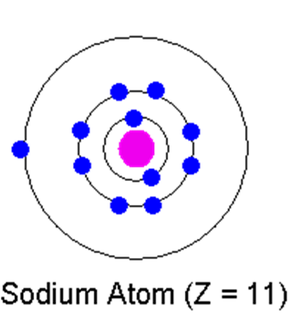
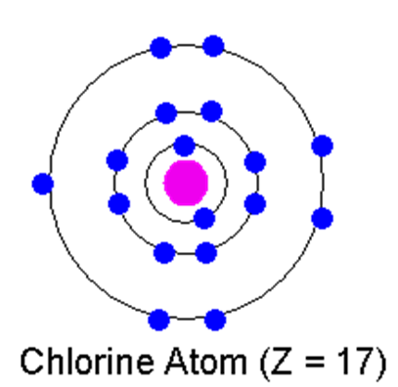
ELECTRON CLOUD
Each energy level can hold a certain numbers of electrons!
Second and third energy levels each hold EIGHT electrons.

Slide 5
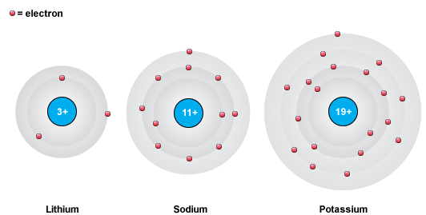
ELECTRON CLOUD
Different atoms have different numbers of electrons!
19
11
3

Slide 6
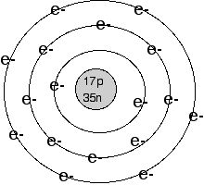
BOHR’S DIAGRAM
Nucleus is in the middle.
Indicates how many protons and how many neutrons.

Slide 7
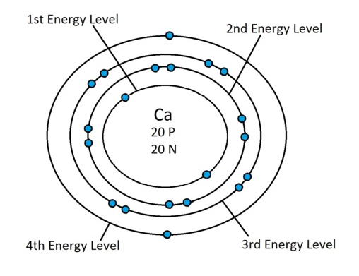
BOHR’S DIAGRAM
Draw concentric circles (rings) outside nucleus.
Fill in the electrons.
  Level 1: 2 e- total
  Level 2: 8 e- total
  Level 3: 8 e- total

Slide 8
WATCH
How to Draw a Bohr Model

Slide 9
PRACTICE
You will need your periodic table to find the number of electrons.
Remember the number of electrons is equal to the number of protons.
Let’s draw Lithium.
Atomic # ____
p⁺ ____
nº ____
e⁻ ____

Slide 10
ELECTRON DOT DIAGRAMS
Usually we are only concerned with the electrons in the outermost energy level.
Those are the electrons involved in chemical reactions.
We can symbolize these electrons using the Lewis Electron Dot Diagram.

Slide 11
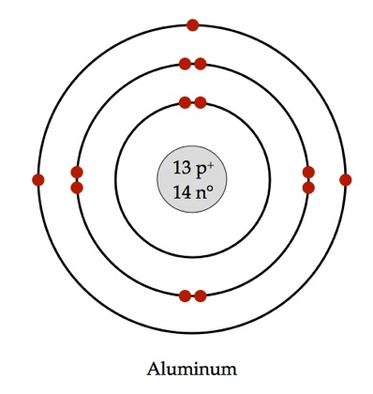
ELECTRON DOT DIAGRAMS
To write an electron dot diagram, follow these steps:
Write the symbol for the element (symbolizes the nucleus and all inner energy levels).
Look at the Bohr diagram. Find the outermost energy level and count the electrons in it.

Slide 12

ELECTRON DOT DIAGRAMS
3. Each ‘side’ of the symbol represents an orbital. Draw the dots on the appropriate sides to represent the electrons in that orbital.

Slide 13
PRACTICE
Let’s draw Lithium.
Atomic # ____

