Slide 1
ISOTOPES
Isotopes are atoms of the same element that have a different number of neutrons.
They differ in mass, but the atom’s chemical behavior are the same.
To identify an isotope, you write the element’s name and follow it with its mass number.
Examples: Carbon-12, Uranium-238.

Slide 2
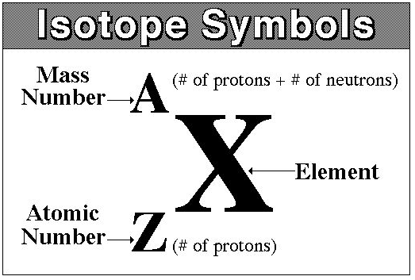
ISOTOPES
It can also be identified by writing an element symbol:

Slide 3
ISOTOPES
The ATOMIC MASS (number from periodic table) is the weighted average of the isotopes of an element and can be calculated if you know the isotope’s mass numbers and the percentage abundance of each.

Slide 4
ISOTOPES
Most isotopes are stable but radioactive isotopes are unstable and break down into more stable forms by emitting particles and energy (radiation).
Radiation can be detected, so radioactive isotopes are useful as labels in scientific research and medical diagnostic procedures.

Slide 5
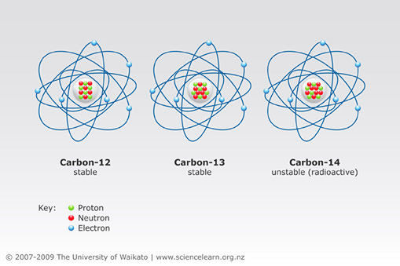
ISOTOPES
Carbon-12 p⁺=6 n°=6
Carbon-13 p⁺=6 n°=7
Carbon-14 p⁺=6 n°=8
Carbon-14 is not as stable as carbon-12 and breaks down radioactively.

Slide 6
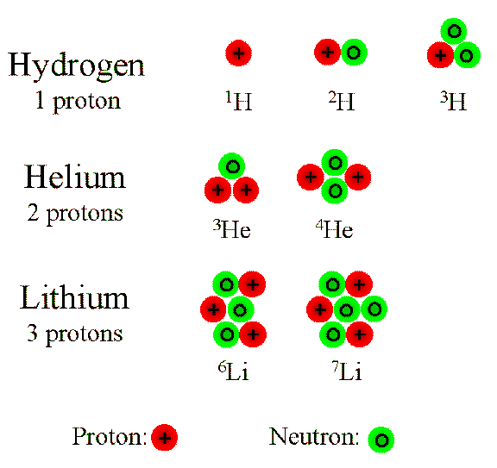

Slide 7

ISOTOPES
The Importance of Isotopes:
They help scientists understand the origins of the Universe and the Earth.
The Big Bang created both hydrogen and helium.
Supernovas created the rest of the elements.
Cosmic Ray crashes created isotopes.

Slide 8
PRACTICE –same or different?
1. Element D 6 p+ and 7 n°
Element F 7 p+ and 7 n°
2. Element J 27 p+ and 32 n°
Element L 27 p+ and 33 n°
3. Element X 17 p+ and 18 n°
Element Y 18 p+ and 17 n°
4. Element Q 56 p+ and 81 n°
Element R 56 p+ and 82 n°

Slide 9
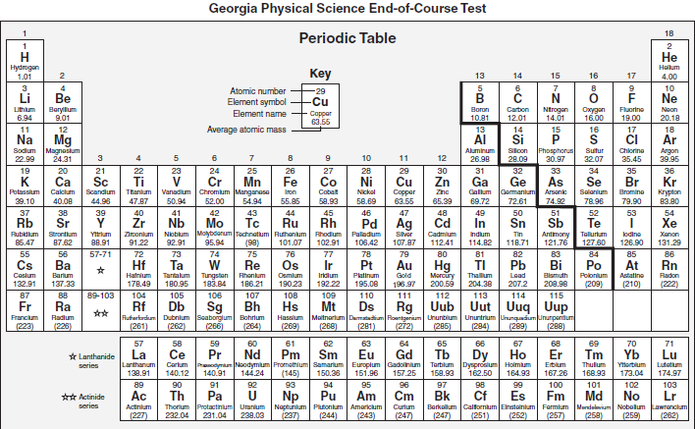

Slide 10
PRACTICE
5. Element T Z = 20 and A = 40
Element Z Z = 20 and A = 41
6. Element W 8 p+ and 8 n°
Element V 7 p+ and 8 n°
7. Element P Z = 92 and A = 238
Element S 92 p+ and 143 n°

