Slide 1
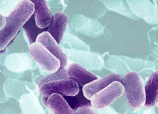
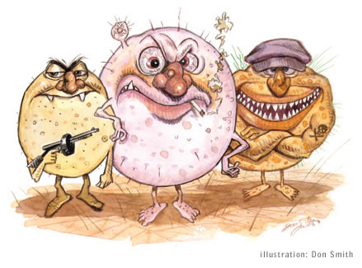
BACTERIA
Bacteria

Slide 2
BACTERIA
Used to all be in one Kingdom called Monera.
Scientists realized there were real differences in the bacterial types and developed TWO kingdoms:
Archaebacteria – “ancient” bacteria
Eubacteria – “true” bacteria

Slide 3
SECTION E
DIFFERENCES | SIMILARITIES

Slide 4
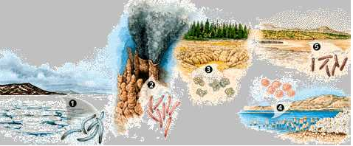
ARCHAEBACTERIA
Domain: Archae (only kingdom)
Kingdom: Archaebacteria
prokaryotes
cells walls lack peptidoglycan
live in extremely harsh environments

Slide 5
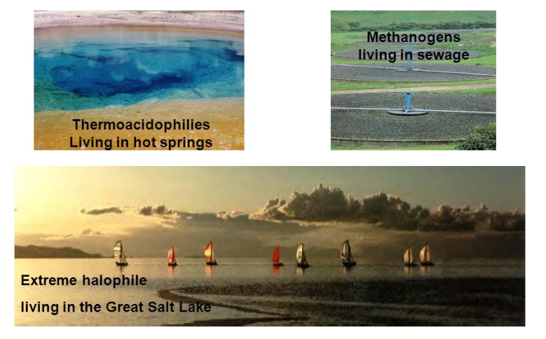
ARCHAEBACTERIA
Make oxygen
May be ancestors of eukaryotes - DNA sequences of key genes are more like eukaryotes
Three groups

Slide 6
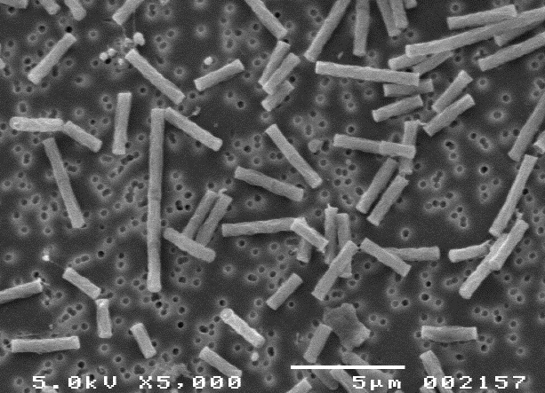
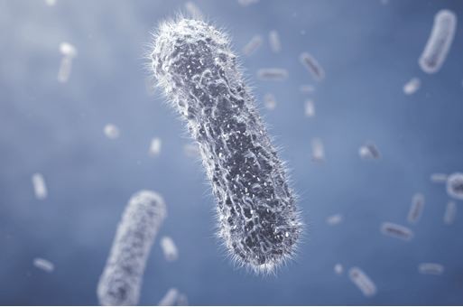
METHANOGENS
All anaerobes (no oxygen)
Produce methane from carbon dioxide
Live in marsh mud, swamps, etc.

Slide 7
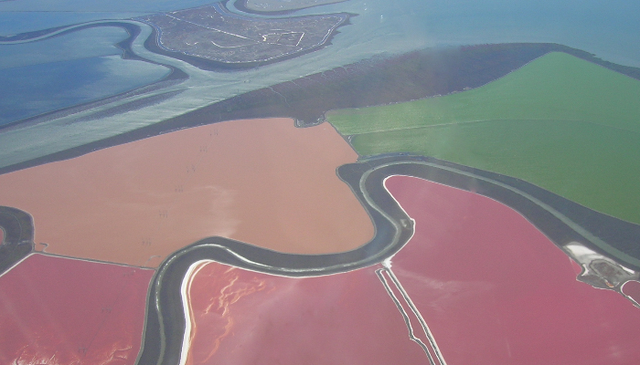
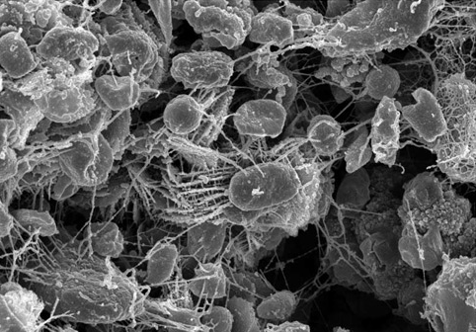
HALOPHILES
Aerobic or anaerobic
Live in extreme salt environments
Require sodium chloride for growth
In the Great Salt Lake in Utah

Slide 8
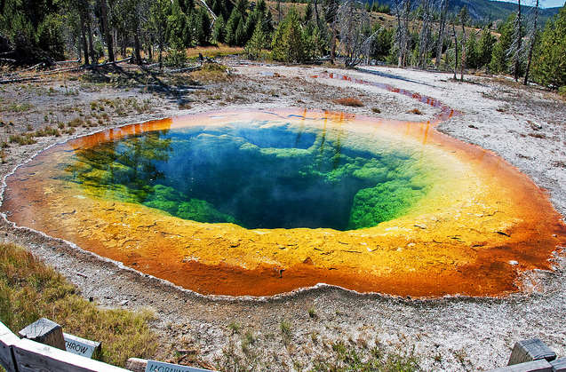
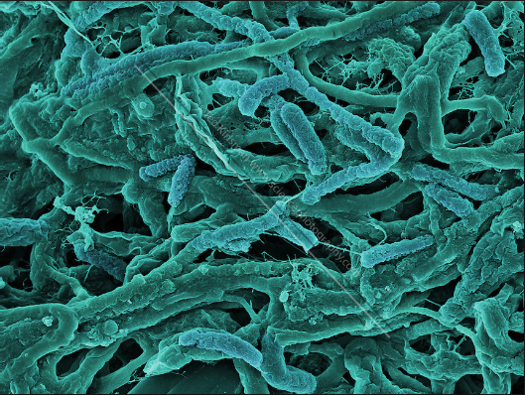
THERMOACIDOPHILES
Aerobic or anaerobic (require sulfur)
live in acidic/hot places; thrives in 41°C to 122°C temperatures
volcanic vents, hot springs
Suggested by some to be some of the earliest bacteria.

Slide 9
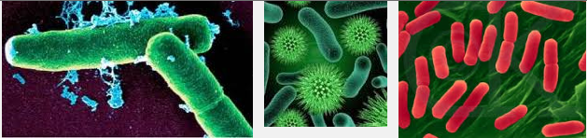
EUBACTERIA
Domain: Bacteria (only kingdom)
Kingdom: Eubacteria
prokaryotes
cells walls with peptidoglycan (sugar & amino acid molecule)

Slide 10
EUBACTERIA
can live almost everywhere
cause diseases
small, most about 1um in diameter. Smallest free-living cells – lack cell walls – called mycoplasms.
Unicellular
Some form filaments: Anabaena (Cyanobacteria)
Some form colonies: Nostoc (Cyanobacteria).

Slide 11
CLASSIFICATION
Classification based on:
shape and cell arrangement
movement - flagella, cilia or use vectors
Nutrition Intake
O₂ requirements
Gram Stain lab test

Slide 12
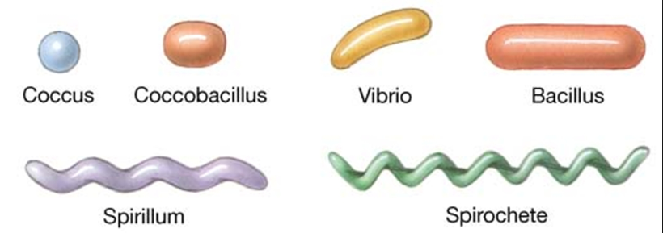
CLASSIFICATION
Shape and cell arrangement
  arrangement: staphylo(clusters) or strepto (chains) or diplo (pairs)
  shape: coccus(round) or bacillus(rod) or spirillum(spiral)

Slide 13
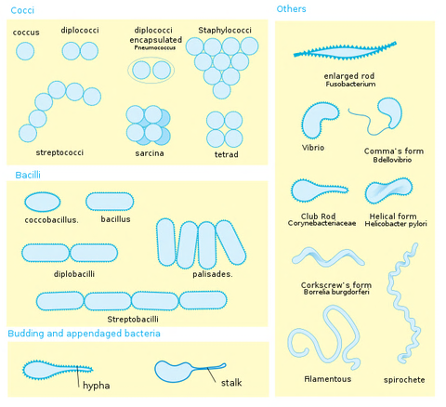
CLASSIFICATION

Slide 14
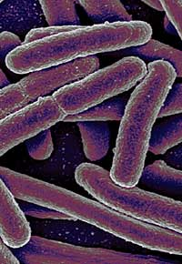
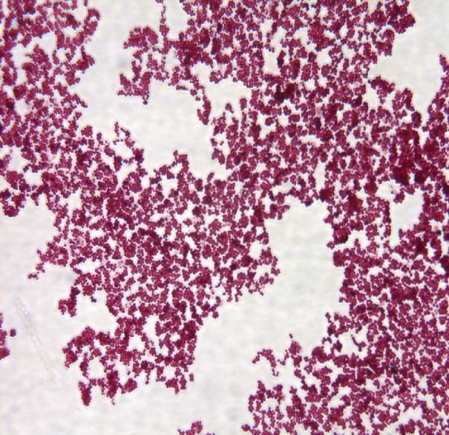
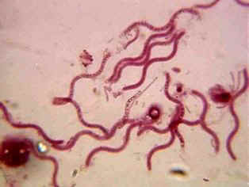
CLASSIFICATION
Bacillus: rod-shaped
Coccus: round-shaped
Spirillum: spriral-shaped

Slide 15
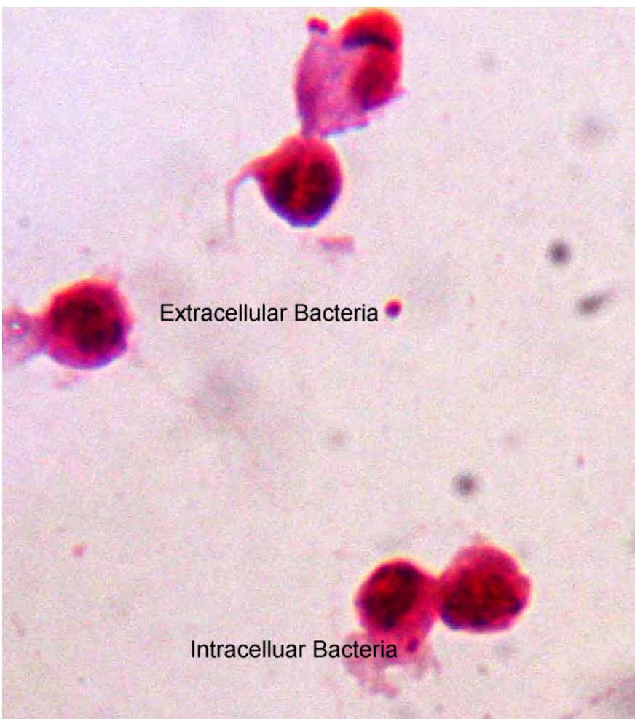
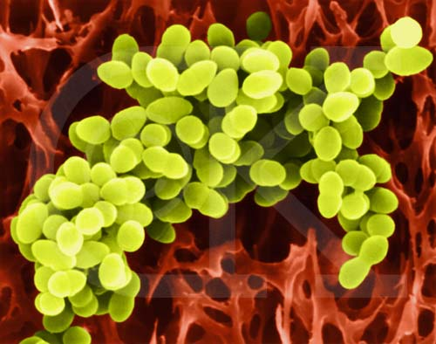
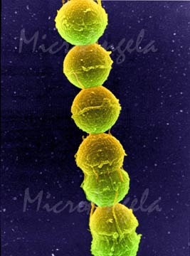
CLASSIFICATION
Diplococci: pair
Staphylococci: cluster
Streptococci: chain, form filaments.

Slide 16
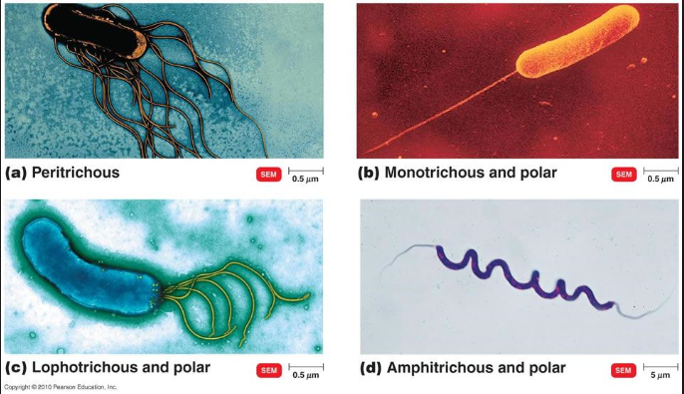
CLASSIFICATION
Classification based on movement:
flagella, cilia or use vectors

Slide 17
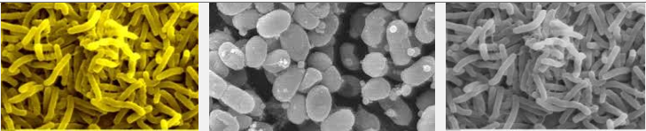
CLASSIFICATION
Classification based on Nutritional Requirements:
Heterotrophic (use endocytosis/exocytosis)
  Decomposers, pathogens, nitrogen fixing bacteria

Slide 18
CLASSIFICATION
Classification based on Nutritional Requirements:
Autotrophic (photosynthesis – use light energy) cyanobacteria – has chlorophyll

Slide 19
CLASSIFICATION
Classification based on Nutritional Requirements:
Chemoautotrophic (use inorganic compounds and carbon dioxide to make food). Live in soil and play a role in nitrification.

Slide 20
CLASSIFICATION
Classification based on O₂ Requirements:
Obligate anaerobe (can’t survive in O₂)
Obligate aerobes (must have O₂ to survive)
Facultative anaerobe (live with or without O₂)

Slide 21
CLASSIFICATION
Classification based on Gram Stain Lab Test:
Gram positive (+) turns purple, more peptidoglycan;
Gram negative (–) turns pink, less peptidoglycan
  Gram– are more resistant to antibiotics

Slide 22
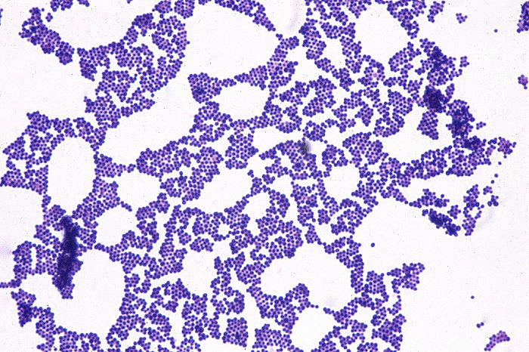
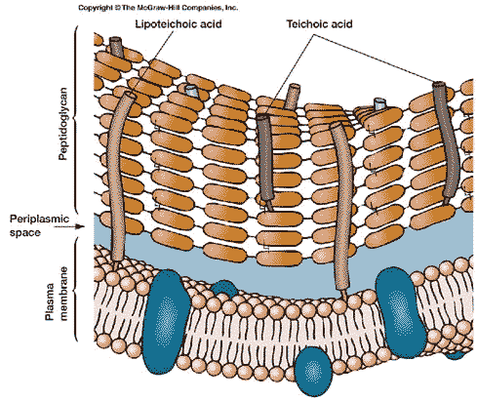
Gram positive = purple because of large amount of peptidoglycan in cell wall.

Slide 23
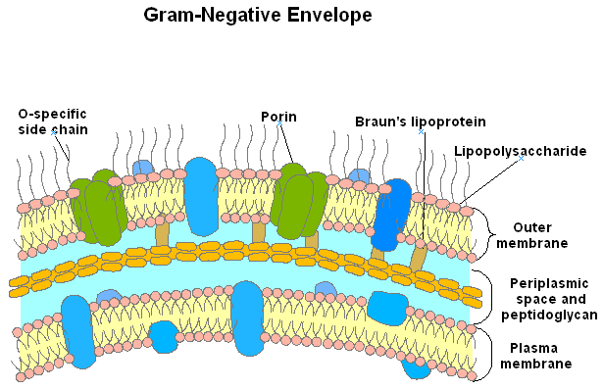
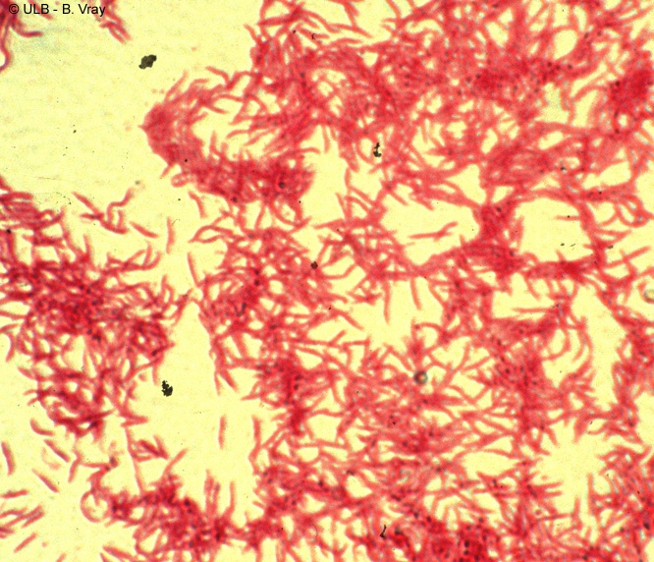
Gram negative = pink because lipopoly-saccharide membrane is removed by alcohol and thin peptidoglycan layer allows dye to escape.

Slide 24
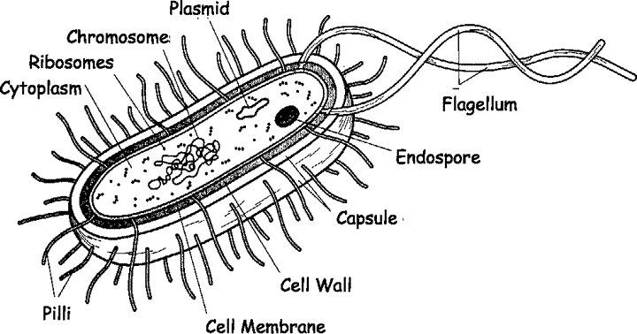
BACTERIAL STRUCTURE
Flagella – used for movement
Pili - allow bacteria to stick to surfaces
Capsule - sticky protective layer that helps evade immune system and adhere to substances

Slide 25
BACTERIAL STRUCTURE
Bacteria have cell walls made of peptidoglycans (polysaccharide molecules linked with chains of amino acids). Cell wall type determines stain.
Gram Stain: differential stain used to distinguish between types of bacteria.
Crystal violet: Gram + Safranin (pink): Gram - Antibiotics are more effective against Gram +

Slide 26
BACTERIAL STRUCTURE
Cell Wall: outer covering; gives shape and rigidity to the cell; peptidoglycan included.
Cell Membrane: Selectively permeable

Slide 27
BACTERIAL STRUCTURE
Plasmid: accessory rings of DNA; can be used as vectors to carry foreign DNA into bacteria during genetic engineering procedures; can carry resistant genes
Bacterial chromosome: a single circular piece of DNA.

Slide 28
BACTERIAL STRUCTURE
Ribosome: site of protein synthesis
Endospore: thick internal wall that encloses the DNA; formed so bacteria can remain dormant during harsh environmental conditions.

Slide 29
BACTERIAL REPRODUCTION
Binary Fission
Conjugation
Transformation

Slide 30
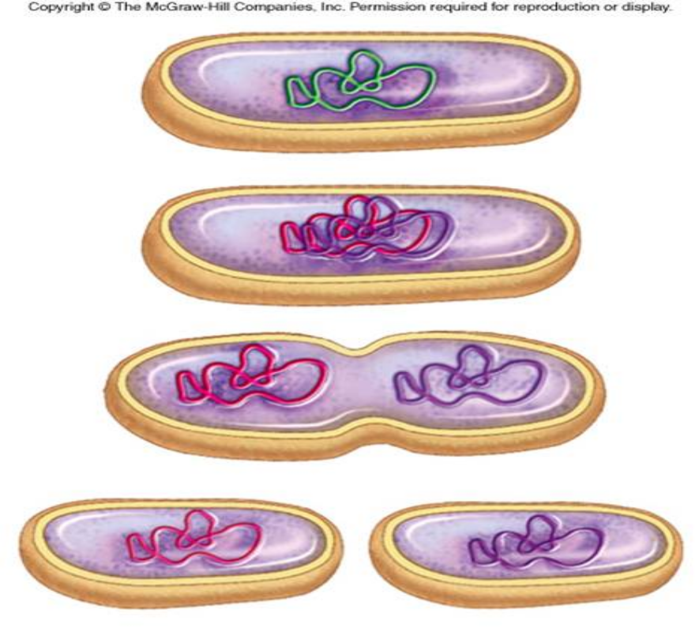
BACTERIAL REPRODUCTION
Binary Fission
grows, replicates DNA, and divides
Asexual
identical daughter cells

Slide 31
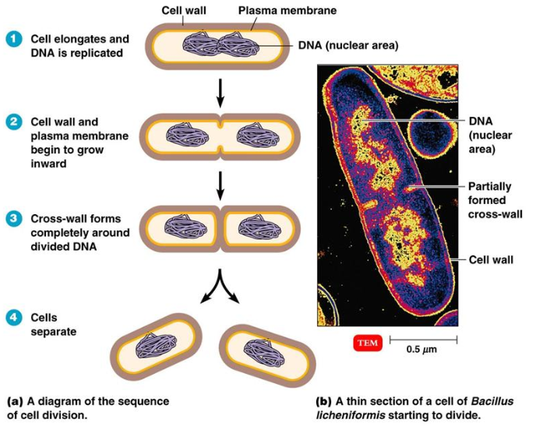

Slide 32
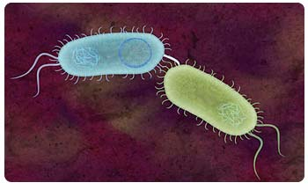
BACTERIAL REPRODUCTION
Conjugation
pili form bridge, exchange DNA then split
Sexual
diversifies population

Slide 33
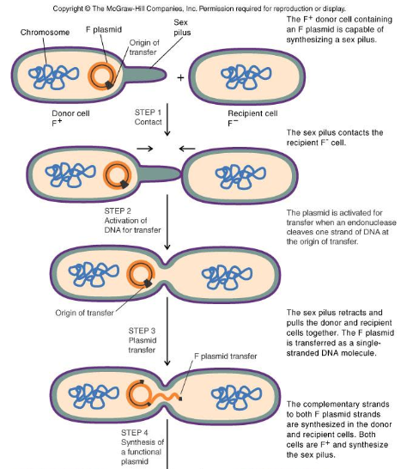

Bacterial Conjugation

Slide 34
BACTERIAL REPRODUCTION
Transformation
bacteria taking up free pieces of DNA secreted by live bacteria or released by dead bacteria
Sexual

Slide 35
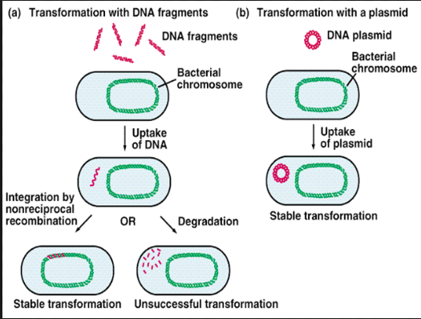

Slide 36
HELPFUL BACTERIA
Decomposers – these break down dead matter and recycle nutrients.
Nitrogen Fixation – these convert atmospheric nitrogen into soil nitrogen form. Some plants could not survive without them.
Denitrification – convert excess soil nitrogen form into atmospheric nitrogen.

Slide 37
HELPFUL BACTERIA
More
Rhizobium, also known as nitrogen-fixing bacteria are present in the root nodules of plants and fix the nitrogen present in the atmosphere. They are considered to be very helpful to the environment.
Bacteria also break down the organic waste material in the soil which helps in maintaining soil fertility.
Azotobacters convert the gaseous nitrogen into nitrates which is further used by Rhizobium for nitrogen-fixing.

Slide 38
HELPFUL BACTERIA
Photosynthesis – produces oxygen
Human Uses – food, digest petroleum, remove waste from H₂O, synthesize drugs, bacterial enzymes used in genetic engineering
Mutualistic Relationships – both organisms benefit; ex. bacteria in human colon

Slide 39
HELPFUL BACTERIA
Human body has millions of bacteria which participate in different functions of the body.
These bacteria can be present in all parts of the body but mostly they are found in the intestine where they help in the process of digestion.
Some beneficial bacteria to humans are helpful in maintaining the pH of the body.
Some are involved in protecting the skin from many infections.
They are also helpful in the production of vitamin K and have an important role to play in the functioning of immune system.

Slide 40
HELPFUL BACTERIA
Escherichia coli is associated with the process of digestion. It is present in the large intestine where the maximum digestion takes place. These bacteria release enzymes which help in the process of digestion and synthesis of various vitamins and nutrients.
Beneficial bacteria are also very helpful for the pregnant women. They reduce the chances of postpartum complications and also protects the baby from fungal infections.

Slide 41
HELPFUL BACTERIA
Antibiotics can be used to kill bacteria, produced from bacteria, fungi (Penicillium discovered by Fleming), and chemicals.
Food Production: pickles, buttermilk, cheese, sauerkraut, olives, vinegar, sourdough bread, sausages, and yogurt all get part of their taste from bacteria.
Drugs for medicines and useful chemicals.
Chemoautotrophic bacteria used for mining to harvest copper and uranium.
Used to clean up petroleum and chemical spills.

Slide 42
HARMFUL BACTERIA
Pathogens – cause disease by breaking down tissue or release toxins
BACTERIAL DISEASES
Strep throat | Syphilis
Tuberculosis | Lyme disease
Typhoid fever | Pneumonia
Tetanus | Gonorrhea

Slide 43
HARMFUL BACTERIA
Heterotrophic bacteria obtain nutrients by secreting enzymes that destroy body tissues. Example: In the throat or lungs - Tuberculosis
Bacteria also cause disease by secreting chemical compounds (toxins) into their environment. Example: diphtheria, grows in the throat, but the toxins attack the heart, nerves, liver, and kidneys.
Food toxins or food poisons: Staphylococcus aureus

Slide 44
HARMFUL BACTERIA
Endotoxins: Made of lipids & carbohydrates. Found in the cell walls of most gram – bacteria. Ex: E. coli Released when bacteria die. Cause fever, weakness, & damage to the circulatory system. Example: Typhoid Fever
Exotoxins: Made of protein. Product of bacteria metabolism, secreted in area around bacteria. Steadily released by living Gram + bacteria. Some of the most potent poisons.
Ex: tetanus, diphtheria, and botulism.
Clostridium botulinum, deadly food poison.

Slide 45
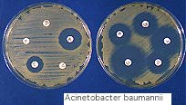
TREATMENT
Antibiotics – destroy bacterial cells by inhibiting cell wall growth or protein synthesis
  Alexander Fleming created first antibiotic – penicillin
Vaccine (prevention) – stimulates immune response

Slide 46
ANTIBIOTIC RESISTANCE
Changes in the DNA of the bacterium: The genetic mutation may prevent the antibiotics from deactivating the proteins in the bacteria or increase the production of these proteins. The wall of the bacterium may become less permeable for the drug.
Transfer of genes that are resistant to antibiotics: The resistant genes develop naturally when microorganisms are exposed to antimicrobial drugs. These genes may be transferred from one bacterium to another.

Slide 47
CONTROLLING BACTERIA
Sterilization – kill bacteria by heat or chemical action
  Joseph Lister created the first antiseptic to disinfect instruments before surgery (1860).
Refrigeration – bacteria grows at a slow rate in cold temperatures.
Hand Sanitizer – the alcohol kills bacteria by dissolving the bacteria's cellular membrane which kills the cell.

