Slide 1
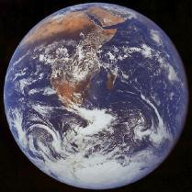
TERRESTRIAL BIOMES
As we go along, fill in the terrestrial Biome organizer with facts about each.

Slide 2
WATCH
Introduction to Biomes

Slide 3
TERRESTRIAL BIOMES
REMEMBER:
Biome- geographic areas that have similar climates and ecosystems
Climate – the weather conditions prevailing in an area in general or over a long period.
Ecosystem - all the organisms living in an area together with their physical environment.

Slide 4
TERRESTRIAL BIOMES
The 6 most common biomes are:
Tundra
Taiga
Temperate Deciduous Forest
Tropical Rain Forest
Grassland
Desert

Slide 5
TERRESTRIAL BIOMES
are characterized by specific type of climate and certain types of plants and animal communities.
Climate refers to the average weather conditions such as temperature, precipitation, humidity, and winds in an area.
The climate zones are caused by differences in latitude and the angle the sun hits the Earth.

Slide 6
TERRESTRIAL BIOMES
The unequal heating causes winds and ocean currents which transport heat throughout the biosphere.
Topography interferes with the movement of the air masses.

Slide 7
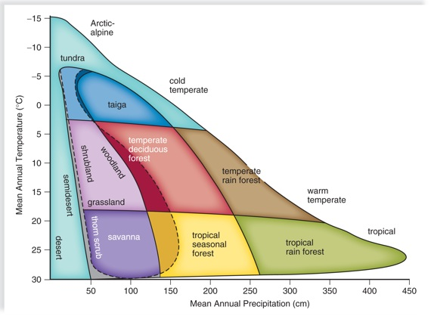
TERRESTRIAL BIOMES

Slide 8
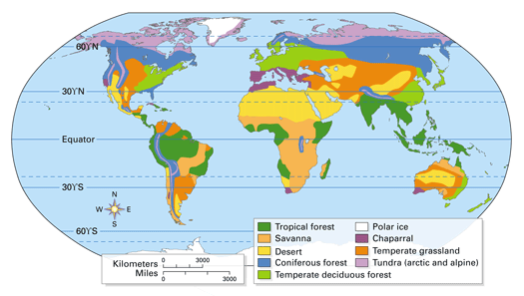
TERRESTRIAL BIOMES

Slide 9
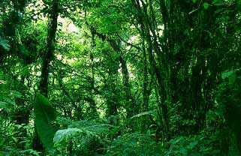
Tropical Rain Forest
Found near the equator in Africa, South America, Australia, and the Pacific Islands

Slide 10
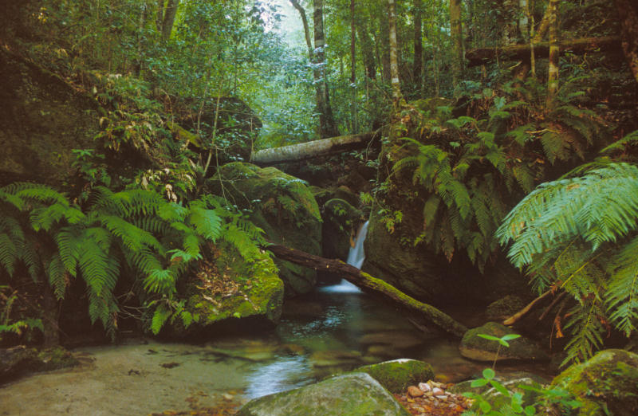
Tropical Rain Forest
The most widespread biome
Greatest diversity of plants, animals, and other organisms.

Slide 11
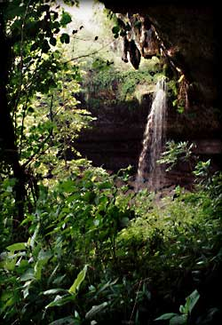
Tropical Rain Forest
200 to 225 cm precipitation yearly
Hot and humid all year
Temperatures are fairly constant around 25ºC

Slide 12
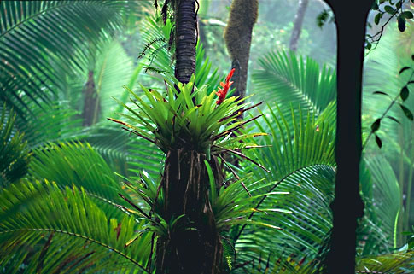
Tropical Rain Forest
Soil is nutrient poor and acidic.
Nutrients are in within the plants.
Most plants have shallow roots.

Slide 13
Tropical Rain Forest
Layers of the forest
Emergent layer – tallest trees.
Canopy – epiphytes grow to help support life.
Understory – plants adapted to shade grow here.
Forest Floor – no sunlight; where decomposition takes place.

Slide 14
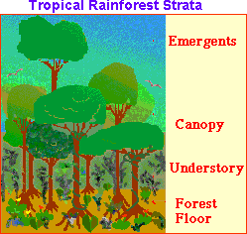
Tropical Rain Forest Layers of Vegetation

Slide 15
Life in the Tropical Rain Forest
The tropical rain forest is a lush, productive ecosystem containing more than half of all the species that live on Earth.

Slide 16
Plants of the Tropical Rain Forest
A rain forest may contain more than 700 species of trees and over 1000 species of flowering plants.
Examples:
Mahogany trees; Bromeliads and orchids; Giant ferns; Many flowering plants

Slide 17
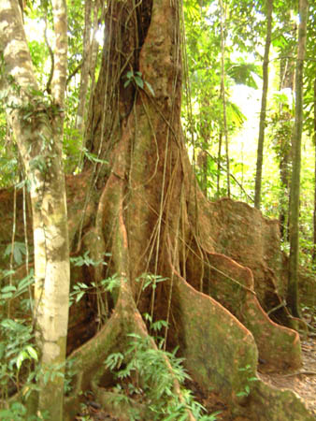
Plants of the Tropical Rain Forest
Mahogany tree
Notice how the roots rise above the ground to help support this giant tree!

Slide 18
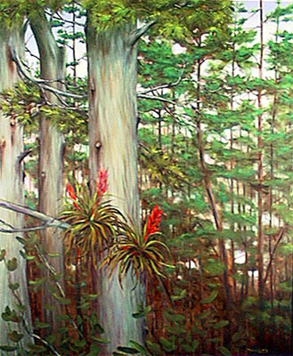
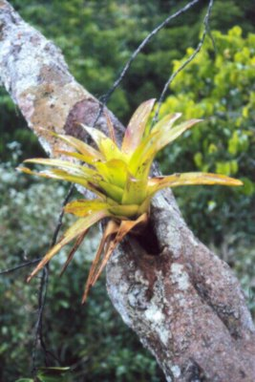
Plants of the Tropical Rain Forest
Bromeliads

Slide 19
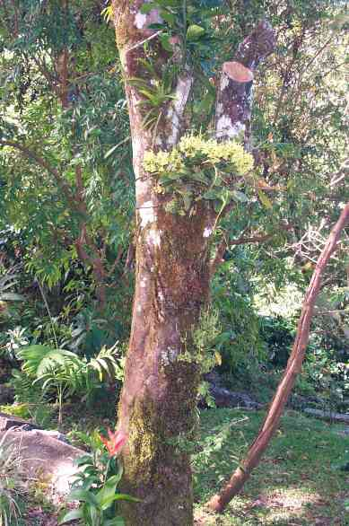
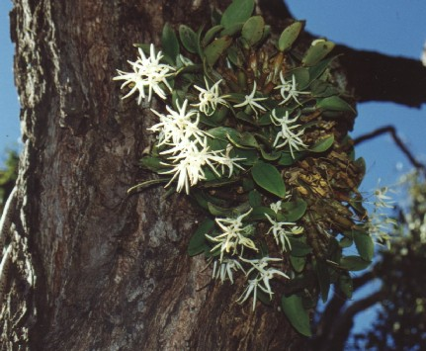
Plants of the Tropical Rain Forest
Orchids

Slide 20
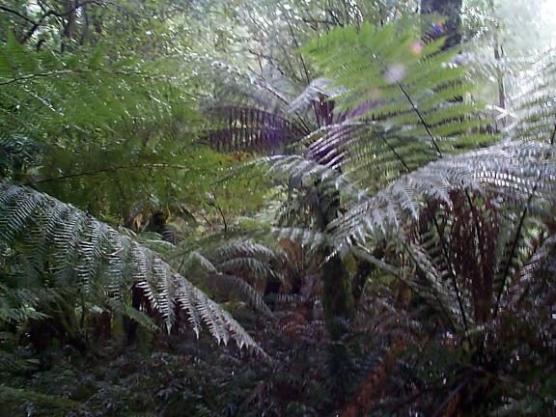
Plants of the Tropical Rain Forest
Giant ferns

Slide 21
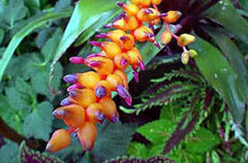
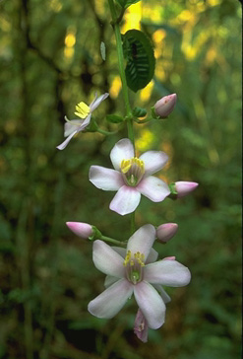
Plants of the Tropical Rain Forest
Flowering plants

Slide 22
Animals of the Tropical Rain Forest
The rain forest is home to a huge number of animals.
Examples:
Monkeys
Exotic birds
Snakes
Sloths
Bats
Insects
Large cats
Exotic mammals

Slide 23
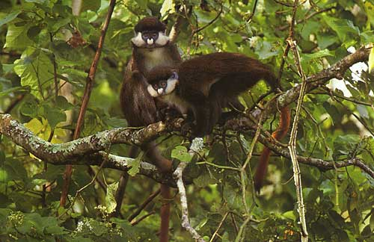
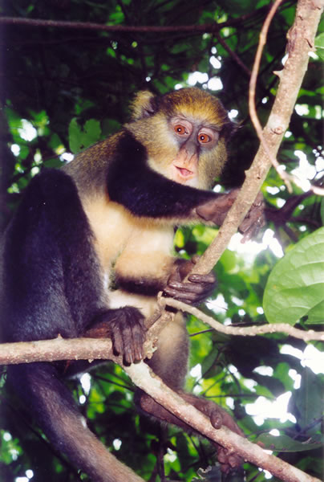
Animals of the Tropical Rain Forest
Monkeys

Slide 24
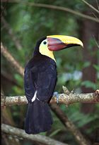
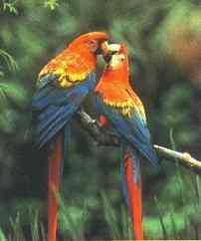
Animals of the Tropical Rain Forest
Exotic birds
Toucan Parrots

Slide 25
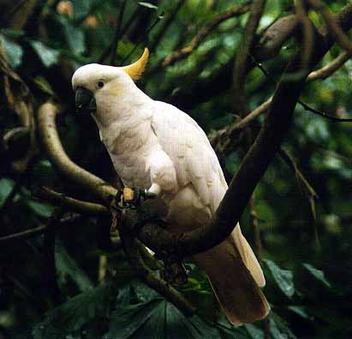
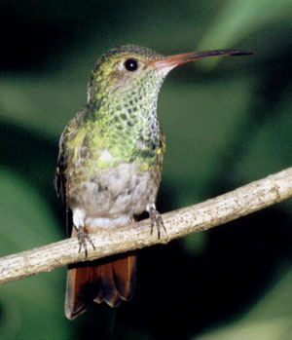
Animals of the Tropical Rain Forest
Exotic birds
Cockatoo Hummingbird

Slide 26
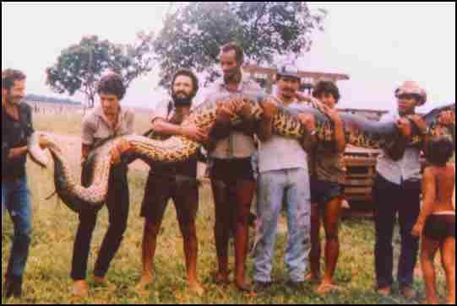
Animals of the Tropical Rain Forest
Snakes (Anaconda)

Slide 27
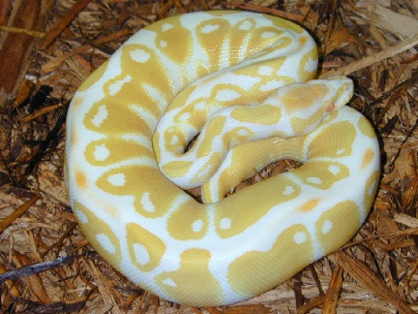
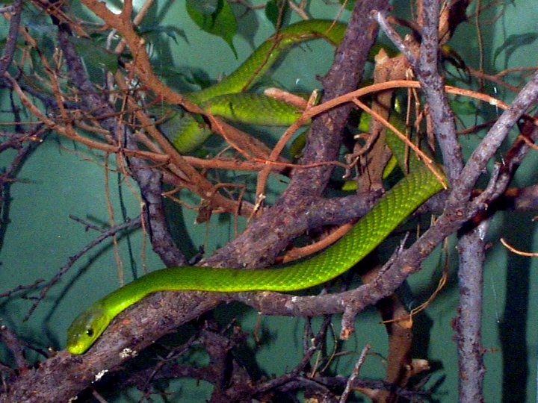
Animals of the Tropical Rain Forest
Snakes
Albino Ball Python Green Mamba

Slide 28
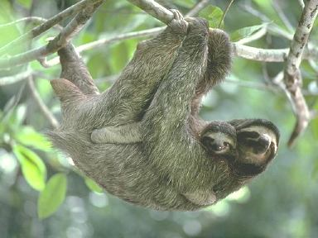
Animals of the Tropical Rain Forest
Sloths

Slide 29
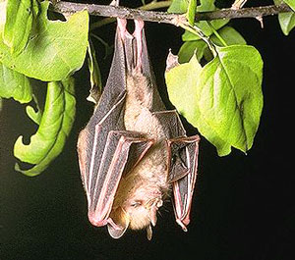
Animals of the Tropical Rain Forest
Bat (Fruit bat)

Slide 30
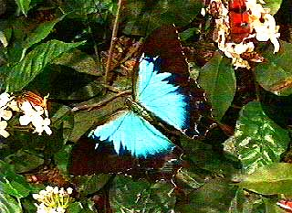
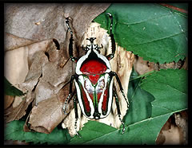
Animals of the Tropical Rain Forest
Insects
Butterfly Beetle

Slide 31
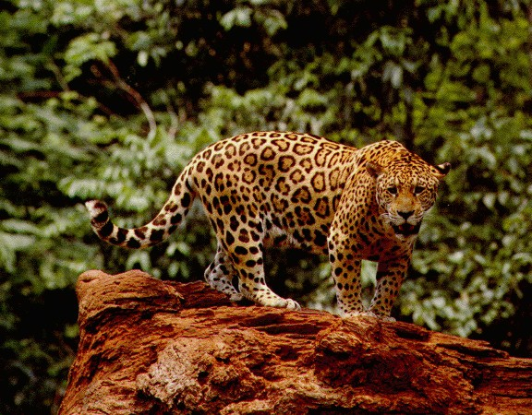
Animals of the Tropical Rain Forest
Large Cats (Jaguar)

Slide 32
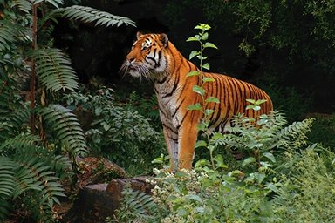
Animals of the Tropical Rain Forest
Large Cats (Sumatran Tiger)

Slide 33
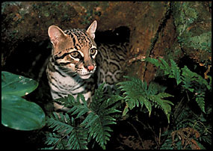
Animals of the Tropical Rain Forest
Large Cat (Ocelot)

Slide 34
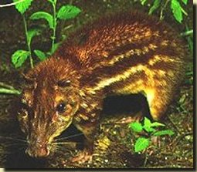
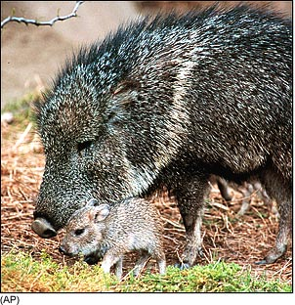
Animals of the Tropical Rain Forest
Exotic mammals
Paca Peccary

Slide 35
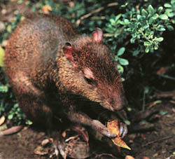
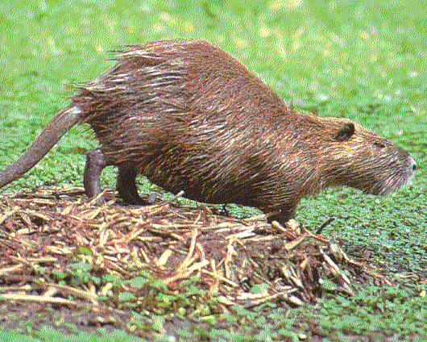
Animals of the Tropical Rain Forest
Exotic mammals
Agouti Nutria

Slide 36
WATCH
Tropical Rain Forest

Slide 37
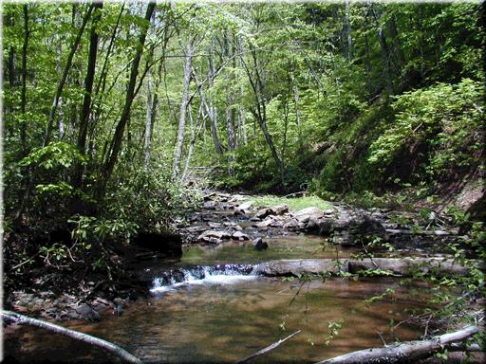
Temperate Deciduous Forest
Found in Europe, the Eastern part of the United States, and China

Slide 38
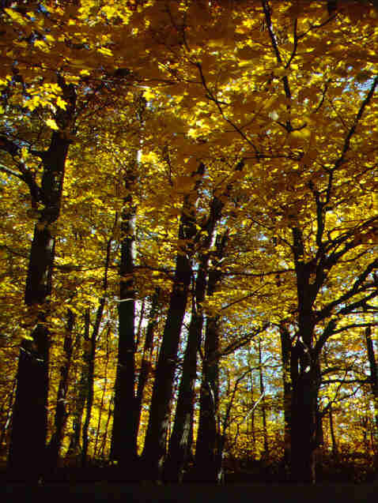
Temperate Deciduous Forest
Found between 30ºN - 50ºN latitudes
75 to 150 cm precipitation yearly

Slide 39
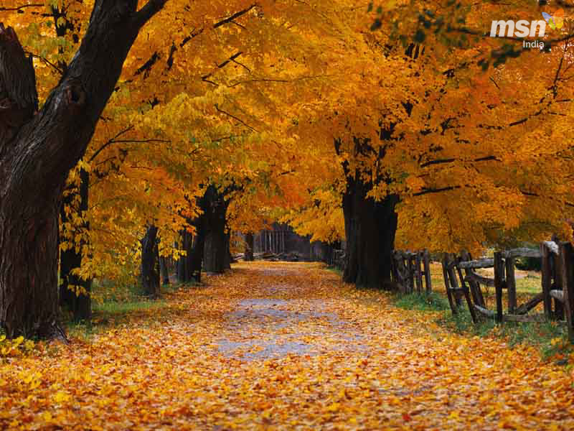
Temperate Deciduous Forest
Wide range of temperatures with four seasons
Below freezing in winter to 30ºC in summer

Slide 40
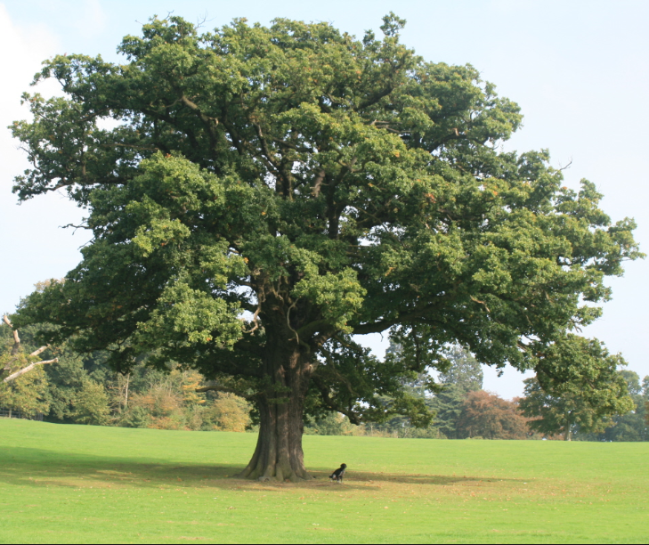
Temperate Deciduous Forest
the growing seasons lasting only 4 to 6 months.
Plants are adapted to survive seasonal changes.
Trees are predominately are broad, flat leaf which drop during the fall.

Slide 41
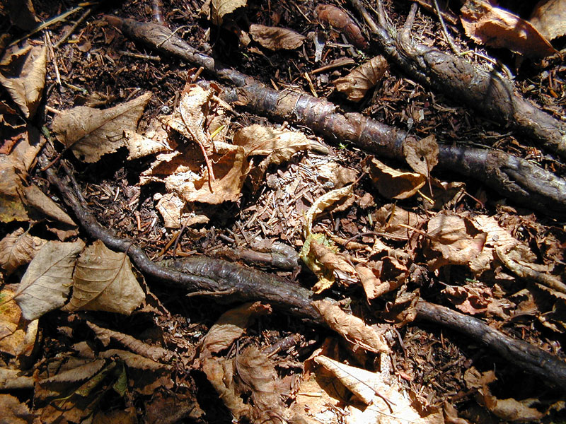
Temperate Deciduous Forest
Soil is rich in nutrients from layers of decomposing leaves - which happens slowly.

Slide 42
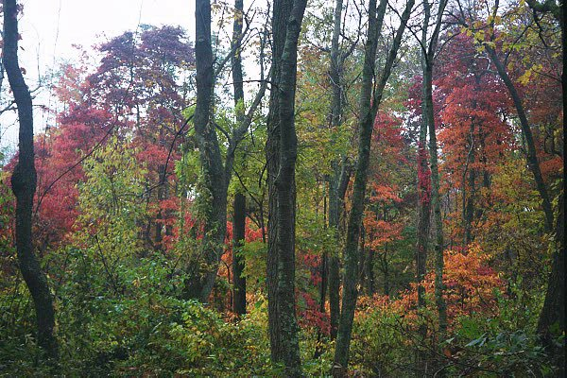
Temperate Deciduous Forest
Layers of vegetation
  Canopy
  Understory
  Forest floor

Slide 43
Temperate Deciduous Forest
Layers of Vegetation
Canopy- tree tops that shade the ground below
Understory- shrub layer
Forest floor- dark and moist layer of dead leaves, twigs, and seeds

Slide 44
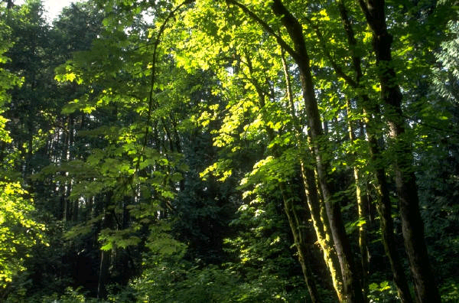
Temperate Deciduous Forest
Canopy

Slide 45
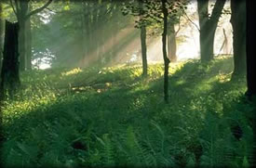
Temperate Deciduous Forest
Understory

Slide 46
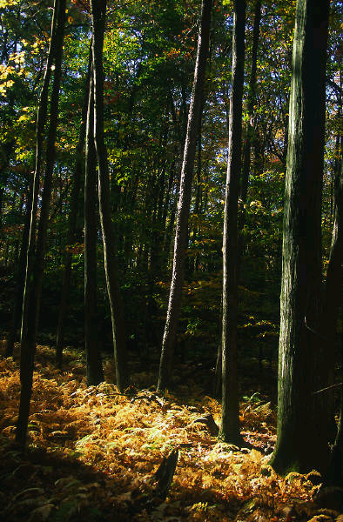
Temperate Deciduous Forest
Forest floor

Slide 47
Life in the Temperate Deciduous Forest
The mild climate and rich soil of the temperate deciduous forest supports a wide variety of plant and animal life.
Animal usually hibernate or migrate during the winter months.

Slide 48
Plants of the Temperate Deciduous Forest
Plant life is abundant.
Examples:
Oak trees
Hickory trees
Maple trees
Shrubs
Wildflowers
Ferns

Slide 49
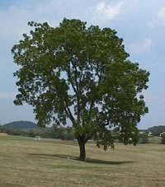
Plants of the Temperate Deciduous Forest
Oak tree

Slide 50
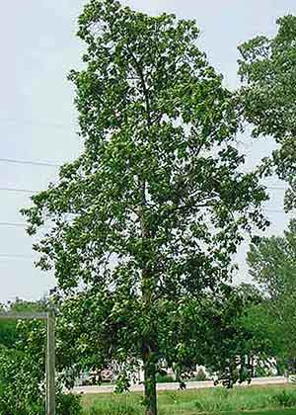
Plants of the Temperate Deciduous Forest
Hickory tree

Slide 51
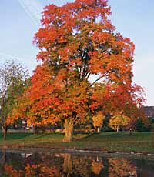
Plants of the Temperate Deciduous Forest
Maple tree

Slide 52
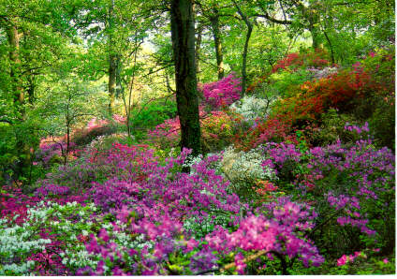
Plants of the Temperate Deciduous Forest
Shrubs (Azalea)

Slide 53
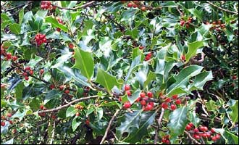
Plants of the Temperate Deciduous Forest
Shrubs (Holly)

Slide 54

Plants of the Temperate Deciduous Forest
Wildflowers

Slide 55

Plants of the Temperate Deciduous Forest
Wildflowers

Slide 56

Plants of the Temperate Deciduous Forest
Ferns

Slide 57
Animals of the Temperate Deciduous Forest
Animal life is diverse.
Examples:
Deer
Foxes
Snakes
Bears
Birds
Raccoons
Amphibians
Small mammals

Slide 58

Animals of the Temperate Deciduous Forest
Deer

Slide 59

Animals of the Temperate Deciduous Forest
Fox

Slide 60

Animals of the Temperate Deciduous Forest
Snakes (Eastern Garter Snake)

Slide 61

Animals of the Temperate Deciduous Forest
Snakes (Copperhead)

Slide 62

Animals of the Temperate Deciduous Forest
Black bear

Slide 63

Animals of the Temperate Deciduous Forest
Birds (Bald Eagle)

Slide 64

Animals of the Temperate Deciduous Forest
Birds
(Barn Owl)

Slide 65


Animals of the Temperate Deciduous Forest
Birds
Woodpecker Cardinal

Slide 66

Animals of the Temperate Deciduous Forest
Raccoon

Slide 67


Animals of the Temperate Deciduous Forest
Amphibians
Wood frog Leopard Frog

Slide 68


Animals of the Temperate Deciduous Forest
Amphibians
Spotted Salamander Jefferson Salamander

Slide 69


Animals of the Temperate Deciduous Forest
Small Mammals
Field Mouse Squirrel

Slide 70

Taiga or Coniferous Forest
Found in parts of Canada, Alaska, and Russia

Slide 71

Taiga or Coniferous Forest
World’s largest land biome
Latitudes between 50ºN and 60ºN

Slide 72

Taiga-
Winters are long and cold (6-10 months)
Average temperatures are below freezing.
35 to 40 cm of precipitation yearly (mostly snow)

Slide 73
Plants of the Taiga
Plant growth is abundant during summer months because of nearly constant daylight and larger amounts of precipitation.
Mostly conifers trees grow which have needle-like leaves and seeds that develop in cones.

Slide 74
Plants of the Taiga
The shape of the leaves and their cuticle prevents the tree from losing too much water especially important when ground is frozen and the roots cannot replace lost water by absorbing more from the soil.
There is no permafrost, so trees can grow. Mosses and lichens grow on the forest floor.

Slide 75
Plants of the Taiga
Conifer needles contain substances that make the soil acidic when the needles fall.
Most plants cannot grow in acidic soil, which is one reason the forest floor has few plants.
Soil forms very slowly because the climate and acidity of fallen leaves slows decomposition.

Slide 76
Plants of the Taiga
Cone-bearing Evergreen trees
  Firs
  Spruces
  Pines
  Hemlocks
  Cedars

Slide 77

Plants of the Taiga
Fir tree

Slide 78

Plants of the Taiga
Spruce tree

Slide 79

Plants of the Taiga
Hemlock tree

Slide 80

Plants of the Taiga
Liverwort (a moss)

Slide 81

Plants of the Taiga
Mosses

Slide 82
Animals of the Taiga
Many animals live in the Taiga.
This biome has many lakes and swamps which attract birds that feed on aquatic organisms.
Examples:
Moose
Black Bear
Lynx
Wolves
Badgers
Wolverines
Ermines
Deer

Slide 83

Animals of the Taiga
Moose

Slide 84

Animals of the Taiga
Black bear

Slide 85

Animals of the Taiga
Lynx

Slide 86

Animals of the Taiga
Wolf

Slide 87

Animals of the Taiga
Badger

Slide 88

Animals of the Taiga
Wolverine

Slide 89
THREATS TO FOREST BIOMES
Deforestation reduces the amount of water that is absorbed by plants after it rains. As deforestation increases, an increase in flooding is likely to occur.
Tropical rain forest once covered about 20% of Earth, but today it only covers about 7%. Forests are cleared for logging operations, agriculture or oil exploration. Habitat destruction usually results in species endangerment or extinction.

Slide 90
WATCH
Taiga Biome

Slide 91

Grassland
“The Bread Basket of the World”
Found on every continent.

Slide 92
Grassland
Grasslands are known by many names.
Veldt or Savanna - Africa
Savanna - Australia
Prairie or Plains – United States
Steppe - Asia
Pampas - South America

Slide 93
Savanna
Grassland found in Africa, western India, northern Australia and South America.
A tropical biome that is dominated by grasses, shrubs and small trees.
Because most rain falls during the wet season, plants must be able to survive prolonged periods without water.

Slide 94

Savanna
Wet seasons followed by a season of drought
25 to 75 cm precipitation yearly – mostly during the wet season

Slide 95
Savanna
During the dry season, plants lose their leaves or die down to the ground.
Many plants have horizontal root systems so they can draw water from a larger area.
Most plants have vertical leaves to reduce water loss and thorns to keep herbivores away.

Slide 96

Savanna
A tropical biome that is dominated by grasses, shrubs and small trees.
The soil is rich and fertile.
The grass has extensive root systems, called sod.

Slide 97
Plants of the Savanna
The African Savanna is a thornbush savanna.
Examples:
acacia Senegal
candelabra tree
jackalberry tree
baobabs
Umbrella thorn acacia
Whistling thorn
Bermuda grass
Elephant grass

Slide 98

Plants of the Savanna
acacia Senegal

Slide 99

Plants of the Savanna
candelabra tree

Slide 100

Plants of the Savanna
jackalberry tree

Slide 101

Plants of the Savanna
baobabs

Slide 102

Plants of the Savanna
Umbrella thorn acacia

Slide 103


Plants of the Savanna
Whistling thorn

Slide 104

Plants of the Savanna
Bermuda grass

Slide 105

Plants of the Savanna
Elephant grass

Slide 106
Animals of the African Savanna
Grazing herbivores have adopted a migratory way of life and follow the rains.
Many animals give birth during the rainy season when food is abundant and the young are more likely to survive.

Slide 107
Animals of the African Savanna
Examples:
Gazelle
Wildebeest
Lion
Elephant
Giraffe

Slide 108

Animals of the African Savanna
Gazelle

Slide 109

Animals of the African Savanna
Wildebeest

Slide 110

Animals of the African Savanna
Lion

Slide 111

Animals of the African Savanna
Elephant

Slide 112

Animals of the African Savanna
Giraffe

Slide 113
Animals of the Australian Savanna
Australian grassland animals are marsupials
Examples:
Kangaroo
Long nosed Bandicoot
Wallaby
Wombat

Slide 114

Animals of the Australian Savanna
Kangaroo

Slide 115

Animals of the Australian Savanna
Long Nosed Bandicoot

Slide 116

Animals of the Australian Savanna
Wallaby

Slide 117

Animals of the Australian Savanna
Wombat

Slide 118
WATCH
Savannas

Slide 119
Grassland
Grasslands are known by many names.
Veldt or Savanna - Africa
Savanna - Australia
Prairie or Plains – United States
Steppe - Asia
Pampas - South America

Slide 120
Temperate Grassland
Wet seasons followed by a season of drought
25 to 75 cm precipitation yearly
Not enough for trees to grow.

Slide 121
Temperate Grassland
This grassland covers a large area of the interior of continents
Vegetation consists of mainly grasses and wildflowers.

Slide 122

Temperate Grassland
Near the banks of streams, the soil contains more water so shrubs and trees can grow.
The root systems form dense layers that survive drought and fire.

Slide 123
Temperate Grassland
Grasslands are highly productive because of their fertile soil.
The summer is hot and the winter is cold, so the plants die back to their roots in winter.
Low temperatures in the winter slow decomposition and organic matter accumulate in the soil making it the most fertile soil in the world.

Slide 124
Plants of the Grassland
Grassland regions of the world are important farming areas. Cereal and grains grow here.
Examples:
Wheat
Rye
Barley
Corn

Slide 125

Plants of the Grassland
Wheat

Slide 126

Plants of the Grassland
Rye

Slide 127

Plants of the Grassland
Barley

Slide 128

Plants of the Grassland
Corn

Slide 129
Animals of the Grassland
The most noticeable animals in grassland ecosystems are usually grazing animals (herbivores) and burrowing animals.
Examples:
Bison
Prairie Dog
Pronghorn
Coyote

Slide 130

Animals of the American Grassland
Bison

Slide 131

Animals of the American Grassland
Prairie Dog

Slide 132

Animals of the American Grassland
Pronghorn

Slide 133

Animals of the American Grassland
Coyote

Slide 134
THREATS TO GRASSLANDS AND SAVANNAS
Farming and overgrazing has caused soil erosion and depletion of nutrients from the soil making the soil less fertile.

Slide 135

Desert
Found on every continent.
The driest biome on Earth

Slide 136

Desert
Extreme temperatures- Very hot during the day and cool at night.
Even in hot deserts near the equator, there is little insulating moisture in the air that temps change rapidly in a 24-hour period. The temperature may go from 40ºC in the day to near freezing at night.

Slide 137

Desert
Very little rainfall
Less than
25 cm precipitation yearly
Deserts are often located near mountain ranges, which block the passage of rain clouds.

Slide 138

Desert
The soil ranges from gravel to sand.
Soil is nutrient poor.
Areas that have widely scattered vegetation

Slide 139
Plants of the Desert
Plants have adaptations for obtaining and conserving water, which allow the plants to live in dry desert conditions.
Succulents are plants that have thick, fleshy stems and leaves that store water.
Their leaves have a waxy coating that prevents water loss.
Sharp spines protect the plants from animals.

Slide 140
Plants of the Desert
Rainfall rarely penetrates deep into the soil, so many plant roots spread out just under the surface to absorb as much rain as possible.
Many shrubs drop their leaves during dry periods and grow new leaves when it rains again.
When conditions are too dry, some plants die and drop seeds that stay dormant until the next rainfall.

Slide 141
Plants of the Desert
Desert plants have evolved adaptations to help them survive in the extreme temperatures and dryness of this biome.
Examples:
Cactus
Mesquite
Joshua trees
Wildflowers
Creosote

Slide 142


Plants of the Desert
Cactus
Saguaro Prickly Pear

Slide 143

Plants of the Desert
Mesquite

Slide 144

Plants of the Desert
Joshua tree

Slide 145


Plants of the Desert
Wildflowers

Slide 146

Plants of the Desert
Creosote

Slide 147
Animals of the Desert
Reptiles have thick, scaly skin that prevents water loss.
Amphibians survive summers by estivating – burying themselves in the ground and sleeping during the dry season.
Desert insects and spiders are covered with body armor that helps retain water.

Slide 148
Animals of the Desert
Most desert animals are nocturnal which means they are active mainly at night when the air is cooler.
Examples:
Lizards
Camels
Snakes
Scorpions
Kangaroo rat
Gila Monster
Predatory birds
Tarantula

Slide 149


Animals of the Desert
Lizards
Desert Iguana Frilled Lizard

Slide 150

Animals of the Desert
Camel

Slide 151


Animals of the Desert
Snakes
Diamondback Rattlesnake Sidewinder

Slide 152

Animals of the Desert
Scorpion

Slide 153

Animals of the Desert
Kangaroo rat

Slide 154

Animals of the Desert
Gila Monster

Slide 155


Animals of the Desert
Predatory birds
Great Horned Owl Kestrel

Slide 156

Animals of the Desert
Tarantula

Slide 157
WATCH
Desert Biome

Slide 158

Tundra
Found in parts of Canada, Alaska, and Siberia

Slide 159

Tundra –
“The Cold Desert”
Found at latitudes around the North Pole; northern arctic regions.
Less than 25 cm precipitation yearly
Very cold year round (-40ºC in winter)

Slide 160
Tundra –
“The Cold Desert”
Very cold year round (-40ºC in winter)
Too dry to permit the growth of trees.

Slide 161

Tundra –
“The Land of the Midnight Sun”
Winter lasts 6 to 9 months with no daylight
Summer is short and cold with 24 hours of sunlight a day

Slide 162

Tundra
Permafrost
    Deepest layers of soil is permanently frozen
Soil is poor

Slide 163

Tundra
In the summer the thin topsoil layer thaws and becomes a moist, spongy wet area ideal for insects and birds.

Slide 164
Tundra
Moss and lichen which can grow without soil cover vast areas of rock.
The soil is thin, so plants have wide, shallow roots to anchor them against the icy winds.
Most plants are short and grow close to the ground to avoid wind and help absorb heat from the sunlit soil during the summer.

Slide 165
Plants of the Tundra
Tundra plants are resistant to drought and cold
Examples:
Reindeer moss (a lichen!)
Lichens
True mosses
Grasses
Small shrubs and flowers

Slide 166

Plants of the Tundra
Reindeer moss – It’s a lichen!

Slide 167

Plants of the Tundra
Lichens

Slide 168

Plants of the Tundra
Lichen

Slide 169

Plants of the Tundra
True Mosses

Slide 170

Plants of the Tundra
Small shrubs and flowers

Slide 171

Plants of the Tundra
Small shrubs and flowers

Slide 172

Plants of the Tundra
Small shrubs and flowers

Slide 173

Plants of the Tundra
Grasses

Slide 174
Animals of the Tundra
Migratory birds and other animals are present during the summer.
Some animals burrow underground during the winter, but are still active.
Many animals that live in the tundra year-round lose their brown fur and grow white fur to camouflage them in the winter snow.
These animals are also extremely well insulated.

Slide 175
Animals of the Tundra
Many animals of the tundra migrate there during the short summer
Examples:
Biting insects
Snowy owls
Arctic hares
Caribou
Musk oxen
Lemmings

Slide 176


Animals of the Tundra
Biting insects
Mosquito Blackfly

Slide 177

Animals of the Tundra
Snowy owl

Slide 178

Animals of the Tundra
Arctic hare

Slide 179

Animals of the Tundra
Caribou – “Reindeer”

Slide 180

Animals of the Tundra
Musk oxen

Slide 181

Animals of the Tundra
Lemmings

Slide 182
Threats to the Tundra
It’s the most fragile biome and is easily disrupted.
Because conditions are so extreme, the lands is easily damaged and slow to recover.
Until recently, the tundra was undisturbed by humans, but oil exploration, extraction and transport has disrupted the habitats of plants and animals.

Slide 183
Threats to the Tundra
Pollution caused by spills of oil or other toxic materials may poison the food and water sources of organisms.

Slide 184
WATCH
Arctic Tundra

Slide 185
Water Biomes

Slide 186
Water Biomes
The limiting factors in water biomes are:
  Amount of salt (salinity)
  Amount of dissolved oxygen
  Sunlight

Slide 187
2 Types of Water Biomes
Freshwater
  Lakes and Ponds
  Wetlands (combination of land and water)
  Rivers and Streams

Slide 188
2 Types of Water Biomes
Saltwater
  Coastal Wetlands
  Salt marshes
  Mangrove Swamps
  Rocky and Sandy Shores
  Coral Reefs
  Ocean

Slide 189
Freshwater Biomes
Freshwater contains little or no salt, so it has a LOW salinity.
Still Freshwater = lakes and ponds
Flowing freshwater = rivers and streams
Land and Water = wetlands

Slide 190
Freshwater
Ponds
  Small, shallow bodies of water
  Sunlight penetrates all the way to the bottom
  Most completely filled with plant material
  Very high amount of nutrients

Slide 191

Freshwater
Ponds

Slide 192
Freshwater
Lakes
  Larger and deeper than ponds
  Plant growth is limited to the shoreline
  Sunlight does NOT penetrate to the bottom= no plants after a certain depth!

Slide 193

Freshwater
Lakes

Slide 194
Freshwater
Near the shore, aquatic life can be diverse and abundant.
Plants are rooted in mud underwater and their upper leaves and stems emerge above the water.
In the open water, sunlight near the surface support drifting phytoplankton.
At the bottom which is inhabited by decomposers, insect larvae and clams.

Slide 195
Freshwater
Freshwater Wetlands
Land is covered with freshwater for at least part of the year such as marshes and swamps.
Most freshwater wetlands in the U.S. are located in the Southeast.

Slide 196
Freshwater
Wetlands act as filters because they absorb and remove pollutants from the water that flows through them.
Wetlands improve the water quality of lakes, rivers and reservoirs downstream.
They control flooding by absorbing extra water when rivers overflow.
Many game fish use wetlands for feeding and spawning. These areas provide habitats for wildlife.

Slide 197

Freshwater
Wetlands

Slide 198
Freshwater
Threats to the Wetlands by Humans
Wetlands have been drained, filled and cleared for development.
For example, the Florida Everglades once covered 8 million acres, but now covers less than 2 million acres.
The government now protects many wetlands and prohibits their destruction.

Slide 199


Water Biomes
  Plankton are microscopic algae, plants, and other organisms that float on the surface of water biomes.
They need sunlight to survive.

Slide 200

Water Biomes
  Phytoplankton are important producers in water biomes.
They are the first step in many aquatic food chains

Slide 201
Flowing Freshwater
Rivers
  The faster the water flows, the greater the amount of dissolved oxygen in it.
  Faster water flows = oxygen

Slide 202
Flowing Freshwater
Rivers
Many rivers originate from the snow melt in mountains.
At its headwaters, a river is usually cold, full of oxygen and runs swiftly through a shallow riverbed.
As the river flows down a mountain, it becomes warmer, wider, slower, contains more vegetation and less oxygen.

Slide 203

Flowing Freshwater
Rivers
  The fish that live in flowing water are adapted to fast moving water

Slide 204
Flowing Freshwater
Rivers
  Water can move slower in a larger river and debris settles on the bottom.
  Because of this, rivers tend to have more nutrients and less dissolved oxygen.
  nutrients and oxygen

Slide 205
Flowing Freshwater
Rivers
A river changes with the land and the climate through which it flows.
Runoff washes nutrients and sediments into rivers affecting the growth and health of organisms.

Slide 206
Flowing Freshwater
Rivers
Near the headwaters, moss anchor themselves to rocks using root-like structures called rhizoids.
Trout and minnows are adapted to the cold, oxygen-rich headwaters.
Downstream the plants set roots into the sediment and other species of fish live in the calmer waters.

Slide 207

Flowing Freshwater
  Rivers

Slide 208
Flowing Freshwater
Human Impact on Rivers
People draw water to use in homes and manufacturing.
Sewage and garbage have been disposed of in rivers resulting in toxins that kill organisms and make the organisms unsuitable for eating.
Runoff of pesticides and other poisons accumulate in sediments.
Dams also alter ecosystems in rivers.

Slide 209
Saltwater Biomes
About 95% of the water on Earth has a high concentration of salt. (High salinity).

Slide 210
Saltwater
Coastal Wetlands
  Area where a river meets an ocean
  Mix of salt and freshwater
  Located near coastlines, border land
  Extremely fertile
  Nutrient levels are higher than both salt and freshwater.

Slide 211
Saltwater
Coastal Wetlands
Coastal lands covered by salt water for all or part of the time.
Coastal wetlands provide habitat and nesting areas for fish and other wildlife.
Coastal wetlands absorb excess rain, protect areas from flooding, filter out pollutants and sediments and provide a recreational area for humans.

Slide 212
Saltwater
Coastal Wetlands
Many coastal wetlands form in estuaries where fresh water rivers mix with the salt water from the ocean.
As the two bodies meet, currents form and cause mineral-rich mud and dissolved nutrients to fall to the bottom.

Slide 213
Saltwater
Coastal Wetlands
These nutrients become available and in shallow areas, marsh grass will grow in the mud.
Estuaries constantly receive fresh nutrients from the river.
The surrounding land protects estuaries from the force of ocean waves.

Slide 214
Saltwater
Coastal Wetlands
Estuaries support many marine organisms that are able to tolerate variations in salinity when tides go in and out.
Estuaries provide protective harbors, access to the ocean and connection to a river.

Slide 215

Saltwater
Estuaries
  Chesapeake Bay

Slide 216
Saltwater
Threats to Estuaries/Coastal Wetlands
used as building sites.
Pollutants such as sewage, industrial waste and agricultural runoff damage the ecosystem.
Most pollutants are broken down over time, but estuaries cannot cope with the excessive amounts produced by humans.

Slide 217
Saltwater
Salt Marshes
In estuaries, where river deposit their load of mineral-rich mud, salt marshes form.
The marsh supports a community of clams, fish and aquatic birds.
It serves as a nursery for many species.
It absorbs pollutants and protects inland areas.

Slide 218

Saltwater
Salt Marsh

Slide 219
Saltwater
Mangrove Swamps
Mangroves are small trees adapted for growing in shallow salt water (i.e. above-ground root systems for support).
Dense growths of mangrove trees in swampy areas form mangrove swamps that grow in tropical and subtropical zones.
These areas protect the coastline from erosion and reduce the damage from storms.

Slide 220

Saltwater
Mangrove Swamp

Slide 221
Saltwater
Rocky and Sandy Shores
  Rocky shores have more plant and animal species than sandy shores do.
  The rocks anchor seaweed and many animals live on it.
  Life on sandy shores is abundant in the water, the sand and in sediments.
  Animals in these areas are adapted to the effects of drying and exposure at low tide.

Slide 222
Saltwater
Rocky and Sandy Shores
Can be sandy or rocky
Small fish, clams, crabs, other mussels are trapped in the TIDAL POOLS during low tide
Barrier islands often run parallel to sandy shores and help protect the mainland and coastal wetlands from storms and ocean waves.

Slide 223

Saltwater
Rocky Shore

Slide 224
Saltwater
Coral Reefs
Reefs are limestone ridges built by tiny coral animals called polyps and the algae that live inside them.
Thousands of species live in the reefs making it one of the most diverse ecosystems.
Reefs are found in shallow, clear tropical seas.

Slide 225
Saltwater
Threats to Coral Reefs
If the water is too hot or cold for too long or if it is too polluted, muddy or high in nutrients, the algae that live in the coral will leave or die.
As a result, the coral turn white causing coral bleaching.
If bleaching occurs often or long enough, the animals and reef will die.

Slide 226
Saltwater
Threats to Coral Reefs
About 50% of the world’s coral reefs are now in danger of destruction.
In addition, global warming, oil spills and polluting runoff have been linked to the destruction of coral reefs.
Overfishing upsets the balance of reef ecosystem by devastating fish populations.

Slide 227

Saltwater
Threats to Coral Reefs
Because coral reefs grow slowly, a reef may not be able to repair itself when stressed or destroyed.

Slide 228

Saltwater
Coral Reefs

Slide 229
Saltwater
Oceans
  Can be divided into 2 main life zones
    1. Photic zone- sunlight penetrates
    2. Aphotic zone- NO sunlight

Slide 230


Slide 231

Saltwater
Oceans
Much of ocean’s life is concentrated in the shallow, coastal waters (photo zone) where sunlight penetrates to the bottom and rivers wash nutrients from the land.

Slide 232
Saltwater
Oceans
Seaweed and algae grow anchored to rocks and phytoplankton drift on the surface.
In the open ocean, phytoplankton grows only in areas where there is enough light and nutrients.
Zooplankton and other herbivores feed and live in areas with more plant life.

Slide 233


Saltwater
Oceans
Fish and marine mammals feed on these herbivores.
Deep ocean water organisms depend on food that drifts down from above.

Slide 234
Saltwater
Arctic and Antarctic Ecosystems
The Arctic Ocean is rich in nutrients from the surrounding land masses.
It supports large populations of plankton which provide food for other organisms.
The Antarctic is the only continent never colonized by humans.

Slide 235
Saltwater
Arctic and Antarctic Ecosystems
Even during the summer, only a few plants grow at rocky edges.
As in the Arctic, plankton forms the basis of the food web and support a large numbers of organisms.

Slide 236



Saltwater
Oceans
Many of the denizens of the deep ocean have a special adaptation known as bioluminescence.

Slide 237

Saltwater
Threats to Oceans
Pollution from agricultural runoff and industrial waste may cause algal blooms to occur depleting the nutrients from the water.
Overfishing and certain fishing methods have reduced the number of ocean animals.

