Slide 1
BIOSPHERE
Environmental Issues

Slide 2
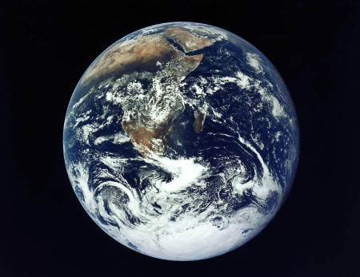
ENVIRONMENTAL ISSUES
BIOSPHERE
The thin layer of Earth and the atmosphere that supports life.
The highest level of organization

Slide 3
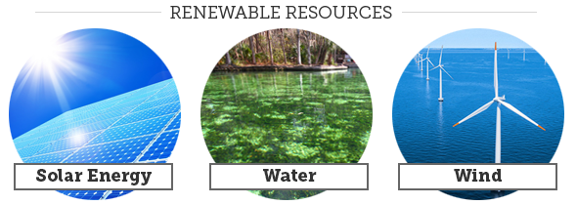
ENVIRONMENTAL ISSUES
Whether a resource is "renewable" or "nonrenewable" is about how long nature takes to renew it.
Renewable resources can regenerate and are replaceable. However, a renewable resource is not necessary unlimited such as freshwater. Drought and overuse could make it limited.

Slide 4
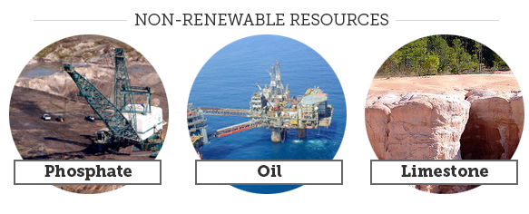
ENVIRONMENTAL ISSUES
Nonrenewable resources cannot be replenished by natural processes such as fossil fuels: coal, oil and natural gas. Fossil fuels formed over millions of years from buried organic

Slide 5
ENVIRONMENTAL ISSUES
Sustainable Use – is a way of using natural resources at a rate that does not deplete them.
This system operates without causing long-term harm to the ecological resources on which it depends.
We need to rethink which resources we use and how we use them. We should also ask ourselves if we really need to use them in the first place.
Sustainable resource use occurs when our rate of consumption can continue forever without damaging the environment.
To do this we should try to:
  use renewable resources, like wind and solar energy, instead of non-renewable resources, like fossil fuels.
  use those resources which cause less harm to the environment.
  cut back on the amount of natural resources, and in particular non-renewable resources we use, by reducing, reusing and recycling.

Slide 6
ENVIRONMENTAL ISSUES
Land Resources – Soil can be permanently damaged if it is mismanaged.
Soil erosion
Desertification
Deforestation

Slide 7
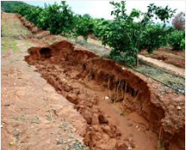
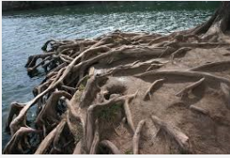
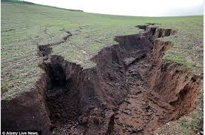
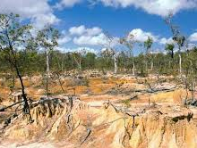
ENVIRONMENTAL ISSUES
Land Resources
Soil erosion occurs when the surface soil wears away by water or wind. Plowing the land removes roots that hold the soil in place and can cause soil to erode easily.

Slide 8
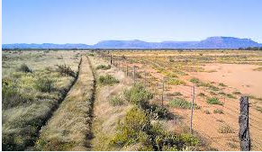
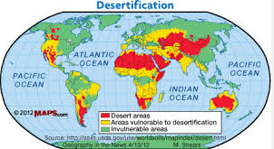
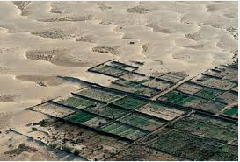
ENVIRONMENTAL ISSUES
Land Resources
Desertification occurs in dry climates, when a combination of farming, overgrazing and drought has turned once productive areas into deserts.
Combating Desertification

Slide 9
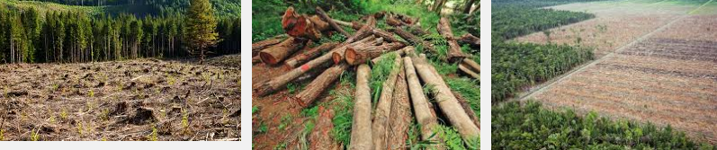
ENVIRONMENTAL ISSUES
Land Resources
Deforestation occurs when forests are cut down and lead to severe erosion as soil is exposed to heavy rains.
Erosion can wash away nutrients.
Grazing and plowing after deforestation can change the soil and microclimates that in turn prevent the re-growth of trees.
Deforestation and Climate Change

Slide 10
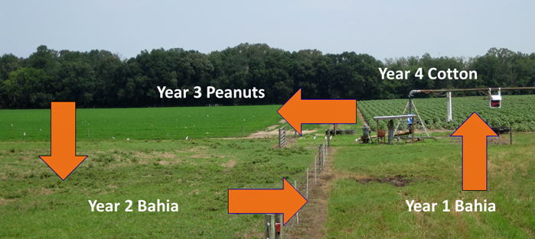
ENVIRONMENTAL ISSUES
Land Resources
There are a variety of sustainable-use practices that can reduce these problems such as contour plowing -- leaving previous year’s crop in place to help hold the soil -- crop rotation and livestock rotation – harvest mature trees.

Slide 11
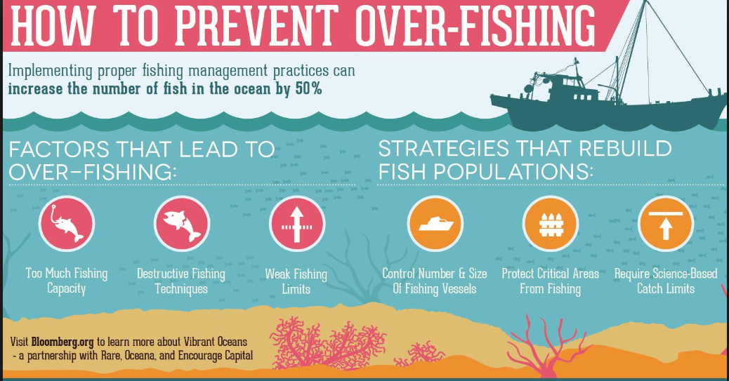
ENVIRONMENTAL ISSUES
Water Resources
Overfishing occurs when fish stocks are being harvested faster than they can reproduce. Depletion of this food resource can alter the ecosystem by collapsing fish populations.

Slide 12
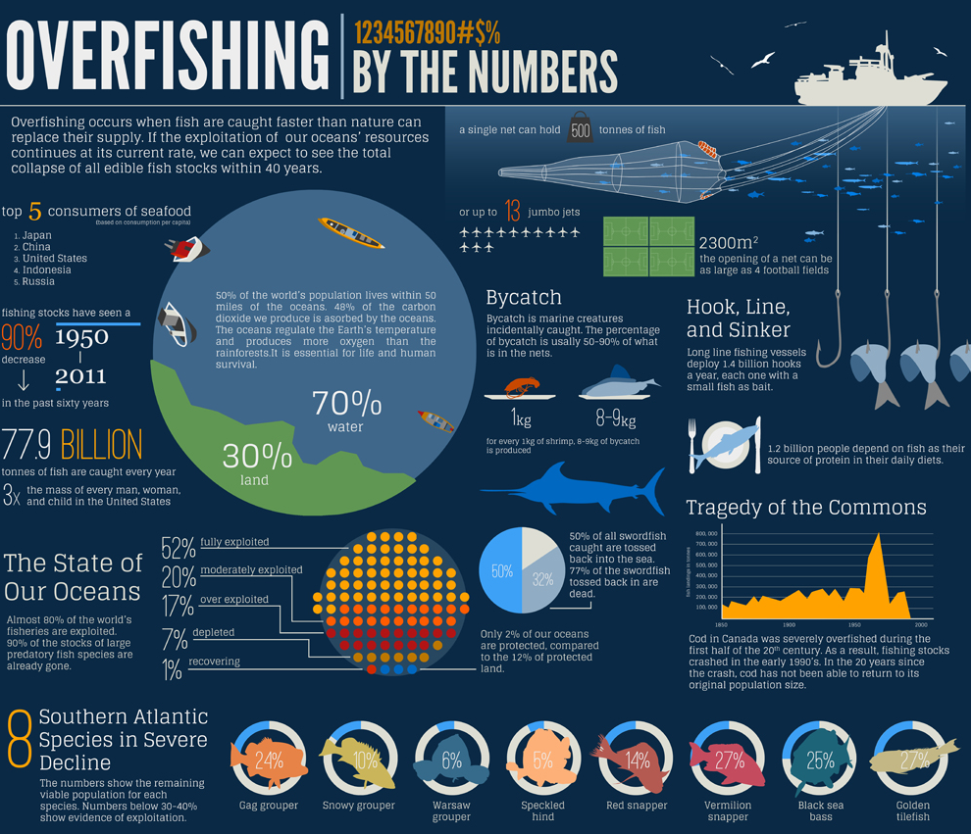

Slide 13
ENVIRONMENTAL ISSUES
Water Resources
Pollutants such as chemicals, waste and sewage enter the water cycle and contaminate water. Pollutants can increase the growth of algae and bacteria.
Sustainable use of resources includes limit fishing and use aquaculture to farm aquatic organisms. Protection of natural water systems such as wetlands to filter pollutants.

Slide 14
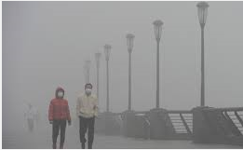
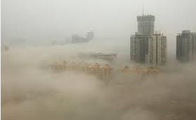
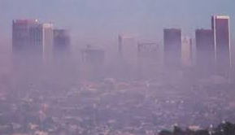
ENVIRONMENTAL ISSUES
Air Resources –
Smog – mixture of chemicals that create a haze in the atmosphere. Primarily due to automobile exhaust and industrial emissions.

Slide 15
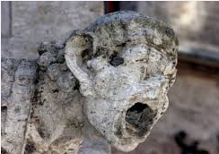
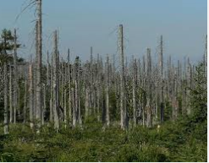
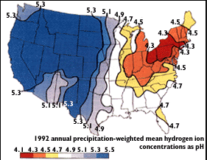
ENVIRONMENTAL ISSUES
Air Resources
Acid Rain - Burning of fossil fuels release acidic gases containing nitrogen and sulfur compounds into the atmosphere. These gases combine with water vapor to form nitric and sulfuric acids.

Slide 16
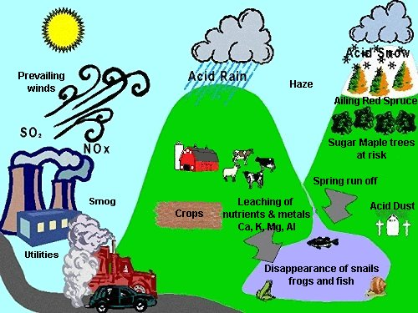

Slide 17
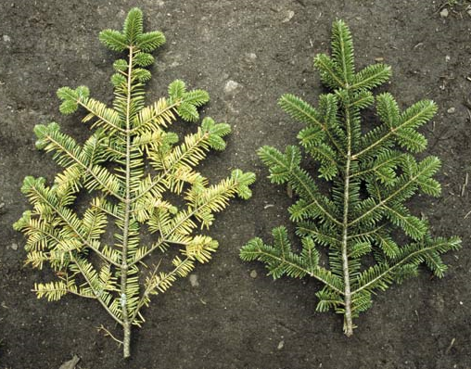
ENVIRONMENTAL ISSUES
Air Resources
Acid rain changes the chemistry of the soil. Lowering the soil pH leaches away nutrients and reduces nutrient availability. It also increases availability of toxic elements like mercury from the soil which can enter other parts of the biosphere.
Acid rain changes the chemistry of the water killing aquatic organisms.
Acid rain causes corrosion of metals.

Slide 18
ENVIRONMENTAL ISSUES
BIODIVERSITY
refers to the number of different species in a given area.
variation of life in the biosphere including species, ecosystem and genetic diversity.
Species play an important role in an ecosystem because species are either dependent on or depended upon by at least one other species.
When on species disappears from an ecosystem, a strand in a food web is removed.

Slide 19
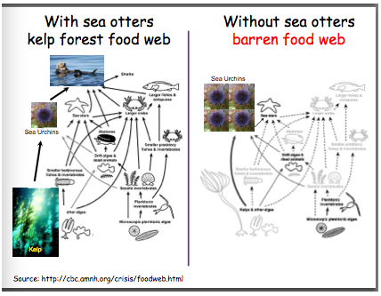
ENVIRONMENTAL ISSUES
Keystone species are critical to the functioning of an ecosystem. These species control the population size of organisms in lower tropic levels.
has a disproportionately large effect on its environment relative to its abundance.

Slide 20
ENVIRONMENTAL ISSUES
THREATS TO BIODIVERSITY include altering habitats, hunting species to extinction, introducing toxic compounds into food webs and introducing invasive species to new environments.
About 65 million years ago, a series of changes in the Earth’s climate and ecosystems caused the extinction of about half the species of Earth.
It takes many years for biodiversity to rebound after a mass extinction, the extinction of many species in a short period of time.

Slide 21
ENVIRONMENTAL ISSUES
THREATS TO BIODIVERSITY
Large populations that adapt easily too many habitats are not likely to become extinct (i.e. rats & cockroaches).
Species with small populations in limited areas can easily become extinct.
At risk species include those that migrate, those that need special habitats and those that are exploited by humans.

Slide 22
ENVIRONMENTAL ISSUES
THREATS TO BIODIVERSITY
Endangered species – A species that is likely to become extinct if protective measures are not taken immediately.
Threatened species – A species that has a declining population and that is likely to become endangered if it is not protected.

Slide 23
Endangered Means
There’s Still Time
Endangered species are like fire alarms. They tell us about problems in our home we call Earth.
If we listen to their alarm calls, they could help us improve our lives and the health of our planet.

Slide 24
Definitions
Endangered
A species of plant or animal that is likely to become extinct if protective measures are not taken immediately.
Threatened
A species that has a declining population and that is likely to become endangered if it is not protected.

Slide 25

Definitions
Extinct
A species of plant or animal that is no longer living.

Slide 26
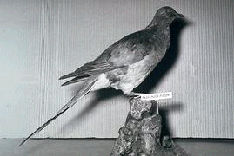
Passenger Pigeon – Now Extinct

Slide 27
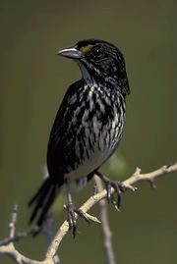
Dusky Seaside Sparrow
Last of these birds died in 1987
Sparrows lost their homes as marshes were destroyed

Slide 28
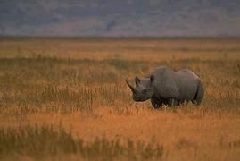
Endangered Means
There’s Still Time
An endangered species is one that is getting close to extinction.
Black Rhino of Africa

Slide 29
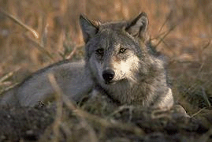
Endangered Means
There’s Still Time
Gray wolves are also endangered in most of the lower 48 states.

Slide 30
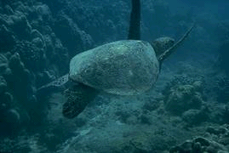
Endangered Means
There’s Still Time
A threatened species is just a step behind, and may soon become endangered if we don't help.

Slide 31
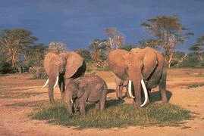
Endangered Means
There’s Still Time
African Elephant
Poachers cut off their ivory tusks to make carvings and sell them for money.

Slide 32
Ways That Species Become Endangered
Habitat loss
Unregulated or illegal killing or collection
Pesticides, pollution
Competition with other species
Disease
Predation

Slide 33
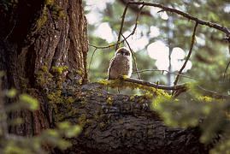
Endangered Means
There’s Still Time
It is because of habitat loss that spotted owls are threatened.

Slide 34
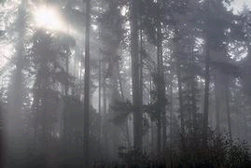
Endangered Means
There’s Still Time
Different aged trees like this are perfect for owls nests, food, shelter and protection from predators.

Slide 35
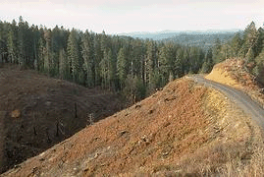
Endangered Means
There’s Still Time
The spotted owl's problem started years ago when old growth forests were cut faster than they could regrow.

Slide 36
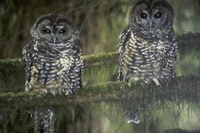
Endangered Means
There’s Still Time
The spotted owl is our fire alarm to the problem of over-cutting our forests.

Slide 37
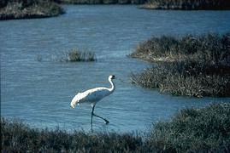
Endangered Means
There’s Still Time
It is also because of habitat loss that whooping cranes are endangered.

Slide 38
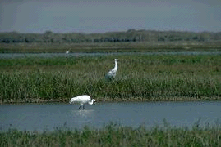
Endangered Means
There’s Still Time
Whooping cranes need wetlands for food and protection.

Slide 39
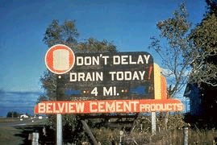
Endangered Means
There’s Still Time
Historically, wetlands were considered wastelands, suitable only for mosquitoes and draining.

Slide 40
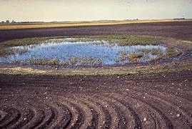
Endangered Means
There’s Still Time
When wetlands are drained of all their water, this is habitat loss.

Slide 41
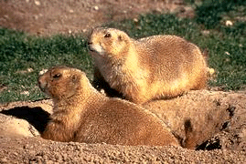
Endangered Means
There’s Still Time
Ferrets depend on these prairie dogs for food.

Slide 42
Endangered Means
There’s Still Time
Prairie dogs were considered pests by the settlers
Thousands of prairie dog towns were killed off
Without the prairie dogs, the ferrets had no food

Slide 43
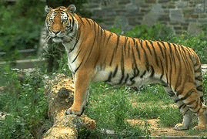
Endangered Means
There’s Still Time
There are two reasons why tigers are endangered, habitat loss and illegal killing.

Slide 44
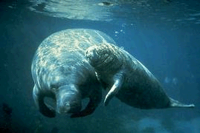
Endangered Means
There’s Still Time
Certain human activities are also the main problem facing the endangered manatee, or sea cow.

Slide 45
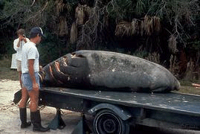
Endangered Means
There’s Still Time
Sometimes speed boats run over the manatees.

Slide 46
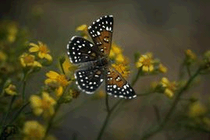
Endangered Means
There’s Still Time
Not all endangered species are mammals and birds we are familiar with.

Slide 47
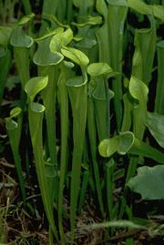
Endangered Means
There’s Still Time
Many plants, like this insect-eating pitcher plant, are endangered.

Slide 48
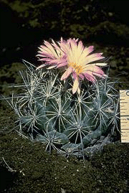
Endangered Means
There’s Still Time
This is a bunched Cory Cactus, a very endangered plant found in the Southwest deserts.

Slide 49
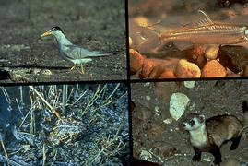
Endangered Means
There’s Still Time
All living things, from mammals to fish and insects, are connected and depend on each other for survival.

Slide 50
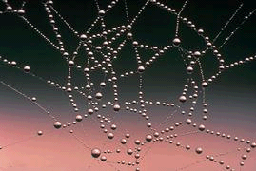
Endangered Means
There’s Still Time
All living things are connected to each other including humans.

Slide 51
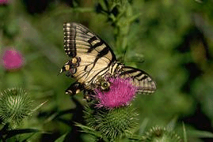
Endangered Means
There’s Still Time
It has been estimated that a disappearing plant can take with it up to 30 other species.

Slide 52
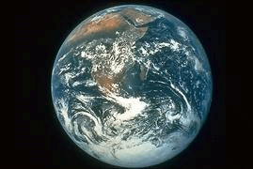
Endangered Means
There’s Still Time
Endangered species show us that our world may not be as healthy as we think.

Slide 53
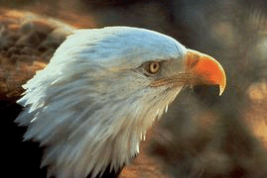
Endangered Means
There’s Still Time
The use of a dangerous pesticide called DDT caused bald eagles to begin laying eggs with shells so thin they often broke.

Slide 54
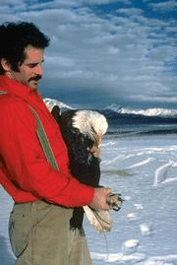
Endangered Means
There’s Still Time
DDT was being used on farms to control agricultural pests.

Slide 55

Endangered Means
There’s Still Time
Brown pelicans also signaled the DDT alarm to us when their egg shells started thinning.

Slide 56

Endangered Means
There’s Still Time
The system of living things depending on one another is called an ecosystem.

Slide 57

It is the job of the U.S. Fish and Wildlife Service to manage over 500 refuges with over 90 million acres for the conversation of endangered species, ecosystems, and natural diversity.

Slide 58

In 1973, the Endangered Species Act was passed by our government to protect disappearing plants and animals.

Slide 59

More than 900 species of plants and animals in the U.S., and more than 530 species living in other parts of the world, are protected by the Endangered Species Act.

Slide 60

According to the Act, it is illegal to import, export, or sell animals and plants on the list across state lines.

Slide 61

What can you do to help endangered species?

Slide 62
Learn as much as you can about endangered species in your area
Visit a nearby national wildlife refuge or nature center
Volunteer to help
Don’t buy species illegally taken from the wild
Don’t buy products made from threatened or endangered species.

Slide 63

The most hope for endangered species lies in the hands of young people like you who care enough to make a difference.

Slide 64

ENVIRONMENTAL ISSUES
Habitat Destruction and Fragmentation – As human populations grow, we use more land to build homes and harvest resources. Humans destroy and fragment the habitats of other species. Natural habitats are destroyed and the remaining pieces of habitat contain fewer species and less diversity. It is estimated that habitat loss causes almost 75% of the extinction now occurring.

Slide 65

ENVIRONMENTAL ISSUES
Invasive Species – A non-indigenous species is introduced into a particular region and can threaten native species that have no natural defenses against them.

Slide 66


ENVIRONMENTAL ISSUES
Excessive Hunting, Harvesting and Poaching – Many countries now have laws to regulate hunting, fishing, harvesting and trade of wildlife.

Slide 67

ENVIRONMENTAL ISSUES
Pollution – Chemicals used by humans are making their way into food webs around the world.
The long-term effects may not be clear until after many years of use (i.e. DDT & bald eagle).

Slide 68

ENVIRONMENTAL ISSUES
Biological magnification occurs when toxic substances enter the food chain.
Concentrations of harmful substances increase in organisms at higher trophic levels in the chain or web.

Slide 69
CRITICAL AREAS
CRITICAL areas of Biodiversity –
Some parts of the world contain a greater diversity of species than others.
An important feature is that they have a large portion of endemic species ---- species that are native to and found only within a limited area.
Ecologist often use the numbers of endemic species of plants as an indicator of overall biodiversity, because plants from the bases of ecosystems on land.

Slide 70

CRITICAL AREAS
The remaining tropical rain forests cover less than 7% of the Earth’s land. Biologist estimate that over ½ of the world’s species live in these forests. Unknown numbers of species are disappearing as tropical forests are cleared for farming or cattle grazing.

Slide 71

CRITICAL AREAS
Coral reefs occupy a small fraction of the marine environment yet contain the majority of the biodiversity. Nearly 60% of Earth’s reefs are threatened by human activities such as overfishing and pollution. Similar threats affect other coastal ecosystems which are travel routes for many migrating species and are linked to ecosystems on land.

Slide 72

CRITICAL AREAS
Biodiversity hotspots have high numbers of endemic species and are the most threatened areas on Earth. Most hotspots have lost 70% of their original natural vegetation. The U.S. hotspots include the Florida Everglades, the Californian coastal region, Hawaii, the Midwestern prairies and the forest of Pacific Northwest.

Slide 73
GLOBAL WARMING
Ozone
The ozone contains a layer of ozone gas (O₃) in the upper atmosphere of Earth.
It is naturally occurring and absorbs much of the ultraviolet (UV) radiation emitted by the sun from reaching Earth’s surface.
Ozone is a “global sunscreen”.
The increase in UV radiation causes sunburn, cancer, damage plant leaves, phytoplankton and decrease organisms’ resistance to disease.

Slide 74

GLOBAL WARMING
Ozone depletion is caused by chlorofluorocarbons (CFCs).
CFCs are used in aerosol cans and as coolants in refrigerators and air conditioners.
In the cold of the polar atmosphere, CFCs act as catalysts that enable UV light to break apart ozone molecules.

Slide 75

GLOBAL WARMING

Slide 76
GLOBAL WARMING
Climate Change Basics

Slide 77
GLOBAL WARMING
Greenhouse Effect
The Greenhouse Effect is a natural process in which atmospheric gases absorb thermal radiation (heat).
Some of sun’s radiation is reflected back into space, but some passes through and is absorbed by Earth.
Heat from the Earth is radiated outward and absorbed by “greenhouse gases”.
Greenhouse gases regulate our climate by trapping heat and keeping Earth warm enough to sustain life.
The main greenhouse gases are Carbon Dioxide (CO₂), Methane (CH₄) and Nitrous Oxide (N₂O).

Slide 78

GLOBAL WARMING

Slide 79
GLOBAL WARMING
Humans accelerate this natural process by creating more greenhouse gases in the atmosphere through activities such as:
  Burning fossil fuels – deforestation -- creates more CO₂
  Industrial processes and mining -- emissions from livestock and agricultural practices -- decomposition in landfills – creates more CH₄
  Agricultural and industrial practices – combustion of fossil fuels and solid waste – creates more N₂O
Ultimately, more greenhouse gases mean more infrared radiation trapped which gradually increases the temperature of the Earth’s surface. This increase in average temperature of the biosphere is called Global Warming.

Slide 80
GLOBAL WARMING
IMPACTS OF GLOBAL WARMING:
Ice sheets and glaciers are melting worldwide, especially at the Earth’s poles.
Ecosystems will change—some species will move farther north or become more successful; others won’t be able to move and could become extinct.
Sea level rise became faster over the last century.
Precipitation has increased across the globe, on average.
Floods and droughts will become more common.
Less fresh water will be available.
Hurricanes and other storms are likely to become stronger.
Species that depend on one another may become out of sync. For example, plants could bloom earlier than their pollinating insects become active.
Some diseases will spread such as malaria carried by mosquitoes.

Slide 81
GLOBAL WARMING
Climate Change Basics

