Slide 1
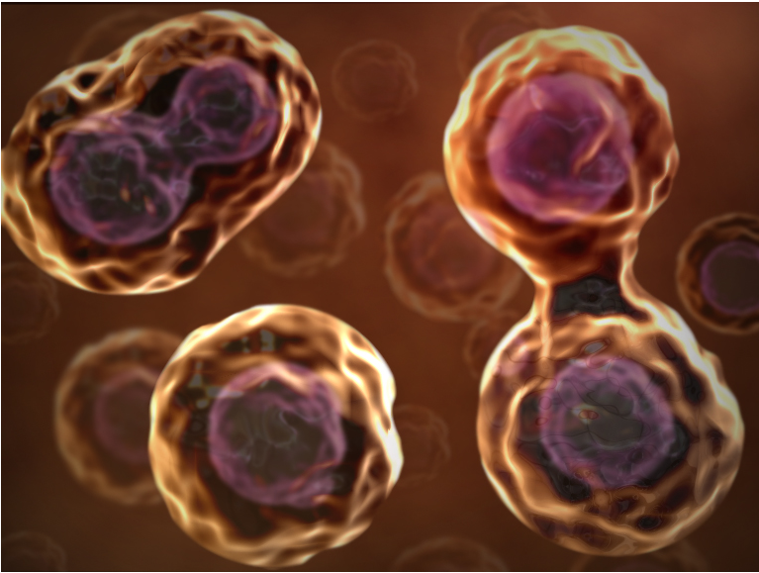
Cell Reproduction
Chapter 6

Slide 2
WHY DIVIDE?
Cell division functions in reproduction, growth and repair.
The division of unicellular organisms reproduces the entire population.
In multicellular organisms, division is used to repair and for growth. Also, division is needed to produce egg or sperm used for reproduction.

Slide 3
WHY DIVIDE?
Cells grow until they reach their size limit, then they either stop growing or divide.
The ratio of a cell’s surface area to cell volume determines the limit of cell growth for cells.
Cell size is limited by the cell’s ability to transport materials and communicate instructions from the nucleus.

Slide 4
WATCH
Introduction to Cell Reproduction

Slide 5
CHROMOSOMES
Chromosomes consist of tightly packed DNA coiled around proteins (histones) that support its structure.
DNA contains genes which are segments of DNA that code for a protein.
Humans have about ~20,000 genes

Slide 6
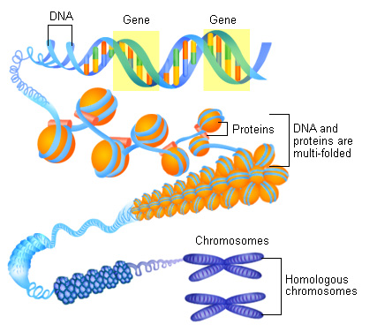
CHROMOSOMES
Histones

Slide 7
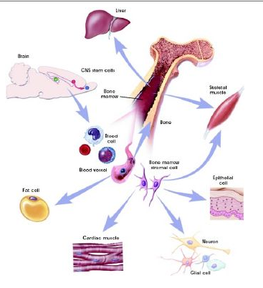
CHROMOSOMES
Eukaryotic Cells
Somatic (body) cells
  46 chromosomes
  Diploid (2n)
Sex cells (gametes)
  23 chromosomes
  Haploid (n)

Slide 8
CHROMOSOMES
In Humans, there are 23 pairs of chromosomes.
The first 22 pairs are called autosomes.
The 23rd pair, the sex chromosome differs between males and females.
Females have two X chromosomes, and males have one X and one Y chromosome.

Slide 9
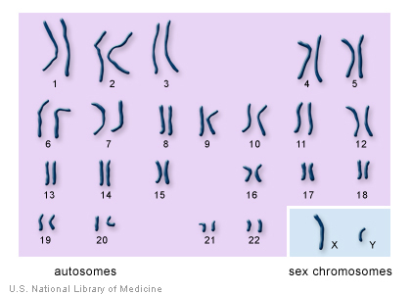

Slide 10
VOCABULARY TO KNOW
Chromatid – half of a chromosome
Centromere – the constriction region that divides the chromosome into two chromatids
Sister chromatids – two identical DNA molecules attached at the centromere
Homologous Chromosomes – a chromosome pair, one inherited from the mother and one from the father, containing genes for the SAME trait or characteristic.

Slide 11
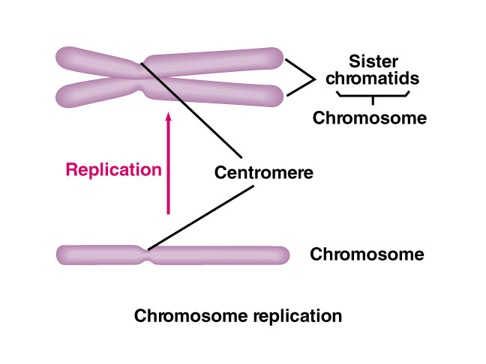
VOCABULARY TO KNOW
Chromatid, Centromere, Sister chromatids, Homologous Chromosomes

Slide 12
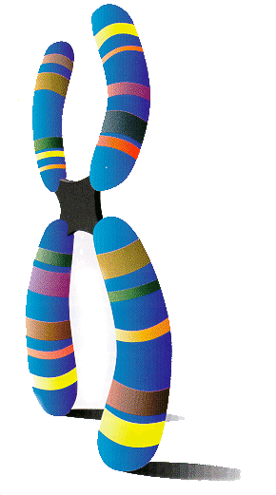
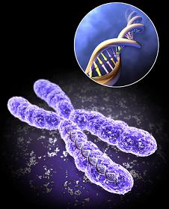
CHROMOSOMES
During cell division the nuclear membrane disappears and the chromatin coils up and darkens.
This creates chromosomes that are easily visible.
The “doubled” chromosomes are produced during DNA replication.
-happens in interphase.

Slide 13
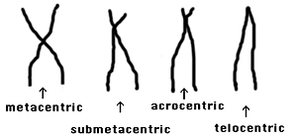
CHROMOSOMES
The doubled chromosomes are held together by a centromere.
Types of Centromeres:

Slide 14
CHROMOSOMES
Chromosomes can be studied to determine genetic abnormalities
Amniocentesis: a test done on pregnant women to get fetal cells to study.
Amniotic fluid is drawn from the womb.
Then a Karyotype is done to determine the amount and type of chromosomes present.

Slide 15
KARYOTYPE
A Karyotype is the number and visual appearance of the chromosomes in the cell nuclei of an organism or species.
Scientists take a picture of the cells while they are dividing and blow up the picture to see the chromosomes.
The chromosomes are cut out and sorted.
Karyotype

Slide 16
KARYOTYPE
Chromosomes are aligned by size, centromere location, and banding patterns.
  Autosomes first, numbered
  Sex chromosomes last
    XX = female
    XY = male
Chromosome errors can be spotted
such as additions, deletions, and extra or less whole chromosomes (ex. Down’s Syndrome)

Slide 17
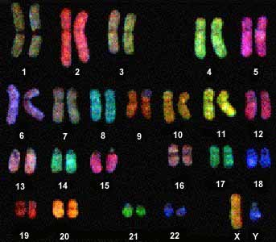
KARYOTYPE

Slide 18
KARYOTYPE
Look at the Karyotypes given to you.
Answer the questions in Section B, #10.
Then do Section B #11-13.
Quiz Friday over page one of the notes and vocabulary.

Slide 19
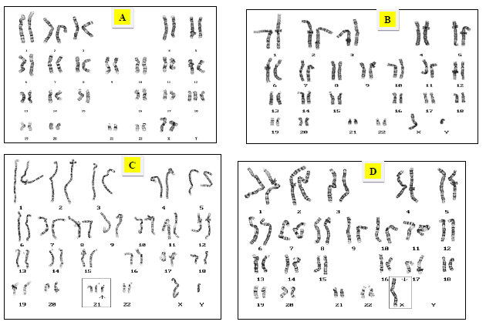
KARYOTYPES

Slide 20
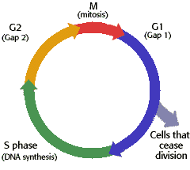
CELL CYCLE
series of events of cell growth and division
all cells are on their own cycle - this is from the time of cell division through growth to the next division.

Slide 21
CELL CYCLE
Steps of Cell Cycle:
Interphase – G1, S, G2
M phase – mitosis or meiosis
Cytokinesis

Slide 22
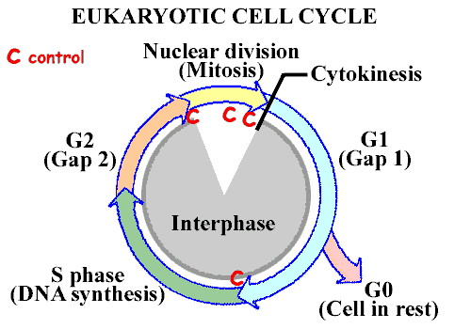

Slide 23

INTERPHASE
3 parts
90-95% of the life of the cell
G1: 1st growth phase
-cell makes new proteins
S: synthesis of DNA (DNA replication)
G2: 2nd growth phase
-cell makes new organelles
Notes:
Interphase:The cell is engaged in metabolic activity and performing its prepare for mitosis (the next four phases that lead up to and include nuclear division). Chromosomes are not clearly discerned in the nucleus, although a dark spot called the nucleolus may be visible. The cell may contain a pair of centrioles (or microtubule organizing centers in plants) both of which are organizational sites for microtubules.

Slide 24
INTERPHASE
During interphase, a cell:
Increases in mass
Roughly doubles its organelles, enzymes, etc.
Duplicates its DNA
For most cells, it is the longest portion of the cell cycle.

Slide 25
INTERPHASE
G1 Phase
“G” stands for “Gap”.
Longest phase
Builds proteins, carbohydrates, and lipids and more cytoplasm.

Slide 26
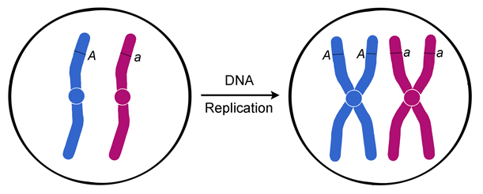
INTERPHASE
S Phase
“S” stands for “Synthesis”.
More histones are made.
DNA is replicated.

Slide 27
INTERPHASE
G2 Phase
The cell synthesizes a variety of proteins.
More organelles are made and the cytoplasm expands.
Mitochondria and chloroplasts divide to make more of themselves.
Other organelles “bud” off parts.

Slide 28
INTERPHASE
The advantage of having three phases in interphase is that it allows time for preparations for mitosis to happen in an orderly fashion.
It also allows time to check that things are happening as they should.

Slide 29
CELL CYCLE
Sometimes the cells exit the cell cycle and enter the G₀ phase.
In the G₀ phase, cells are alive and metabolically active, but do not divide.
Many cells in the human body, including those in heart muscle, eyes, and brain are in the G₀ phase.
If these cells are damaged, they cannot be replaced.

Slide 30
CELL CYCLE
Some cells can be “called back” from the G_{o} phase to the cell cycle by certain external cues such as growth factors.

Slide 31
TO DO
ANIMATION: How the Cell Cycle Works
Do Section C

Slide 32
CELL DIVISION
Mitosis
nucleus divides into 2 identical nuclei with identical genetic information
In Eukaryotes
  It is the main process of growth and repair. It is the process by which unicellular and multicellular organisms asexually reproduce.

Slide 33
CELL DIVISION
Mitosis takes place in somatic (body) cells.
Each cell is 2N or diploid
-this means that there are 2 chromosomes of
every type present.
In humans there are 46 chromosomes.
2 daughter cells will be formed from every parent cell.
Mitosis ensures genetic continuity (cloning).

Slide 34
CELL REPRODUCTION
Organelles involved in cell division are:
-centrioles (animals only)
-nucleus
-spindle fibers

Slide 35

STEPS OF MITOSIS
PROPHASE
The longest phase of cell division
Chromatin condenses and becomes visible chromosomes.
Centrioles move to opposite sides of the cell.
Spindle fibers appear and each chromosome attaches to one fiber.
Nuclear membrane disappears
Notes:
Chromatin in the nucleus begins to condense and becomes visible in the light microscope as chromosomes. The nucleolus disappears. Centrioles begin moving to opposite ends of the cell and fibers extend from the centromeres. Some fibers cross the cell to form the mitotic spindle.

Slide 36

STEPS OF MITOSIS
Metaphase
Fastest phase
Spindle fibers attach to centromeres.
Chromosomes line up along the equator of the cell – midway.
Notes:
Spindle fibers align the chromosomes along the middle of the cell nucleus. This line is referred to as the metaphase plate. This organization helps to ensure that in the next phase, when the chromosomes are separated, each new nucleus will receive one copy of each chromosome.

Slide 37

STEPS OF MITOSIS
Anaphase
Doubled chromosomes pull apart
Sister chromatids are pulled to opposite sides of the cell by the spindle fibers.
Notes:
The paired chromosomes separate at the kinetochores and move to opposite sides of the cell. Motion results from a combination of kinetochore movement along the spindle microtubules and through the physical interaction of polar microtubules.

Slide 38

STEPS OF MITOSIS
Telophase
All the events that happened in prophase have to be reversed.
Chromosomes decondense (uncoil) to form chromatin
Nuclear membrane reform – there are now two nuclei.
Spindle fibers dissolve into the cytoplasm.
Notes:
Chromatids arrive at opposite poles of cell, and new membranes form around the daughter nuclei. The chromosomes disperse and are no longer visible under the light microscope. The spindle fibers disperse, and cytokinesis or the partitioning of the cell may also begin during this stage.

Slide 39

CYTOKINESIS
Cytokinesis occurs.
Cytoplasm divides.
Cell pinches in half to form two new cells.

Slide 40
CYTOKINESIS
Animal cells: cytokinesis results when a fiber ring composed of a protein called actin around the center of the cell contracts pinching the cell into two daughter cells, each with one nucleus.
Plant cells: the rigid wall requires that a cell plate be formed between the two daughter cells.

Slide 41
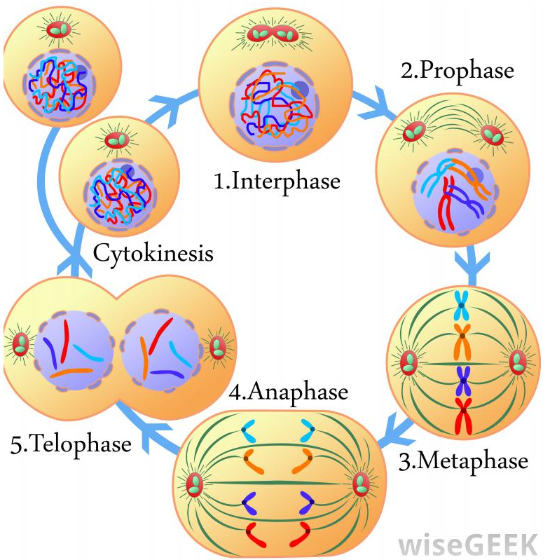
YIELD
2 diploid daughter cells
genetically identical to parent

Slide 42
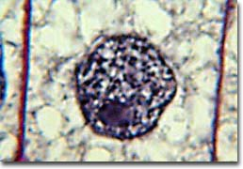
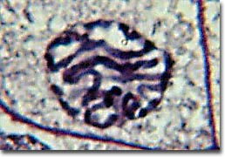
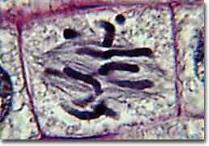
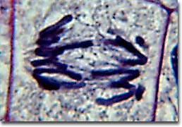
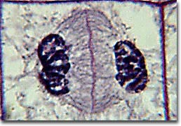
MITOSIS IN
ONION ROOT TIP
INTERPHASE
PROPHASE
METAPHASE
ANAPHASE
TELOPHASE

Slide 43
TO DO
VIDEO: Mitosis and Cytokinesis
Work on Cell Reproduction Practice packet – due next Friday.

Slide 44
DO NOW
VIDEO: Mitosis
COMPUTERS:
  Section E: Cell Cycle
  Section F: Cell Division
  Section G: Online Onion Root Tips
PRACTICE: Work on Cell Reproduction Practice Questions.

Slide 45
DO NOW
Mitosis in Onion Root Tip
Section H
Section I
Work on Cell Reproduction Practice Questions

Slide 46
CELL CYCLE : CREATING GAMETES
Three Phases: Interphase, Meiosis I and II, Cytokinesis
Meiosis: sex cell formation
Reduces the chromosome number by half
Meiosis

Slide 47
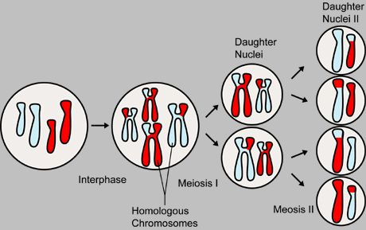
MEIOSIS

Slide 48
MEIOSIS
Nucleus divides twice into 4 different nuclei with different genetic information.
In Eukaryotes, it is the formation of gametes for sexual reproduction.
Each gamete cell will contain one of the pairs of homologous chromosomes
As a result: 4 cells form from 1 parent cell and they contain the haploid (N) number of chromosomes

Slide 49
MEIOSIS
Meiosis leads to genetic variation: mixing of the genes within an individual’s sex cells.
Ex. Tall or short
Curly hair or short hair

Slide 50
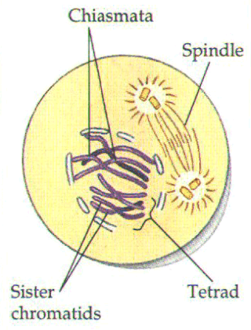
MEIOSIS I: PMAT I
Prophase I
the same events that occur in mitosis except for synapsis- the pairing of homologous chromosomes to form a tetrad
During this time crossing over of the chromosome occurs and this leads to even more variation

Slide 51
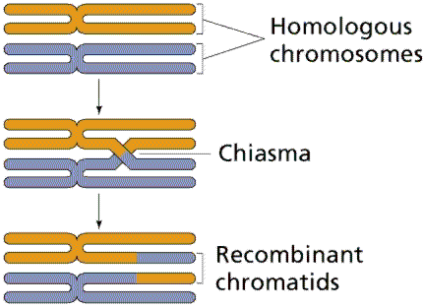
MEIOSIS I: PMAT I
A single cell divides into 2 daughter cells that are not genetically identical.
Crossing over:
greater genetic variation

Slide 52
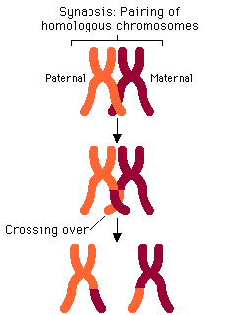
MEIOSIS I: PMAT 1
The homologous chromosomes come together and literally swap parts of themselves with each other.
This process is called Crossing Over and ensures that the daughter cells produced after the first cytokinesis will not be genetically identical.

Slide 53
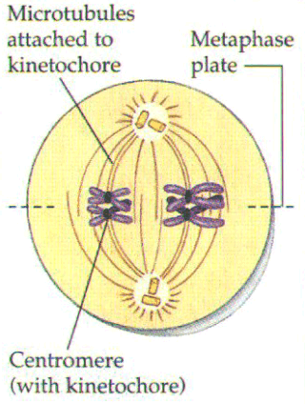
MEIOSIS I: PMAT 1
Metaphase I
same as mitosis

Slide 54
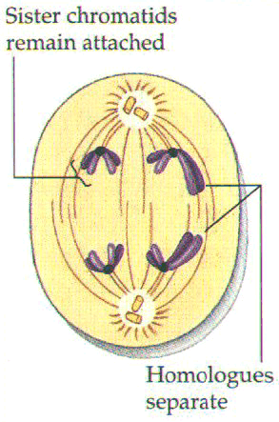
MEIOSIS I: PMAT 1
Anaphase I
chromosome reduction
centromeres stay in tact, chromosomes don’t separate into chromatids.
Independent Assortment – each homologous chromosome is randomly assorted at the equator and into different gametes.

Slide 55
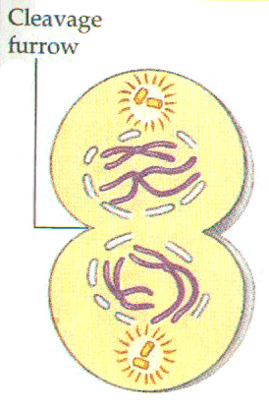
MEIOSIS I: PMAT 1
Telophase I
cell splits, but the nucleus and nucleolus don’t reform
There is one more round of cell division

Slide 56
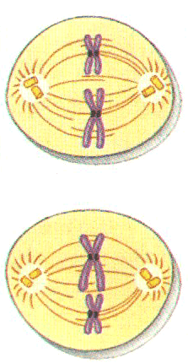
MEIOSIS II: PMAT 2
Metaphase II
line up in the middle

Slide 57
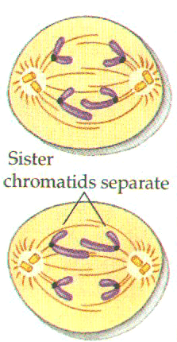
MEIOSIS II: PMAT 2
Anaphase II
chromosomes separate at their chromatids

Slide 58
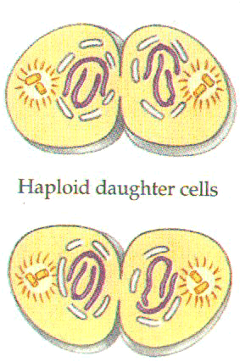
MEIOSIS II: PMAT 2
Telophase II
nucleus reforms
nucleolus reforms
membrane reforms
cytokinesis occurs
4 haploid cells are formed

Slide 59
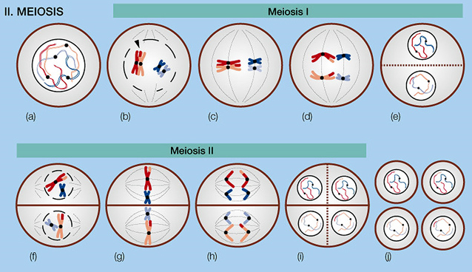
CYTOKINESIS
division of the cytoplasm

Slide 60
YIELD
4 haploid daughter cells
genetically different from parent

Slide 61
OOGENESIS VS. SPERMATOGENESIS
Oogenesis is formation of an egg
Only one egg is formed (three polar bodies are also formed).
Spermatogenesis is formation of sperm.
4 sperm cells are formed from 1 parent cell.

Slide 62
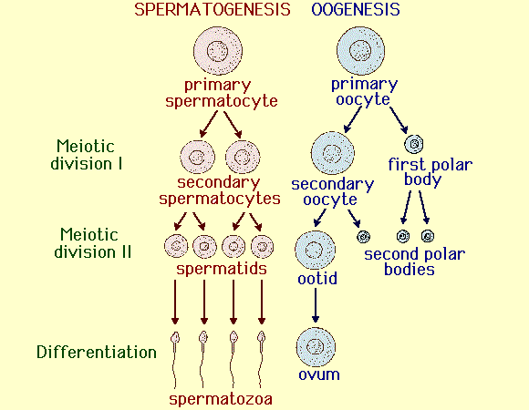
OOGENESIS VS. SPERMATOGENESIS

Slide 63
TO DO
Animation: How Meiosis Works
Section J
Cell reproduction Practice is due Friday.

Slide 64
DO NOW
Get out your notes and worksheet packet.
Cell reproduction Practice is due tomorrow.
Control of the Cell Cycle

Slide 65
CELL CYCLE CONTROL
A Molecular Control System
Several checkpoints act as built-in stop signs that halt the cell until they are over-ridden by go ahead signals.
Three checkpoints exists in G1, G2, and M.
Cells also have a predetermined lifespan.

Slide 66
CELL CYCLE CONTROL
Three checkpoints exist during interphase to make sure that everything has gone as planned and fix errors if needed.
G1-S checkpoint (end of the G1 phase) makes sure that the DNA is intact and that the cell has enough energy to enter the S phase.
The S phase checkpoint makes sure that DNA is replicated correctly without any breakages.
The G2-M checkpoint at the end of the G2 phase is another safeguard in case something happens to the DNA or cell before it undergoes the massive task of dividing.

Slide 67
CELL CYCLE CONTROL
Timing is controlled by regulatory proteins – cyclins and kinases. These proteins selectively access, activate and silence information in DNA.
Contact Inhibition – Cells release chemicals to inhibit growth when they become too crowded.

Slide 68
CELL CYCLE CONTROL
When things go wrong?
Uncontrolled Cell Growth
Mutant genes cause tumors to form by disrupting normal cell cycle controls
Altered cells grow and divide abnormally.
Tumors may be cancerous

Slide 69
TO DO
The Effect of Contact Inhibition on Cell Division
Mistakes in Meiosis
Cancer and the Cell Cycle
Cell reproduction Practice is due tomorrow.

Slide 70
DO NOW
Turn in Cell Reproduction Practice packet.
Pick up review.
Get out notes and worksheet.
How to remember Mitosis versus Meiosis
Mitosis and Meiosis

Slide 71
PROKARYOTIC CELL DIVISION
Prokaryotic fission, which is binary fission, is a form of asexual reproduction and cell division used by
  all prokaryotes (bacteria and archaebacteria)
  some organelles within eukaryotic organisms (e.g., mitochondria).

Slide 72
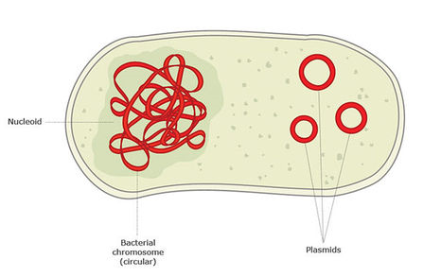
PROKARYOTIC CELL DIVISION
Most bacterial genes are located on a single bacterial chromosome (~4million base pairs) which consists of a circular DNA molecule and associated proteins.

Slide 73
PROKARYOTIC CELL DIVISION
Bacteria do not have as many genes or DNA molecules as long as those in eukaryotes.
Humans ~2.3 billion base pairs.
Bacteria circular chromosome is still highly folded and coiled in the cell.

Slide 74
PROKARYOTIC CELL DIVISION
Prokaryotes reproduce by binary fission, not mitosis.
In binary fission, chromosome replication begins at one point in the circular chromosome, the origin of replication site.
Binary Fission

Slide 75
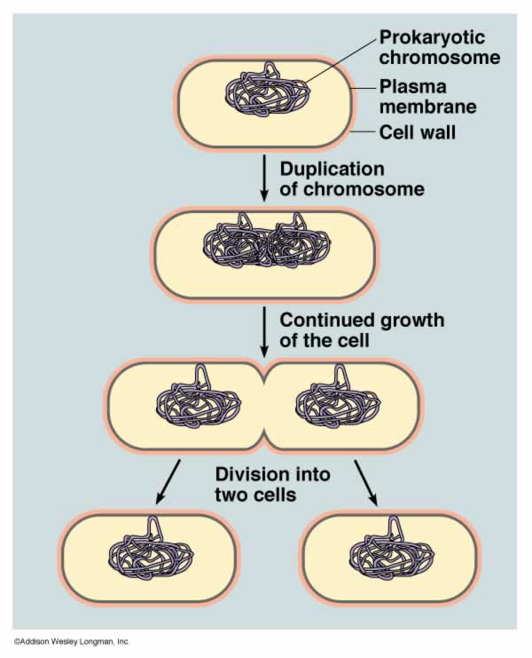
PROKARYOTIC CELL DIVISION

