Slide 1
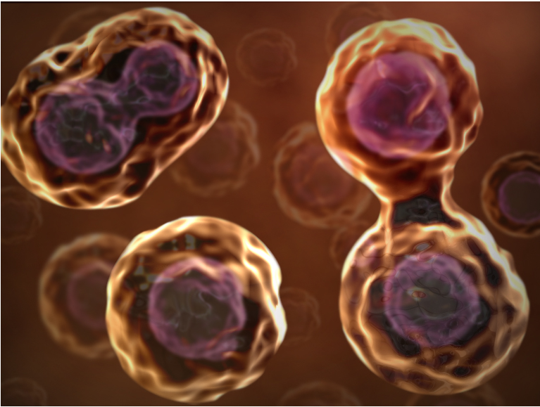
Cell Reproduction
Chapter 6

Slide 2
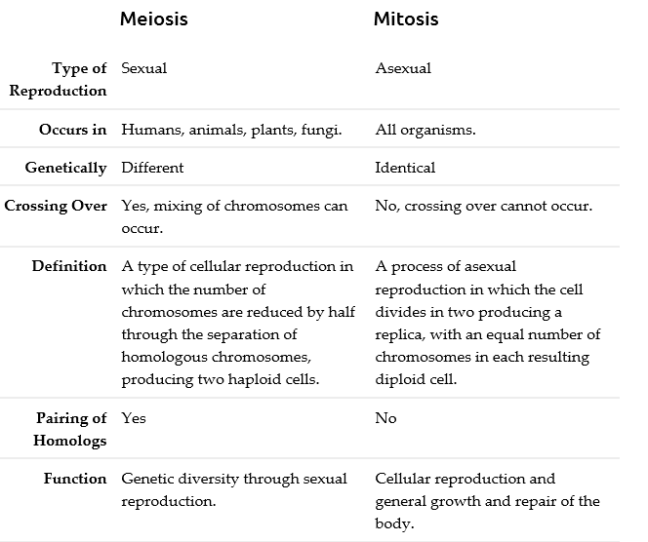

Slide 3
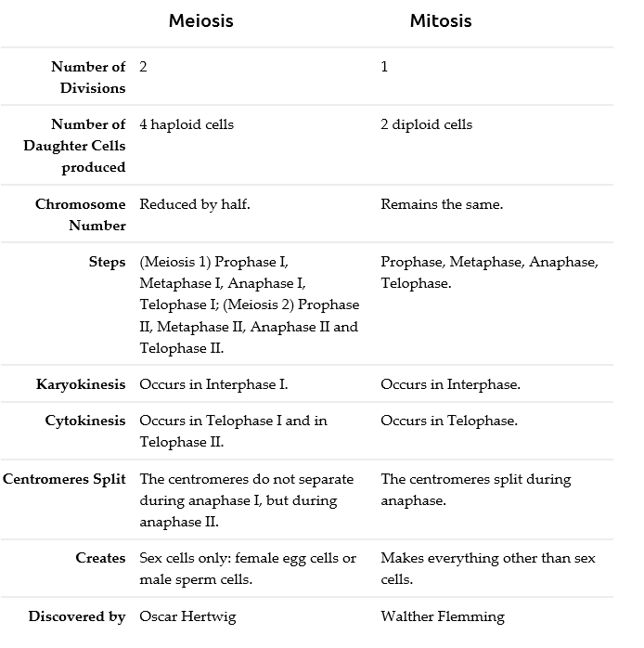

Slide 4
REVIEW
Cell Division
  Purpose
  End result
Genetic Material
  Called?
  Consist of?
  Tightly wound around?
  Number in Cells
    Somatic cells, diploid, 2N
    Gametes, haploid, N
  Vocabulary
    Chromatid, centromere, sister chromatids, homologous chromosomes, gene, trait
  Karyotype
    Define
    What information does it give
    Autosome versus sex chromosome

Slide 5
REVIEW
Interphase
Define
Purpose
How much of total cell cycle?
G1 – what happens, number of chromosomes
S – what happens
G2 – what happens, number of chromosome
G₀ – what happens

Slide 6
REVIEW
Mitosis
Define
Purpose
Parts - know what happens in each and be able to recognize a drawing of each.
  Prophase
  Metaphase
  Anaphase
  Telophase

Slide 7
REVIEW
Cytokinesis
Define
Purpose
Yield and number of chromosomes
How is plant cytokinesis different from animal?

Slide 8
REVIEW
Meiosis
Define
Purpose
Parts - know what happens in each and be able to recognize a drawing of each.
  Prophase I
    Crossing over
  Metaphase I
    Independent assortment
  Anaphase I
  Telophase I (plus number of chromosomes)
  Prophase II
  Metaphase II
  Anaphase II
  Telophase II

Slide 9
REVIEW
Cytokinesis
Define
Purpose
Yield and number of chromosomes

Slide 10
REVIEW
Cycle Control Mechanisms
Checkpoints
  G1
  G2
  M
How is timing controlled?
Contact inhibition
Controlled cell growth

Slide 11
REVIEW
Prokaryotic Cell Division
Type of genetic material?
Binary fission

