Slide 1
CELLULAR TRANSPORT

Slide 2
PASSIVE AND ACTIVE TRANSPORT REVIEW
Passive Transport
Active Transport
Doesn’t require energy inputs
Solutes diffuse through a channel inside the protein’s interior
Net movement is down concentration gradient
Requires ATP
Protein is an ATPase pump
Pumps solute against its concentration gradient

Slide 3
TONICITY
Tonicity is the measure of osmotic pressure of two solutions separated by a semipermeable membrane.
Solutions are composed of the solute and solvent.

Slide 4
SOLUTION REVIEW
Solution: A mixture in which the molecules of one substance are evenly dispersed in another substance. Ex: sugar-water solution.
Solvent: The greater part; dissolves the other substance. Ex: water.
Solute: The substance being dissolved in the solvent. Ex: sugar.
Aqueous Solution: Water solutions. Water is the solvent in most solutions in the cell. For example, plasma, is the liquid part of the blood.

Slide 5
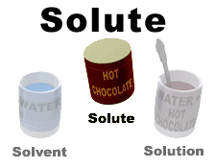
SOLUTION

Slide 6
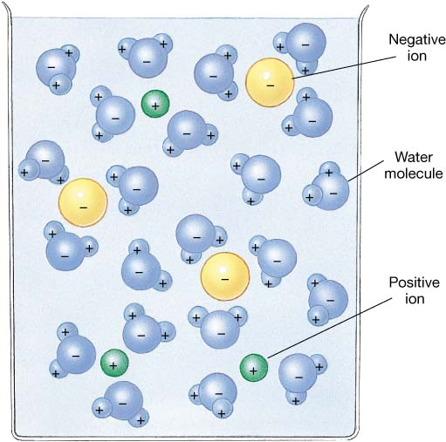
WATER: UNIVERSAL SOLVENT

Slide 7
TYPE OF SOLUTIONS
The concentration of water on each side of the membrane is determined by the concentration of solutes in solution.
Isotonic solution: concentration of solutes outside the cell is the same as the concentration inside the cell.
Hypertonic solution: the concentration of solute molecules is higher outside than inside the cell.
Hypotonic solution: the concentration of the solute molecules is lower outside the cell than inside the cell.

Slide 8
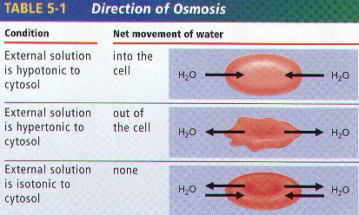
OSMOSIS

Slide 9
ISOTONIC SOLUTIONS
If a cell is placed into an isotonic solution, the rate of osmosis into the cell is exactly the same as the rate of osmosis out of the cell.
Isotonic solutions are important to living organisms.
Plasma, the liquid part of the blood is isotonic with respect to red blood cells.
Examples: blood plasma, body fluids, tears, sweat, saline (IV).

Slide 10
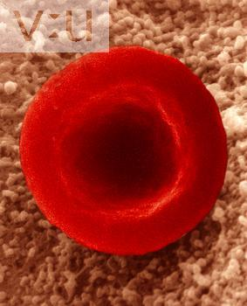
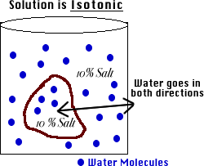
ISOTONIC SOLUTION

Slide 11
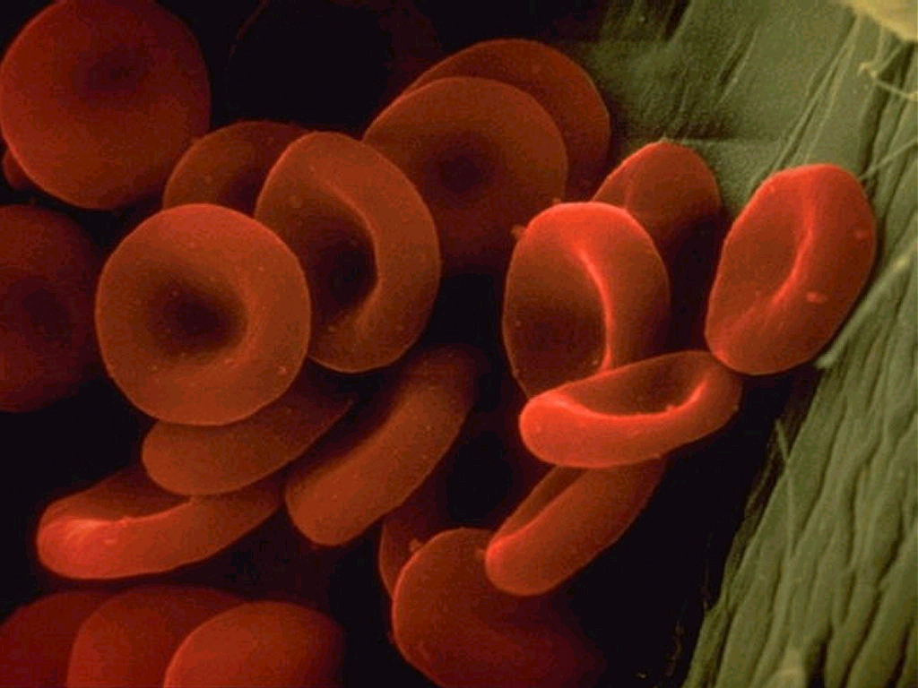

Slide 12
HYPOTONIC SOLUTIONS
Cell swells. Water moves inside the cell.
Osmotic pressure increases on the membrane.
Solute concentration of the environment outside the cell is lower than inside the cell.
Solute is lower, water is higher.
Water moves from high to low.
Cytolysis: cells will swell and burst (lyse).
Hemolysis: red blood cells swell and burst.
Distilled water (no solutes) is the ultimate hypotonic solution.
Plant cells are prevented from bursting by cell walls. Creates turgor pressure.
Unicellular organisms living in fresh water have contractile vacuoles to pump out excess water.

Slide 13
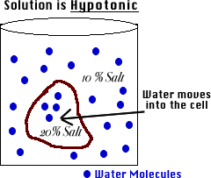
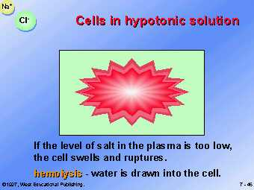
HYPOTONIC SOLUTION

Slide 14
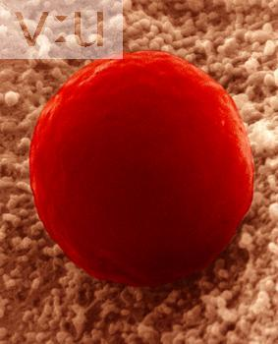
RED BLOOD CELL IN
HYPOTONIC SOLUTION

Slide 15
HYPERTONIC SOLUTIONS
Cell shrinks. Water moves out of the cell.
Osmotic pressure decreases on the membrane.
Solute concentration of the environment outside the cell is greater than inside cell.
Solute is higher, water is lower.
Water moves from high to low.
Plasmolysis: as a result, cells placed in hypertonic solutions shrivel and lose their shape.
Plant cells lose turgor pressure and wilt.
Humans should not drink salt water. It is hypertonic relative to our body tissue.

Slide 16
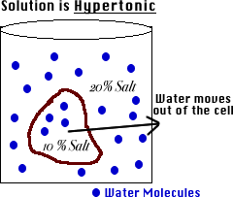
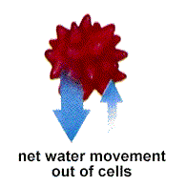
HYPERTONIC SOLUTION

Slide 17
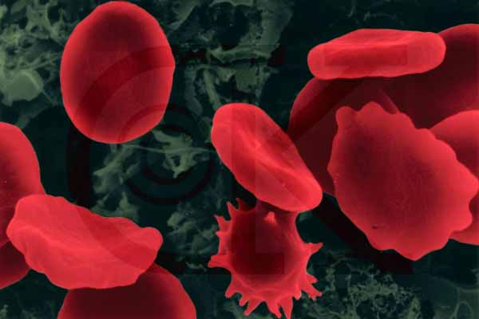
RED BLOOD CELL IN
HYPERTONIC SOLUTION

Slide 18
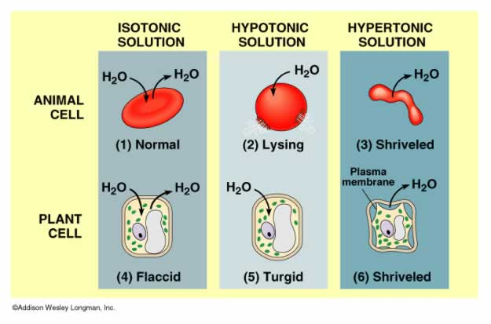
TYPES OF SOLUTIONS

Slide 19
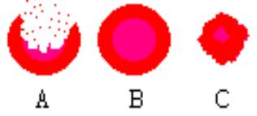
WHICH SOLUTION?

Slide 20
WATCH
Tonicity
Osmosis and Tonicity

Slide 21
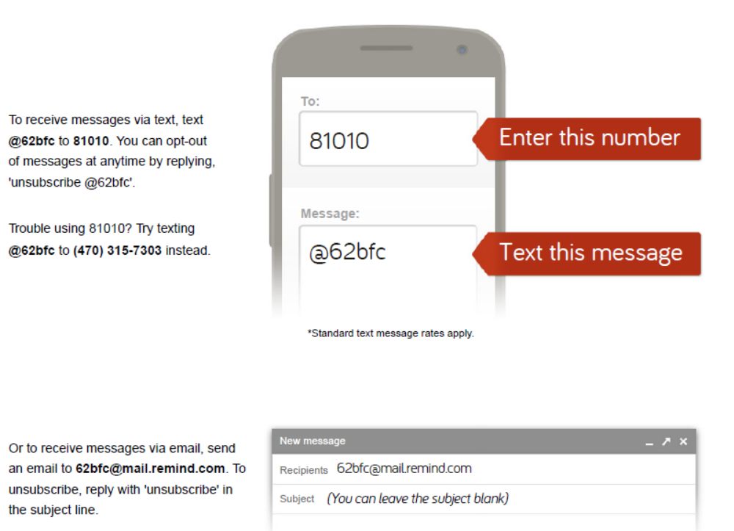
GET OUT YOUR PHONES

Slide 22
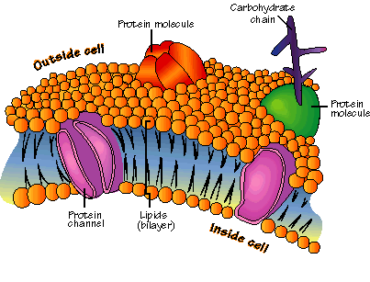
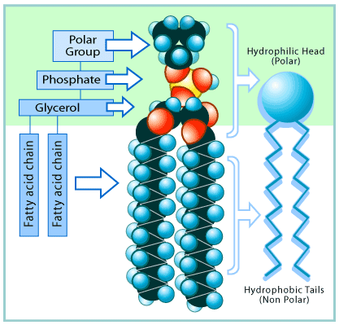
REVIEW
Plasma Membrane
Responsible for
Model name
Composed of
  Phospholipids
  Proteins – different types
  Cholesterol
Know the drawing/parts/diagram
Four factors that affect the rate of transport

Slide 23
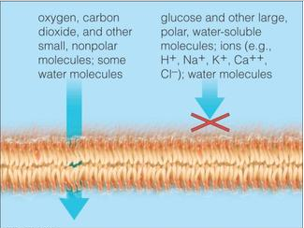
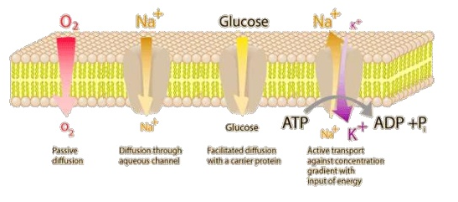
REVIEW
Selective Permeability
  Definition
  Nonpolar versus polar molecules
  Large molecules pass through how?

Slide 24
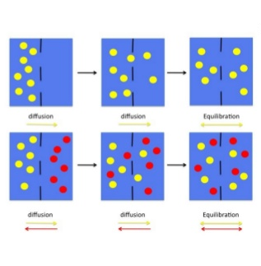
REVIEW
Equilibrium
Define dynamic equilibrium
Rate depends on three factors
    Size of particle
    Temperature
    Composition of solution
Concentration gradient

Slide 25
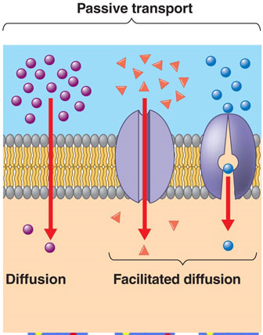
REVIEW
Passive Transport
  No energy required
  Moves from high to low concentration
  Three types (define, know examples)
Osmosis
Diffusion
Facilitated Diffusion

Slide 26
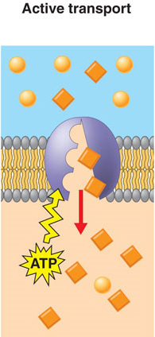
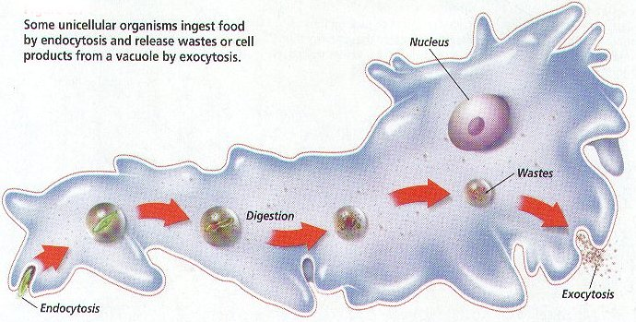
REVIEW
Active Transport
Energy required
Moved from low to high concentration
Three types (Define, know examples)
      Membrane Transport Proteins
      Endocytosis
      Exocytosis

Slide 27
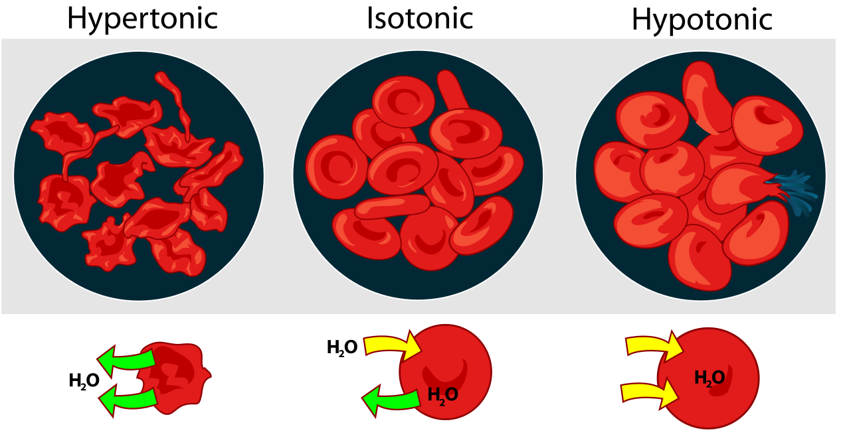
REVIEW
Solution
  Definition, Parts (solute, solvent)
  Tonicity definition
  Three types of solutions – know definition, what happens to cell, what happens to osmotic pressure; be able to recognize in a drawing
      Isotonic, Hypotonic, Hypertonic

Slide 28
REVIEW
** Practice Quizzes**
http://www.sciencegeek.net/Biology/review/U1Membranes.htm
http://edhsgreensea.net/Biology/taters/cell_membrane_vocab_mc.htm
http://edhsgreensea.net/Biology/taters/cell_membrane_mc.htm

