Slide 1
CHEMICAL REACTIONS

Slide 2
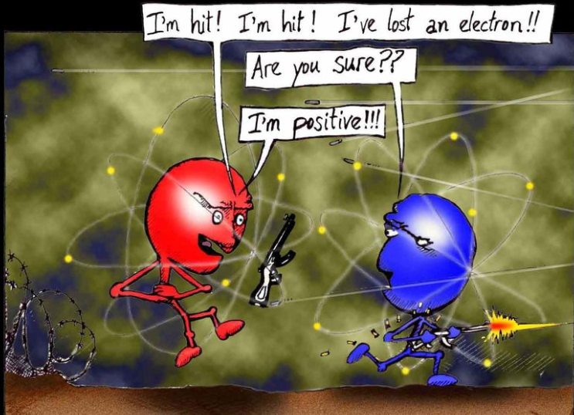
Another casualty in the war of atoms.

Slide 3
CHARACTERISTICS OF CHEMICAL REACTIONS
A chemical reaction is a process in which the physical and chemical properties of the original substances change as new substances with different chemical and physical properties are formed.
Remember: a new substance is always formed.

Slide 4
CHARACTERISTICS
A. There are always two kinds of substances:
1. Reactant - substance that enters into a chemical reaction; substance that reacts.
2. Product - substance produced by a chemical reaction; the substance that is made or produced.
Reactants → Products

Slide 5
CHARACTERISTICS
B. There is always a change in energy in a chemical reaction.
Exergonic - energy is given off; Example: burning
Endergonic - energy is absorbed; Example: Photosynthesis

Slide 6
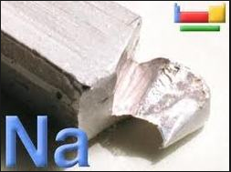
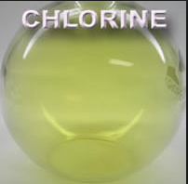
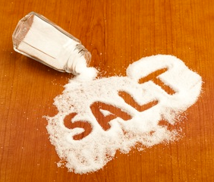
CHARACTERISTICS
C. Physical Properties Change
The physical properties of the substance(s) that go into the reaction are not the same as the physical properties of the substance(s) that are produced.
+ →

Slide 7
CHARACTERISTICS
D. Conservation of Mass
Atoms (matter) cannot be created or destroyed. The number of reactant atoms must equal the number of product atoms.
H₂ + I₂ → 2HI
H = 2 H = 2
I = 2 I = 2

Slide 8
GETTING READY
Determine the total number of atoms in the following chemical formulas.
1. NaCl ________
2. H₂SO₄ ________
3. KNO₃ ________
4. CaCl₂ ________
5. C₂H₆ ________
6. Ba(OH)₂ ________
7. NH₄Br ________
8. Ca₃(PO₄)₂ ________
9. Al₂(SO₄)₃ ________
10. Mg(NO₃)₂ ________
11. Cu(NO₃)₂ ________
12. KMnO₄ ________
13. H₂O₂ ________
14. (NH₄)₃PO₄ ________

Slide 9
GETTING READY
Determine the type of and number of each atom.
15. NaCl
16. H₂SO₄
17. KNO₃
18. CaCl₂
19. C₂H₆
20. Ba(OH)₂
21. NH₄Br
22. Ca₃(PO₄)₂
Na – 1
Cl - 1

Slide 10
GETTING READY
Determine the type of and number of each atom.
23. Al₂(SO₄)₃
24. Mg(NO₃)₂
25. Cu(NO₃)₂
26. KMnO₄
27. H₂O₂
28. (NH₄)₃PO₄

Slide 11
BALANCING CHEMICAL EQUATIONS
A chemical reaction is a process in which one or more substances are converted into new substances.
Chemical reactions (rxns) involve a rearrangement of atoms and the bonds in compounds and molecules.
Chemical equations make it possible to determine what is happening during a chemical reaction.

Slide 12
BALANCING CHEMICAL EQUATIONS
Chemical equations are expressions in symbols and formulas that represent a chemical reaction.
A balanced chemical equation has the same number of atoms of each element on both sides of the equation.
H₂ + I₂ → 2HI

Slide 13
RULES TO FOLLOW
Change coefficients only.
Never change a symbol, formula, or subscript.
Place coefficients in front of the entire chemical formula.

Slide 14
STEPS TO BALANCING
AN EQUATION
1. Count the number of atoms of each element on both sides of the arrow.
If the atom numbers are equal, then the equation is balanced.
Balance the equation using coefficients. A coefficient is a whole number placed in front of a chemical formula to indicate the number of molecules present.
Look for the least common multiple (LCM).
Balance metals, then nonmetals, then hydrogen, then oxygen.

Slide 15
STEPS TO BALANCING
AN EQUATION
3. Check your work by recounting the number of atoms on each side of the arrow.
4. Continue adding coefficients and counting atoms until the equation is balanced.

Slide 16
PRACTICE
1. ______Li + ______H₂O → ______LiOH + ______H₂
Li – Li -
H – H -
O - O –
______H₂O → ______H₂ + ______O₂
H – H -
O - O -

