Slide 1
CHEMICAL REACTIONS

Slide 2
ENERGY IN CHEMICAL REACTIONS
All chemical reactions either release or absorb energy.
The energy can take many forms: HEAT, LIGHT, SOUND, and ELECTRICITY
Chemical bonds are the source of this energy.
When most chemical reactions take place, chemical bonds must be broken and breaking these bonds takes energy. Forming new chemical bonds releases energy.

Slide 3
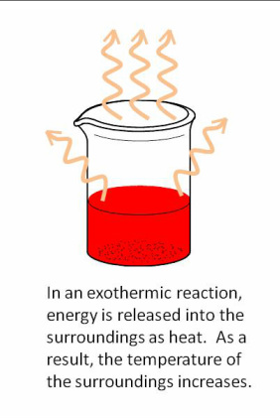
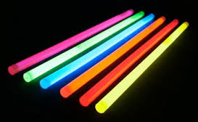
ENERGY IN CHEMICAL REACTIONS
MORE ENERGY OUT:
Chemical reactions that release energy are exergonic reactions.
Examples include glow sticks, heat packs, burning a match.
If heat is the energy released, it is called an exothermic reaction. “Thermic” means heat.

Slide 4
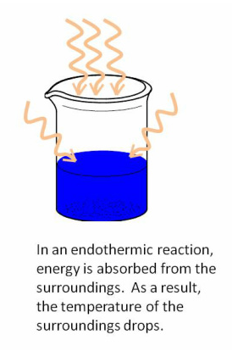
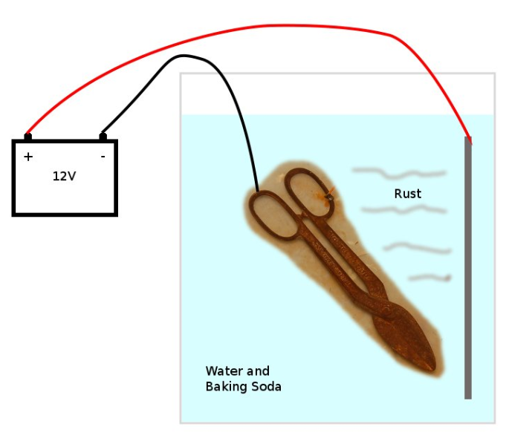
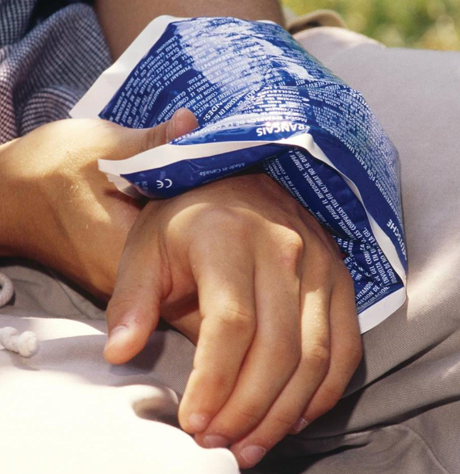
ENERGY IN CHEMICAL REACTIONS
MORE ENERGY IN:
Chemical reactions that absorb energy are endergonic reactions.
Examples include cold packs and rxns that require electricity to work.
If heat is the energy absorbed, it is called an endothermic reaction.

Slide 5
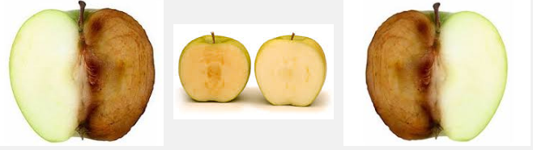
CHEMICAL REACTION SPEED
Some reactions proceed too slowly.
To speed a chemical reaction up, a catalyst can be used.
A catalyst is a substance that speeds up a chemical reaction without being permanently changed itself.
The catalyst is there at the beginning of the reaction and it is there at the end of the reaction.
The catalyst can be recovered and used again.
Example: when you cut an apple and it turns brown, that is due to an catalyst/enzyme which speeds up the browning process.

Slide 6
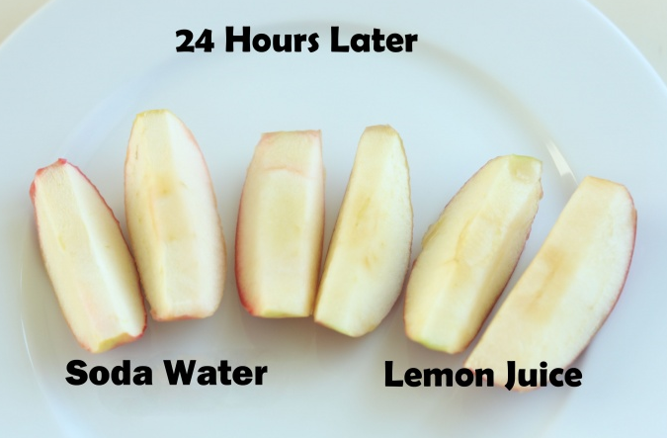
CHEMICAL REACTION SPEED
Some reactions need to be slowed down.
To slow down a chemical reaction, an inhibitor can be used.
An inhibitor is a substance that slows down a chemical reaction or prevents it from occurring by bonding with a reactant.
This ties up the reactant so it cannot form the original product.
Example: You can pour lemon juice on your cut apple to prevent the catalyst/enzyme from reacting.

Slide 7
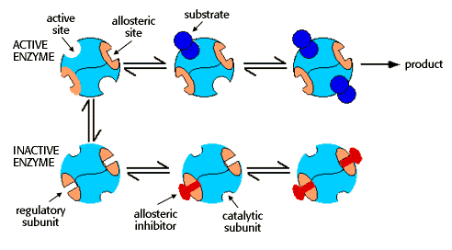
CHEMICAL REACTION SPEED
Catalysts and inhibitors do not change the amount of reactants used or products formed.
They only change the speed of the reaction.

Slide 8
TO DO
Watch: Exothermic and Endothermic Reactions
DO: Energy and Chemical Reactions on the back side of the Classifying Reactions handout. Due tomorrow.
Vocabulary Quiz is Thursday

