Slide 1
CHEMICAL REACTIONS

Slide 2
HELPFUL HINTS
Symbols you should know:
means “yields” or “produces”
(s) means solid Ag _{(s)}
(g) means gas H_{2 (g)}
(l) means liquid H₂O _{(l)}
(aq) means aqueous NaCl _{(aq)}
dissolved in water

Slide 3
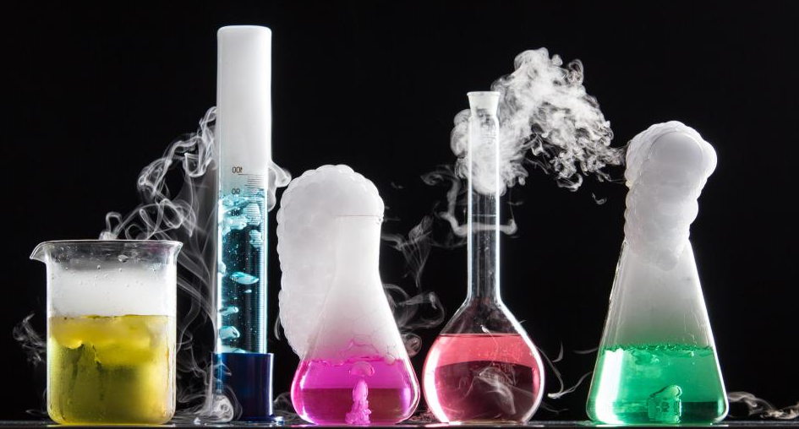
TYPES OF CHEMICAL REACTIONS
There are five basic types of chemical reactions.
Not all reactions will take these five forms.

Slide 4
SYNTHESIS Reaction
Two or more substances combine to form a different substance.
What to look for: one product
EX. 2 Mg _{(s)} + O_{2 (g)} → 2 MgO _{(s)}

Slide 5
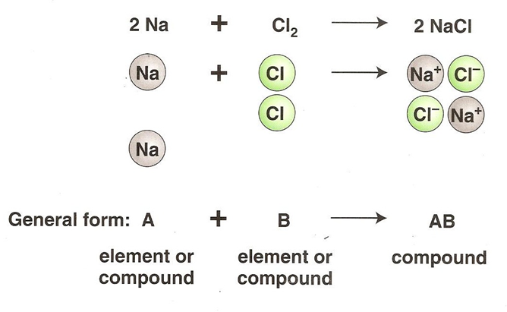
SYNTHESIS Reaction

Slide 6
DECOMPOSITION Reaction
one substance breaks down into two or more substances.
What to look for: one reactant
H₂SO₄
Ex. C₁₂H₂₂O_{11(s)} → 11 H₂O_{(g)} + 12 C_{(s)}
sucrose → water and carbon
I⁻¹
H₂O_{2(l)} → H₂O_{(l)} + O_{2(g)}
Hydrogen peroxide → water and oxygen gas

Slide 7
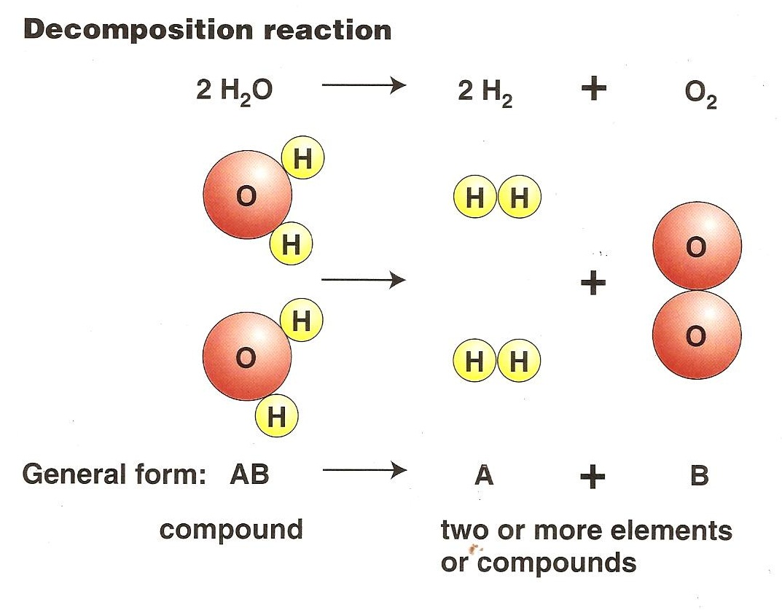
DECOMPOSITION Reaction

Slide 8
SINGLE REPLACEMENT Rxn
Also called single displacement reaction
one element replaces another element in a compound.
What to look for: uncombined elements on
both sides of the arrow
Cu _{(s)} + AgNO_{3 (aq)} → Cu(NO₃) _{2 (aq)} + Ag _{(s)}
2 Na _{(s)} + 2 H₂O _{(l)} → 2 NaOH _{(aq)} + H_{2 (g)}
Mg _{(s)} + 2 HCl _{(aq)} → MgCl_{2 (aq)} + H_{2 (g)}

Slide 9
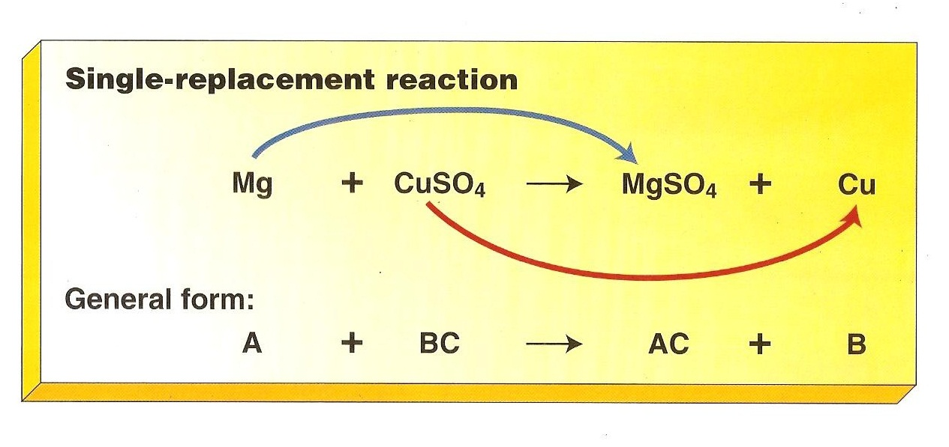
SINGLE REPLACEMENT Rxn

Slide 10
DOUBLE REPLACEMENT Rxn
Also called double displacement reaction
Produces a precipitate, water, or a gas when to ionic compounds in a solution are combined.
What to look for: two compounds on each side
Ex. HCl _{(aq)} + NaOH _{(aq)} → NaCl _{(aq)} + H₂O _{(l)}
Ba(NO₃)₂ + K₂SO₄ → BaCl_{2(s)} + 2KNO₃

Slide 11
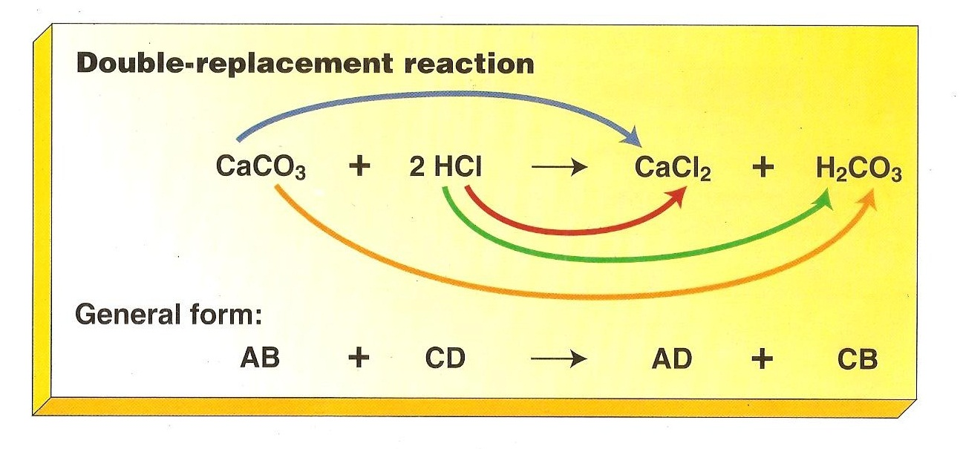
DOUBLE REPLACEMENT Rxn

Slide 12
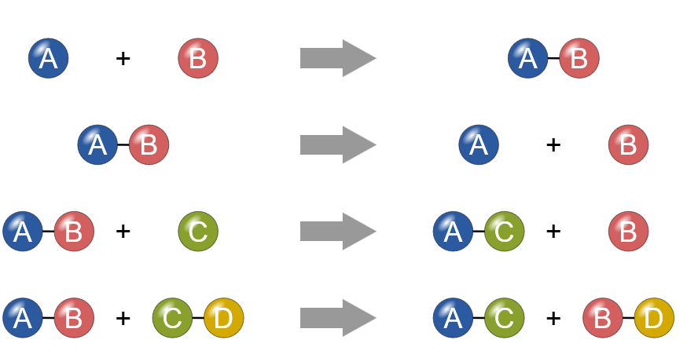
WHICH REACTION TYPE?
1.
SYNTHESIS
DECOMPOSITION
2.
3.
SINGLE REPLACEMENT
4.
DOUBLE REPLACEMENT

Slide 13
COMBUSTION reaction
when compounds react with oxygen to produce energy in the form of heat and light.
What to look for: a compound and oxygen
produce CO₂ and H₂O
EX. Hydrocarbon + O₂ → water + carbon dioxide
CH_{4 (g)} + 2O_{2 (g)} → CO_{2 (g)} + 2H₂O _{(g)}

Slide 14
Practice
1. Br₂ + NaI → NaBr + I₂
2. SO₃ + H₂O → H₂SO₄
3. Zn + HCl → ZnCl₂ + H₂
4. Ga₂O₃ → Ga + O₂
5. H₂O₂ → H₂O + O₂
6. Ba(NO₃) ₂ + Na₂SO₄ → BaSO₄ + NaNO₃
7. KCl + AgNO₃ → KNO₃ + AgCl
8. P₂O₅ + BaO → Ba₃(PO₄) ₂
9. C₄H₈ + O₂ → CO₂ + H₂O
10. PdCl₂ + HNO₃ → Pd(NO₃)₂ + HCl

Slide 15
Practice
C₂H₆ + O₂ → CO₂ + H₂O
11. C₂H₆ + O₂ → CO₂ + H₂O
12. SiCl₄ → Si + Cl₂
13. CaCO₃ → CaO + CO₂
14. P + O₂ → P₄O₁₀
15. C₃H₈ + O₂ → CO₂ + H₂O
16. Fe + H₂O → Fe₃O₄ + H_{2­}
17. B + F₂ → BF₃
18. Na₂SO₄ + CaCl₂ → CaSO₄ + NaCl

