Slide 1
ENERGY UNIT
Common Assessment Review

Slide 2
DO NOW
Turn in “How Much Energy” lab – remember that I am not taking it late so you need to turn in what you have.
Get out Common Assessment Review

Slide 3
REVIEW
Know what motion is and that it is measured by distance and time.
- a change in position of an object with respect to time.
  Speed is the distance an object travels in a certain period of time.
  Velocity is speed in a particular direction.
  Acceleration is changing speed; can be positive or negative (deceleration).

Slide 4
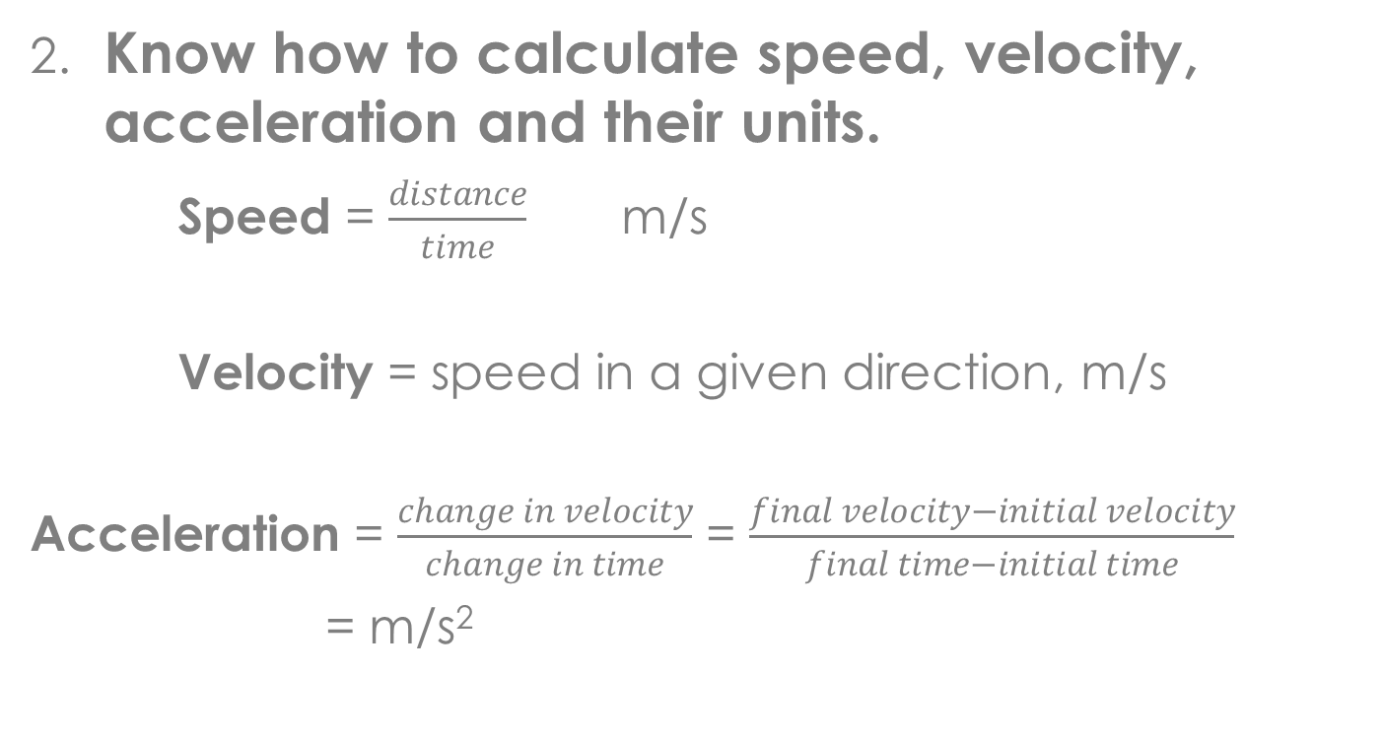
REVIEW
2. Know how to calculate speed, velocity, acceleration and their units.
Speed = $\frac{distance}{time}$ m/s
Velocity = speed in a given direction, m/s
Acceleration = $\frac{change in velocity}{change in time}$ = $\frac{final velocity−initial velocity}{final time−initial time}$
= m/s²

Slide 5
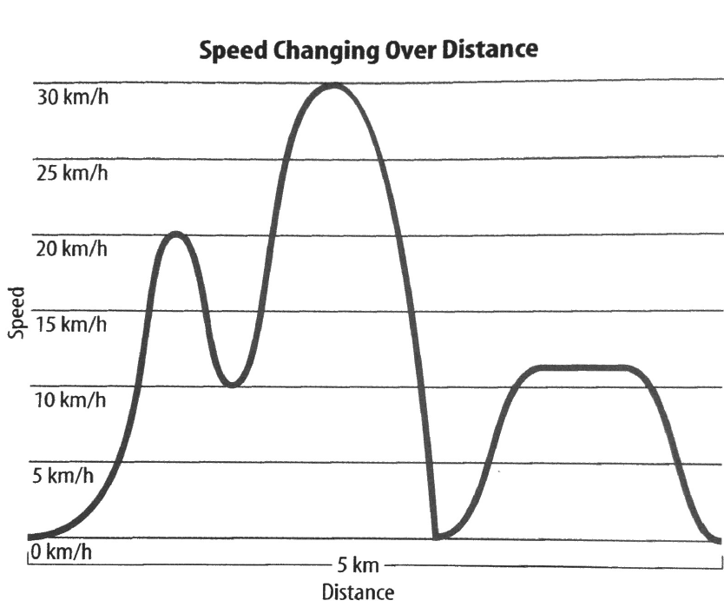
REVIEW
3. Be able to identify the distance-time graphs for the following:
  Constant speed
  Average speed
  Acceleration
  Deceleration

Slide 6
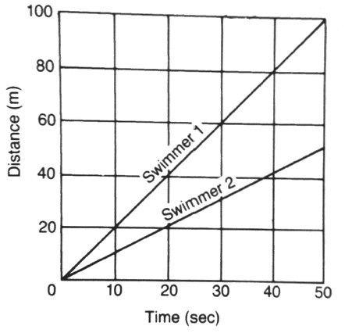
REVIEW
How many meters can Swimmer 1 cover in 30 seconds?
How far will Swimmer 2 go in 30 seconds?
Predict the number of meters that Swimmer 2 can go in 60 seconds.
Which swimmer has the greater speed?
Is the graph showing constant speed or changing speed?

Slide 7
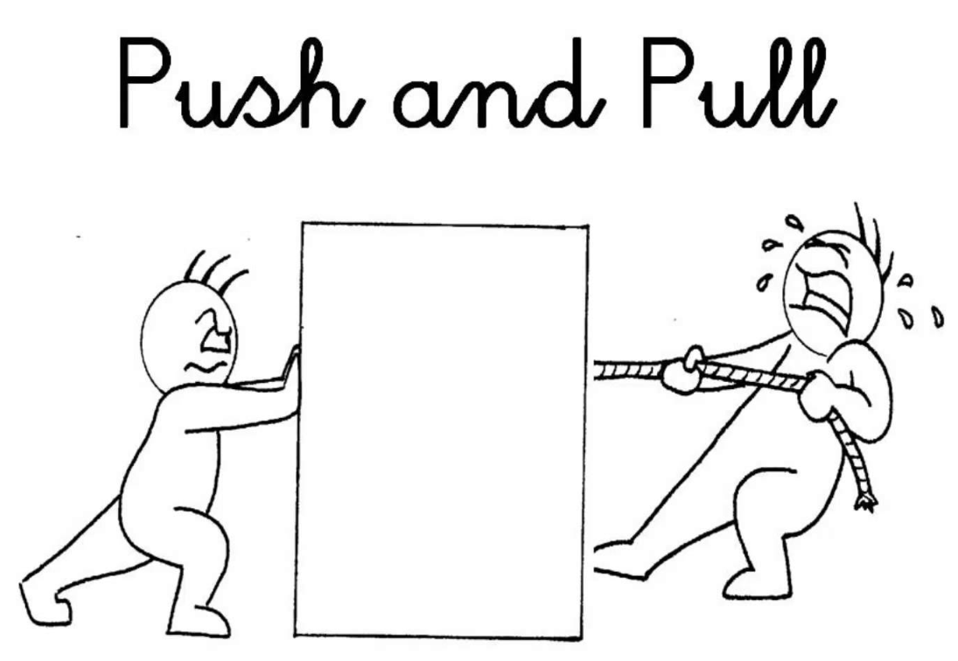
REVIEW
4. Define and explain force.
  A push or a pull that one body exerts on another.
  It gives energy to an object and causes it to:
start moving
stop moving
change its motion.

Slide 8
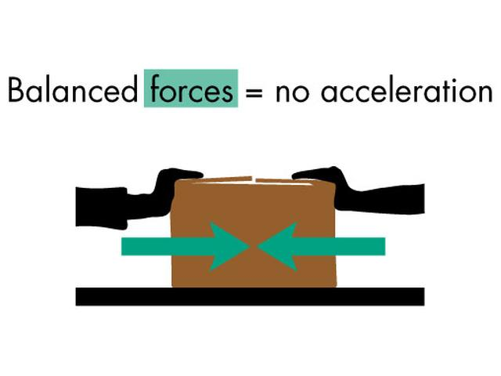
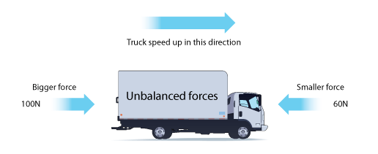
REVIEW
5. Define balanced forces and unbalanced forces. Know the motion involved.

Slide 9
REVIEW
State Newton’s First Law and be able to identify examples.
LAW OF INERTIA
An object at rest stays at rest and an object in motion stays in motion until acted on by a net external force.
Examples:

Slide 10
REVIEW
7. Define Inertia and know the relationship between mass and inertia.
Inertia - is the tendency of an object to resist any change in its motion.
The more mass you have, the more inertia you have.

Slide 11
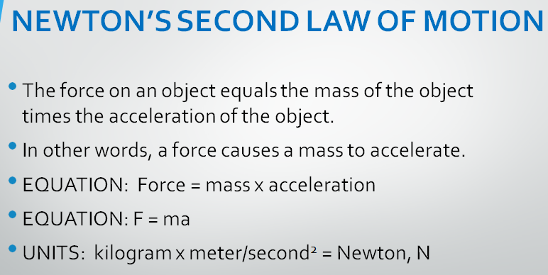
REVIEW
State Newton’s Second Law and be able to identify examples.
10. Know the unit for force.

Slide 12
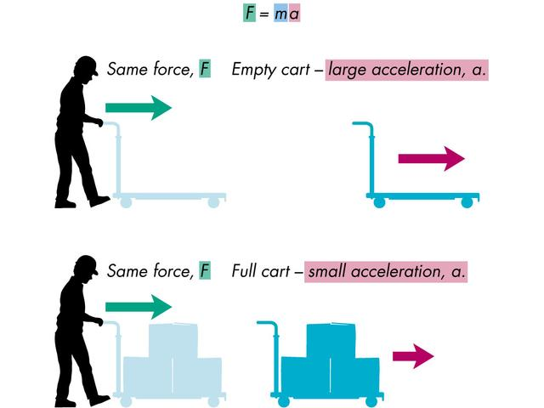
REVIEW

Slide 13
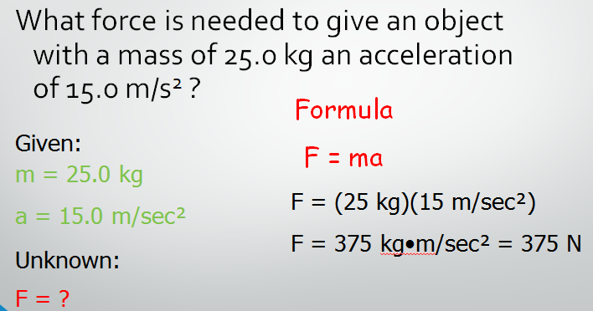
REVIEW
9. Be able to solve problems with F = ma.

Slide 14
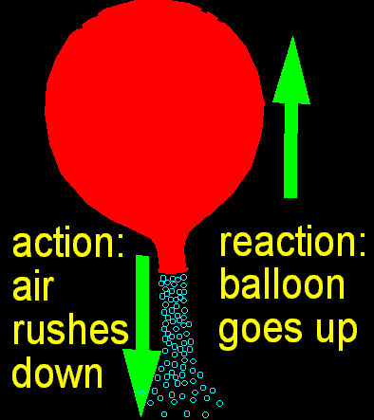
REVIEW
11. State Newton’s Third law and be able to identify examples.
LAW OF ACTION-REACTION
For every action force, there is an equal and opposite reaction force.

Slide 15
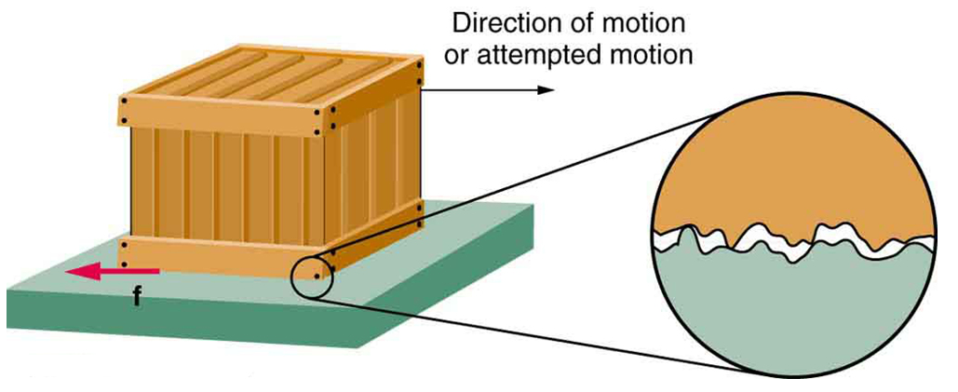
REVIEW
12. Define Friction and know how it affects motion.
a force that opposes motion between two surfaces that are touching each other.
A force that brings an object to rest.
Acts between surfaces.

Slide 16
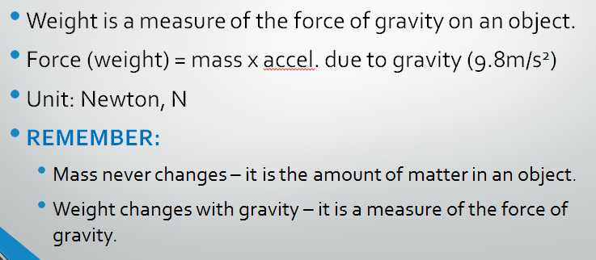
REVIEW
13. Define weight and be able to calculate it using F_{w} = ma where ‘a’ is 9.8m/s².

Slide 17
REVIEW
14. Describe Kinetic and Potential energy and distinguish between them.
  Energy is the capacity (ability) to do work.
  Kinetic Energy: Associated with an object in motion.
  Potential Energy: Present in an object that has the potential to move because of its position.

Slide 18
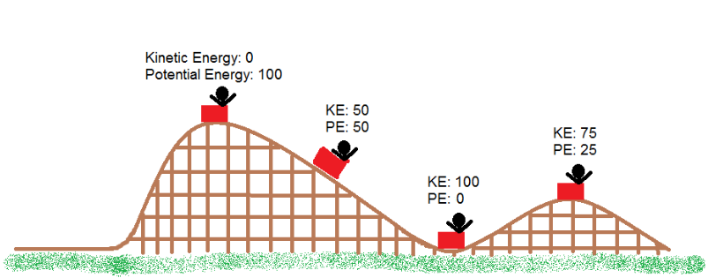
REVIEW

Slide 19
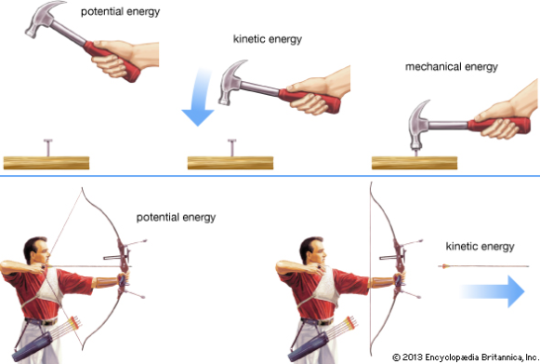
REVIEW
15. Know the unit for energy. joules, J
16. State examples of objects with kinetic energy and potential energy.

Slide 20
REVIEW
17. Know the definition of work, the unit for work, and how to calculate it.
A transfer of energy
For there to be work on an object, there must be a displacement and the force must cause that displacement.
Must move in the direction of the force.
Work = force x distance
Unit: joules, J (Nm)

Slide 21
REVIEW
A box is pushed across the floor for a distance of 15 meters with a force of 20 Newtons in 5 seconds.
  How much work is done?
F = 20N W = Fd = (20N)(15m)
d = 15m = 300J

Slide 22
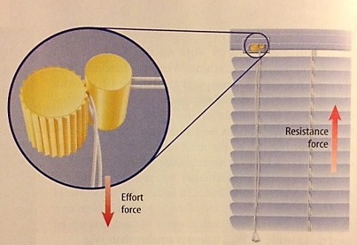
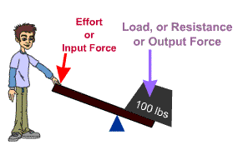
REVIEW
18. Know the two forces involved with simple machines: Effort Force, F_{e}, and Resistance Force, F_{r}.
  The force applied to the machine is the EFFORT FORCE, F_{e}.
  The force applied by the machine to overcome resistance is called the RESISTANCE FORCE, F_{r}.

Slide 23
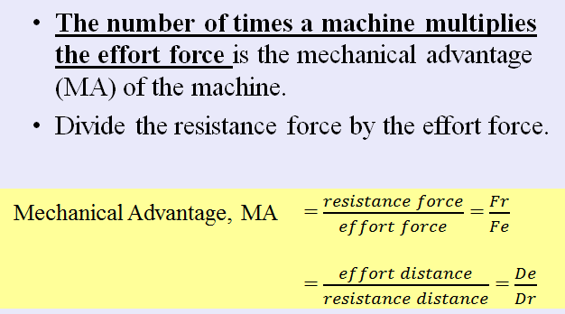
REVIEW
19. Define mechanical advantage and be able to calculate for all the simple machines both with distance and force.

Slide 24
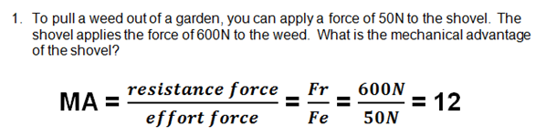
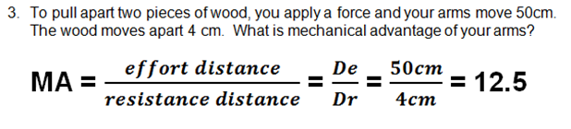
REVIEW

Slide 25
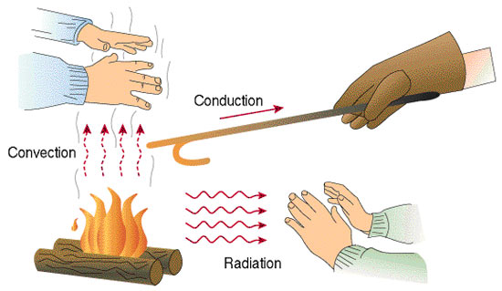
REVIEW
20. Compare and contrast thermal energy transfer by conduction, convection, and radiation.

Slide 26
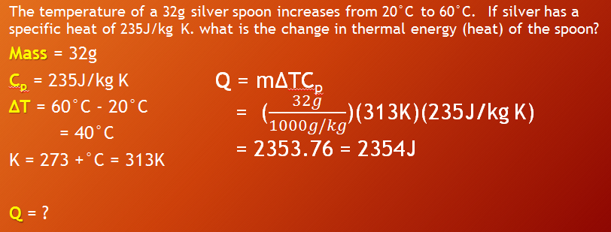
REVIEW
21. Be able to calculate changes in thermal energy using specific heat, Q = mΔTC_{p}

Slide 27
TEST FORMAT
25 multiple choice questions.
Bubble in the answers.

Slide 28
TO DO
Work on the review. Due tomorrow for the test redo point if complete and on time.

Slide 29
DO NOW
Prepare for test.

