Slide 1
DO NOW
Pick up notes – go to lab desk and get each of the FIVE sheets – staple together. Just walk through the line.
Pick up vocabulary if you did not get it yesterday.
Turn in “Half-Life of Pennium” Lab.

Slide 2
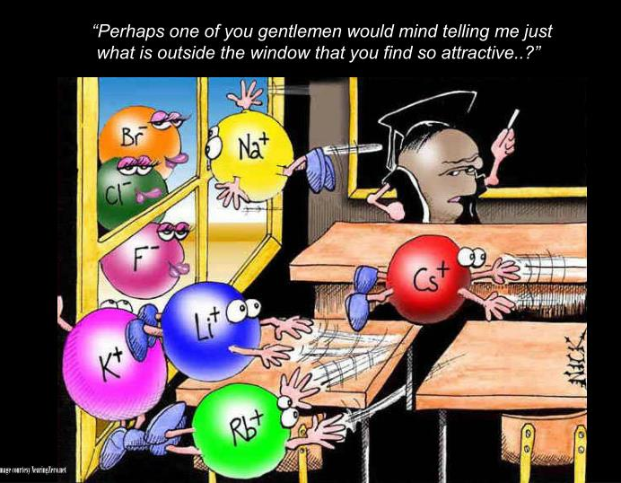
CHEMICAL BONDING AND NOMENCLATURE

Slide 3
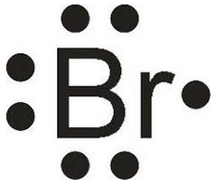
CHEMICAL BONDING
When atoms interact to form a chemical bond, only the outer energy level electrons, the valence electrons interact.
Electron Dot Diagrams are used to keep track of the valence electrons.

Slide 4
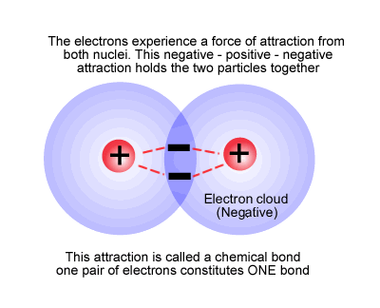
CHEMICAL BONDING
A Chemical Bond is the force that holds atoms together in a compound.
They are formed in definite ways according to certain rules.

Slide 5
PRACTICE
Draw the Electron Dot Diagrams for the following elements:
K Se Be Ga
Ge P Ar

Slide 6
CHEMICAL STABILITY
It is the goal of every atom to have a full outermost energy level. Remember full is eight electrons (octet) except for hydrogen and helium which have two.
The atom gets a full energy level by losing or gaining electrons to form an octet.
This is the most stable formation.

Slide 7
CHEMICAL STABILITY
The number of valence electrons determines whether or not the atom will bond with another element in a chemical reaction.
Noble gases are chemically stable. Their outer energy levels are full.
Every element wants the same number of valence electrons as a noble gas and will gain electrons or lose electrons to get it.

Slide 8
IONS
IONS: Ions are charged particles that have more or fewer electrons than protons.
Cation: positive ion (lost electrons)
Anion: negative ion (gained electrons)

Slide 9
OXIDATION NUMBER
positive or negative number that indicates how many electrons an atom has gained, lost, or shared to become stable.
Is written as a superscript with a positive or negative sign.
F⁻¹ Mg⁺² O⁻² Na⁺¹

Slide 10
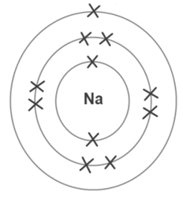
OXIDATION NUMBER
Na⁺¹ means that sodium has p⁺ = 11 and nº = 12 but e⁻ = 10.
It is a +1 charge because there is one more proton than there are electrons.

Slide 11
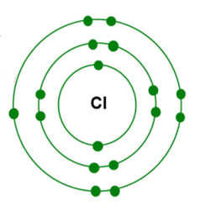
OXIDATION NUMBER
Cl⁻¹ means that chlorine has p⁺ = 17 and nº = 18 but e⁻ = 18.
It is a -1 charge because there is one more electron than there are protons.

Slide 12
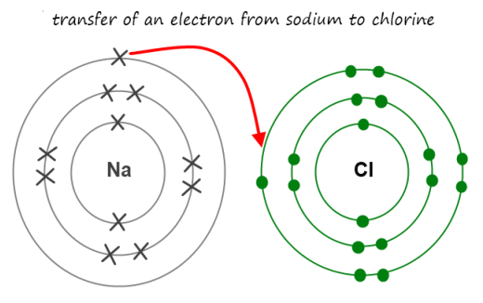
OXIDATION NUMBER
In order for sodium to be “happy”/stable, it wants to lose an electron. In order for chlorine to be “happy”/stable, it wants to gain an electron.

Slide 13
PRACTICE
Look at the electron dot diagrams you did above. Predict the ion formed for each below:
K ___ Se___ Be___
Ga___ Ge___ P___
Ar___

Slide 14
PRACTICE
Write the correct ion for each below:
K ___ Se___ Be___
Ga___ Ge___ P___
Ar___

Slide 15
PRACTICE
Write the number of valence electrons in each of the groups listed. Then write the ion formed.
Group 1 ve: _____ ion: ____
Group 2 ve: _____ ion: ____
Group 13 ve: _____ ion: _____ Group 14 ve: _____ ion: _____ Group 15 ve: _____ ion: _____ Group 16 ve: _____ ion: _____
Group 17 ve: _____ ion: _____
Group 18 ve: _____ ion: _____

Slide 16
IONIC BONDING
Video

Slide 17
IONIC BONDS
involves a TRANSFER of electrons from one atom to another.
is held together by electric/electrostatic force (+/-).
happens between positive ions and negative ions.
When the cation and the anion come together, there is zero net charge.
The basic rule is that opposites attract. A strong attraction between oppositely charged ions (formed by the transfer of electrons) hold the ions together in an ionic bond.

Slide 18
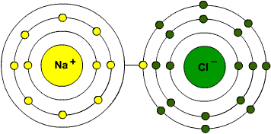
EXAMPLE

Slide 19
CHARACTERISTICS
high melting and boiling points
tend to be soluble in water
Solids are poor conductors of heat and electricity.
When dissolved in a liquid or melted, they become good conductors of heat and electricity.
Generally forms between elements on opposite sides of the periodic table.

Slide 20
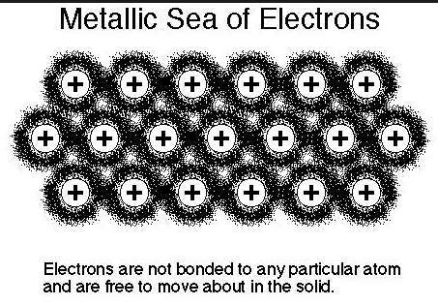
METALLIC BONDS
Metallic solids have only metals in them.
Metals give up electrons easily.
A metallic bond is where the electrons in the outermost energy level overlap and form a common electron cloud (a sea of electrons).

Slide 21
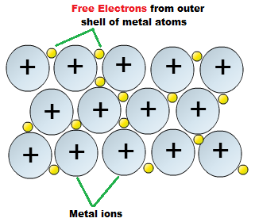
METALLIC BONDS
The many electrons easily dislodged from a large group of metal ions flow freely through the assembly of metal ions.
These electrons are called DELOCALIZED.
This ‘fluid’ of electrons holds the positively charged metal ions together.

Slide 22
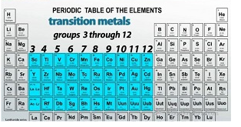
METALLIC BONDS
Transition metals are the hardest and strongest metals because they have more electrons in this sea.

Slide 23
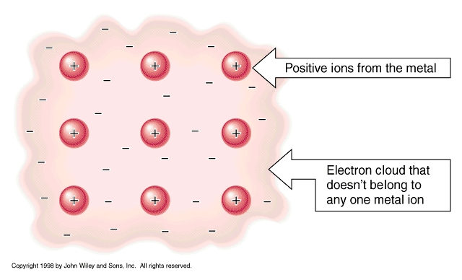
METALLIC BONDS
It is the mobility of the electrons in metals that makes metals both malleable and ductile.
This also accounts for the metal’s high thermal and electrical conductivities.

Slide 24
CHARACTERISTICS
Flexibility – the metal ions slide past each other, yet hold together.
Conductivity – free flowing electrons conduct heat and electricity well
High melting point – it takes a lot of energy to overcome this bond

Slide 25
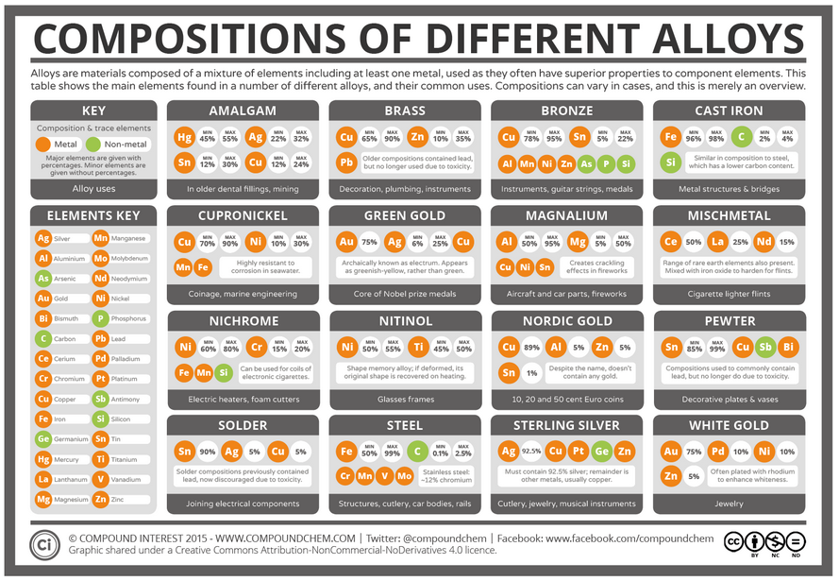
ALLOYS
Alloys – solid solutions of metals; two metals bonded to each other.
There are TWO kinds.

Slide 26
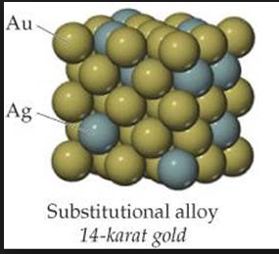
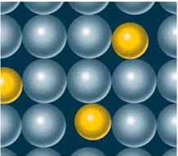
ALLOYS
Substitutional alloys – alloys where atoms of the original metal are replaced by metal atoms of a similar size.
Examples: Sterling silver (silver/copper) and 10-karat gold (gold/copper or silver)

Slide 27
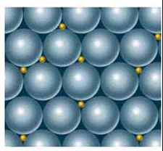
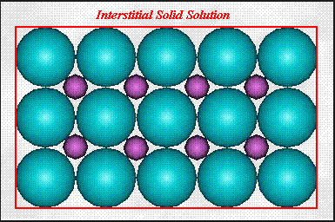
ALLOYS
Interstitial alloys – small holes in the metal crystal are filled with atoms of a smaller size.
Example: carbon steel (iron/carbon)

Slide 28
TO DO
Do Lose ‘Em and Gain ‘Em and the Overview on the backside. Due tomorrow.

