Slide 1
DO NOW
Pick up notes packet.
Turn in You So Cool, Isotope lab

Slide 2
The Periodic Table

Slide 3
PERIODIC
appearing or occurring at intervals.
Name some things that are periodic:
Why is it labeled the Periodic Table?
  It is periodic because there are patterns that repeat each row or period.

Slide 4
A BRIEF HISTORY
We have not always had the periodic table.
The modern table as we know it is only about 100 years old.

Slide 5
A BRIEF HISTORY
Father of the Periodic Table
DMITRI MENDELEEV published 1869.
He discovered a basic chemistry principle.
He felt there was a certain pattern with the elements.
- He tested his hypothesis that there was a periodic relationship among the elements.
- He set up the periodic table by ATOMIC MASS and left blanks for undiscovered elements (three were later discovered).

Slide 6
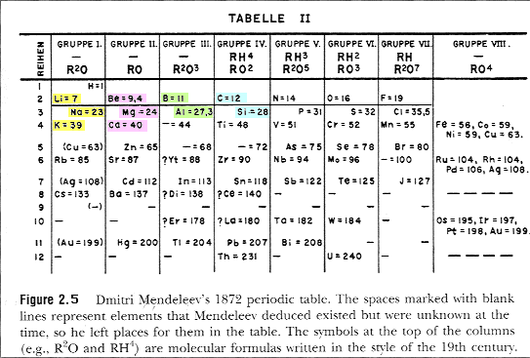
MENDELEEV’S TABLE

Slide 7
A BRIEF HISTORY
Father of the Modern Periodic Table
HENRY MOSELEY 1913
- He saw some elements were out of place in Mendeleev’s table.
He determined atomic numbers using x-rays.
The elements were placed according to ATOMIC NUMBER. This was an important change.
- This is the modern periodic table.

Slide 8
A BRIEF HISTORY
The Final Changes to the Table
Glenn Seaborg
The last major change to the periodic table resulted from Glenn Seaborg's work.
Starting with plutonium in 1940, Seaborg discovered transuranium elements 94 to 102 and reconfigured the periodic table by placing the lanthanide/actinide series at the bottom of the table.
In 1951 Seaborg was awarded the Nobel Prize in chemistry and element 106 was later named seaborgium (Sg) in his honor.

Slide 9
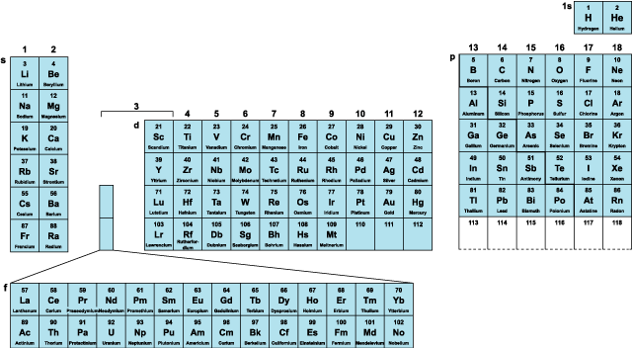
Seaborg’s Contribution

Slide 10
WATCH
The Genius of Dmitri Mendeleev

Slide 11
PERIODIC TABLE ORGANIZATION
Columns
- vertical, called groups (numbers) or families (names)
- 18 total (8 main ones)
- elements in the same column are not identical, but similar in properties.

Slide 12
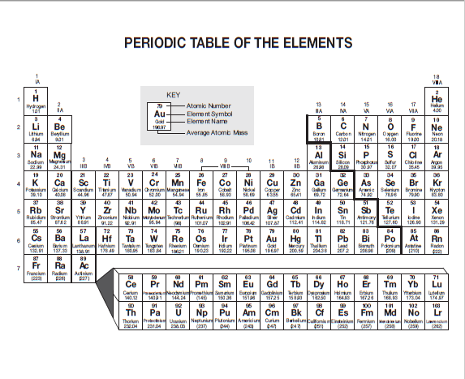

Slide 13
PERIODIC TABLE ORGANIZATION
ROWS
horizontal, called periods,
7 total (at this time)
elements are not alike in any way
PATTERN: left side elements are active solids, far right side elements are inert (nonreactive) gases. Last two rows are rare earth elements. Atomic number increases from left to right.

Slide 15
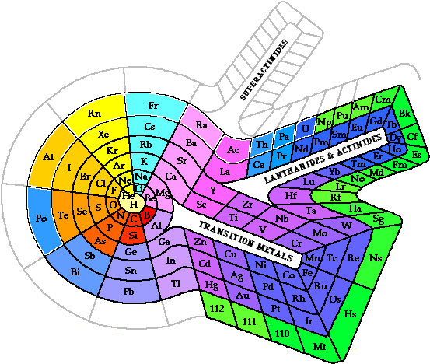
ALTERNATIVE PERIODIC TABLES:
SPIRAL

Slide 16
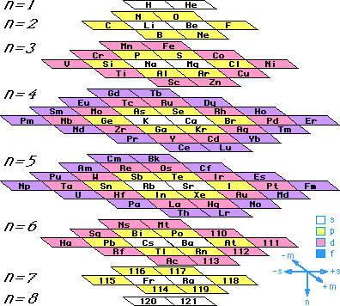
ALTERNATIVE PERIODIC TABLES:
STOWE

Slide 17
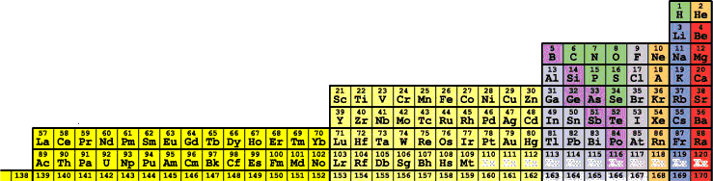
ALTERNATIVE PERIODIC TABLES:
TARANTOLA

Slide 18
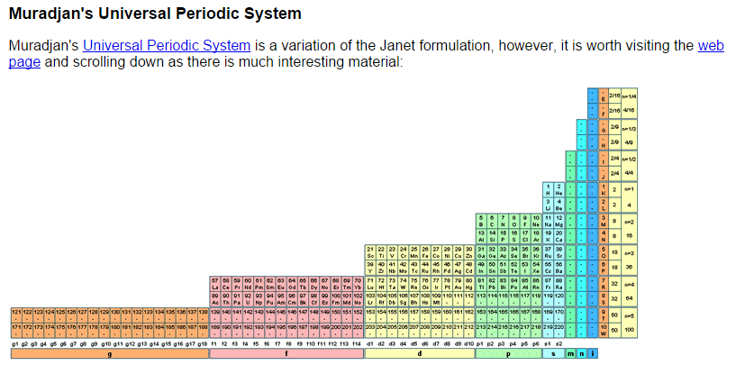
ALTERNATIVE PERIODIC TABLES:
MURADJAN

Slide 19
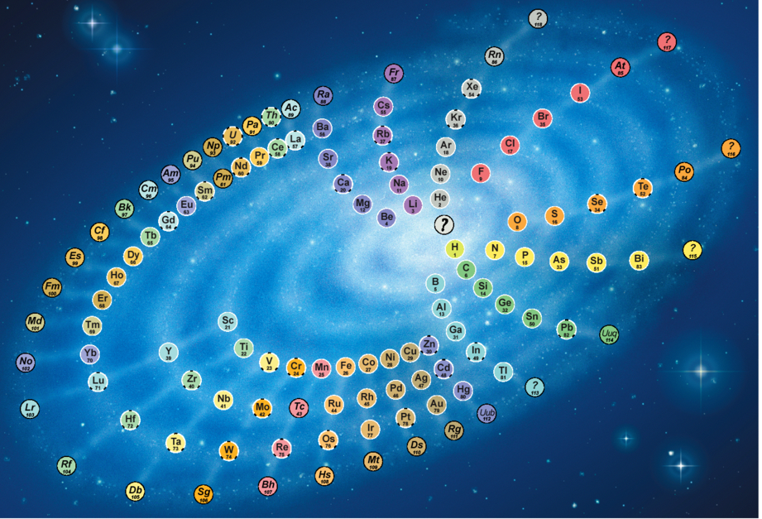
ALTERNATIVE PERIODIC TABLES: CHEMICAL GALAXY

Slide 20
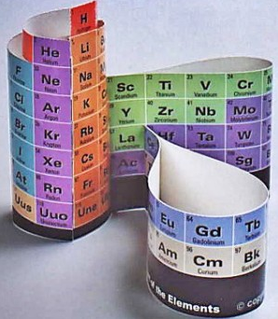
ALTERNATIVE PERIODIC TABLES: 3D

Slide 21
CHARACTERISTICS OF THE PERIODIC TABLE
Gases: hydrogen, helium, nitrogen, oxygen, fluorine, chlorine, neon, argon, krypton, xenon, radon.
Liquids: mercury, bromine
Solids: all the rest

Slide 22
PERIODIC TABLE
Number the groups 1-18.
Number the periods 1-7.
Find element 92 (fourth one from the left in the bottom most row).
Outline or lightly shade the elements that appear AFTER it in the row.
Find the seventh period in the main table. Outline or lightly shade the elements that appear AFTER the first two in the row.

Slide 23
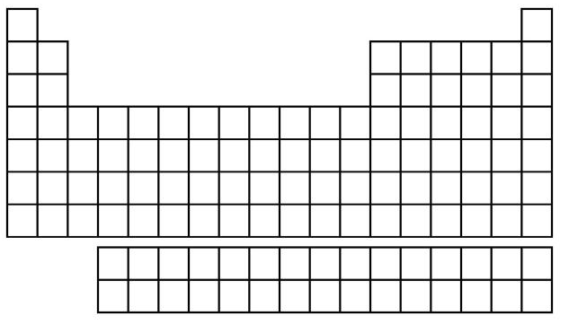
1 2 3 4 5 6 7 8 9 10 11 12 13 14 15 16 17 18
1
2
3
4
5
6
7
6
7

Slide 24
PERIODIC TABLE
You have just outlined the synthetic elements.
Synthetics: artificial elements, called the transuranium elements (“After” uranium). These are made in particle accelerators.

Slide 25
TO DO
Mendeleev’s Table handout – due tomorrow (front side only).
Periodic Table Vocabulary (on backside of Atomic Structure Vocabulary): Diatomic molecule, Metal, Nonmetal, Allotrope, Radioactive element, Metallic Bonding, Ductile, Malleable, Metalloid, Transition element, Transuranium element, Semiconductor

