Slide 1
NOMENCLATURE
A ReView

Slide 2
REVIEW
1. Explain what a chemical formula represents.
A chemical formula tells:
what type of atoms are present.
the number of each type of atom present.
ratio of one atom to another.
H₂O Cl₂ Al₂O₃

Slide 3
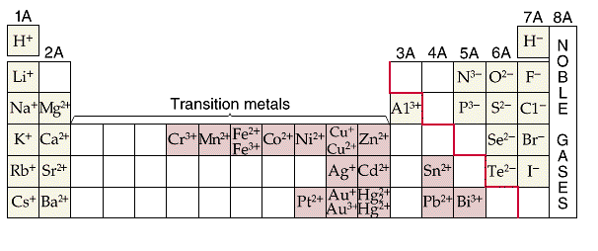
REVIEW
8. Determine the ions forms by representative elements.

Slide 4
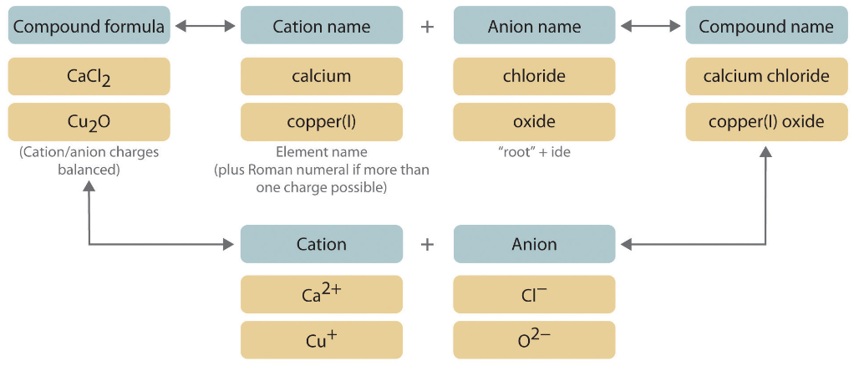
REVIEW
9. Write the names and formulas for ionic compounds.

Slide 5
REVIEW
9. Write the names and formulas for ionic compounds.
Potassium fluoride CaS
Nickel (II) phosphide K₂S
Aluminum chloride Na₃P
Iron (III) oxide BaI₂

Slide 6
REVIEW
10. Be able to use some representative polyatomic ions in nomenclature.
Nickel (II) nitrate CaSO₄
Aluminum carbonate NaHCO₃
Magnesium hydroxide NH₄Cl

Slide 7
REVIEW
12. Write the names and formulas for covalent compounds.
Rules:
Use prefixes to identify the number of atoms present.
If only one of the first atom (nonmetal), then NO prefix is used.
Last element ends in “ide”.
1. Write the symbol of the first element adding a subscript of the number of atoms present. If only one of the first atom (nonmetal), then NO number is used.
2. Write the symbol of the second element adding a subscript of the number of atoms present.

Slide 8
REVIEW
12. Write the names and formulas for covalent compounds.
P₄S₆ tricarbon dioxide
NO₂ dinitrogen tetroxide
SCl₆ carbon diselenide
PCl₅ tetraphosphorus heptasulfide

Slide 9
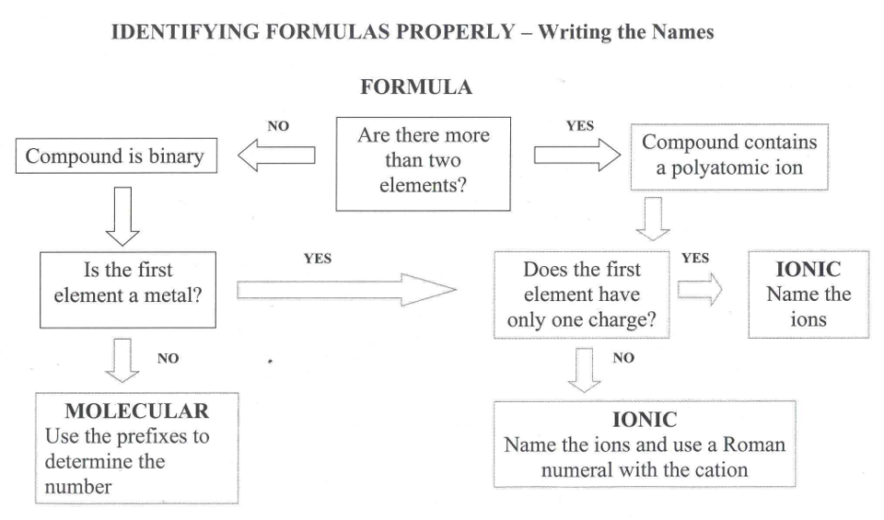
REVIEW

Slide 10
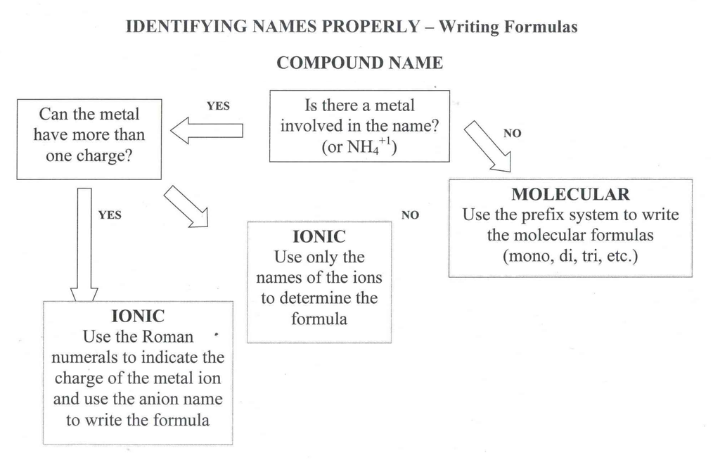
REVIEW

Slide 11
REVIEW
11. Write the names and formulas for hydrates.
Example: CuSO₄ • 5H₂O
ionic compound prefix+hydrate
copper (II) sulfate pentahydrate
CaCl₂ ∙ 2H₂O
Iron (II) sulfate hexahydrate

Slide 12
TO DO
Go to my website: nancybrim.me/physical-science/
Or google Nancy Brim physical science
Have your notes and periodic table.

