Slide 1
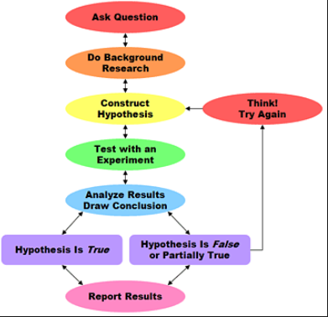
TEST REVIEW
1. Be able to identify the steps involved in the scientific method.
State the problem
Gather information
State a hypothesis
Test the hypothesis
Record and analyze data
Form a conclusion

Slide 2

TEST REVIEW
Independent variable is the one factor you change in the experiment.
Dependent variable is the one factor that changes as a result of your independent variable.

Slide 3
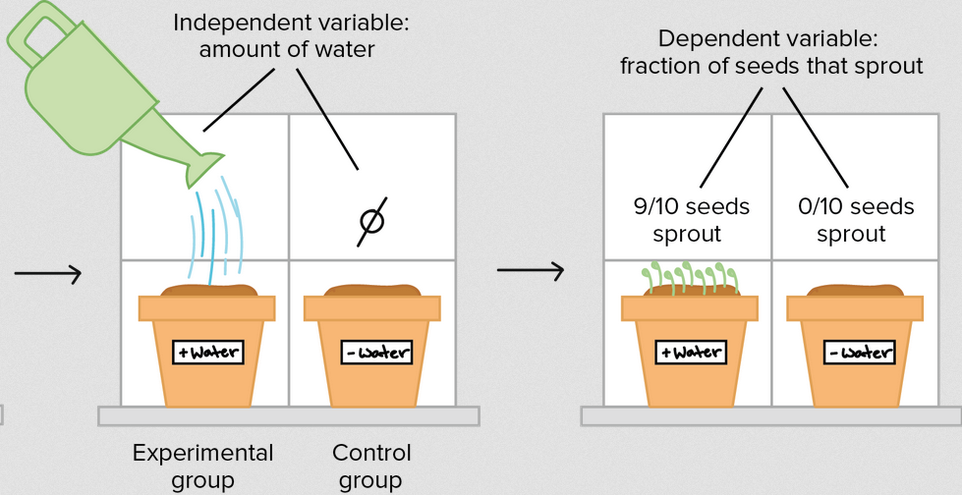
TEST REVIEW
The Control Group is the group you make no changes to.
The Experimental Group is the group that has the independent variable changed.

Slide 4
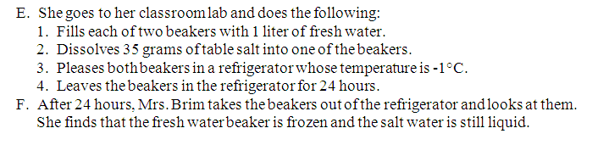
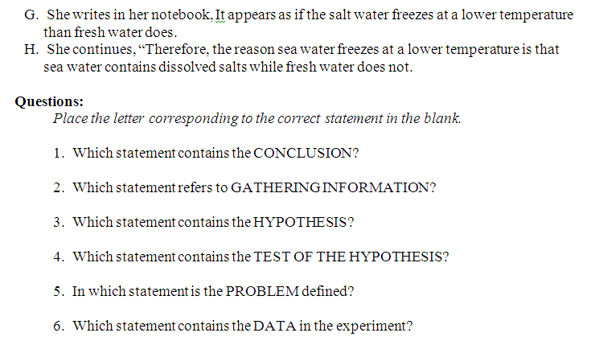
TEST REVIEW
2. Be able to identify the steps if given an experiment to read through.

Slide 5
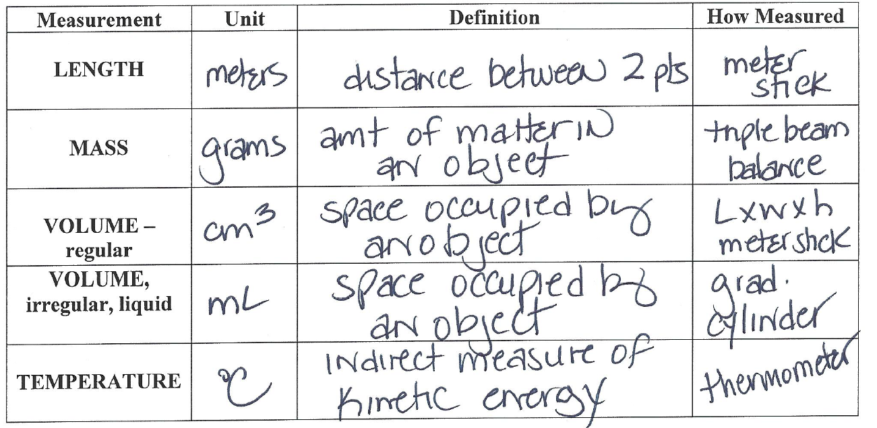
TEST REVIEW
3. Identify the basic parts of the metric system. Know the definition, unit, and how each is measured:
MASS VOLUME
LENGTH TEMPERATURE

Slide 6
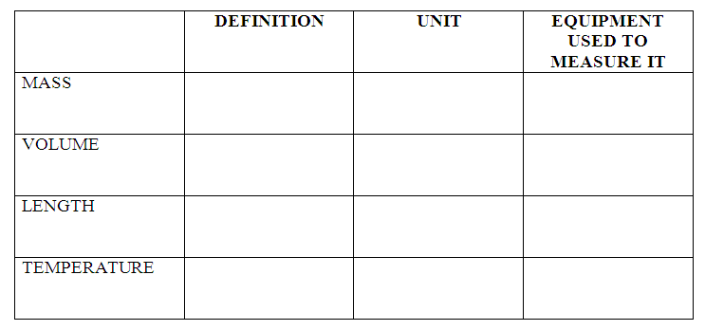
METRIC MEASUREMENTS

Slide 7
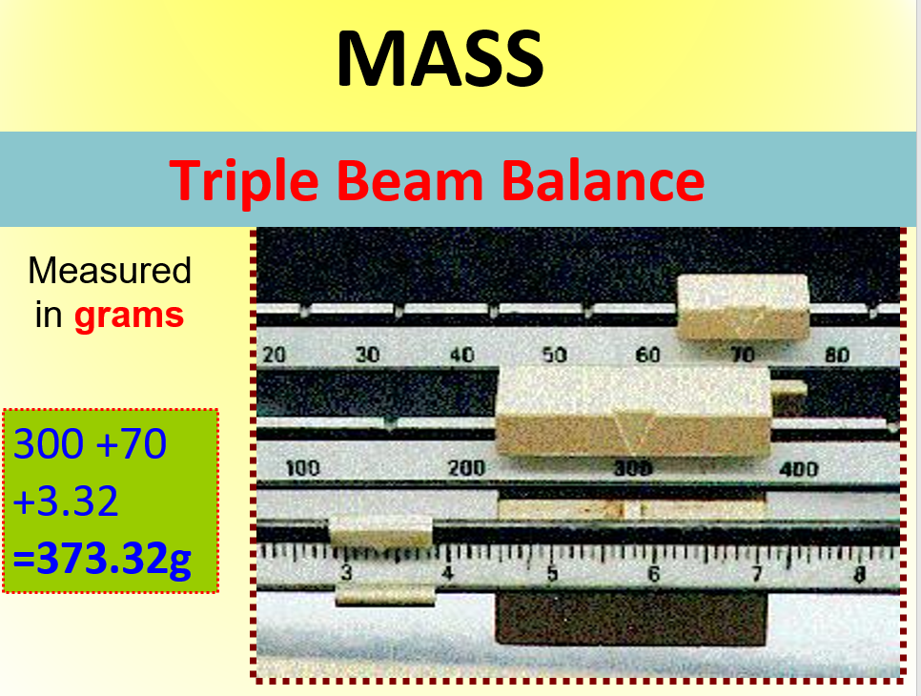
TEST REVIEW
4. Know how to measure mass, volume of a liquid, volume of a regular and irregular solid, and read a thermometer.

Slide 8
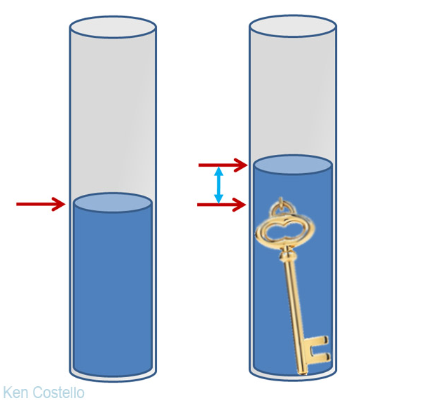
READING LAB EQUIPMENT
Final Reading
Initial Reading
The difference between the two is the volume of the object.

Slide 9
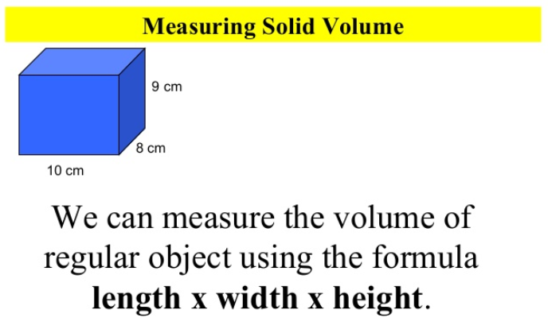
READING LAB EQUIPMENT

Slide 10
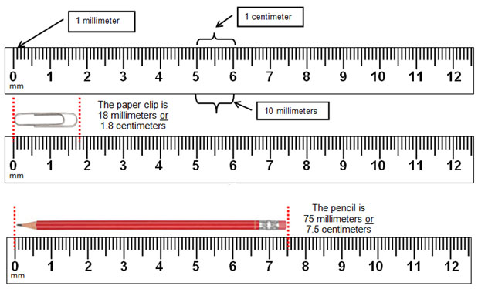
READING LAB EQUIPMENT

Slide 11
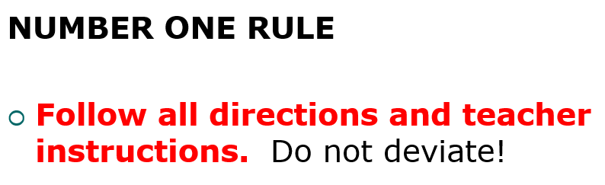
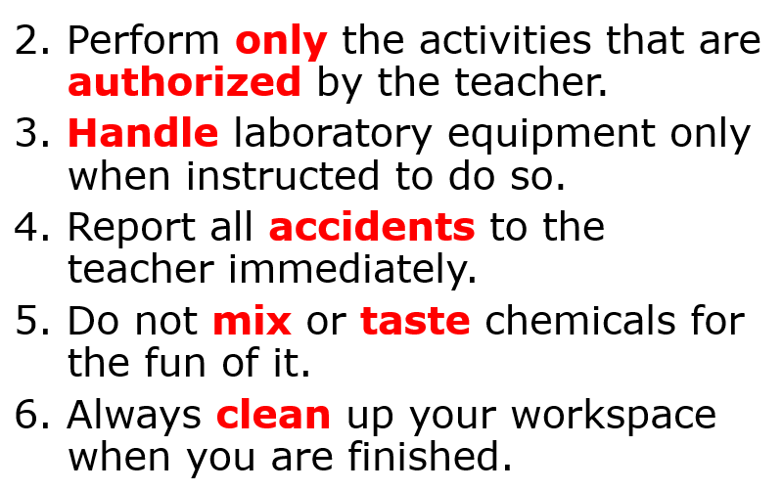
TEST REVIEW
5. Know accepted safety practices.

Slide 12
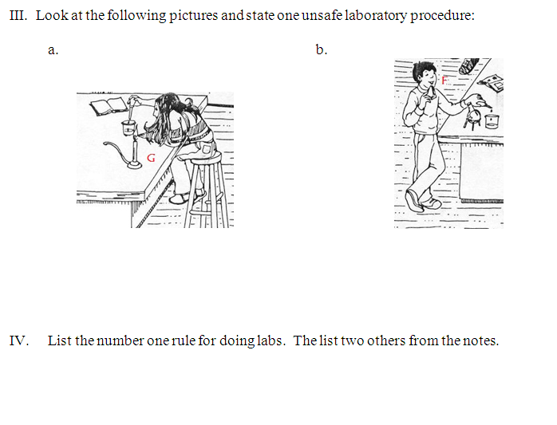
TEST REVIEW
Look at your safety contract and notes.

Slide 13
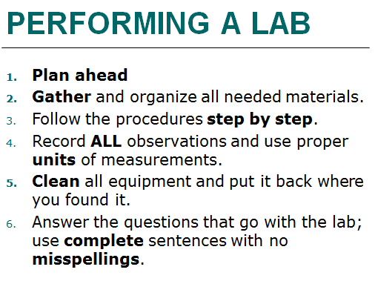
TEST REVIEW
6. Know the steps to performing a lab experiment.

Slide 14
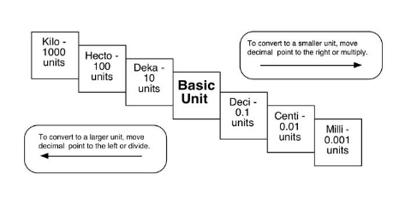
TEST REVIEW
7. Be able to perform metric conversions using the prefixes kilo-, hecto-, deka-, deci-, centi-, and milli-.

Slide 15
METRIC CONVERSIONS
110kL = _____________ DL
270mg = ___________ g
45dm = ___________ hm
1000cg = __________ g

Slide 16
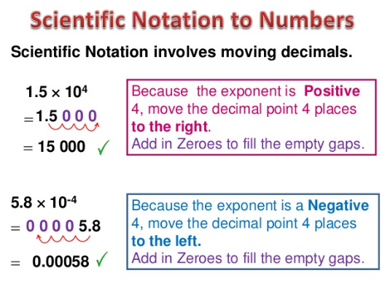
TEST REVIEW
8. Be able to write number in scientific notation and take number out of scientific notation.

Slide 17
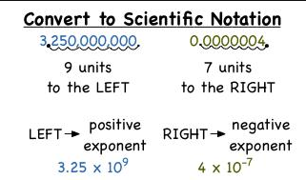
TEST REVIEW
8. Be able to write number in scientific notation and take number out of scientific notation.

Slide 18
SCIENTIFIC NOTATION
Be able to change a number into scientific notation.
4000 → ________________
0.004 → _______________
Be able to change a number out of scientific notation.
4.662 x 10⁴ → ____________
5.25 x 10⁻³ → _____________

Slide 19
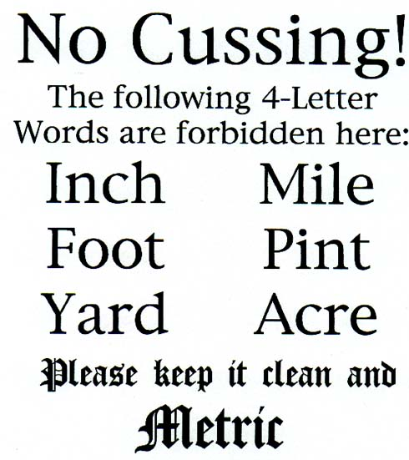

Slide 20
REVIEW PACKET
Completion of the review packet will be for a test redo point.
Must be turned in on the day of the test only – complete
After four such review points, you will be given the chance to redo a test of your choice.

Slide 21
TEST FORMAT
5 MC questions
Table on metric measurements
2 questions on lab safety
4 metric conversions
4 scientific notation to regular or vice versa conversions
2 density problems
6 questions on the scientific method
2 questions on reading lab equipment

