Slide 1
DO NOW
Get out notes and homework handout.

Slide 2
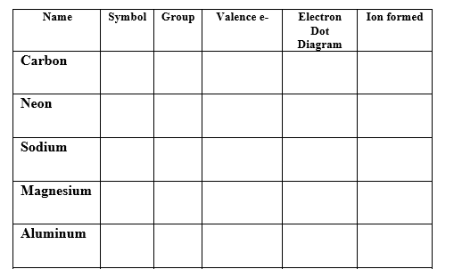
Lose ‘Em and Gain ‘Em

Slide 3
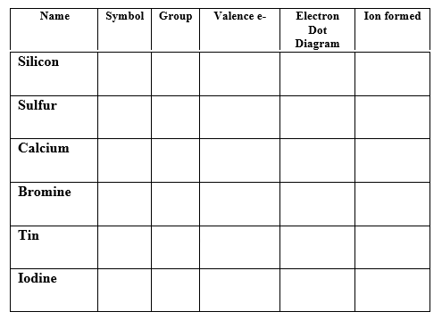
Lose ‘Em and Gain ‘Em

Slide 4
COVALENT BONDS
Atoms with similar electron affinities tend to SHARE electrons.
There are not enough electrons for each individual atom to have a full octet.
Neither atom wants to lose electrons; both want to gain them.
Usually forms between nonmetals.

Slide 5
COVALENT BONDING
The positively charged nucleus of both atoms attracts the negative electrons to be shared.
Covalent bonds form a unit called a MOLECULE.
A molecule is the smallest particle of a covalent bond that has all the properties of that substance.

Slide 6
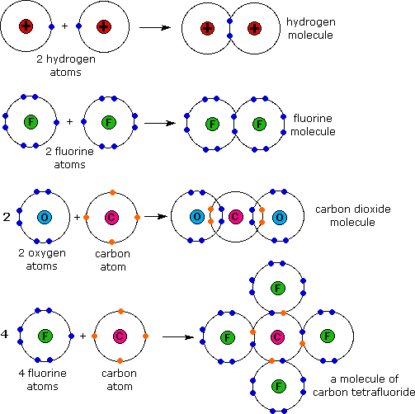
COVALENT BONDING

Slide 7
CHARACTERISTICS
low melting points compared to ionic
many exist as gases or vaporize easily at room temperature
relatively soft, brittle
Poor conductors of electricity.

Slide 8
TYPES OF COVALENT BONDS
1. Single - When a single pair of electrons is shared
2. Multiple - When more than one pair of electrons are shared.

Slide 9
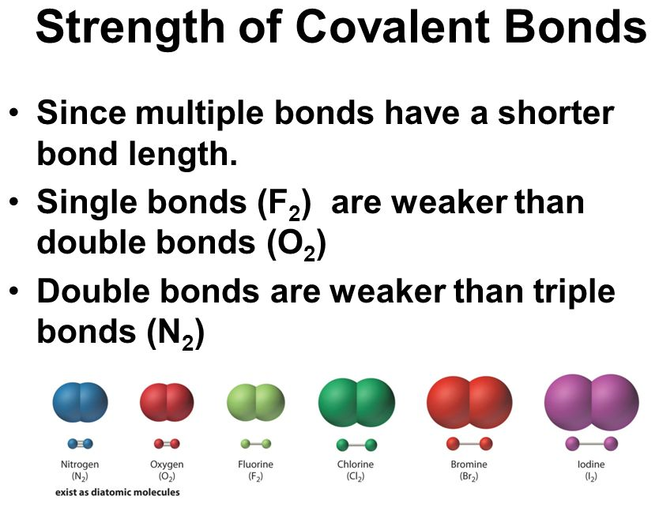
Types of Covalent Bonds

Slide 10
BONDING
Video

Slide 11
SHARING ELECTRONS
Electrons are not always shared equally between atoms in a covalent bond.
The strength of the attraction of each atom is related to:
1. Size of the atom
2. Charge of the nucleus
3. Total number of electrons the atom contains.

Slide 12
SHARING ELECTRONS
An example of unequal sharing is HCl. Chlorine has a stronger attraction for electrons than hydrogen does.
As a result, the electrons will spend more time surrounding the chlorine nucleus than they will the hydrogen nucleus.
The chlorine atom is partially negative and the hydrogen atom is partially positive.

Slide 13
SHARING ELECTRONS
This is called a polar molecule – a molecule with a slightly positive end and a slightly negative end resulting in the electrons being shared unequally.
Molecules where the electrons are shared equally and do not have oppositely charged ends, like H₂, N₂, and O₂, are nonpolar molecules.

Slide 14
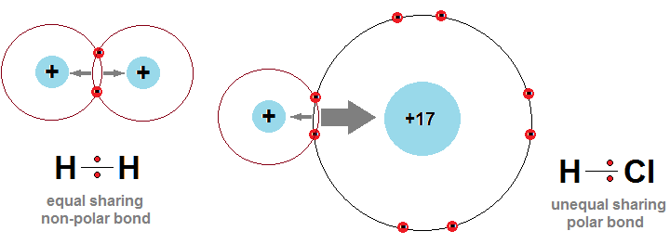
SHARING ELECTRONS

Slide 15
BONDING LAB
INFORMATION:
Compounds are either covalent or ionic depending upon the nature of the forces that hold them together. In ionic compounds, the force of attraction is between oppositely charged ions. In covalent compounds, atoms are held together by an interaction between adjacent nuclei and shared electrons.

Slide 16
BONDING LAB
These different forces account for many of the properties of ionic and covalent compounds, such as degree of volatility (ability to turn into a gas) and solubility.

Slide 17
BONDING LAB
In this experiment, you will examine the properties of several ionic and covalent compounds. The properties studied will be ease of melting and electrical conductivity. Your goal is to determine if the compounds are ionic or covalent.

Slide 18
BONDING LAB
PROBLEM:
How do the properties of ionic and covalent compounds differ?

Slide 19
BONDING LAB
MATERIALS:
Three solids
conductivity tester
test tube clamp
test tube brush
Candle and holder
distilled water
matches
stopwatch
2 100 mL beakers
three test tubes
stirrer

Slide 20
BONDING LAB
SAFETY PRECAUTIONS:
You must wear goggles at ALL times.
Never leave your flame unattended.
The glassware will be hot- use care when touching.
When using the conductivity tester, be sure to just get the prongs wet.

Slide 21
BONDING LAB
PROCEDURE:
Ease of Melting (not BURNING!!!!)
1. Place a green pea-sized amount of one of the solids in a test tube.
2. Using a test tube clamp, heat with the candle flame. Start your stopwatch when you place the test tube in the flame.

Slide 22
BONDING LAB
PROCEDURE:
Ease of Melting (not BURNING!!!!)
3. Determine how long it takes for the solid to melt (NOT BURN). Immediately stop heating when the melting begins. Record the time. Stop after 3 minutes if it has not melted.
4. Repeat with the two solids.

Slide 23
BONDING LAB
Electrical Conductivity
1. Pour approximately 50 mL of distilled water into a 100-mL beaker. Get the water from your teacher.
2. Add a small amount of a solid and stir for ten seconds.
3. Place the two wires of the conductivity tester into the solution. Just get the prongs wet. Record whether the conductivity tester lights up or not.

Slide 24
BONDING LAB
Electrical Conductivity
4. Rinse the conductivity tester prongs in tap water and dry with a clean paper towel. Rinse your beaker with tap water and dry it with a clean paper towel.
5. Repeat the procedure using the other two solids.

Slide 25
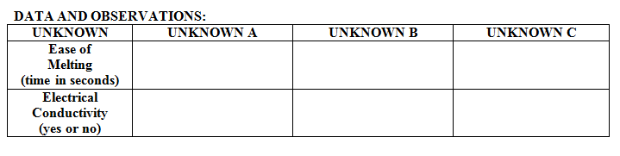
BONDING LAB

Slide 26
BONDING LAB
CONCLUSIONS:
1. Which compounds were ionic and which were covalent? Circle the appropriate letters for each
COVALENT: A B C
IONIC: A B C

Slide 27
BONDING LAB
CONCLUSIONS:
When you look at covalent and ionic compounds, one type is a better conductor of electricity than the other.
  Which one is a better conductor? Circle one. IONIC COVALENT
  Tell me why.

Slide 28
BONDING LAB
3. Does the strength of the bond have anything to do with the time it takes to melt a substance? YES NO
Explain your answer.
4. Think about table salt, sodium chloride.
  Where are sodium and chlorine found on the periodic table?
  Do the relative positions of these two elements in the periodic table agree with the fact that they form an ionic bond? Explain.

Slide 29
REMINDERS
If you take your goggles off while in the lab area, you will be removed from the lab area.
Matches and wooden stirrers go in the trash, NOT in the sink.
Lab is due on Wednesday.

