Slide 1
TO DO
Pick up notes sheet.
Turn in safety contract, syllabus, student information sheet (if you did not get it on Friday).
First Day Stations/Fortune Teller Fish handout is due Wednesday.

Slide 2
SYLLABUS
Course Description: This course is designed to meet the requirements in Physical Science for all students in Georgia. This course is also designed to help students understand scientific principles and the relationship between matter and energy. This class will provide students with the knowledge and skills required by the state standards for the Physical Science End of Course Test.

Slide 3
SYLLABUS
Topics covered in this class include but are not limited to: standards and measurement, states and composition of matters, atomic structure, elements, chemical bonds and reactions, acids, bases, and salts, radioactivity, organic compounds, motion, simple machines, electricity, magnetism, wave properties, sound, and light. All objectives are in accordance with the Georgia Standards of Excellence which can be found at www.doe.k12.ga.

Slide 4
SYLLABUS
Students will also be prepared to perform real world problem solving based on scientific processes and be ready for higher level science.
Course Goals: Demonstrate an understanding of the fundamentals of chemistry and physics and their importance in society. Conduct quality scientific research and communicate findings.

Slide 5
SYLLABUS
Course Outline and Weighting:
25% Energy, Force, and Motion
25% Waves, Electricity, and Magnetism
5% Midterm
25% Atomic Theory, the Periodic Table, and Chemical Reactions
20% Properties of Matter, Solutions, and Acids and Bases

Slide 6
SYLLABUS
Required Materials:
Each student is to have every day in class:
a three ring binder, paper,
pen/pencil,
scientific calculator with exponential notation ability (example: TI-30) - Phones cannot be used as calculators.

Slide 7
SYLLABUS
Classroom Expectations:
Respect your fellow students and your teacher.
Follow directions the first time they are given.
Be prepared for class - bring all required materials.
Leave food, candy, and drink at home. Water is OK for class.
Be in your seat before the tardy bell stops ringing.
6. Use lab equipment when in the lab only.
Cell phones can only be out if being used academically and with teacher permission.
**Certain infractions will automatically result in an administrative referral.

Slide 8
SYLLABUS
Consequences:
1st Offense: verbal warning
2nd Offense: Parent Contact
3rd Offense: 30 min. detention and Parent Contact
4th Offense: Administrative referral

Slide 9
SYLLABUS
Class procedures:
Immediately read the screen and get started with its instructions.
Put away cell phones.
Have homework and all materials (notebook, pencil, etc.) out and ready to go.

Slide 10
SYLLABUS
Work Required of Students:
Students will keep an organized notebook.
Students will do in class and out of class work and projects.
Students will demonstrate knowledge on quizzes and tests.
Students will participate in laboratory exercises and complete any written lab work.

Slide 11
SYLLABUS
Class Website: A calendar for the class as well as all assignments are posted on the on the wall and on the website by unit. If you are unsure if you have homework or when the next test will be, you can access the website – at http://nancybrim.me/ physical-science. You can also access Infinite Campus through the school website.

Slide 12
SYLLABUS
Late Assignments: Assignments are considered late if they are received three days after the due date OR they are received AFTER the assignment checked and had been returned to the class by the teacher. You will receive a grade no higher than 70 on a late assignment. You may only turn in three late labs per semester. After that, your lab must be turned in on time or it will not be accepted.

Slide 13
SYLLABUS
Re-do Policy: Each student is given the opportunity to redo tests. For every four completed test review sheets turned in on time, a test of your choice can be re-taken. This does not include the midterm.

Slide 14
SYLLABUS
Classwork/Homework: Completing your classwork/homework assignments will greatly increase your opportunities for success in this class. Learning takes PRACTICE by doing, not watching someone else do it. I expect each student to complete classwork/homework assigned as it contributes to content mastery. If there are five problems and you can demonstrate mastery by just doing three, that is acceptable. The ultimate determination of mastery is the quizzes and tests so learn the content before then.

Slide 15
SYLLABUS
Free Passes: You get two free bathroom passes a semester from me. There are no actual paper passes – I keep track of them on the seating chart. Once you use them up, there is no leaving class, even in an emergency. Use them wisely.
Tardies: If you are not in the classroom when the bell rings, then you are tardy. Consequences: 1 = warning/conference; 2 = contact parents; 3 = Brim 30 minute detention; 4 or more = admin referral

Slide 16
SYLLABUS
Cell Phone Use: Rarely are cell phones used in the classroom. You are to put the cell phone away when you walk in the door. No cell phones will be plugged in any outlet in this room during class. The consequences for using your cell phone inappropriately are: 1 = warning/conference; 2 = contact parents; 3 = Brim 30 minute detention; 4 or more = admin referral (detention ISS, OSS)

Slide 17
SYLLABUS
HELP SESSIONS:
Mon.-Thurs. until 4:00 in room 441

Slide 18
SYLLABUS
MAKE-UP WORK POLICY
If you have eight or more unexcused absences, then you can no longer get credit for this class. You can fix this by attending morning sessions or afternoon sessions. You must let me know when you are going so that I can send the work that you missed. You only have five days after the eight (or more) unexcused absence to get the work done during the before or after school times.

Slide 19
SYLLABUS
MAKE-UP WORK POLICY
If you have less than three absences at the end of each nine weeks and have turned in all assignments for those nine week topics, credit recovery is available to you. This is the ONLY way I will give work for credit recovery.
all projects are due on the assigned date during the class period. If you are out the day a project is due, then you need to make arrangements to bring the project in on that date. NO EXCEPTIONS.

Slide 20
SYLLABUS
MAKE-UP WORK POLICY
You are held accountable for everything you missed during your absence. It is your responsibility to keep up with your missed work.
You are given FIVE days to make up work after an absence. This includes tests and quizzes.

Slide 21
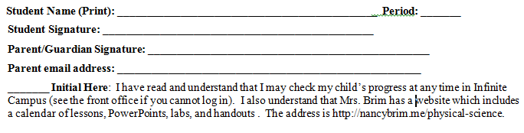
SYLLABUS

Slide 22
THIS AND THAT…
Recycle
Kleenex
Washing hands
Pencil sharpeners
Stapler/tape/hole punch
Eight ball/Easy button/Nail game
Three ring binder with paper and writing utensil/calculator
Cell phones

Slide 23
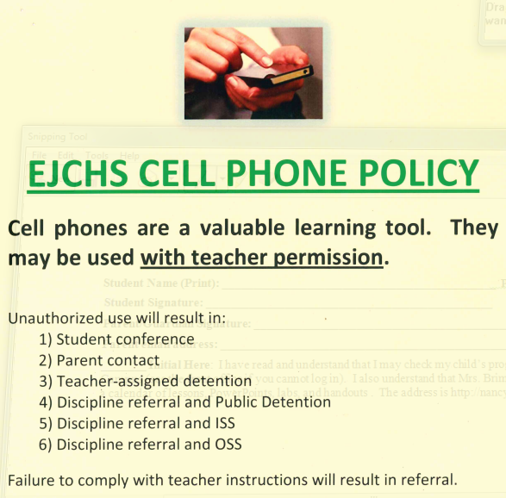
CELL PHONE POLICY

Slide 24
SCIENTIFIC METHOD
Science is an organized way of investigating the natural world.
It is A WAY OF KNOWING about the world.
The SCIENTIFIC METHOD is a way to search for an answer in an orderly, systematic way.

Slide 25
SCIENTIFIC METHOD
State the Problem
Analyze the problem (gather information)
Form a hypothesis (educated guess)
Test the hypothesis (experiment)
Record and analyze the data
Form a conclusion

Slide 26
STATE THE PROBLEM
Be curious
Ask questions about what you observe

Slide 27
ANALYZE THE PROBLEM
Gather information.
Look for patterns.
Look at what other research has done.

Slide 28
FORM A HYPOTHESIS
Form an educated guess about a solution to the problem.
A hypothesis is an educated guess. Make sure you have educated yourself about the problem.
Usually “If, Then” statements.
Cause and Effect statements.

Slide 29
VARIABLES
Independent variable is the one factor you change in the experiment.
Dependent variable is the one factor that changes as result of your independent variable.

Slide 30
TEST THE HYPOTHESIS
Your experiment
The experiment should be tested multiple times (multiple trials).

Slide 31
CONTROL
The parts of the experiment that you do not change.
Why is it necessary to have a control in an experiment?
What would happen if we did not have a control?

Slide 32
CONTROL VS EXPERIMENTAL
The Control Group is the group you make no changes to.
The Experimental Group is the group that has the independent variable changed.

Slide 33
RECORD AND ANALYZE DATA
Write down your data and look for patterns
Put in an organized data table.
Qualitative data: recorded by observation
Quantitative data: recorded with measuring devices.

Slide 34
FORM A CONCLUSION
Was your hypothesis true?
Does your data prove or disprove your hypothesis?
Discuss your hypothesis and support your findings with your data.

Slide 35
PRACTICE
Get in groups of two. Choose someone next to you.
Each group will get a scenario to read and answer the questions on.
We will go over this shortly.

Slide 36
SCENARIO ONE – Floor Wax
Independent variable
Dependent variable
Control
Repeated Trials
Constants
Title
Hypothesis

Slide 37
SCENARIO TWO – Brands of Car Wax
Independent variable
Dependent variable
Control
Repeated Trials
Constants
Title
Hypothesis

Slide 38
SCENARIO TWO – Compost and Bean Plants
Independent variable
Dependent variable
Control
Repeated Trials
Constants
Title
Hypothesis

Slide 39
SCENARIO FOUR – Aloe Vera and Planaria
Independent variable
Dependent variable
Control
Repeated Trials
Constants
Title
Hypothesis

Slide 40
THEORY VERSUS LAW
Both are based on tested hypotheses;
Both are supported by a large body of empirical data;
Both help unify a particular field;
Both are widely accepted by the vast majority (if not all) scientists within a discipline.

Slide 41
THEORY VERSUS LAW
Furthermore, both scientific laws and scientific theories could be shown to be wrong at some time if there are data to suggest so. Theory explanation supported by lots of experiments

Slide 42
THEORY VERSUS LAW
Theory - An explanation for an observation or series of observations that is substantiated by a considerable body of evidence (Krimsley, 1995).
Law - A set of observed regularities expressed in a concise verbal or mathematical statement. (Krimsley, 1995).

Slide 43
PERFORMING A LAB
Plan ahead: read the lab twice.
Gather and organize all needed materials.
Follow the procedures step by step.
Record ALL observations (no matter how small) and use proper units of measurements.

Slide 44
PERFORMING A LAB
5. Clean all equipment and put it back where you found it.
6. Answer the questions that go with the lab; use complete sentences with no misspellings.

Slide 45
LAB RULES
NUMBER ONE RULE
Follow all directions and teacher instructions. Do not deviate!

Slide 46
LAB RULES
2. Perform only the activities that are authorized by the teacher.
3. Handle laboratory equipment only when instructed to do so.
4. Report all accidents to the teacher immediately.
5. Do not mix or taste chemicals for the fun of it.
6. Always clean up your workspace when you are finished.

Slide 47
CHOOSING LAB PARTNERS
Mostly groups of two – we will have a few groups of three.
You will keep this partner for the semester.
We work at lab desks.
Need a permanent partner by next Monday.

Slide 48
HOW MANY PAPER CLIPS?
Work in groups of two or three. Complete the lab sheet as you work.
If you need more paperclips, ask.

Slide 49
STATING THE PROBLEM
Write in the form of a question.

Slide 50
GATHERING INFORMATION
Write two complete sentences about information you might look up to help you with this problem.

Slide 51
PREDICTION/HYPOTHESIS
3. PREDICT the number of paper clips and write it on your lab sheet IN INK.
4. Write a hypothesis:
A full beaker of water will hold XXX paperclips.

Slide 52
TO DO
Get papers signed that you did not last night.
Work on Fortune Tell Fish handout – backside – due Wednesday.

