Slide 1

IONIC NOMENCLATURE
Writing Names and Formulas

Slide 2
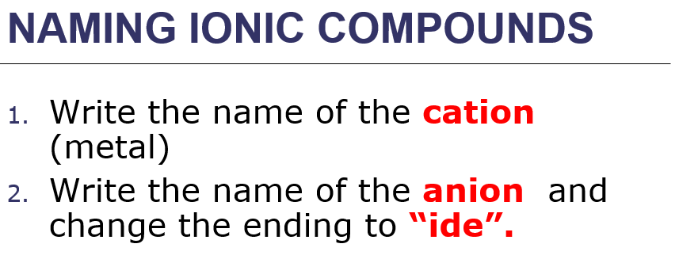
REVIEW
NaBr
MgO

Slide 3
BINARY IONIC NAMES
HBr
KCl
CaO
LiF
MgI₂
Al₂O₃
BeO
K₂S

Slide 4
BINARY IONIC NAMES
9. SrI₂
10. BCl₃
11. AlF₃
12. Rb₃N
13. Mg₃P₂
14. Na₂O

Slide 5
BACKSIDE OF HANDOUT
NaNO₃
K₂CO₃
NH₄HCO₃
Sr(OH)₂
MgSO₄
Mg(C₂H₃O₂)₂

Slide 6
WRITING SIMPLE IONIC FORMULAS
1. Write the charge for the element over the name. You determine the charge by looking at your periodic table or the list of ions in your notes.
2. Write the symbol for the cation, followed by the symbol for the anion.

Slide 7
WRITING SIMPLE IONIC FORMULAS
Monatomic Ions
An ion with only one atom: Mg⁺², Na⁺¹, O⁻².
Most of the charges can be determined by the atom’s position on the periodic table.

Slide 8
WRITING SIMPLE IONIC FORMULAS
3. Crisscross the numbers only (not the signs), writing the oxidation number as a subscript for the other. Do not write the number 1. Balance the charges by placing the subscripts. Net charges must be zero.
4. Make sure the formula is in its simplest form. Mg₂O₂ is reduced to MgO, but MgCl₂ cannot be reduced.

Slide 9
WRITING SIMPLE IONIC FORMULAS
5. Check your work by calculating the total positive and negative charges and confirming that the total charge on the compound is zero.
MgO - Mg: +2 x 1 and
O: -2 x 1 = +2
+2 and -2 which is zero.

Slide 10
PRACTICE
lithium fluoride
lithium chloride
barium bromide
barium oxide
aluminum iodide
aluminum nitride

Slide 11
MULTIPLE OXIDATION NUMBERS
Some cations (positive ions) can have more than one charge.
Most are transition elements. Lead and tin are exceptions.
It is important to distinguish which ion is in the compound.

Slide 12
MULTIPLE OXIDATION NUMBERS
Cu⁺¹ copper (I)
Cu⁺² copper (II)
Fe⁺² iron (II)
Fe⁺³ iron (III)
Sn⁺² tin(II)
Sn⁺⁴ tin (IV)
Pb⁺² lead (II)
Pb⁺⁴ lead(IV)

Slide 13
WRITING THE FORMULAS FOR THESE TYPES
Write the name of the cation (metal)
Write the name of the anion ending in “ide”.
Just remember that the charge for the cation is in the name.
Examples: copper (II) sulfate, CuSO₄ iron (II) oxide, FeO

Slide 14
PRACTICE
Copper(I) fluoride
Copper(II) oxide
Chromium (III) bromide
Manganese (II) iodide
Lead(II) chloride
Cobalt (III) sulfide

Slide 15
NAMING MORE COMPLEX IONIC COMPOUNDS
Write the name of the cation (metal), then write the name of the anion.
If the cation (metal) has more than one charge, designate the correct charge with the roman numeral using the formula as a guide to determine the charge.
Example: Fe(OH)₂ iron (II) hydroxide Fe(OH)₃ iron (III) hydroxide

Slide 16
PRACTICE
1. FeO
2. Fe₂O₃
3. CuCl₂
4. CuCl
5. PbF₄
6. SnCl₂

Slide 17
PRACTICE
1. Potassium hydrogen carbonate
2. Iron(II) hydroxide
3. Iron(III) nitrate
4. Beryllium carbonate
5. Sodium acetate
6. Potassium sulfate

