Slide 1
DO NOW
Turn in Fortune Teller Fish/First Day Stations handout.
Get out yesterday’s notes.

Slide 2
Distance between two points.
LENGTH

Slide 3
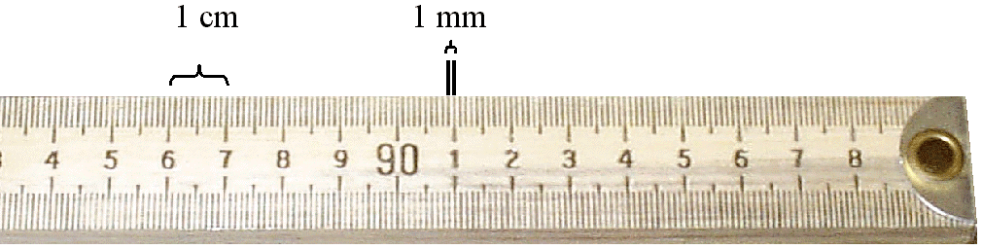
LENGTH
Measured in meters
1m = 100 Centimeters
1m = 1000 millimeters
1cm = 10 mm
Use a meterstick.
Each line on the meter stick is a millimeter.

Slide 4
Amount of matter in an object
MASS

Slide 5
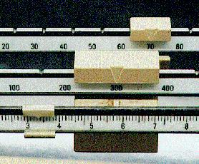
Triple Beam Balance
MASS
Measured in grams
300 +70 +3.32 =373.32g

Slide 6
Space occupied by an Object
VOLUME

Slide 7
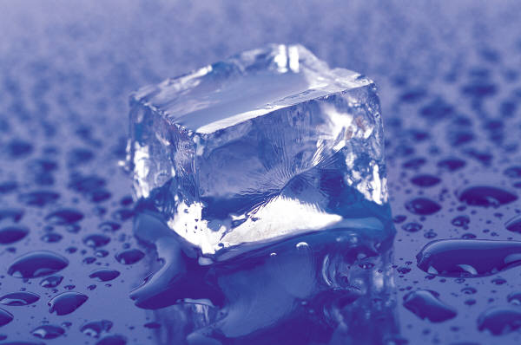
VOLUME – REGULAR OBJECT
Use a meter stick
Length x Height x Width =Volume, cm³
RULER, cm³

Slide 8
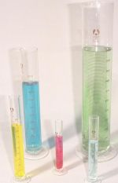
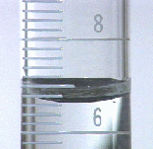
VOLUME – IRREGULAR, LIQUID
Graduated Cylinder, mL

Slide 9
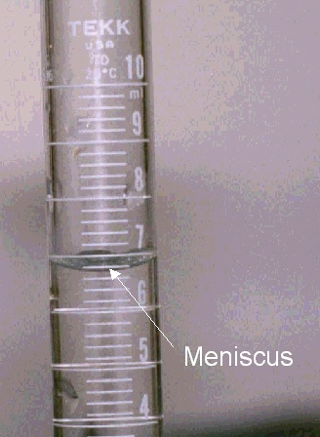
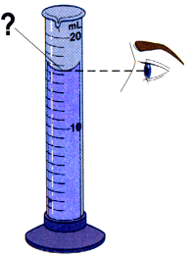

Slide 10
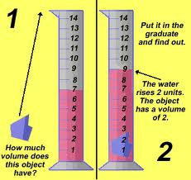
VOLUME –
IRREGULAR OBJECT
GRADUATED CYLINDER

Slide 11
Indirect Measure of Kinetic Energy
TEMPERATURE
12

Slide 12
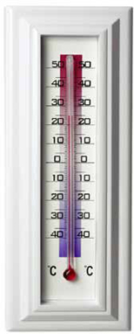
TEMPERATURE
Measure using a thermometer
Measure in degrees Celsius, °C.

Slide 13


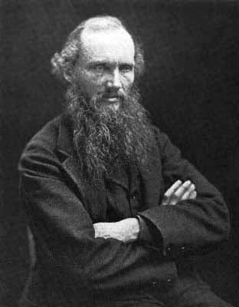
TEMPERATURE
Fahrenheit vs. Celsius vs. Kelvin
1742, Anders Celsius (1701-1744)
Lord Kelvin (1824-1907)
1714:Daniel Gabriel Fahrenheit (1686-1736)
Absolute Zero: temperature at which all matter stops moving.

Slide 14
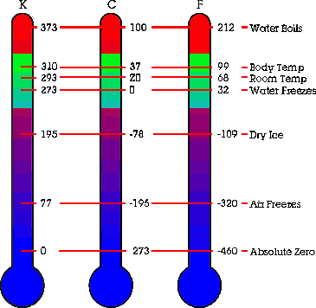

Slide 15
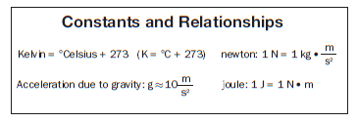
TEMPERATURE
You must be able to make conversions.
Kelvin = ºCelsius + 273
K = ºC + 273

Slide 16
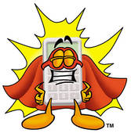
PRACTICE:
1. 250 Kelvin to ºCelsius
2. 339 Kelvin to ºCelsius
3. 17º Celsius to Kelvin
4. -55º Celsius to Kelvin

Slide 17
TEMPERATURE
Answers
1. -23 ºC
2. 66 ºC
3. 290 K
4. 218 K

Slide 18
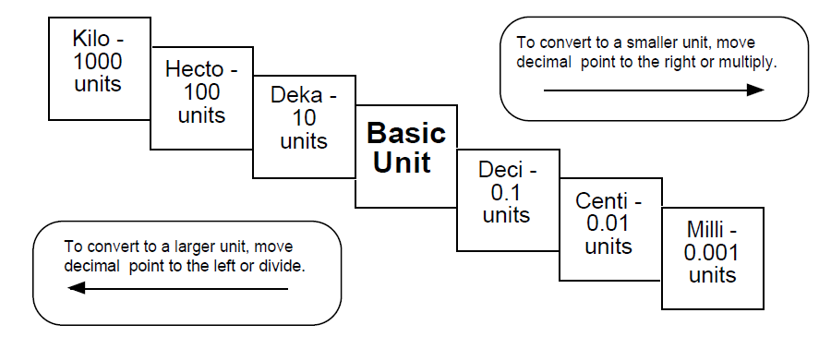
METRIC CONVERSIONS

Slide 19
Metric Conversions
A conversion is changing the way you state the same amount!
Example: 1 dollar
  4 quarters, 100 pennies, 10 dimes
  1 meter = 100 centimeters
Simply move your decimal point.

Slide 20
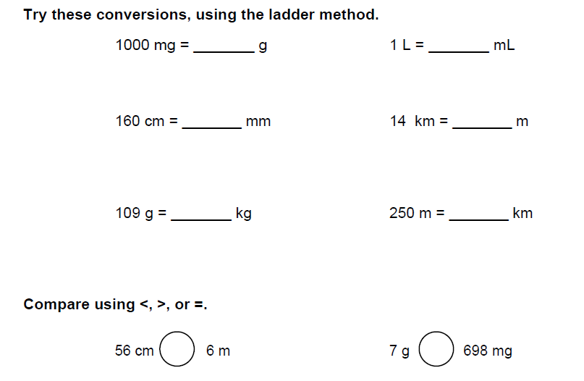
Metric Conversions

Slide 21
METRIC CONVERSIONS
Go to your lab desk and follow the directions.
You must do two objects with volume, one with mass, and one with length.
Have a seat once you have recorded the data.
Make your conversions and work on your vocabulary Chapter One list.

Slide 22
TO DO
Work on Metric Conversions – get data collected and then do the conversions.
Work on Paper Clip lab – due tomorrow
Work on Vocabulary.

