Slide 1
COVALENT NOMENCLATURE
Writing Names and Formulas
H₂O
hydrogen oxide
Dihydrogen monoxide

Slide 2
MOLECULAR COMPOUNDS
Another word for covalent molecules
usually binary; called a molecule
usually contain two nonmetals; solid, liquid or gas
Sometimes contains a metalloid and a nonmetal.

Slide 3
NAMING MOLECULAR COMPOUNDS
Rules:
Use prefixes to identify the number of atoms present.
If only one of the first atom (nonmetal), then NO prefix is used.
Last element ends in “ide”.
* Can combine in different ratios so MUST use prefixes.

Slide 4
NAMING MOLECULAR COMPOUNDS
Prefixes:
1 - mono 6 - hexa
2 - di 7 - hepta
3 - tri 8 - octa
4 – tetra 9 - nona
5 - penta 10 - deca

Slide 5
NAMING MOLECULAR COMPOUNDS
Examples:
CO₂ carbon dioxide
PCl₃ phosphorus trichloride
N₂O dinitrogen monoxide
P₂O₃ diphosphorus trioxide

Slide 6
PRACTICE
1. NCl₃
2. CS₂
3. Si₂Br₆
4. S₄N₄
5. SF₆
6. N₂O₅

Slide 7
WRITING MOLECULAR COMPOUNDS
1. Write the symbol of the first element adding a subscript of the number of atoms present. If only one of the first atom (nonmetal), then NO number is used.
2. Write the symbol of the second element adding a subscript of the number of atoms present.

Slide 8
PRACTICE
boron trifluoride
silicon tetrachloride
iodine heptafluoride
tetraphosphorus decoxide
chlorine trifluoride
sulfur dichloride

Slide 9
HYDRATES
A crystalline compound in which its ions are attached to one or more water molecules.
Hydrates are solids with water molecules trapped in them.
The “•” means that waters are attached.

Slide 10
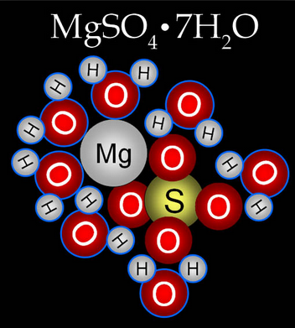
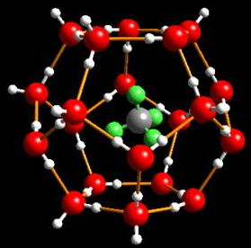
HYDRATES
Methane Hydrate

Slide 11
HYDRATES
The formula is written as:
(ionic formula) (number of waters)
XY • XH₂O
CuSO₄ • 5H₂O
copper (II) sulfate pentahydrate

Slide 12
HYDRATES
Use the same prefixes as with covalent compounds:
mono – 1 penta – 5 nona -9
di - 2 hexa – 6 deca - 10
tri - 3 hepta -7
tetra - 4 octa - 8
Practice Naming
Na₃PO₄ • 2H₂O
SrCl₂ • 6H₂O
Ba(OH)₂ • 8H₂O

