Slide 1
DO NOW
Pick up the notes and a small white paper from the front. Write your name on both.
Turn in Graphing Temperatures.

Slide 2
SINK OR FLOAT?
Diet Coke® - Sink or Float?
Caffeine free Coke® - Sink or Float?
Sprite ® - Sink or Float?
Regular Coke ® - Sink or Float?
Big rock - Sink or Float?
Little rock - Sink or Float?
Small metal orb - Sink or Float?
Big metal orb - Sink or Float?

Slide 3
DERIVED UNITS
Obtained by combining different units. Examples: density, speed
Density is the amount of mass per unit volume; D = m/v
Speed is distance divided by time; S = d/t

Slide 4
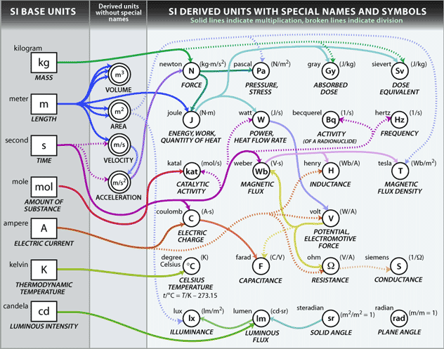

Slide 5
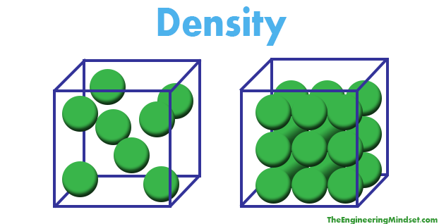
DENSITY

Slide 6
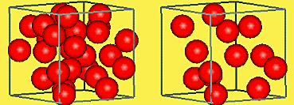
DENSITY
There are physical characteristics of a substance that help identify the substance. One of these characteristics is density.
Density is the amount of matter in a specific volume; mass per unit volume.
These 2 cubes have the same VOLUME, but they have different densities. Why?

Slide 7


DENSITY
We can calculate the density of a solid, liquid, or gas. Note the difference in units in the formulas of the density of a solid and liquid.
The unit for cubic centimeters is cm³ and for milliliters is mL. Since one mL equals one cm³, there is no difference between g/cm³ and g/mL.

Slide 8

DENSITY
This image will help you in figuring out how to solve density problems:
Simply cover up whichever value you need to calculate and the other two are shown in their proper placement, be it to multiply or to divide.

Slide 9
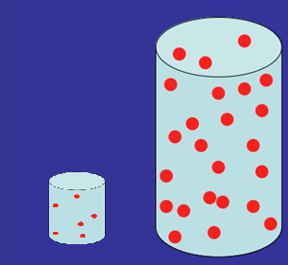
PRACTICE
Which cylinder has the greatest density?
What if I had the same amount of each cylinder (1 mL) - which one would have a greater mass??
Vol: 5 mL
Mass: 10g
Vol: 25 mL
Mass: 15g
Density = 2g/mL
Density = 1.7g/mL

Slide 10

PRACTICE
When you work these problems, you need to do the following:
Write what you know and where you are going.
Write the formula.
Plug in the data given and solve.
Be sure your answer has the correct unit.

Slide 11
DENSITY PROBLEM
A block of aluminum occupies a volume of 15.0mL and weighs 40.5g. What is its density?
V = 15.0mL
M = 40.5g
D = ?
D = M/V
D = 40.5g/15.0mL
= 2.7g/mL

Slide 12
GRO-BEAST LAB
Write down all seven pieces of data in your data table.
Calculate the density for each set of data. Put the density answers in Calculations column next to Observations and Data table.
Then graph the mass and volume data on the backside following the directions.
Answer the two conclusion questions
Lab is due on THURSDAY.

Slide 13
TO DO
Do the five remaining density problems in the notes. Follow the four steps to solving problems.
Calculate the density for all seven pieces of Gro-beast data – Graph and answer the two conclusion questions – due THURSDAY.
Vocabulary Quiz tomorrow.

