Slide 1
BONDING AND NOMENCLATURE
A ReView

Slide 2
REVIEW
State the main reason why chemical bonding occurs.
Chemical bonding occurs because atoms want CHEMICAL STABILITY. They want a Noble Gas valence electron number.
The atom gets a full energy level by losing or gaining electrons to form an octet.
This is the most stable formation.

Slide 3
REVIEW
2. Describe chemical stability.
describes an atom whose outer energy level is completely filled with all the electrons allowed at that level (a Noble Gas number of electrons).

Slide 4
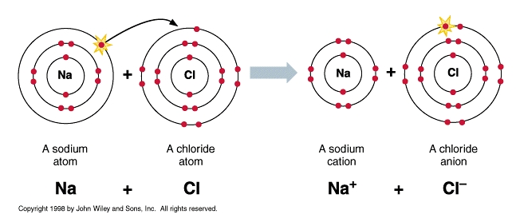
REVIEW
3. Describe ionic bonds and what happens to the electrons.
involves a TRANSFER of electrons from one atom to another.
is held together by electric/electrostatic force (+/-).
happens between positive ions and negative ions.

Slide 5
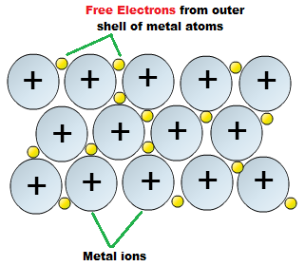
REVIEW
5. Describe metallic bonds and what happens to the electrons.
Metallic solids have only metals in them.
Metals share electrons.
A metallic bond is where the electrons in the outermost energy level overlap and form a sea of electrons.

Slide 6
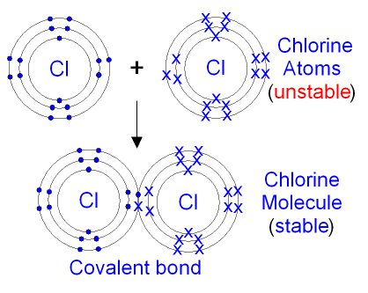
REVIEW
5. Describe covalent bonds and what happens to the electrons.
Atoms with similar electron affinities tend to SHARE electrons.
There are not enough electrons for each individual atom to have a full octet. Neither atom wants to lose electrons; both want to gain them.

Slide 7
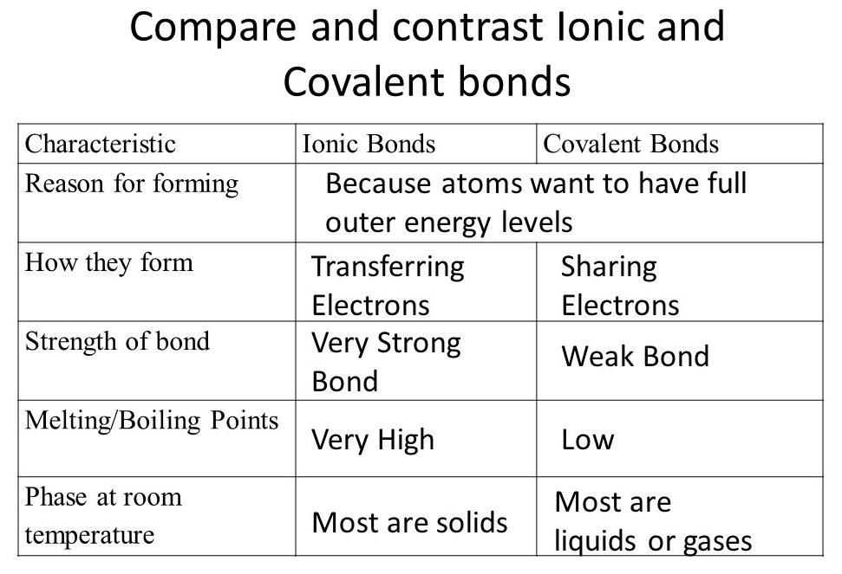
REVIEW
6. Compare and contrast ionic and covalent bonds.

Slide 8
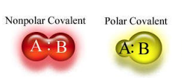
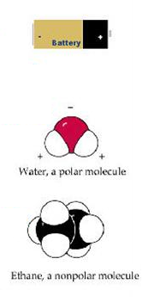
REVIEW
7. Distinguish between a nonpolar molecule and a polar molecule.
Nonpolar molecule: molecule that shares electrons equally and does not have oppositely charged ends.
Polar Molecule: molecule with a slightly positive end and a slightly negative end as a result of electrons being shared unequally.

