Slide 1
PROPERTIES OF MATTER
REVIEW

Slide 2
REVIEW
Explain the kinetic theory of matter.
  All matter is composed of tiny atoms, ions, or molecules (1) that are in constant, random motion (2) and collide with each other and the walls of their container (3).

Slide 3
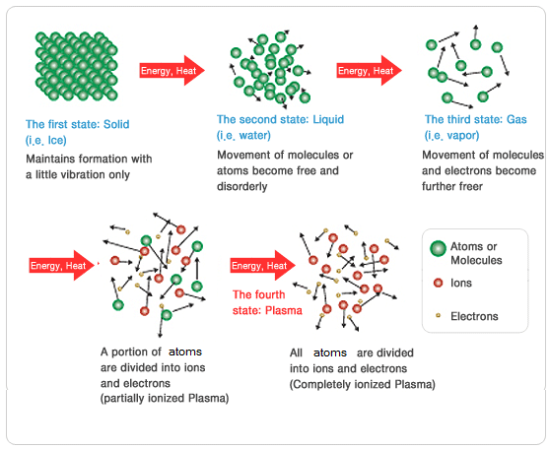
REVIEW
2. Describe the particle movement in the four states of matter.

Slide 4
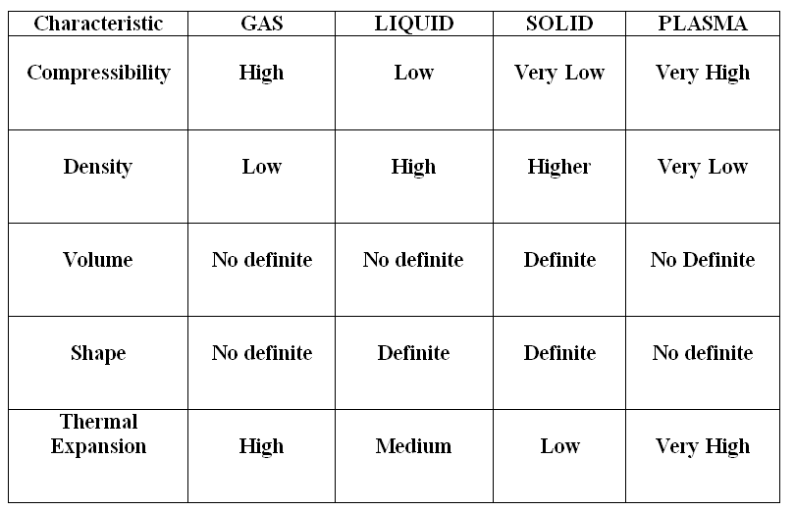
REVIEW
2. Describe the particle movement in the four states of matter.

Slide 5
REVIEW
3. Explain particle behavior AT melting and boiling points.
Melting and Vaporization
The particles are getting heat energy.
The temperature is not changing
All of the heat energy is going to weaken the bonds between the particles
Freezing and Condensation
The particles are losing heat energy.
The temperature is not changing
Energy is being lost as the bonds are strengthened between the particles

Slide 6
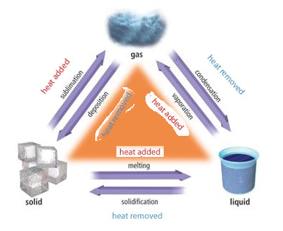
REVIEW
4. Describe the six phase changes and what happens to the heat energy in each.

Slide 7
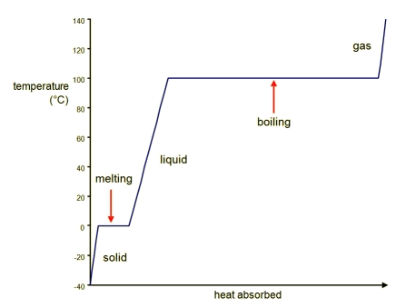
REVIEW
5. Be able to interpret a phase diagram and a heating curve.
6. Know that temperature does not change during a phase change.
- Know the three phases and the four phase changes
- Know how to read the temperature
- Know what happens to temperature during a phase change.

Slide 8
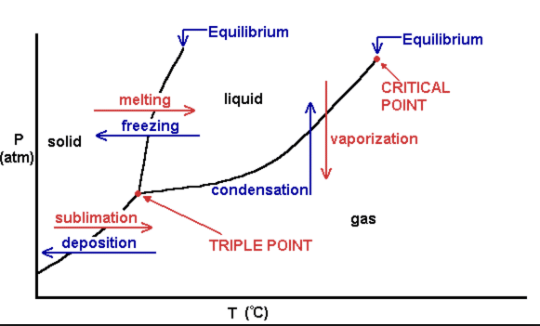
REVIEW
5. Be able to interpret a phase diagram and a heating curve.
6. Know that temperature does not change during a phase change.
- Know the three phases and the six phase changes
- Know how to read the temperature and the pressure.
Know what happens to temperature during a phase change.
Know what happens along the equilibrium lines.

Slide 9
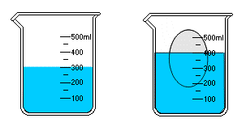
REVIEW
7. Explain Archimedes Principle.
Archimedes Principle - the buoyant force on a submerged object is equal to the weight of the fluid that is displaced by the object.
Buoyancy is the ability of a fluid to exert an upward force on an object immersed in the fluid. Can be a gas or a liquid.

Slide 10
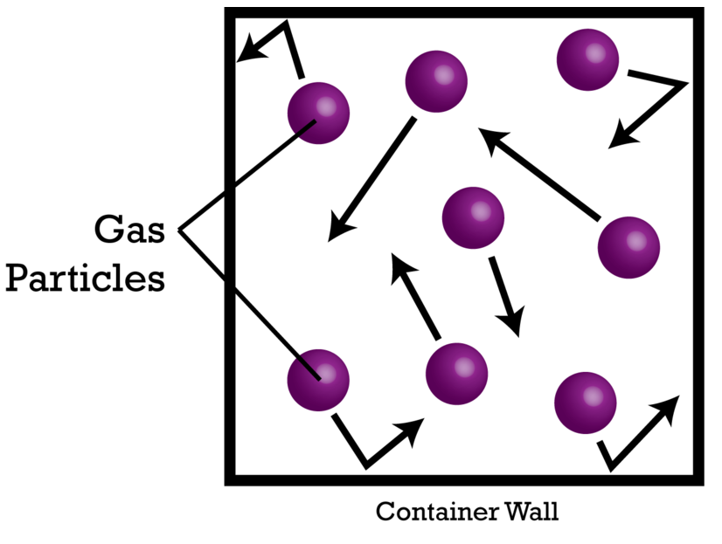
REVIEW
Explain how a gas exerts pressure on its container.

Slide 11
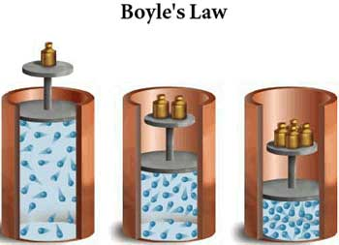
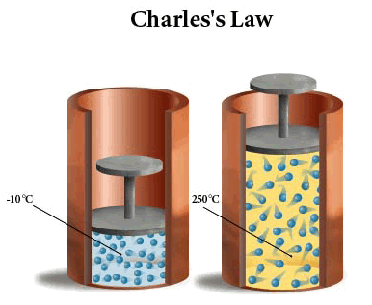
REVIEW
9. Explain how a gas is affected when temperature, pressure, or volume is changed.
Boyle’s Law
shows a relationship between volume and pressure.
They are indirectly proportional.
Charles’ Law
shows a relationship between volume and temperature.
They are directly proportional.

Slide 12
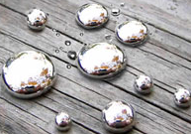
REVIEW
10. Identify substances using physical and chemical properties.
The element mercury.
Physical properties: heavy, silvery white, metal, liquid at room temperature, poor conductor of heat, good conductor of electricity, boiling point - 357°C, melting point -39°C.
Chemical properties: non-flammable, rusts

Slide 13
REVIEW
10. Identify substances using physical and chemical properties.
Other Properties:
Amorphous versus Crystalline - An amorphous solid is a solid where the particles are not arranged in a crystalline pattern; Crystalline solids are arranged in fixed geometric patterns.
Fluidity – experienced by gases and liquids because both can FLOW. Diffusion is the spreading of particles throughout a given volume until they are evenly distributed.
3. Viscosity - a fluid’s resistance to flow; temperature can change it. Low viscosity flows easily – high viscosity flows slowly.

Slide 14
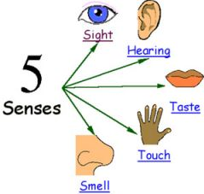
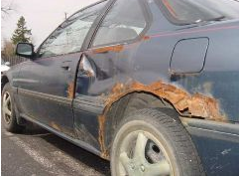
REVIEW
11. Compare and contrast physical and chemical properties.
Physical Properties
The characteristics of a substance that you can observe without changing the identity of the substance.
Examples: color, texture, mass, volume, density, temperature, weight, hardness, phase (state), length.
Chemical Properties
The characteristics of a substance that CANNOT be observed without changing the identity of the substance.
Examples: Flammability, oxidation (rusting, tarnishing)

Slide 15
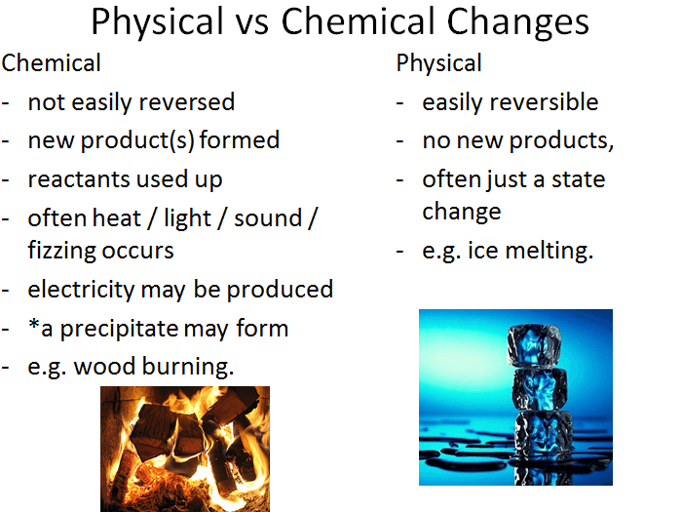
REVIEW
12. Compare and contrast physical and chemical changes.

Slide 16
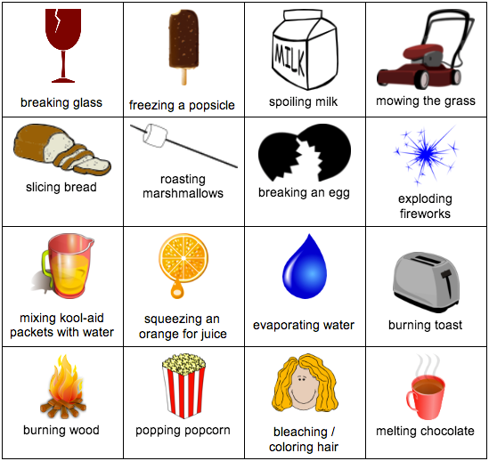
REVIEW
Physical or Chemical Change?
REMEMBER:
The question to ask is: Does it form a new substance?

Slide 17
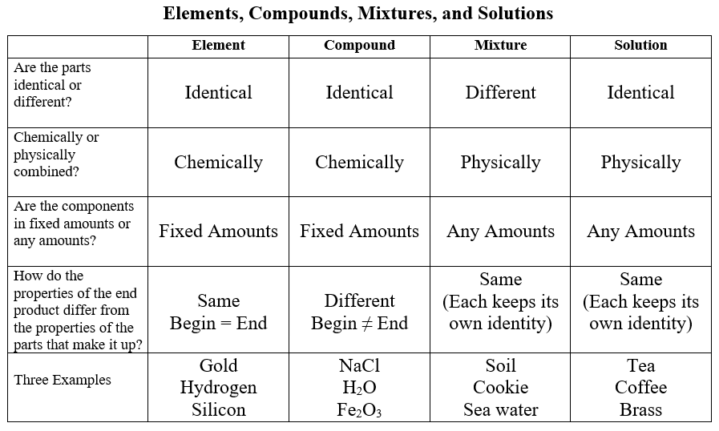
REVIEW
13. Compare and contrast and be able to identify elements, compounds, mixtures, and solutions.

Slide 18
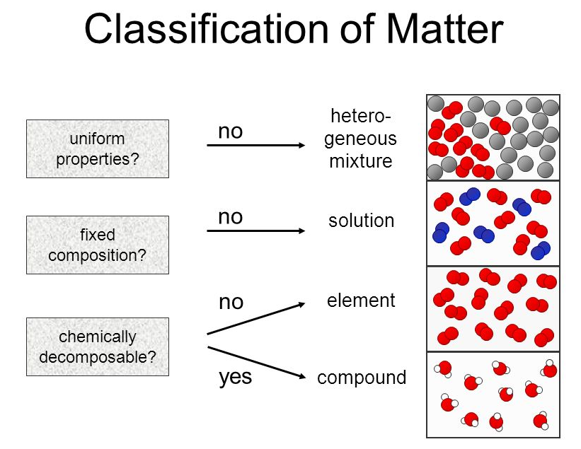
REVIEW

Slide 19
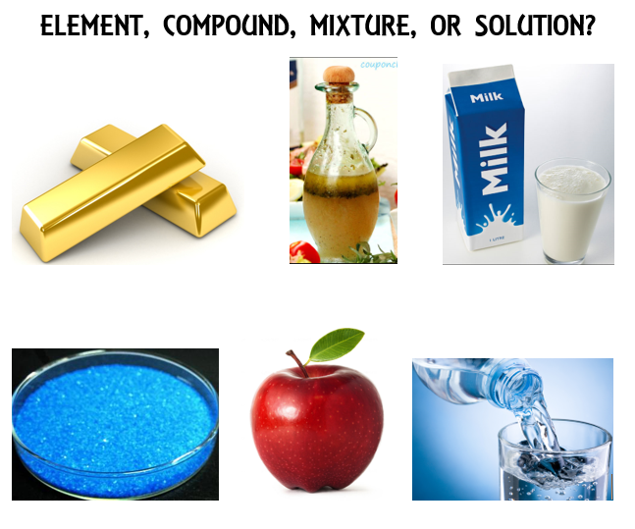
REVIEW
13. Compare and contrast and be able to identify elements, compounds, mixtures, and solutions.

Slide 20
REVIEW
14. Know the 25 vocabulary words.

Slide 21
WATCH
Molecules in Solids
Molecules in Liquids
Evaporation and Condensation
Review video on classes of matter

