Slide 1
DNA Technology

Slide 2
TO DO
Get out notes and worksheet
The Secrets of Our Lives: The Human Genome Project

Slide 3
HUMAN GENOME PROJECT
Started in 1990.
The project’s purpose was to discover all the estimated 25,000 human genes and map the 3 billion nucleotide sequences of DNA in human chromosomes.

Slide 4
HUMAN GENOME PROJECT
Currently, scientists are using this information to identify where genes are located, control mechanisms of genes and the functions of genes.
Mapping every gene location (loci).
Conducted by scientists around the world.

Slide 5
HUMAN GENOME PROJECT INSIGHTS
Only 2% of human genome codes for proteins (exons).
Other 98% (introns) are non-coding.
Only about 20,000 to 25,000 genes (expected 100,000).
Proteome – organism’s complete set of proteins.
About 8 million single nucleotide polymorphisms (SNP) – places where humans differ by a single nucleotide.
About ½ of genome comes from transposons (pieces of DNA that move to different locations on chromosomes).

Slide 6
BENEFITS OF HUMAN GENOME PROJECT
Improvements in medical prevention of disease, gene therapies, diagnosis techniques …
Production of useful protein products for use in medicine, agriculture, bioremediation and pharmaceutical industries.
Improved bioinformatics – using computers to help in DNA sequencing …

Slide 7
GENE THERAPY
The transfer of normal or modified genes into a person’s body cells to correct a genetic defect or boost resistance to disease - possibly cure genetic disorders.
It is a technique for correcting defective genes that are responsible for disease development

Slide 8
GENE THERAPY
There are four approaches:
  A normal gene inserted to compensate for a nonfunctional gene.
  An abnormal gene traded for a normal gene.
  An abnormal gene repaired through selective reverse mutation.
  Change the regulation of gene pairs.
Notes:
Is the most common approach
The abnormal gene would be swapped by homologous recombination
Would cause a return to normal function
Control expression of genes. Similar to epistasis, when one gene affects the expression of another gene.

Slide 9
THE BEGINNING…
In the 1980s, Scientists began to look into gene therapy.
  They would insert human genes into a bacteria cell.
  Then the bacteria cell would transcribe and translate the information into a protein.
  Then they would introduce the protein into human cells.

Slide 10
THE FIRST CASE
The first gene therapy was performed in Sept. 1990.
  Ashanti DeSilva was treated for SCID (Severe combined immunodeficiency ).
  Doctors removed her white blood cells (WBC), inserted the missing gene into the WBC, and then put them back into her blood stream.
  This strengthened her immune system - only worked for a few months.

Slide 11
HOW IT WORKS
A vector delivers the therapeutic gene into a patient’s target cell.
The target cells become infected with the viral vector.
The vector’s genetic material is inserted into the target cell.
Functional proteins are created from the therapeutic gene causing the cell to return to a normal state.
Notes:
A vector is a carrier molecule, usually a virus
The target cells are usually in the liver or lung

Slide 12
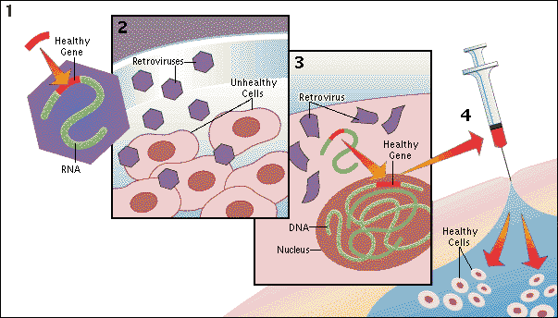
Gene Therapy
http://encarta.msn.com/media_461561269/Gene_Therapy.html

Slide 13
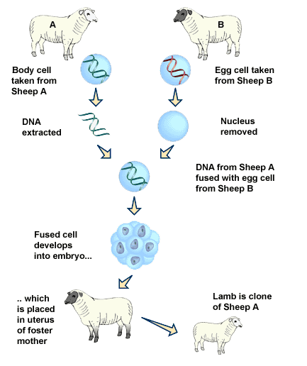
CLONING
Clone- a member of a group of genetically identical cells

Slide 14
CLONING
The production of identical copies of DNA through some asexual method.
A body cell from one organism and an egg cell from another are fused.
The resulting cell divides like a normal embryo.

Slide 15
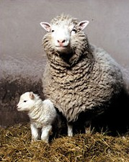
CLONING “Dolly”
CLONING

Slide 16
TO DO
VIDEO: How does Gene Therapy Work?
Section F – use the laptops. Link is on today’s date on my website.

