Slide 1
DNA Technology

Slide 2
DO NOW
Get out notes and worksheet.
VIDEO: The Story of Dolly the Cloned Sheep

Slide 3
DNA FINGERPRINTING
Restriction enzymes and gel electrophoresis are used to splice and separate DNA fragments.
This process produces a gel containing a banded pattern of DNA fragments that are used to compare individuals.
This is used in forensics.

Slide 4
DNA FINGERPRINTING
How it Works:
Extract DNA
Cut DNA
Run a gel electrophoresis

Slide 5
DNA EXTRACTION
Chemical treatments cause cells and nuclei to burst.
The DNA is inherently sticky, and can be pulled out of the mixture.
This is called “spooling” DNA.

Slide 6
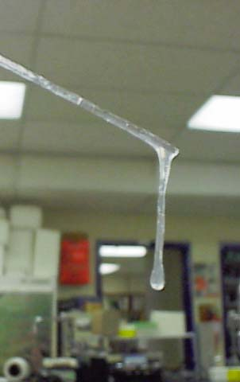
“SPOOLED” DNA

Slide 7
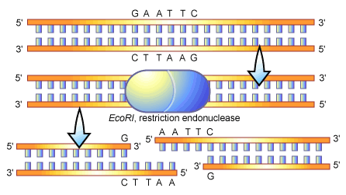
CUTTING DNA
Restriction enzymes cut DNA at specific sequences.
Useful to divide DNA into manageable fragments

Slide 8
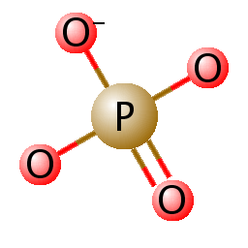
ELECTROPHORESIS
DNA can be separated based on size and charge.
The phosphate groups are negatively charged.
DNA is placed in a gel and electricity is run through it.

Slide 9
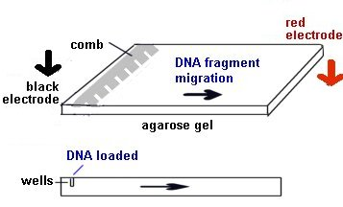
ELECTROPHORESIS
Negative DNA moves toward the positive end.
Smaller fragments move farther and faster that longer ones.

Slide 10
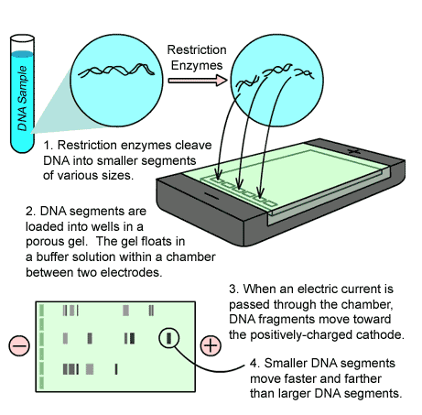
ELECTROPHORESIS

Slide 11
TO DO
DNA Fingerprinting
Section G – use the laptops. The link is on today’s date on my website.
Switched at Birth! DNA Fingerprinting handout
﻿

