Slide 1
DNA Technology

Slide 2
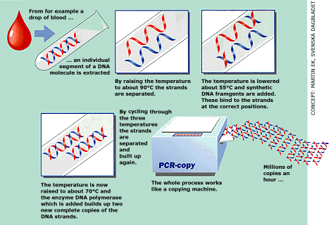
COPYING DNA
Polymerase Chain Reaction
Also called PCR.
A method to replicate DNA. fragments to rapidly amplify DNA samples.

Slide 3
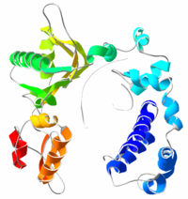
COPYING DNA
  A DNA molecule is placed in a small test tube.
  DNA polymerase that can work at high temperatures is added.

Slide 4
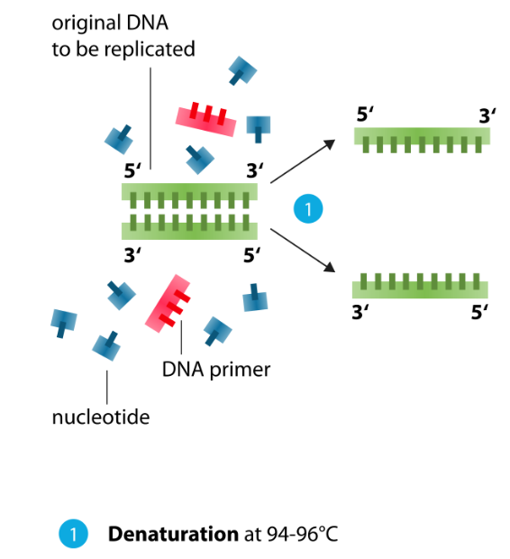

Slide 5
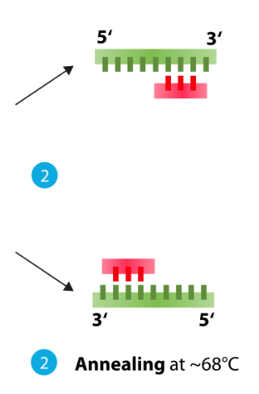
COPYING DNA
The DNA is heated to separate the two strands.
It is then cooled and Primers, short pieces of DNA complementary to the ends of the molecule to be copied, hydrogen bond to the DNA templates.

Slide 6
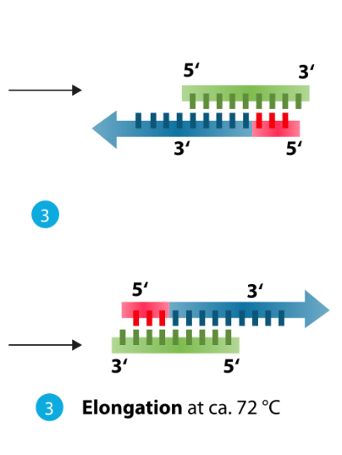
COPYING DNA
  The tube is cooled, and DNA polymerase adds new bases to the separated strands.
  The first round of PCR is complete.
  The process then repeats itself many times over.

Slide 7
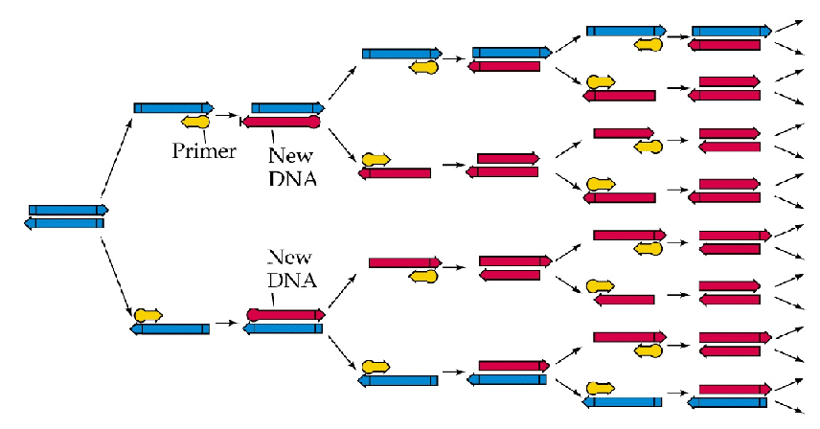
COPYING DNA
Polymerase Chain Reaction
Large amounts of DNA can be made from a small starting sample

Slide 8
GENETIC ENGINEERING
The process of changing the genetic makeup of an organism to introduce a desirable trait.
Genes are transferred from one species into another species resulting in a transgenic organism that contains recombinant DNA.
OR a gene is modified and inserted into an organism of the same species.

Slide 9
GENETIC ENGINEERING
Recombinant DNA contains DNA spliced together from two different organisms.
Restriction enzymes are used to splice DNA at specific base sequences into fragments.
Recombinant DNA

Slide 10
GENETIC ENGINEERING
They cut, splice together, and insert the modified DNA molecules from different species into bacteria or another type of cell that rapidly replicates and divides.
The cells copy the foreign DNA right along with their own DNA.

Slide 11
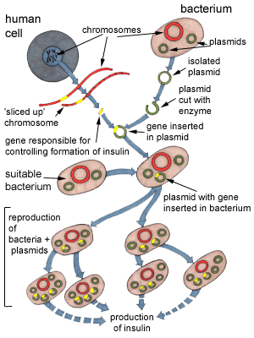
GENETIC ENGINEERING
An example of this is the gene for human insulin inserted into a bacterium. This is how human insulin is mass produced.

Slide 12
BENEFITS
Transgenic plants
help farmers grow crops more efficiently and with less impact on the environment.
Transgenic animals
widely used in medical research – as sources of medically valued proteins or pharmacologicals.
food animals are being altered to be more nutritious, disease resistant, or easier to raise.

Slide 13
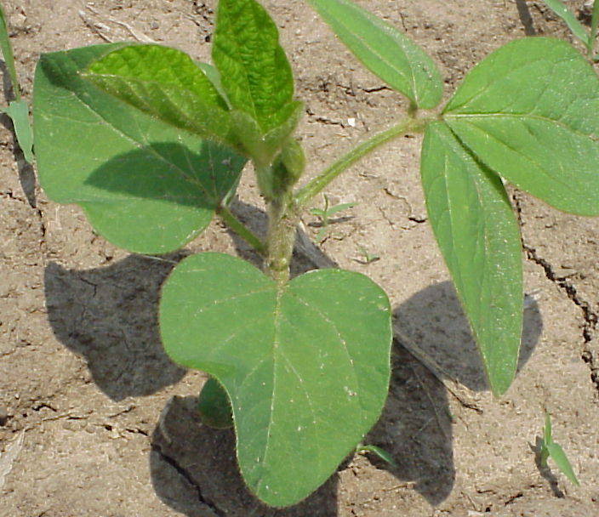
HERBICIDE RESISTANT CROPS
+ CP4 EPSPS = Roundup
gene Ready
Soybeans: Roundup Ready
Corn: Roundup Ready, Liberty Link
Cotton: BXN, Roundup Ready
Canola: Liberty Link, Roundup Ready

Slide 14
BENEFITS
Insulin (1982)
  First commercial biotech product
  Reliable, inexpensive source of insulin
Rice
  Enriched with beta-carotene and iron
Bananas
  Containing edible hepatitis vaccine

Slide 15
BENEFITS
Potatoes
  Higher solid content
Garlic
  Lowers cholestrol
Tomatoes (1994)
  Flavr Savr brand had delayed ripening

Slide 16
BENEFITS
Goats
  Produce the CFTR protein for cystic fibrosis patients.
  Produce TPA protein to counter heart attacks.
Cows
  Resistant to mad cow’s disease
Mice
  Many different varieties with a host of DNA expressions.

Slide 17
ENVIRONMENTAL BENEFITS
Reduced pesticide and herbicide use.
Lower energy requirements.
Cleaner water.
Less soil erosion.

Slide 18
QUESTIONS
Should GM food should be labeled?
What is the the role of government regulators?
What are the effects on health, the environment, pesticide resistance, farmers and on global food supplies.

Slide 19
QUESTIONS
Will the conventional food supply become contaminated?
Is the regulatory process rigorous enough?
Is there too much control of the food supply by GM seed companies?

Slide 20
TO DO
Do Section H.
Works on any of the webquests from Sections D, F, or G on the laptops.

