Slide 1
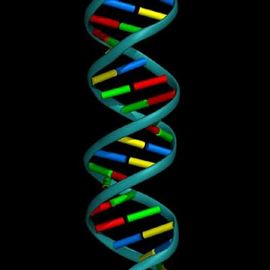
DNA
The Genetic Material

Slide 2
SECTION D
Spitting DNA - DNA extraction from your cells
DNA is found in the nucleus of your cells and is only about 50 trillionths of an inch long. The reason it can be seen in this activity is because you are releasing DNA from a number of cells. One strand of DNA is so thin you would never be able to see it without using a microscope.

Slide 3
SECTION D
What are you doing to your DNA?
The “secret cell lysis” solution is used to lyse or break open the cell membrane and nuclear membrane. The enzyme in meat tenderizer releases the DNA from the proteins it’s wrapped around. The alcohol causes the DNA to precipitate or settle out of the solution.

Slide 4
SECTION D
Materials:
“secret cell lysis” solution (15 g salt, 1000 water & 100 ml clear shampoo)
test tubes
Alcohol
meat tenderizer
graduated cylinder
pipettes

Slide 5
SECTION D
Procedure:
Swish water in your mouth and spit in your tube. Make sure you scrap your teeth on your cheeks while swishing.
Add 3 mL of the “secret cell lysis” solution to your tube.
Add a pinch of meat tenderizer to your tube. Put the lid on your tube and gently flip the tube once to mix contents. Wait 5 minutes. (Work on Section B.)
Slowly add 3 ml of isopropyl alcohol to your tube. Put the lid on your tube. Hold your tube still and watch. Look for clumps of white stringy stuff. This is your DNA!

Slide 6
SECTION D
Clean-up
Rinse graduated cylinder twice and set on paper towel to dry.
Pour DNA solution down drain. Rinse tube and dry, setting on paper towel with graduated cylinder.
Rinse pipet as you were shown and place it on the paper towel.

Slide 7
INTRODUCTION
Chromosomes are found in the nucleus of eukaryotic cells.
Chromosomes are composed of DNA and protein.
DNA stands for Deoxyribonucleic acid.
Experiments in the 1940s and 1950s showed DNA to be the genetic material.

Slide 8
THE HISTORY OF DNA
In 1928, Frederick Griffith was trying to prepare a vaccine against a pneumonia-causing bacterium Streptococcus pneumoniae (S. pneumoniae).
Two strains of Streptococcus:
1) S strain = smooth (surrounded by a capsule and causes deadly pneumonia).
2) R strain = rough (no capsule & does not produce pneumonia in mice).

Slide 9
GRIFFITH’S EXPERIMENT
Experiment:
1) Mice injected with S strain die.
2) Mice injected with R-strain live.
3) Mice injected with heat-killed S strain live.
4) Mice injected with heat-killed S strain & live R strain die.
Why?
Griffith had discovered what is now called transformation.

Slide 10
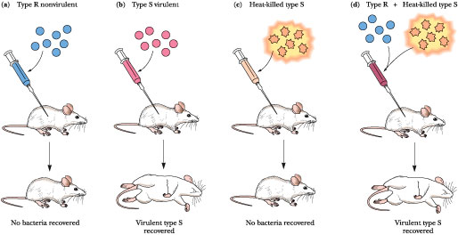

Slide 11
THE PROOF DNA IS THE
GENETIC MATERIAL
The first evidence that DNA was the genetic material came in 1944 from the research of Oswald Avery, Colin Macleod, and Maclyn McCarty.
The researchers removed the DNA from the S strain of bacteria and placed it in the R strain.
The DNA of the S strain took over the DNA of the R strain.
The R strain now produced capsules and caused pneumonia.
Transformation had taken place.

Slide 12
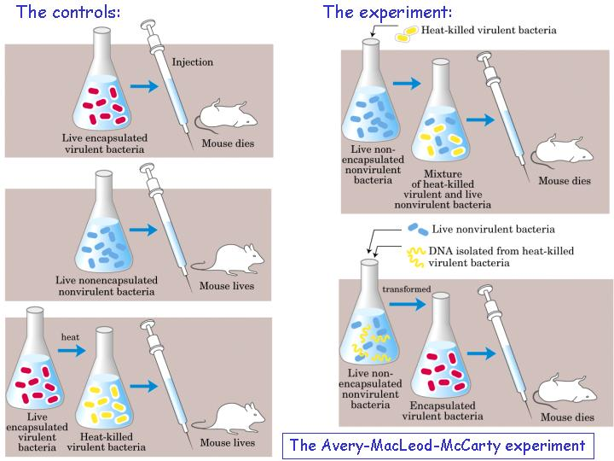

Slide 13
VIRUSES REVEAL DNA’S ROLE
In 1952, scientists Alfred Hershey and Martha Chase conducted experiments that supported Avery’s findings.
Their experiments used bacteriophages, viruses that invade bacteria, and radioactive nutrients.
They were able to show that the DNA of the viruses took over the DNA of the bacteria and caused it to reproduce viruses.

Slide 14
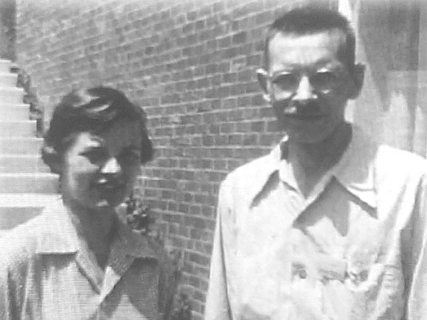
CHASE AND HERSHEY

Slide 15
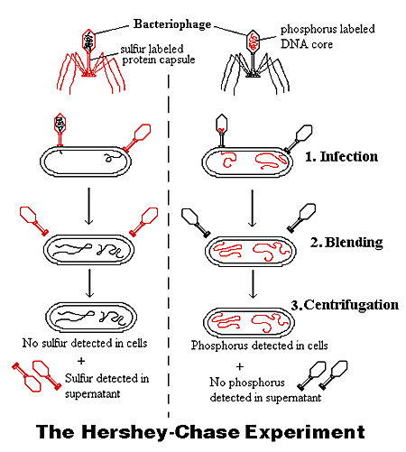

Slide 16
DISCOVERING THE STRUCTURE OF DNA
In 1953, major breakthrough in genetic research, James D. Watson and Francis H. Crick discovered the structure of DNA.
Watson & Crick unified existing information on DNA and figured out the puzzle of its structure.
They determined DNA to be double helix, a spiral staircase or twisted ladder.

Slide 17
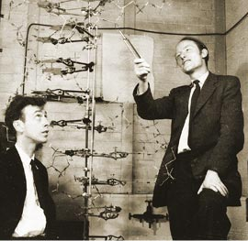
WATSON AND CRICK

Slide 18
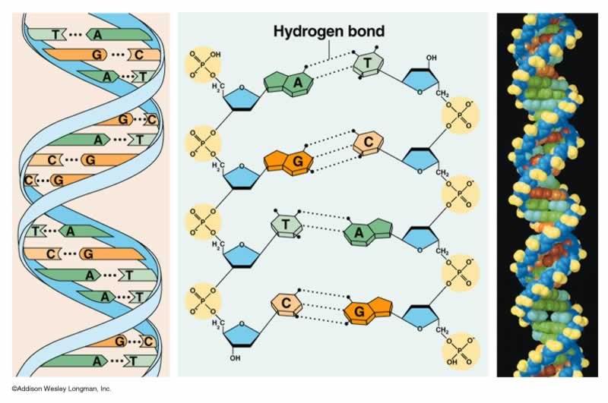
DNA STRUCTURE

Slide 19
SCIENTIFIC CONTRIBUTIONS
In 1920s, Phoebus A. Levene, an American biochemist, discovered DNA was a nucleic acid composed of monomers called nucleotides.
Each nucleotide consists of:
1. a phosphate group
2. a five carbon sugar (deoxyribose)
3. a nitrogenous base (adenine, thymine, guanine, cytosine)

Slide 20
Nucleotides
O -P O
O
ATP
One deoxyribose together with its phosphate and base make a nucleotide.
O
O -P O
O
O
O -P O
O
O
Nitrogenous
base
C
O
Phosphate
C
C
Look familiar?
C
C
Deoxyribose
O
ribose
Notes:
{Ask students where they have seen a similar molecule before in this class.
Answer: ATP . Emphasize that nucleotides are the basic building blocks or units of a DNA molecule and that a single molecule has many millions of nucleotides.}

Slide 21
DNA STRUCTURE
phosphate
The backbone of the molecule is alternating phosphates and deoxyribose sugar
The teeth are nitrogenous bases.
deoxyribose
bases
Notes:
{Point to the 3-D mode, if you have one, to show the parts as you discuss them.}

Slide 22
DNA STRUCTURE
nucleotide
One strand of DNA is a polymer of nucleotides.
One strand of DNA has many millions of nucleotides.
Notes:
{Point to the 3-D mode, if you have one, to show the parts as you discuss them.}

Slide 23
DNA STRUCTURE
Remember, DNA has two strands that fit together something like a zipper.
The teeth are the nitrogenous bases but why do they stick together?
Notes:
{Point to the 3-D model to show the parts as you discuss them.}

Slide 24
HYDROGEN BONDS
Hydrogen bonds are found between the bases.
Hydrogen bonds are weak but there are millions and millions of them in a single molecule of DNA.
G-C has three bonds. The bonds between cytosine and guanine are shown here with dotted lines.
O
N
C
N
C
C
N
N
C
N
C
N
C
N
O
C
C
N
C

Slide 25
HYDROGEN BONDS
When making hydrogen bonds, cytosine always pairs up with guanine.
Adenine always pairs up with thymine.
A-T has two bonds. Adenine is bonded to thymine here.
O
N
C
O
C
C
C
N
N
C
N
C
C
C
N
N
C
N
C

Slide 26
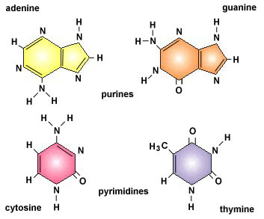
NUCLEOTIDES

Slide 27
NUCLEOTIDES
There are two types of bases.
Pyrimidines are single ring bases.
Purines are double ring bases.
N
N
C
O
C
C
N
C
N
N
C
C
C
N
N
C
N
C

Slide 28
Thymine and Cytosine are pyrimidines
Thymine and cytosine each have one ring of carbon and nitrogen atoms.
N
O
N
N
C
C
O
C
C
O
C
C
C
N
C
N
C
thymine
cytosine

Slide 29
Adenine and Guanine are purines
Adenine and guanine each have two rings of carbon and nitrogen atoms.
N
O
N
C
N
C
C
C
N
C
C
N
N
N
C
N
C
Guanine
C
Adenine
C
N
N

Slide 30
MORE SCIENTIFIC CONTRIBUTIONS
In 1949, Erwin Chargaff analyzed the amounts of the four nucleotides found in DNA and noticed a pattern.
The amount of A-T was the same & G-C was the same.
From this, the base-pair rule was formed.
So, (A=T) & (C≡G). Remember!!
Shows # hydrogen bonds between bases.
The structure and size of each base allows only these pairings.

Slide 31
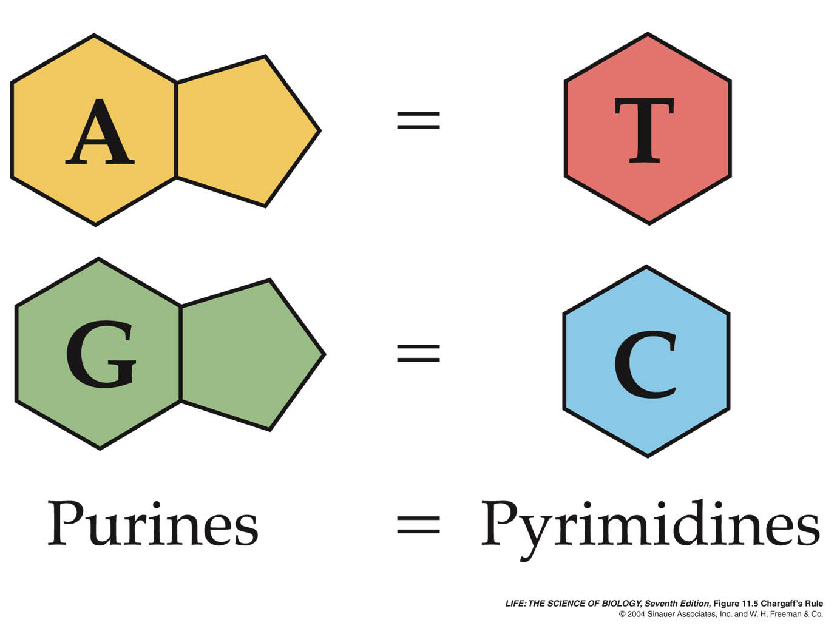
CHARGAFF’S RULE

Slide 32
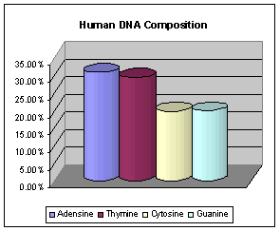
HUMAN DNA COMPOSITION

Slide 33
SCIENTIFIC CONTRIBUTION
In 1952, Rosalind Franklin and Maurice Wilkins spent time taking X-ray diffraction pictures of the DNA molecule in an attempt to determine the shape of the DNA.

Slide 34
EVEN MORE
SCIENTIFIC CONTRIBUTIONS
Finally in 1953, Watson & Crick had the images of DNA produced by Wilkins and Franklin.
The images indicated that DNA was a double helix or a “spiral staircase.”
The process used to produce the image was X-ray diffraction or X-ray crystallography.

Slide 35
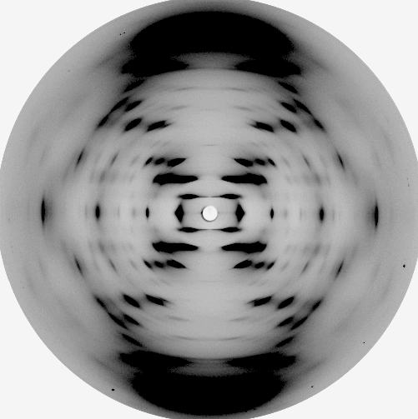
Rosalind Franklin’s x-ray crystallography of DNA

Slide 36
EVEN MORE
SCIENTIFIC CONTRIBUTIONS
Watson and Crick are credited with finally piecing together all the information previously gathered on the molecule of DNA. They established the structure as a double helix. The sugar and phosphates make up the "backbone" of the DNA molecule.

Slide 37
THE WORK OF MANY SCIENTISTS
1869, Friedrich Meischer, German Scientist, isolated a substance from the cell nucleus and called it nucleic acid (DNA).
1912, Lawrence Bragg, British physicist, discovered how to use X-rays to reveal crystal structures.
1914, Robert Feulgen, German scientist, discovered DNA could be stained inside a cell with a red dye, fuschin. This helped scientist learn that DNA is located in chromosomes.

Slide 38
THE STRUCTURE OF DNA
The sides of the DNA “ladder” are composed of alternating phosphate groups & sugar molecules.
The “rungs” on the ladder consist of pairs of nitrogenous bases. The bases are held together by weak hydrogen bonds.
The nitrogenous bases pair up in a specific pattern. Based on Chargaff’s chemical analysis, Watson & Crick reasoned that a purine & pyrimidine must always pair to make a rung the right width.
Two purines would produce a rung too wide.
Two pyrimidines would produce a rung too short.

Slide 39
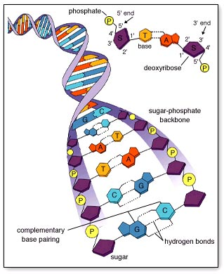
DNA STRUCTURE

Slide 40
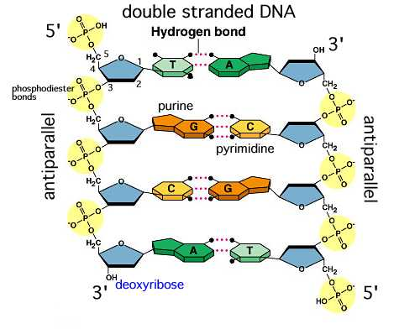
DNA STRUCTURE
Each side has an opposite orientation. One side as a free sugar (the 3' end) the other side has a free phosphate (the 5' end). This arrangement is called: ANTI-PARALLEL.

Slide 41
DNA STRUCTURE
How the code works:
The sequence of bases forms your genetic code.
Each individual has a unique sequence, but about 99.9% of your DNA is identical to one another.
Human DNA contains about 3 billion bases and about 20,000 genes (segments of DNA) on 23 pairs of chromosomes.
Gene size varies: 1,000 bases to 1 million bases in humans

Slide 42
REPLICATION OF DNA
New cells are produced through mitosis for growth & repair.
DNA makes a copy of itself during the S phase of interphase.
DNA replication occurs simultaneously.
The entire process occurs with great accuracy due to enzymes for “proofreading” and “repair.”

Slide 43
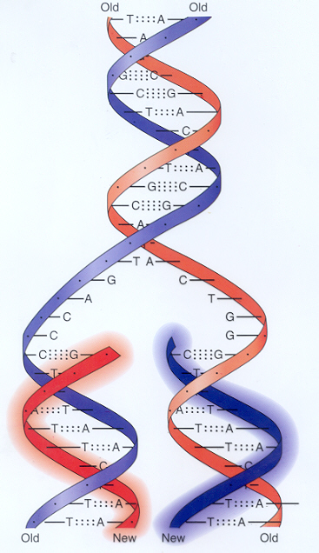

Slide 44
REPLICATION OF DNA
Parental strands of DNA separate serving as templates and produce DNA molecules that have one old and one new strand.
One at a time, nucleotides line up along the template strand according to the base-pairing rules.
The nucleotides are linked to form new strands.

Slide 45
REPLICATION OF DNA
The rate of elongation is about 500 nucleotides per second in bacteria and 50 per second in human cells.
It takes about 6-8 hours to replicate human DNA.

Slide 46
REPLICATION OF DNA
1) DNA helicase, an enzyme, unwinds and unzips the DNA strands at the replication fork. It breaks the hydrogen bonds separating the base pairs.
2) After the DNA unzips, the base pairs start bonding with free-floating nucleotides, forming hydrogen bonds. DNA polymerase adds the complementary nucleotides to the opposite strand traveling in opposite directions. It catalyzes the formation of sugar to phosphate bonds, connecting one nucleotide to another, resulting in a new DNA strand.
3) Enzymes proofread DNA and repair mistakes to the two strands of DNA.

Slide 47
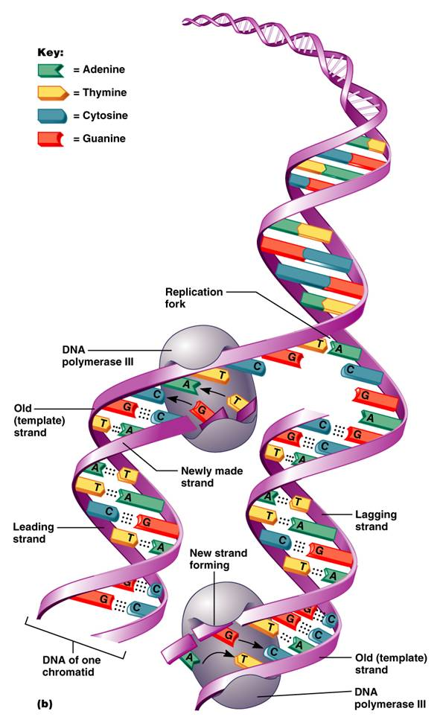
REPLICATION OF DNA
*** The result is two strands of DNA, each with an old strand and a new strand, that are complimentary to each other. That is, the sequence of bases on one strand determine the sequence of bases on the other strand.

Slide 48
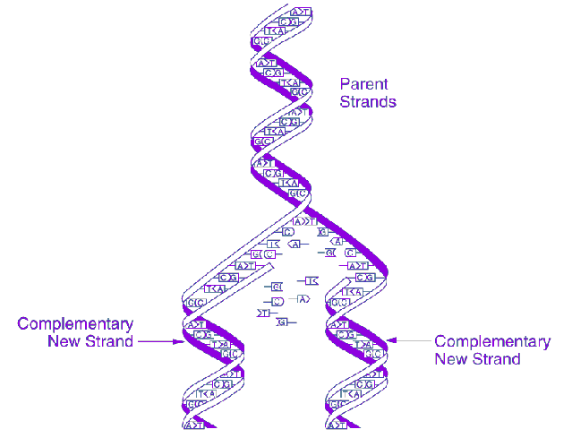

Slide 49
DNA REPLICATION
GCTCAG Original Strand
CGAGTC Complimentary Strand
DNA helicase unzips (unwinds)
Replication forks: two areas on either area of the DNA where the double helix separates
DNA polymerase adds nucleotides & “proofreads”
Two DNA molecules form that are identical to the original DNA molecules.
GCTCAG GCTCAG
CGAGTC CGAGTC

Slide 50
