Slide 1
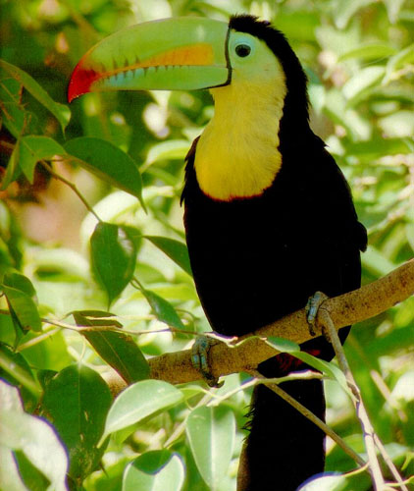
Ecology

Slide 2
WATCH
Populations Distribution

Slide 3
WORKSHEET
Go over Sections F, G, and H

Slide 4
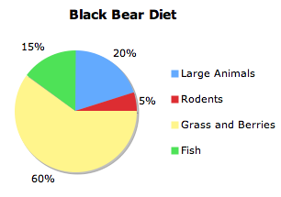
AFTER THE QUIZ
Work on Section I

Slide 5
DO NOW
Get out EOC Daily sheet, worksheet, and notes

Slide 6
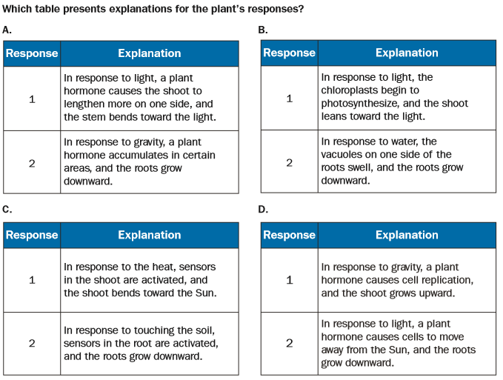
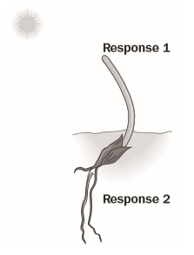
BIOLOGY EOC BIO47
The diagram below shows a plant’s response to stimuli.

Slide 7
BIOLOGY EOC BIO47
Correct answer is A
Phototropism is taking place which causes plants to grow toward the light by lengthening more on one side.
Geotropism is taking lace which causes the roots to grow towards the center of the Earth.

Slide 8
COMMUNITY ECOLOGY
REMINDERS
Habitat: the physical space where an organism lives.
Niche: an organism’s use of the biotic and abiotic resources in its ecosystem; its role in the ecosystem.

Slide 9
COMMUNITY ECOLOGY
Species interactions are based on whether each species causes benefit or harm to the other species in a given relationship.
Each interaction affects evolution, persistence of a species, and the overall diversity of life.
Organisms have evolved together and therefore adjusted to one another. An organism’s niche and habitat are important factors in these interactions.

Slide 10
COMMUNITY ECOLOGY
There is usually a keystone species – a species needed to maintain diversity; these are often the top predators.
A keystone species is a plant or animal that plays a unique and crucial role in the way an ecosystem functions.
Without keystone species, the ecosystem would be dramatically different or cease to exist altogether.

Slide 11
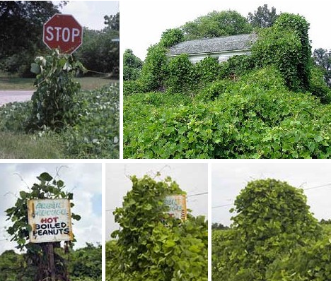
COMMUNITY ECOLOGY
There can also be invasive species – a species introduced into a habitat, often causes major disturbances and even extinction of native species.

Slide 12
COMMUNITY ECOLOGY
We will look at three interactions:
Competition
Predation
Symbiosis

Slide 13
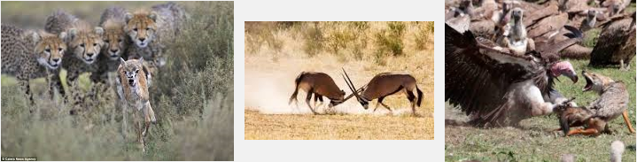
COMMUNITY ECOLOGY
Competition
A relationship in which different individuals or populations attempt to use the same limited resources.
Each individual has less access to the resource & is harmed by the competition.

Slide 14
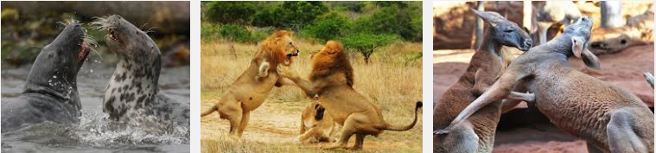
COMMUNITY ECOLOGY
Members of the same species must compete with each other because they require the same resource – they occupy the same niche. When members of different species compete, their niches overlap, which means that both species use some of the same resources in a habitat.

Slide 15
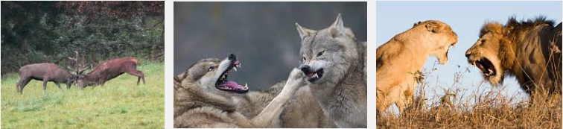
COMMUNITY ECOLOGY
Competitive Exclusive Principle - Two species that have exactly the same requirements cannot coexist in exactly the same habitat. Otherwise, competition will occur.

Slide 16
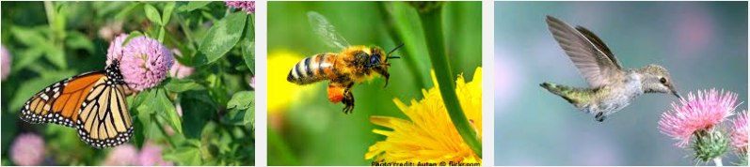
COMMUNITY ECOLOGY
Indirect competition – Species compete even if they never come into direct contact with each other. (i.e. Insects feeding on same plant at different times.)

Slide 17
COMMUNITY ECOLOGY
Predation
The act of one organism (predator) feeding on another organism (prey).
Most organisms are vulnerable to predation, so there are strong selective pressures for adaptations that serve as defenses against predators.
Adaptations that can enhance survival of prey include camouflage, warning coloration, mimicry and protective covering.

Slide 18
COMMUNITY ECOLOGY
Some predators eat only specific types of prey. In this close relationship, the sizes of each population tend to increase and decrease in linked patterns.
However, many predators will feed on whichever type of prey is easiest to capture.

Slide 19
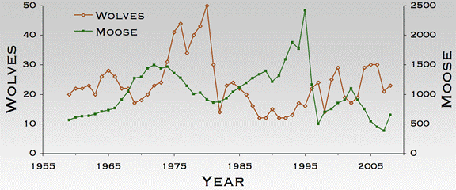
COMMUNITY ECOLOGY
Predator: Wolf Prey: Moose

Slide 20
COMMUNITY ECOLOGY
Symbiosis
A relationship in which two species live in close association.
These species may evolve adaptations that reduce the harm or improve the benefit of the relationship.

Slide 21
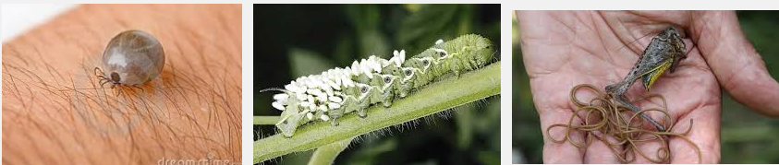
COMMUNITY ECOLOGY
Parasitism – An organism that lives in or on another organism (host) and feeds on it. Parasites usually do not kill their hosts, but weakens or develops a disease.

Slide 22
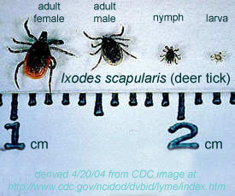
COMMUNITY ECOLOGY
Parasitism

Slide 23
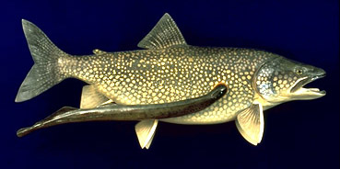
COMMUNITY ECOLOGY
Parasitism
Ex. lampreys,
leeches, fleas,
ticks, tapeworm

Slide 24
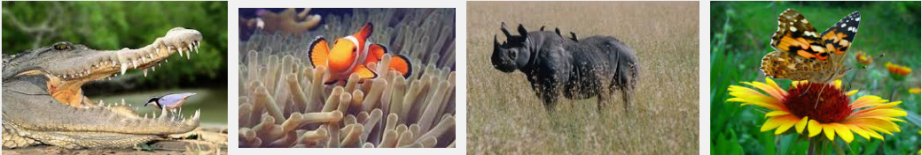
COMMUNITY ECOLOGY
Mutualism – Two species provide a benefit and depend on each other for survival.

Slide 25
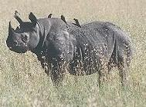
COMMUNITY ECOLOGY
Mutualism
Example:
cleaning birds
Notes:
The Egyptian plover takes insects from the backs of buffaloes, giraffes and rhinos. The plover has also been observed taking leeches from the open mouths of crocodiles! In this association the plover receives a supply of food and the other animal rids itself of unwelcome pests

Slide 26
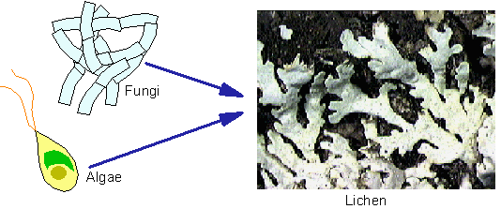
SYMBIOTIC RELATIONSHIPS
Mutualism
Ex. Lichen (fungi & photosynthetic partner, green algae or cyanobacteria)
Notes:
The Egyptian plover takes insects from the backs of buffaloes, giraffes and rhinos. The plover has also been observed taking leeches from the open mouths of crocodiles! In this association the plover receives a supply of food and the other animal rids itself of unwelcome pests

Slide 27
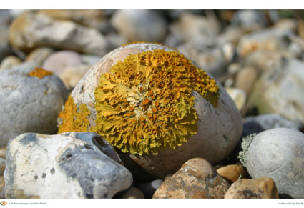
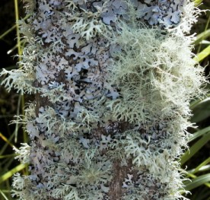
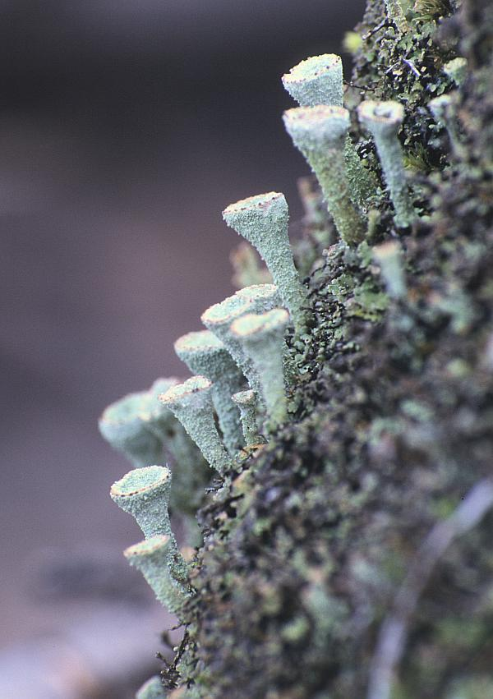
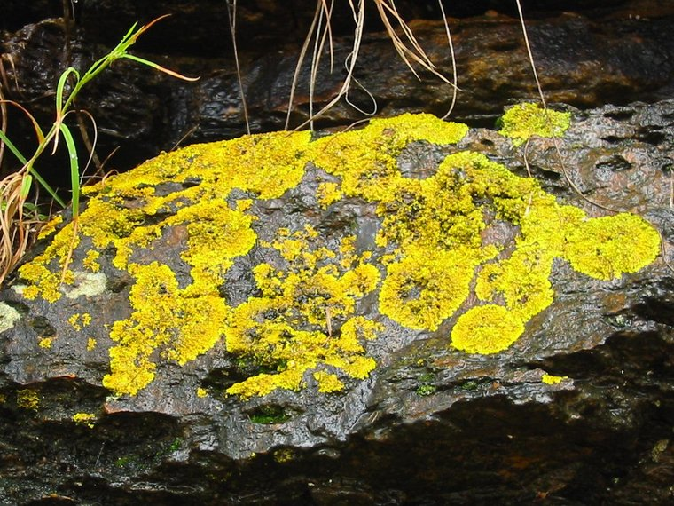

Slide 28
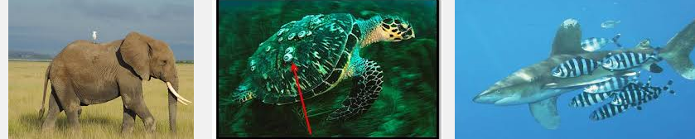
COMMUNITY ECOLOGY
Commensalism – A relationship in which one species benefits and the other species is neither harmed nor helped.

Slide 29
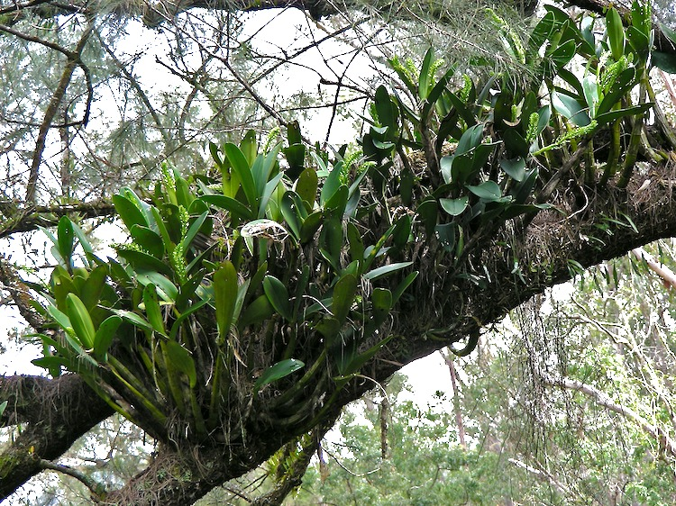
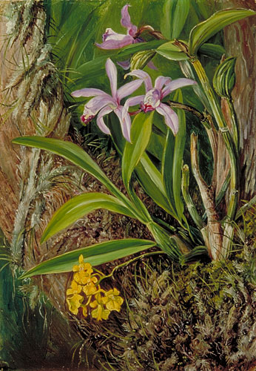
COMMUNITY ECOLOGY
Commensalism
Example:
orchids on a tree
Epiphytes: A plant, such as a tropical orchid or a bromeliad, that grows on another plant upon which it depends for mechanical support but not for nutrients. Also called xerophyte, air plant.

Slide 30
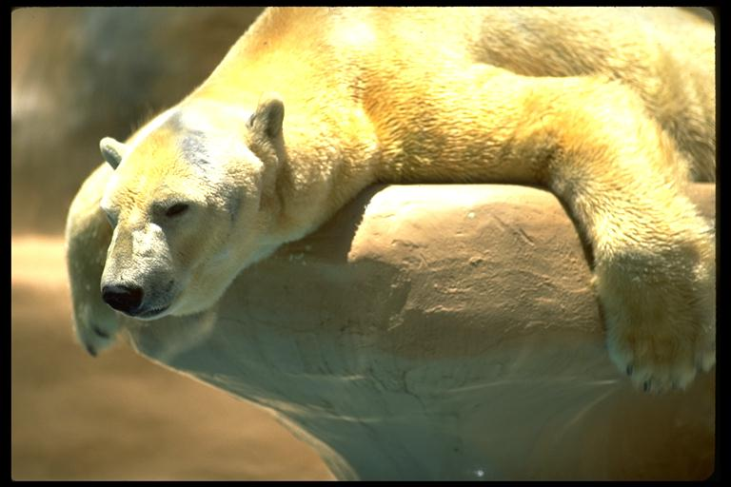
COMMUNITY ECOLOGY
Commensalism-
Example: polar bears and cyanobacteria (fur color has a yellow or green tint)
Notes:
You can see here that this polar bear is no longer white.

Slide 31
COMMUNITY ECOLOGY
Type of relationship | Species harmed | Species benefits | Species neutral
Commensalism
Parasitism
Mutualism
= 1 species

Slide 32
COMMUNITY ECOLOGY
Animal Partnerships

