Slide 1
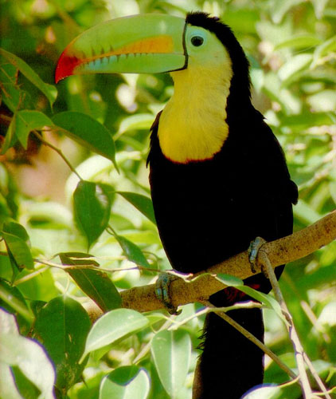
Ecology

Slide 2

CHANGES IN ECOSYSTEMS:
ECOLOGICAL SUCCESSION

Slide 3
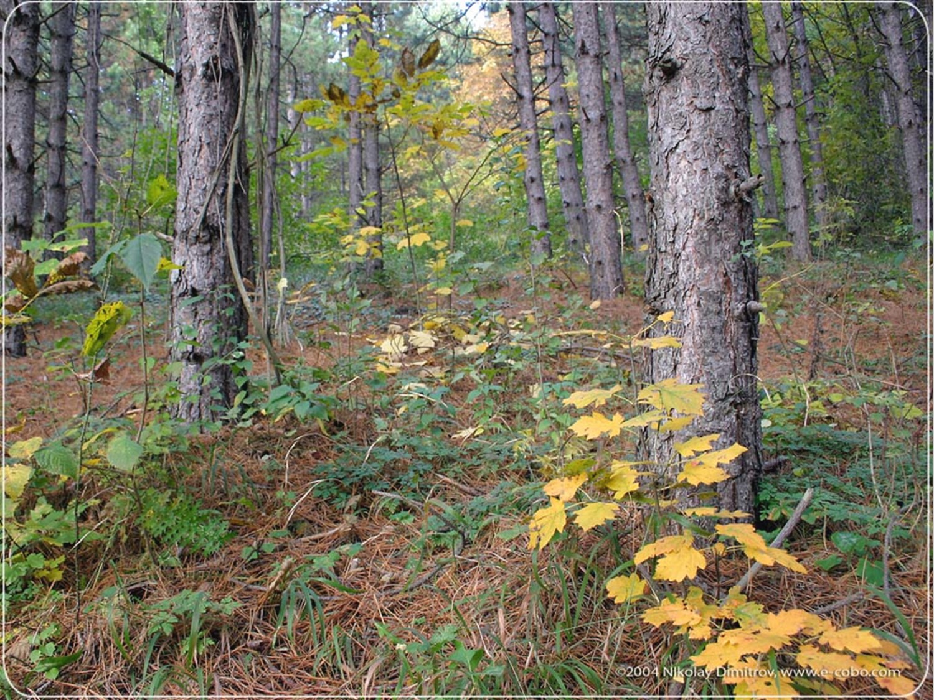
CHANGES IN ECOSYSTEMS
Ecological succession is a gradual process of change and replacement of some or all of the species in a community.
Ecological succession may take hundreds or thousands of years.

Slide 4
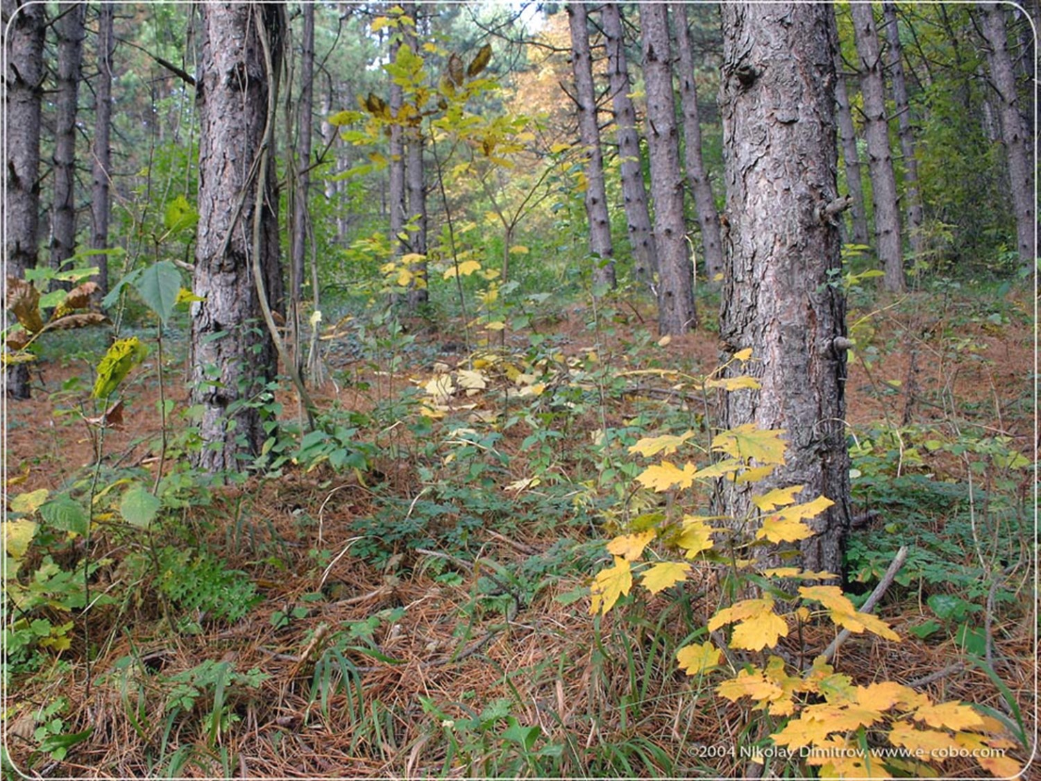
CHANGES IN ECOSYSTEMS
Each new community that arises makes it harder for the previous community to survive, because of competition for resources.
Succession provides opportunities for new resources and niches to become available for the next community.

Slide 5
SUCCESSION
DEFINITION:
Natural, gradual changes in the types of species that live in an area; can be primary or secondary .
The gradual replacement of one plant community by another through natural processes over time.

Slide 6
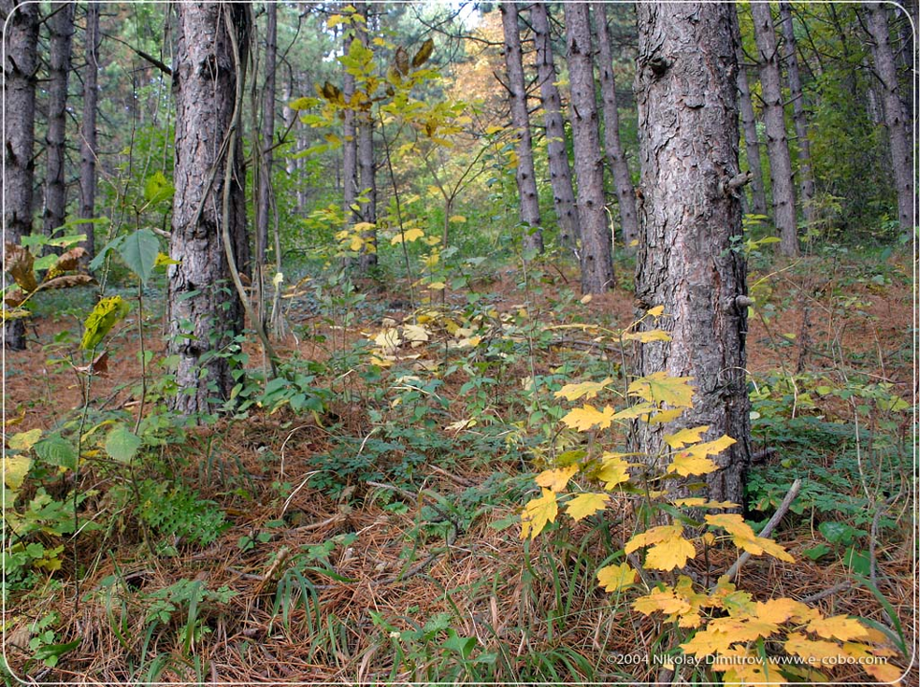
PRIMARY SUCCESSION
  The initial establishment and development of an ecosystem.
  Begins in a place without any soil and no previous life exists.
  Starts with the arrival of living things such as lichen, moss or bacteria that do not need soil to survive.
  These first organisms are called pioneer species.

Slide 7
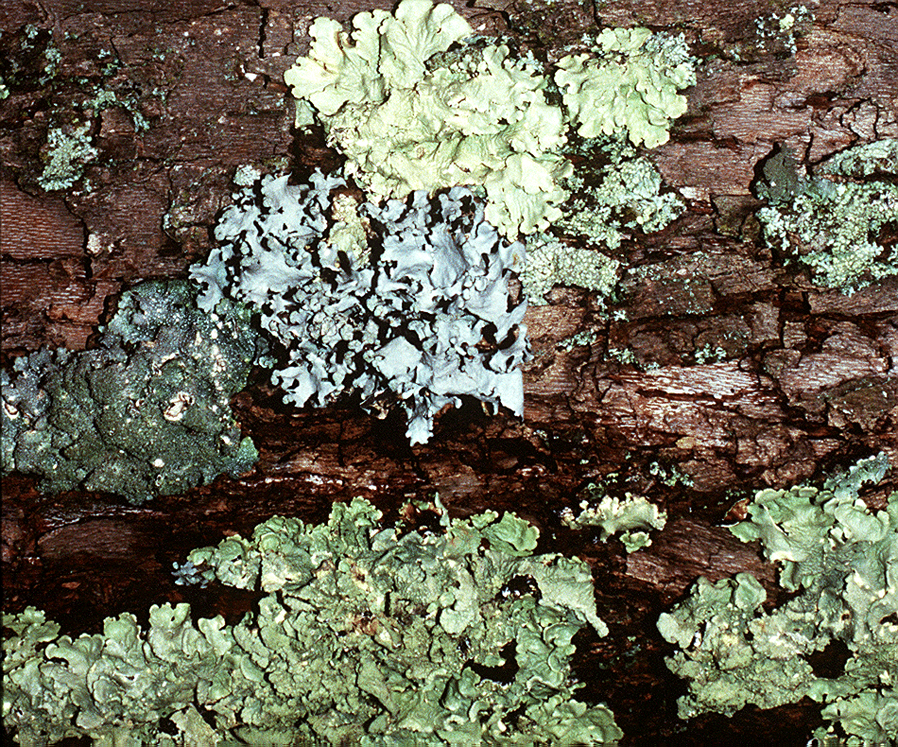
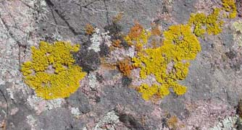
PIONEER SPECIES
http://botit.botany.wisc.edu
http://www.saguaro-juniper.com/

Slide 8
PRIMARY SUCCESSION
  Soil starts to form as pioneer species and the forces of weather and erosion help break down rocks into smaller pieces.
  Pioneer species decompose and add small amounts of organic matter to the rock to make soil.
  Simple plants like mosses and ferns grow in the new soil.
  When these plants decompose, it adds more organic material.

Slide 9
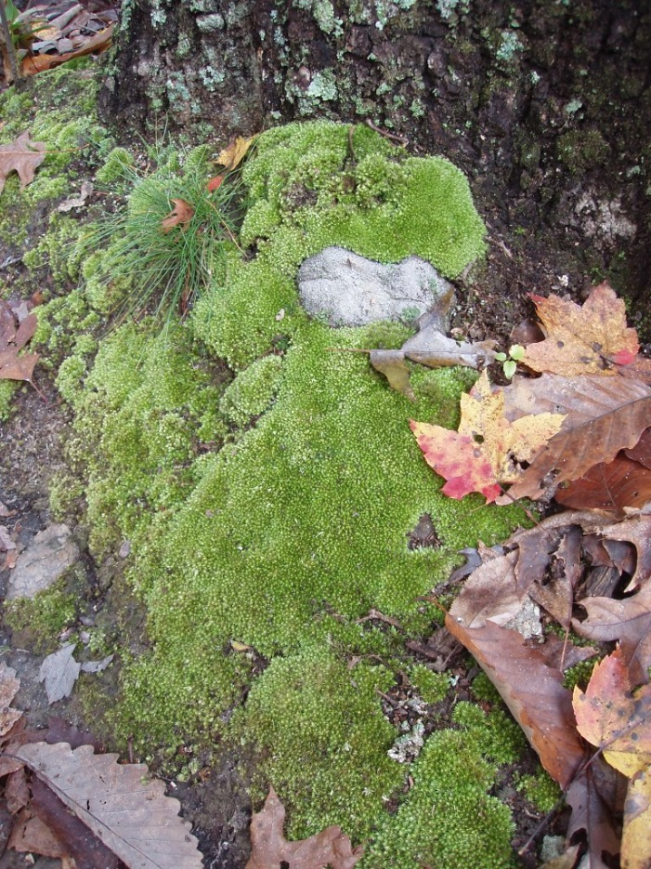
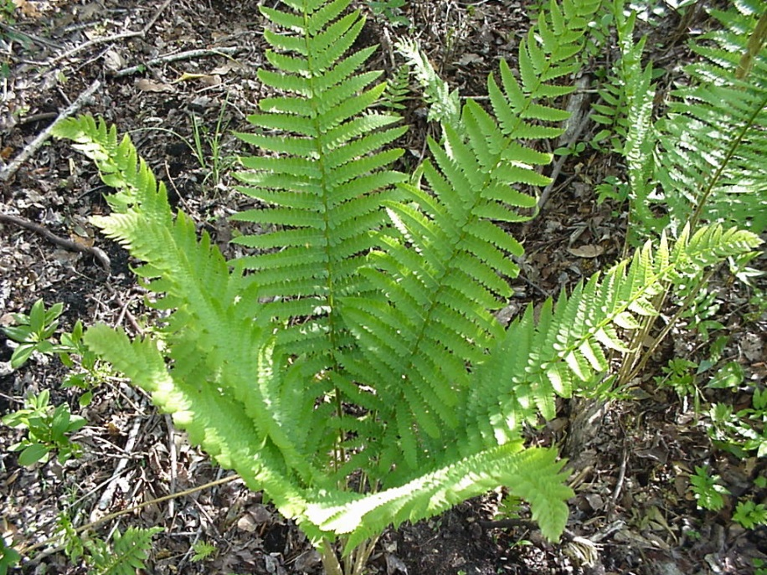
PRIMARY SUCCESSION
Simple plants like mosses and ferns can grow in the new soil
http://www.uncw.edu
http://uisstc.georgetown.edu

Slide 10
PRIMARY SUCCESSION
The soil layer thickens and other plants begin to take over.
These plants die, and they add more nutrients to the soil.
Shrubs and trees can survive now.

Slide 11
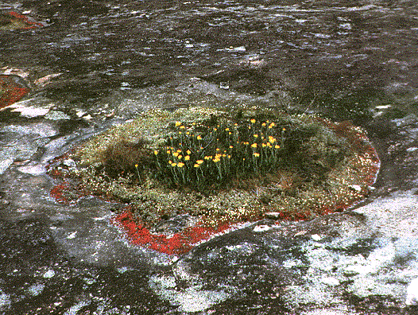
http://www.life.uiuc.edu

Slide 12
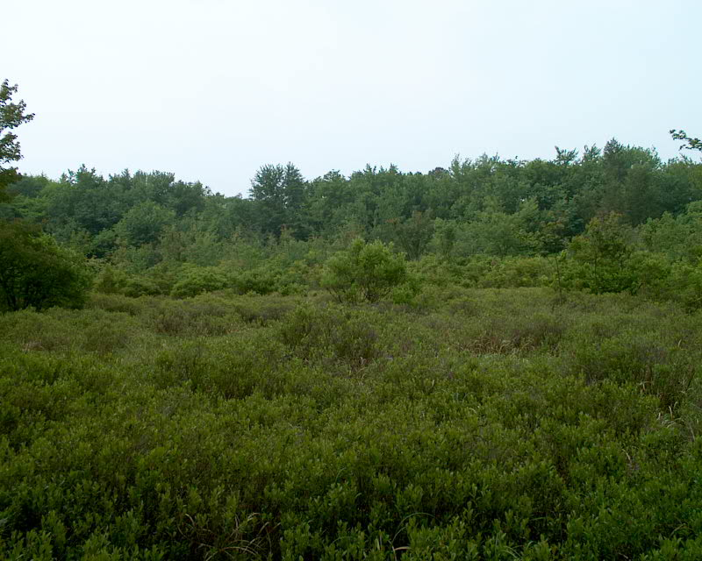
PRIMARY SUCCESSION
The soil layer thickens and other plants begin to take over.
These plants die, and they add more nutrients to the soil
Shrubs and trees can survive now
http://www.rowan.edu

Slide 13
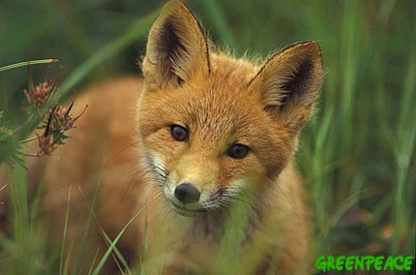
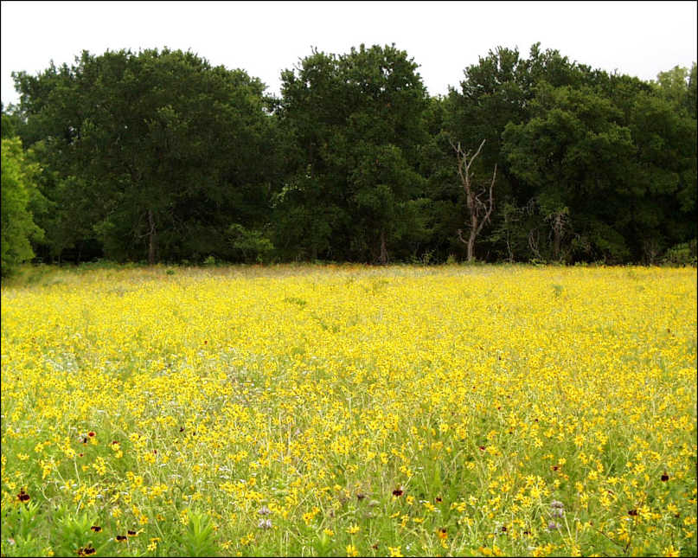
PRIMARY SUCCESSION
Insects, small birds, and mammals have begun to move in. What was once bare rock now supports a variety of life.
http://www.cwrl.utexas.edu

Slide 14
PRIMARY SUCCESSION
Primary succession can occur on new islands created by volcanic eruptions, in areas exposed when a glacier retreats, sand dunes or any other surface that has not previously supported life.
Slow process because it begins with no soil.

Slide 15
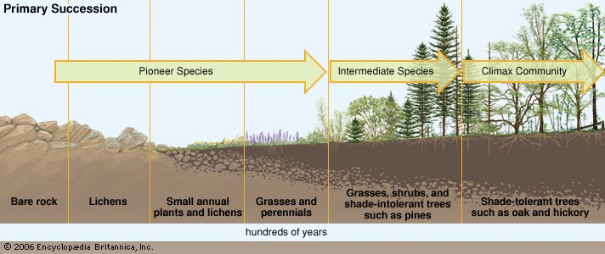
PRIMARY SUCCESSION
Climax Community is composed of species best adapted to conditions in an area and has reached equilibrium. The ecosystem is established and changes are slow.

Slide 16
CLIMAX COMMUNITY
A stable group of plants and animals that is the end result of the succession process
Does not always mean big trees
  Grasses in prairies
  Cacti in deserts

Slide 17
SECONDARY SUCCESSION
Secondary Succession
The reestablishment of an ecosystem that contains soil and vegetation of a previous biological community.
Ecosystems have been disturbed or disrupted by humans or animals, or by natural processes such as storms, floods, fires, earthquakes, etc.

Slide 18
SECONDARY SUCCESSION
Secondary Succession
These disturbances open up opportunities for new niches to be established during the rebuilding of the area.
The soil remains and the process is faster than primary succession.

Slide 19
SECONDARY SUCCESSION
BIG DIFFERENCE
Begins in a place that already has soil and was once the home of living organisms .
Occurs faster and has different pioneer species than primary succession.
Example: after forest fires

Slide 20
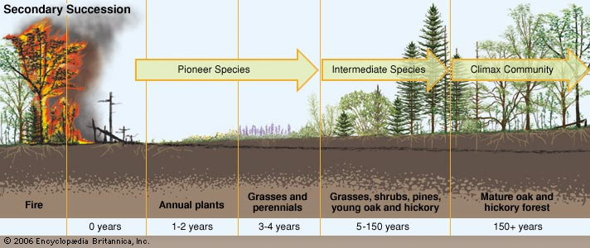
SECONDARY SUCCESSION
Stage of Primary Succession

