Slide 1
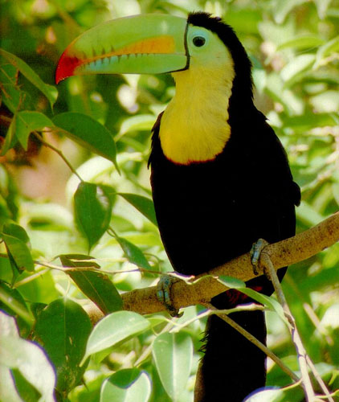
Ecology

Slide 2
WATCH
The Wolves and Moose of Isle Royale

Slide 3
TO DO
Now look at Section A of your worksheet. Answer the two questions..

Slide 4
WHAT IS ECOLOGY?
Ecology- the scientific study of interactions between organisms with one another and with their environments.
Ecology is a science of relationships.
Notes:
What do you think about when I say ecology? Recycling? Acid rain?

Slide 5
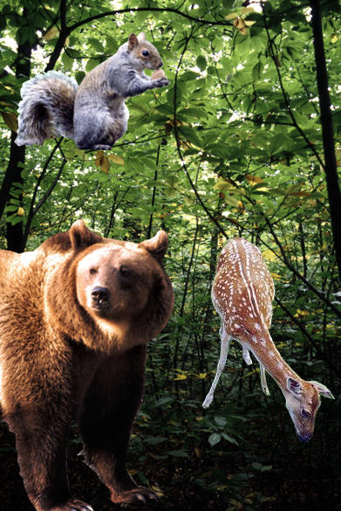
WHAT DO YOU MEAN BY ENVIRONMENT?
The environment is composed of two factors:
Biotic factors - are the living and once living parts of an environment (plants, animals, dead organisms).
Abiotic factors- are the nonliving parts of the environment (i.e. air, water, rocks, sand, light, and temperature).
Notes:
When I say environment you think what—weather. Well Ok but it it much more than that

Slide 6
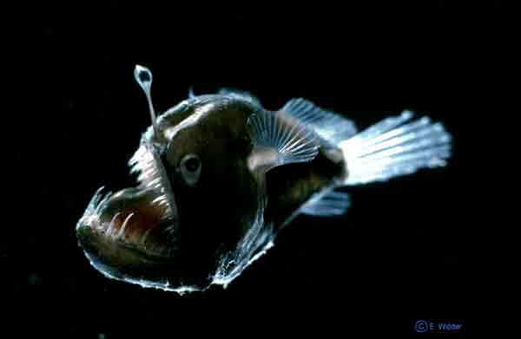
ABIOTIC OR BIOTIC?
Biotic

Slide 7
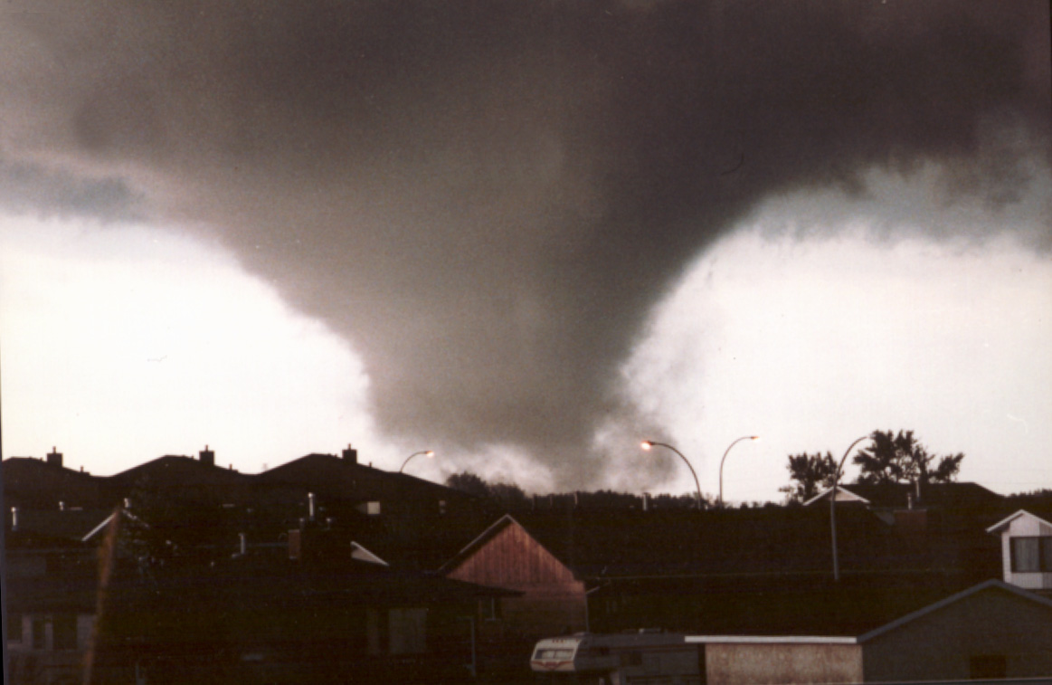
ABIOTIC OR BIOTIC?
Abiotic

Slide 8

ABIOTIC OR BIOTIC?
Abiotic

Slide 9
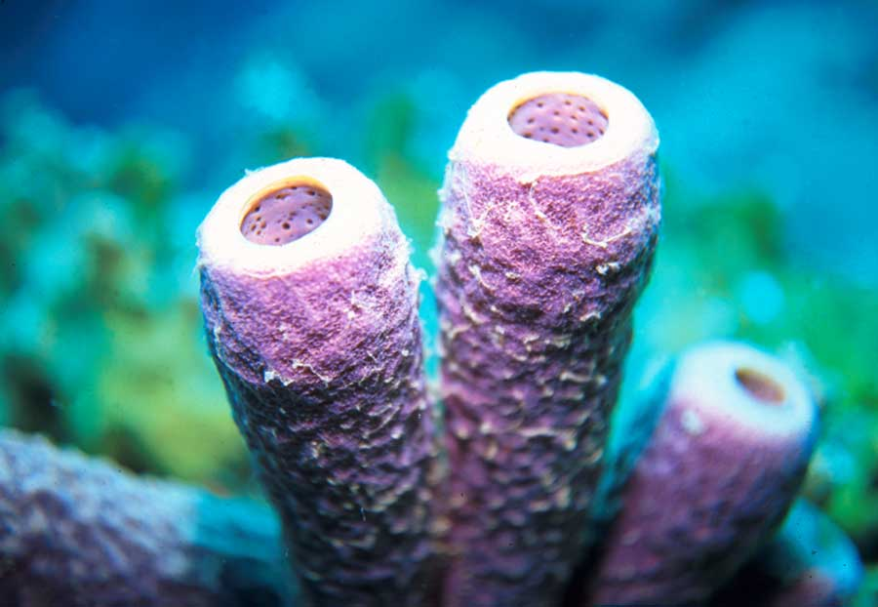
ABIOTIC OR BIOTIC?
Biotic

Slide 10
Biosphere
Biome
Ecosystem
Community
Population
Organism
Notes:
Just like with classification, ecology is hierarchal. Each level builds on itself and they fit together like nesting boxes.

Slide 11
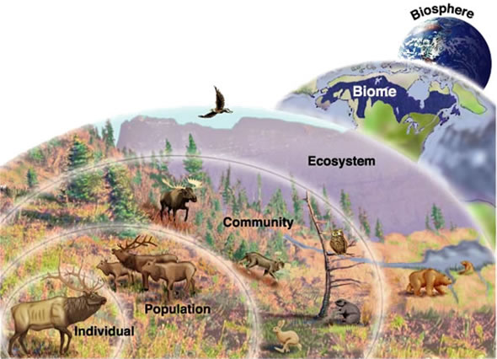

Slide 12
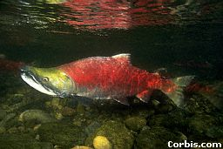
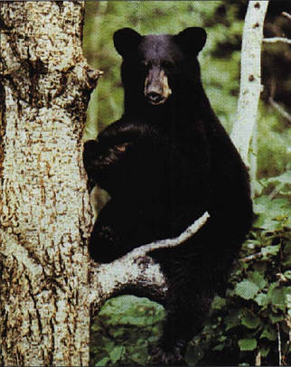
ORGANISM – an individual living thing. A species is a group of organisms that can mate to produce fertile offspring. Each organism is a member of a species.
The lowest level of organization.
Notes:
The lowest level is the individual. The organism. Here we see a salmon and a bear as examples of organisms. REMINDER: organisms die, species go extinct

Slide 13
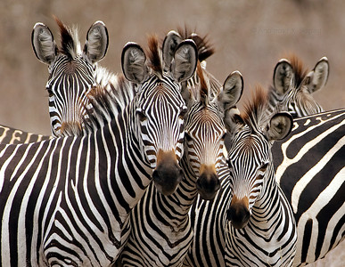
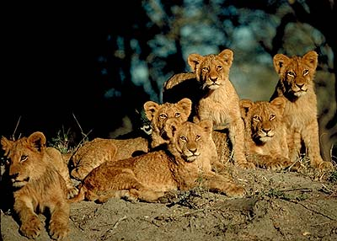
POPULATION
All members of the same species that LIVE in the same place at the same time.
Produce fertile offspring
Compete with each other for resources (food, mates, shelter, etc.)
Notes:
The next level is a population. A population consists of a single species living together and breeding. Give me an example of a population. Ex. large mouth bass living in Lake Meade. Beetles living under the same log. Here we have salmon spwning and two bears fishing.

Slide 14
COMMUNITY
A group of various species that live in the same place and interact with each other.
Several interacting populations that inhabit a common environment and are interdependent.
It is only made of biotic components.
Notes:
Next level is a community which is several populations living together and depending on each other. What does interdependent mean? An example of a community is shown here with the bear and the salmon. They both live in a common environment and the bear needs the fish for food? How does the salmon need the bear?

Slide 15
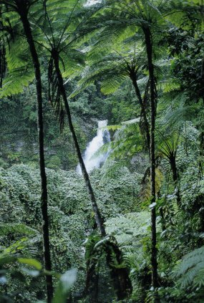
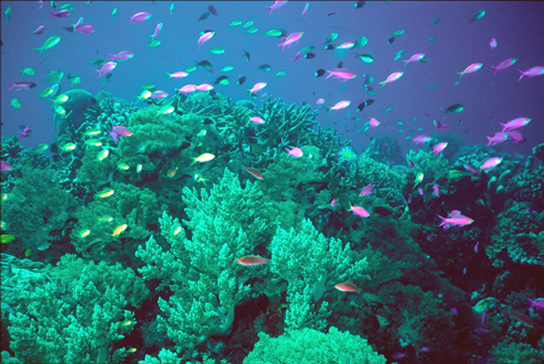
ECOSYSTEM
– all the organisms living in an area together with their physical environment.

Slide 16
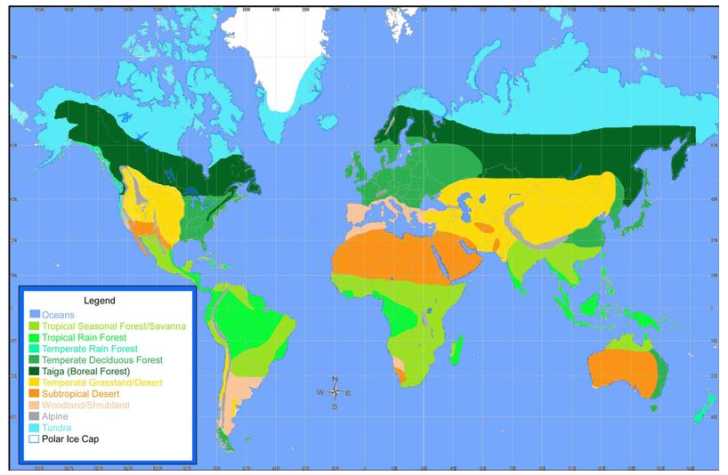
BIOME
Are large climatic regions that contain a number of smaller ecosystems. Biomes may exist in more than one location and are distinguished by plants and animals.

Slide 17
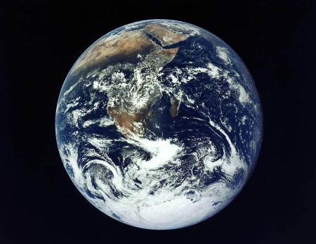
BIOSPHERE
The thin layer of Earth and the atmosphere that supports life.
The highest level of organization
Notes:
Lets review. Organisms make up populations, populations make up communities, communities and abiotic factors make up ecosystems, and all of the ecosystems make up the biosphere. From one to many and each depending on the other.

Slide 18
WATCH
Ecological Niches

Slide 19
HABITAT VS. NICHE
Habitat- the place in which an organism lives out its life
Niche - the role a species plays in a community; its total way of life
Notes:
Although several species may share a habitat they each have their own niche. A niche is a very narrow range where a species fits within a habitat.

Slide 20
HABITAT
All organisms live in particular place called habitats.
Every habitat has specific biotic and abiotic factors that the organism living there needs to survive.
Organisms tend to be very well suited to their natural habitats due to adaptations, inherited traits, which increase their chance of survival and reproduction.

Slide 21
HABITAT
Adaptations:
camouflage (blending in with surroundings)
mimicry (looking or sounding like another organism)
chemical defenses (venom, ink, sprays),
body parts (claws, beaks, armor plates)
unique methods of obtaining food, defending oneself, hibernation, migration, etc.

Slide 22
ECOLOGICAL NICHE
Ecological niche refers to the unique role a species has in its environment – how it meets its needs for food and shelter, how it survives, and how it reproduces.
A niche includes the species’ habitat, the environmental factors necessary for the species’ survival and all the species interactions with other organisms.

Slide 23
HABITAT VS. NICHE
A niche is determined by the tolerance limitations of an organism, or a limiting factor.
Limiting factor- any biotic or abiotic factor that restricts the existence of organisms in a specific environment.
Notes:
Although several species may share a habitat they each have their own niche. A niche is a very narrow range where a species fits within a habitat.

Slide 24
HABITAT VS. NICHE
Examples of limiting factors -
    Amount of water
    Amount of food
    Temperature
    Amount of space
    Availability of mates
Notes:
Although several species may share a habitat they each have their own niche. A niche is a very narrow range where a species fits within a habitat.

Slide 25
ECOLOGICAL NICHE
Example:
A tree frog in a Brazilian rainforest can only survive if temperatures and humidity stay within a certain range. It also needs access to a certain amount and type of food. It must avoid becoming food for predators.
The sum of these conditions is the frog’s niche.

