Slide 1
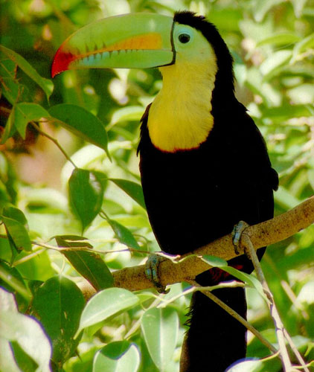
Ecology

Slide 2
TO DO
Go over Sections B and C.
Watch: Seven Billion

Slide 3
POPULATION ECOLOGY
Populations may be described in terms of size, density and dispersion.
These properties can be used to describe populations and to predict changes within them.
Population sizes can be determined by factors such as births, death, immigration and emigration.
rate = (b - d) + (i - e)

Slide 4
POPULATION ECOLOGY
Four variables influence/govern population size:
1. Births
2. Deaths
3. Immigration
4. Emigration.
Increase in population: birth and immigration.
Decrease in population: death and emigration.
rate = (b - d) + (i - e)

Slide 5

POPULATION ECOLOGY
Population density is a measurement of the number of individuals living in a specified habitat.
Environmental influences can alter population density and distribution, age structure and variations in population size.

Slide 6
POPULATION ECOLOGY
Population dispersion refers to the relative distribution of its individuals within an area. Dispersion can occur in patterns:
Clumped - individuals aggregate in patches; influenced by resource availability and behavior. Individuals “flock” together.
Uniform - individuals are evenly distributed; influenced by social interactions such as territoriality.

Slide 7
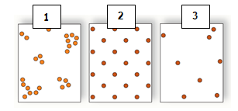
POPULATION ECOLOGY
3. Random - the position of each individual is independent of other individuals
Clumped
Uniform
Random

Slide 8
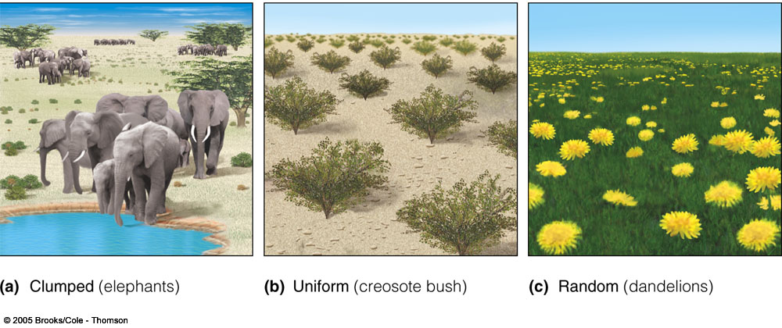
POPULATION ECOLOGY

Slide 9
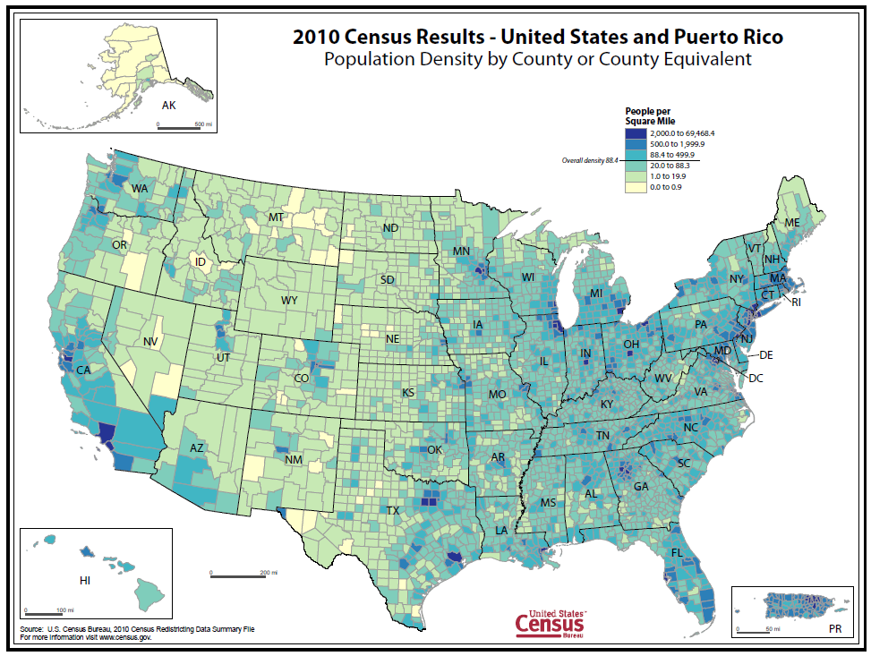

Slide 10
POPULATION ECOLOGY
Populations usually stay about the same size from year to year because various factors kill many individuals before they can reproduce.
A species’ biotic potential is the fastest rate at which its population can reproduce.
This rate is limited by an organism’s reproductive potential which is the maximum number of offspring that each member of the population can produce.

Slide 11
POPULATION ECOLOGY
Reproductive potential increases when individuals:
produce more offspring at a time
reproduce more often
reproduce earlier in life.

Slide 12
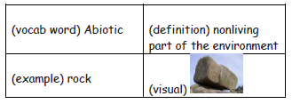
TO DO
Index cards for vocabulary words: organism, population, community, ecosystem, biome, niche, habitat.
Do Sections D and E

