Slide 1
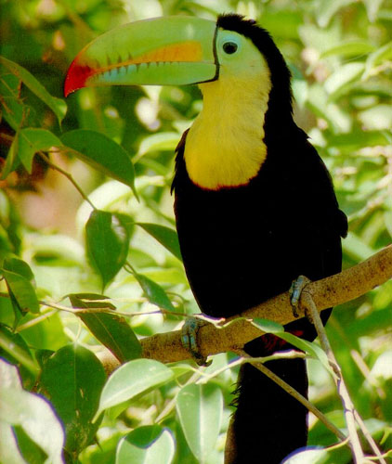
Ecology

Slide 2
WATCH
Go over test
7 Billion – are you typical?
Go over Sections D and E.

Slide 3
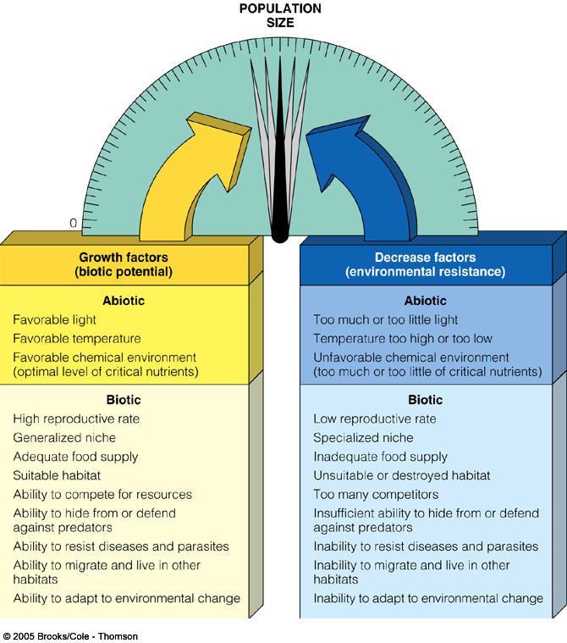
FACTORS AFFECTING POPULATION SIZE
Biotic Potential versus
Environmental Resistance
Fig. 9-3 p. 166

Slide 4
WATCH
Biological Carrying Capacity

Slide 5
POPULATION ECOLOGY
Population Growth Patterns:
Exponential growth
  occurs when populations have plenty of food, space and have little or no competition or predators.
  Populations rapidly increase due to an abundance of resources.
  There are UNLIMITED resources. (J-shaped curve)

Slide 6
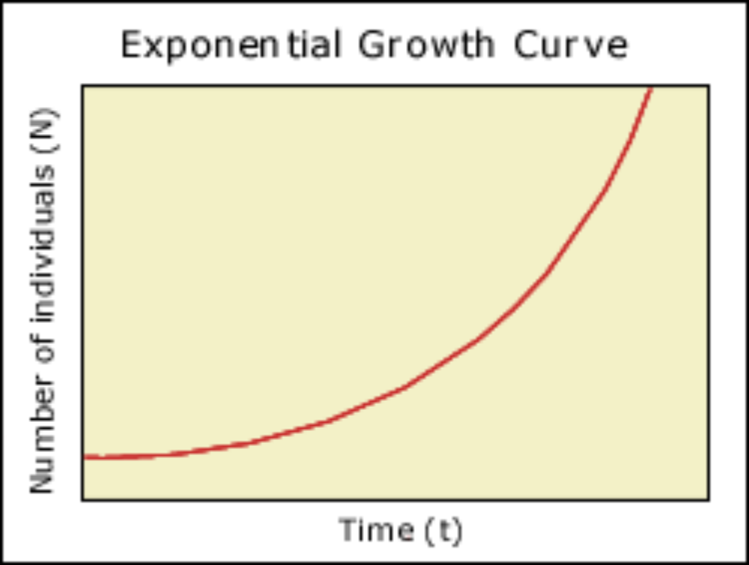
POPULATION ECOLOGY
Exponential Growth

Slide 7
POPULATION ECOLOGY
This growth is not sustainable – short lived in nature.
Natural conditions are neither ideal nor constant; populations cannot grow forever and rarely grow at their reproductive potential.
Resources are used up or the environment changes.

Slide 8
POPULATION ECOLOGY
Logistic growth
  populations are limited by environmental factors and tend to attain equilibrium in size which is determined by available resources. (S-shaped curve)

Slide 9
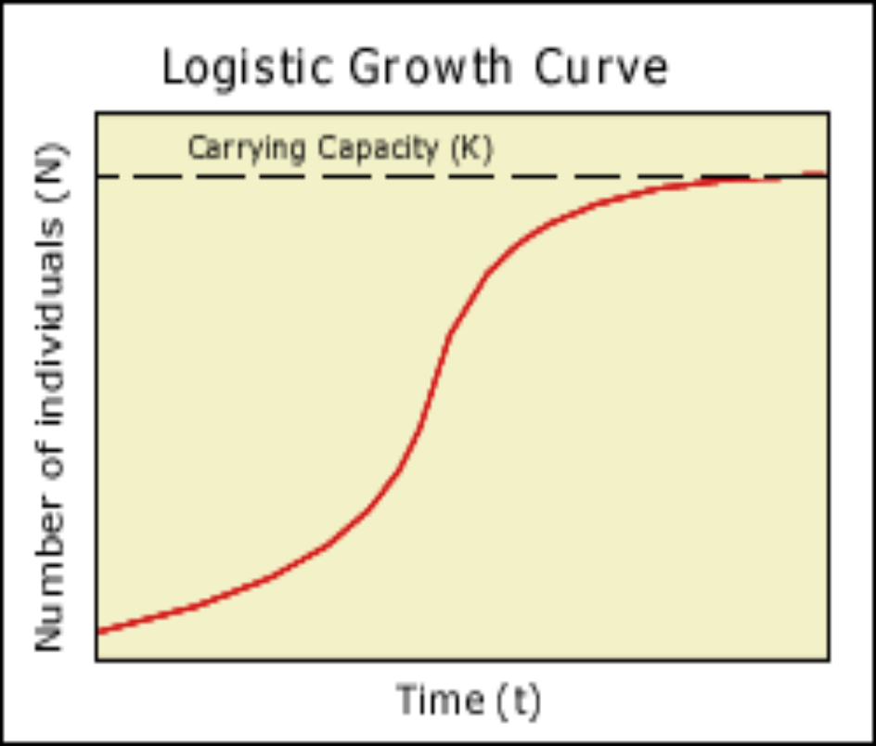
POPULATION ECOLOGY
Logistic Growth

Slide 10
POPULATION ECOLOGY
Carrying capacity of a particular species is the maximum population that the ecosystem can support indefinitely.
A population may increase beyond this number, but it cannot stay at this increased size due to resource availability.

Slide 11
POPULATION ECOLOGY
Carrying Capacity

Slide 12
POPULATION ECOLOGY
Because ecosystems change, carrying capacity is difficult to calculate exactly - it’s a theoretical limit.
A species reaches its carrying capacity when it consumes a natural resource at the same rate at which the ecosystem produces the resources.
The limited resource determines the carrying capacity for a species at a particular time.

Slide 13
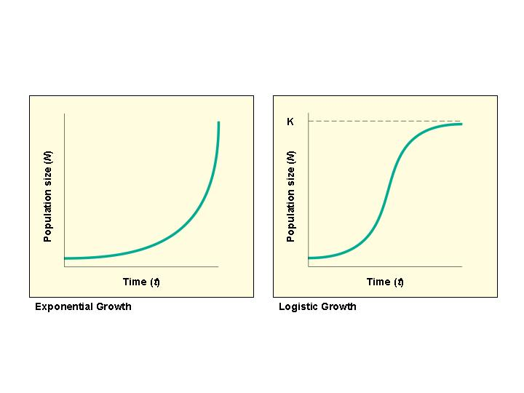
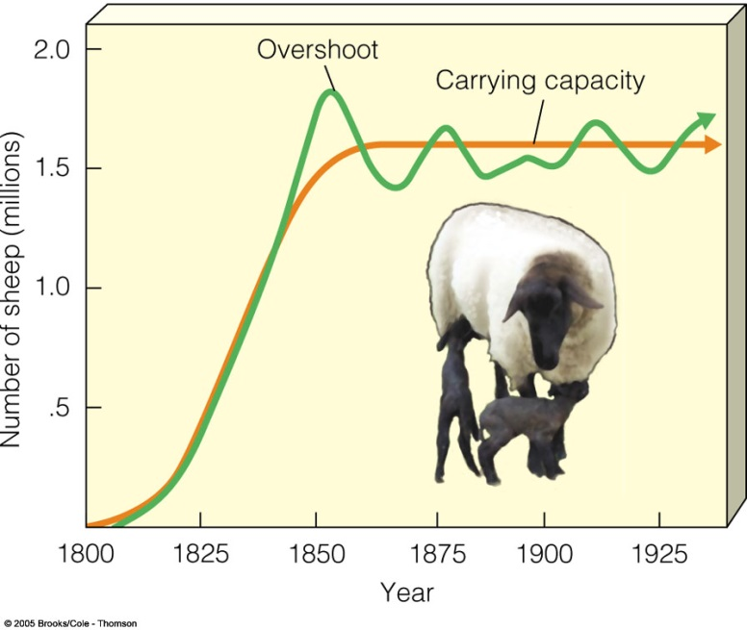
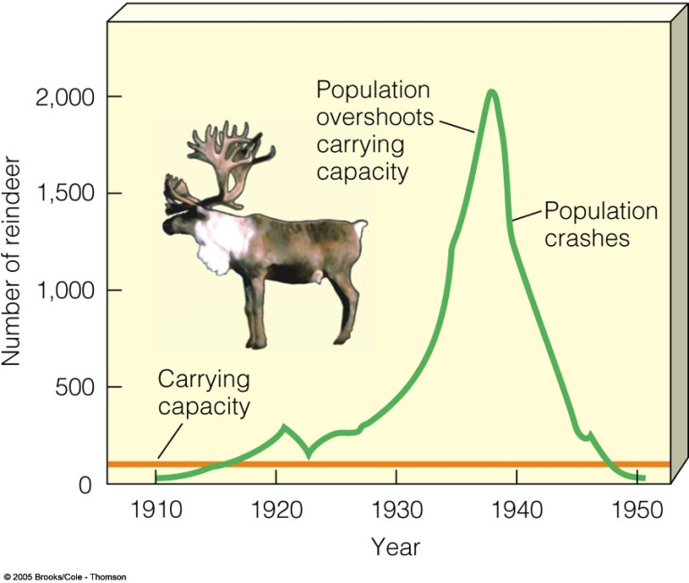
POPULATION ECOLOGY

Slide 14
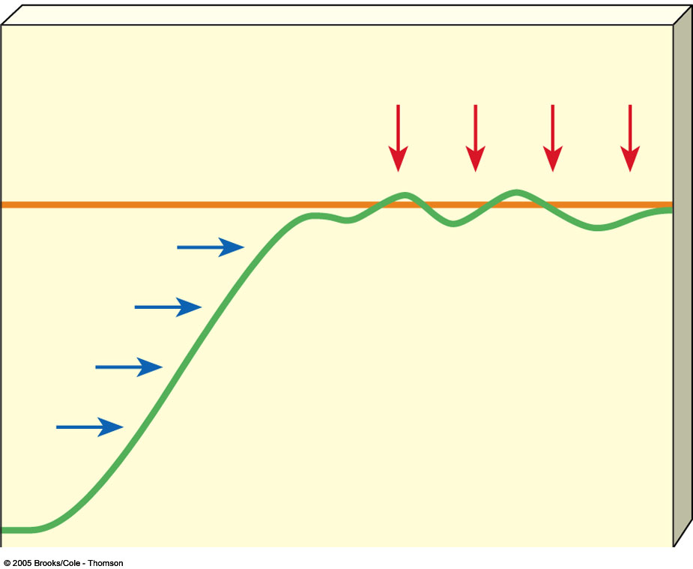
CARRYING CAPACITY
Carrying capacity is determined by biotic potential and environmental resistance.
This is the number of a species' individuals that can be sustained indefinitely in a specific space.
Environmental
resistance
Carrying capacity (K)
Population size (N)
Biotic
potential
Exponential
growth
Time (t)

Slide 15
DENSITY AND LIMITING FACTORS
LIMITING FACTORS
Factors that prevent a population from reaching its biotic potential.
Population size can be limited in ways that may or may not depend on the density of the population.

Slide 16
DENSITY AND LIMITING FACTORS
The density of a population may or may not affect how rapidly it can grow.
1. Density-Dependent Factors - Factors that have an increasing effect as the population increase. As organisms crowd together, these factors cause more damage and spread faster in larger populations.
  resource availability, predation, disease, competition, parasitism, stress due to overcrowding; infectious diseases

Slide 17
DENSITY AND LIMITING FACTORS
2. Density-Independent Factors – Factors that affect any population, regardless of density; NOT influenced by population size. These are abiotic factors in the community.
  weather, natural disasters, human activities, adaptations & behaviors of organisms

Slide 18
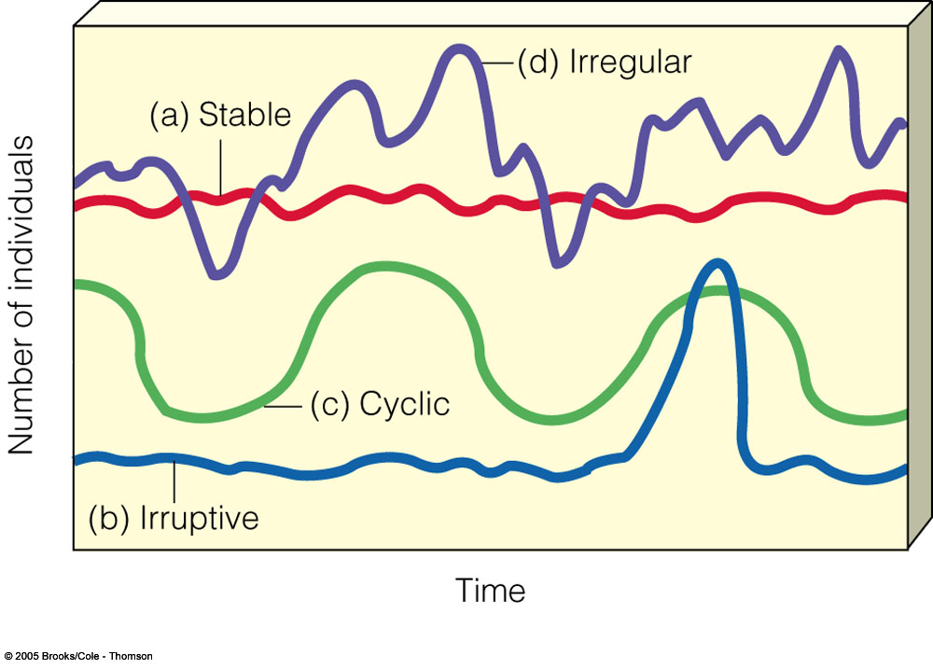
NATURAL POPULATION CURVES
Fig. 9-7 p. 168

Slide 19
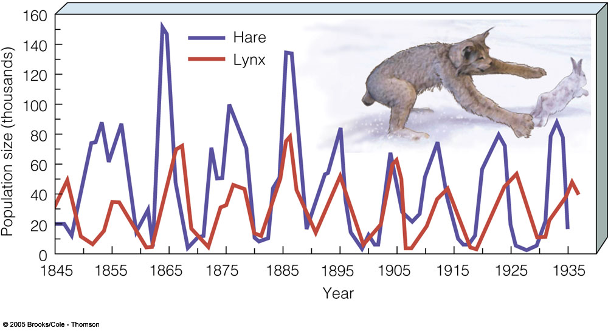
THE ROLE OF PREDATION IN CONTROLLING POPULATION SIZE

Slide 20
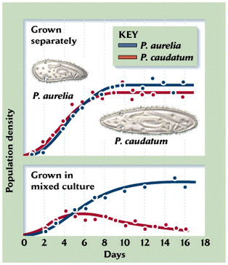
TO DO
Do Sections G and H
Section F due by tomorrow
Quiz tomorrow over notes up to Community Ecology.

