Slide 1
ENZYMES
HONORS BIOLOGY

Slide 2
DO NOW
Pick up worksheets
Pick up notes
Do Section A in the worksheet

Slide 3
ENZYMES
Enzymes are proteins.
Enzymes are biological catalysts.
  Catalysts speed up reactions.
  These reactions would take place anyway…the enzymes just speed them up.
  Enzymes speed up the rate of a chemical reaction by lowering the activation energy (the energy required to get a reaction going).

Slide 4
Enzymes
Catalysts: Substances that reduce the activation energy required in a chemical reaction.
Help organisms maintain homeostasis.
Without enzymes, chemical reactions would not occur quickly enough to sustain life.
Example: Ridding CO₂ from the bloodstream requires carbonic anhydrase, an enzyme.

Slide 5
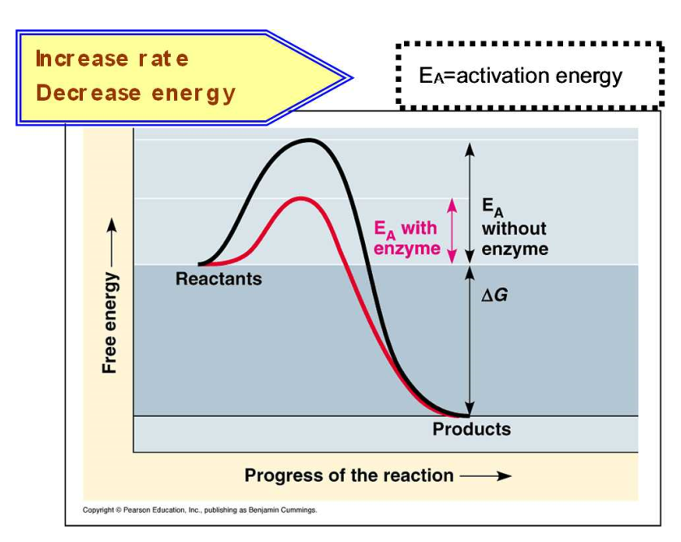

Slide 6
CHARACTERISTICS OF ENZYMES
Enzymes do not make anything happen that couldn’t happen on its own. It just makes it happen faster.
Enzymes are not used up in reactions. They can be used over and over again.
Enzymes are only needed in small amounts.
Each enzyme is highly selective about its substrate.
Enzymes chemically recognize, bind and modify substrates.

Slide 7
Enzymes
Substrate: Substance on which an enzyme acts during a chemical reaction.
Active site: The site on an enzyme that attaches to a substrate.

Slide 8
HOW DO ENZYMES WORK?
Enzymes have a specific shape.
Part of the enzyme matches the shape of the molecule to be reacted called the substrate.
The part of the enzyme that binds to the substrate is the active site.
When the substrate and the enzyme bind temporarily, an enzyme-substrate complex is formed.
The activation energy needed for the reaction to occur is reduced.

Slide 9
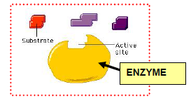
HOW DO ENZYMES WORK?
After the reaction is complete, the substrate has formed a new product and the enzyme is released to be reused.

Slide 10
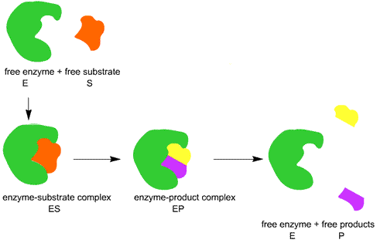
HOW DO ENZYMES WORK?

Slide 11
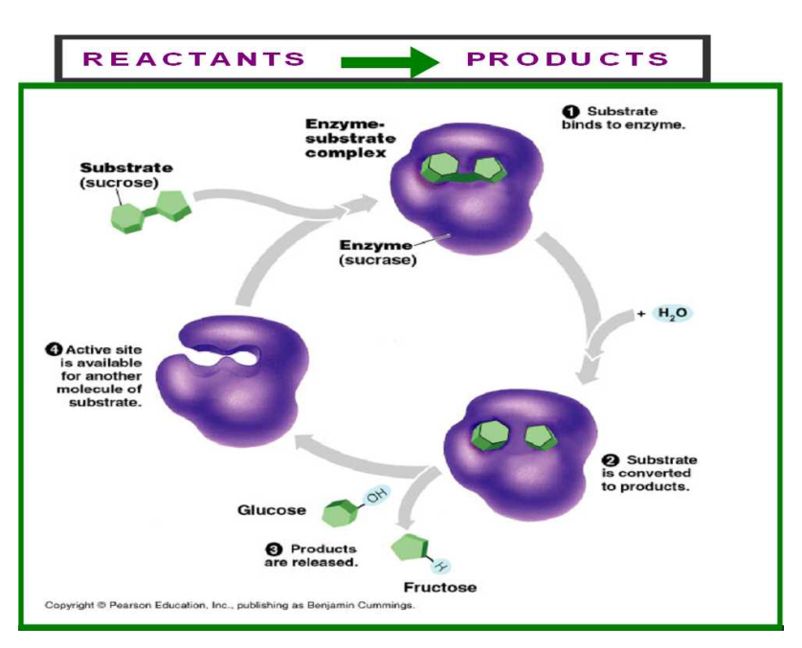

Slide 12
TWO MECHANISMS
Enzymes can work in two ways:
Lock and Key Model: substrate molecules already have the right shape to fit an enzyme.
Induced Fit Model: interaction between the enzyme and substrate induced or changes the shape of the molecules to produce a suitable fit.

Slide 13
LOCK AND KEY MODEL

Slide 14
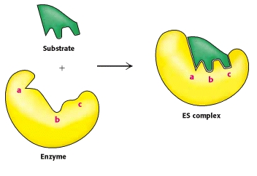
INDUCED-FIT MODEL

Slide 15
WATCH
What are Enzymes and How do they work? video

Slide 16
TO DO
Section B – worksheet

Slide 17
DO NOW
Get out worksheet and notes for Enzymes

Slide 18
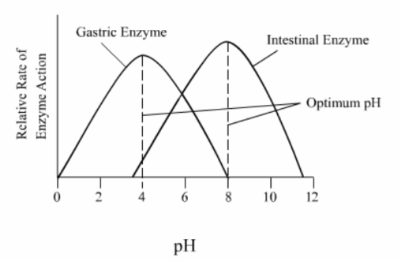
FACTORS AFFECTING ENZYME ACTIVITY
1. TEMPERATURE
Enzymes function optimally at certain temperatures.
  High temps – inactive or denature enzyme
  Warm temps – increase speed
  Cold temps – work slowly or not at all

Slide 19
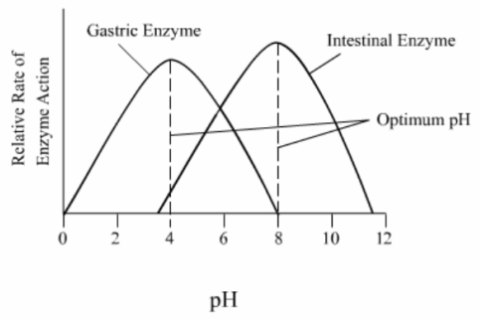
FACTORS AFFECTING ENZYME ACTIVITY
pH
Enzymes are sensitive to changes in acidity.
  Too acidic or too basic will slow or denature enzymes.

Slide 20
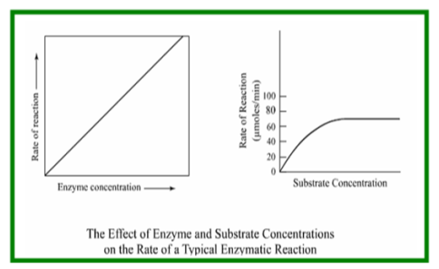
FACTORS AFFECTING ENZYME ACTIVITY
3. Concentration of Enzymes or Substrates
When concentration increases the reaction is faster
When concentration decreases, the reaction is slower.

Slide 21
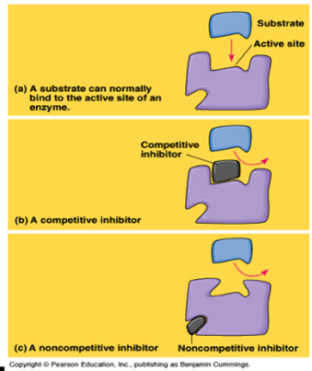
FACTORS AFFECTING ENZYME ACTIVITY
4. Enzyme activators – Coenzymes
  Some vitamins and minerals in small quantities work with enzymes to speed up reactions.

Slide 22
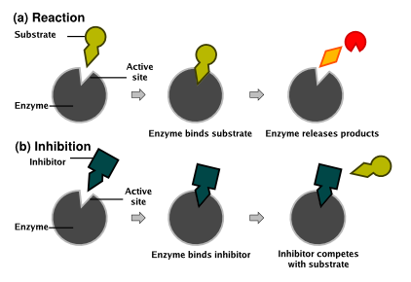
FACTORS AFFECTING ENZYME ACTIVITY
Enzyme Inhibitors
  Stops the action of enzymes by blocking the active site or changing the shape of the enzyme.

Slide 23
WATCH
Factors that affect enzyme activity video

