Slide 1
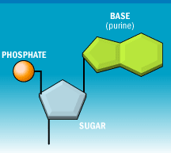
DNA / RNA
Carry genetic information.
Made of a chain of nucleotides.
Nucleotides contain a sugar, phosphate, and a nitrogen base.

Slide 2
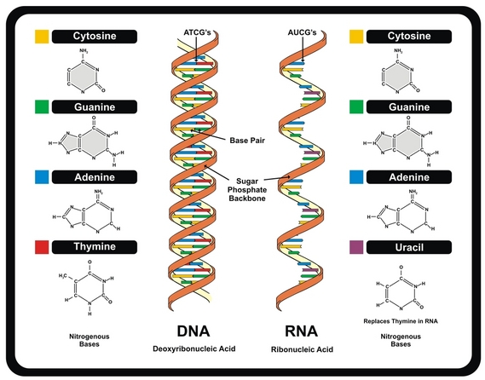
DNA / RNA
DNA
Double stranded
“Double Helix”
Four base pairs: ATGC
Sugar is Deoxyribose
Found in nucleus
RNA
Single stranded
Sugar is Ribose
Four base pairs: AUCG
Found in the nucleus and cytoplasm

Slide 3
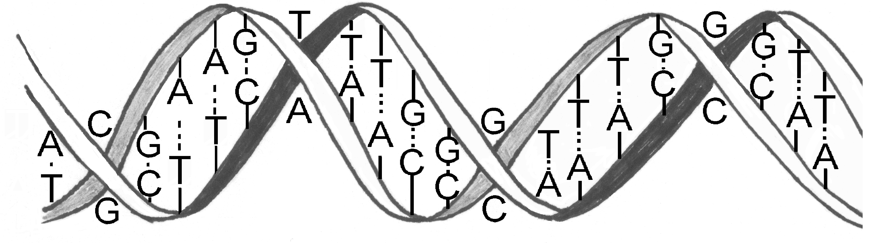
BASE PAIR RULE
In DNA,
Adenine always pairs with Thymine, and
Guanine always pairs with Cytosine

Slide 4
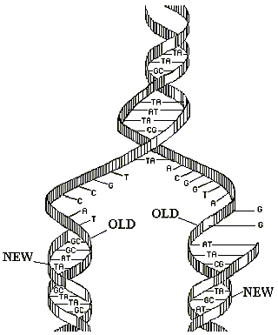
REPLICATION
Making of an identical strand of DNA
“semi” conservative – meaning that one old strand and one new strand stay together.
DNA unwinds, unzips, and makes a copy.

Slide 5
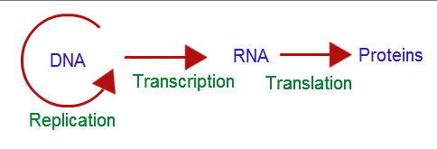
CENTRAL DOGMA
DNA → RNA → protein → trait

Slide 6
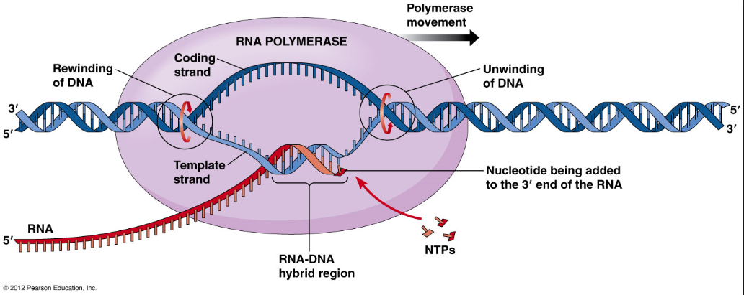
TRANSCRIPTION
DNA → mRNA
Occurs in nucleus
Complementary mRNA strand is produced from a segment of DNA

Slide 7
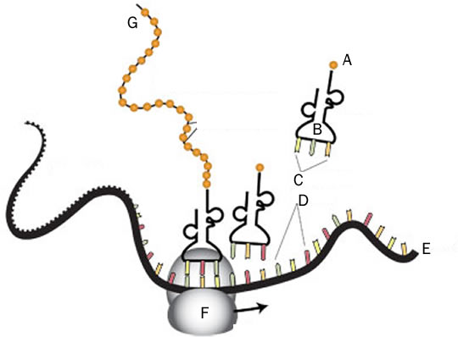
TRANSLATION
Connects amino acids in the correct order to make a protein
Occurs in the cytoplasm within the ribosomes
A- amino acid
B- tRNA
C- anticodon
D- codon
E- mRNA
F- Ribosome
G-polypeptide

Slide 8
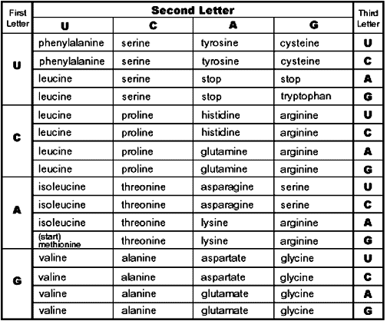
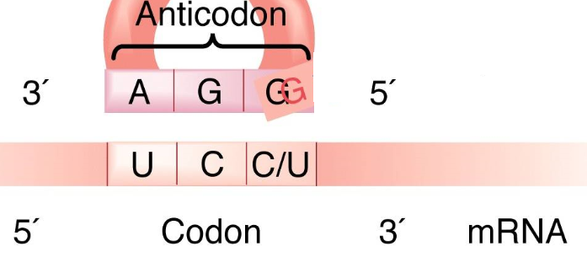
CODON
Sequence of three mRNA nucleotides that code for an amino acid
The anticodon is carried by the tRNA and matches the mRNA codon.

Slide 9
CODON-ANTICODON
mRNA = CODON
  Carrie protein codon sequence to the ribosome
tRNA = ANTICODON
  carries amino acid to ribosome
Amino acid = CODON
  Use codon NOT anticodon sequence to determine amino acid

Slide 10
CHROMOSOMES
Chromosomes consist of tightly packed DNA coiled around proteins (histones) that support its structure.
Humans have 23 pairs of chromosomes in their body cells and 23 chromosome sin their sex cells.
DNA contains genes which are segments of DNA that code for a protein.
Humans have about ~20,000 genes

Slide 11
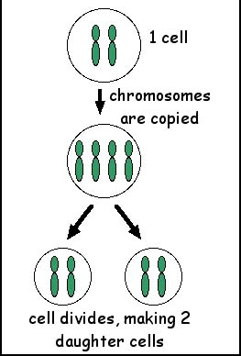
MITOSIS
Cell division
Produces two identical diploid daughter cells
Occurs in body cells to grow and repair.
Interphase, Prophase, Metaphase, Anaphase, telophase

Slide 12
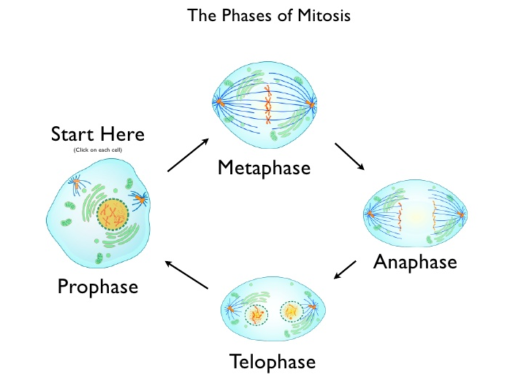
MITOSIS

Slide 13
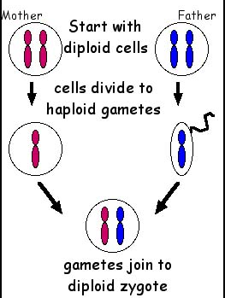
MEIOSIS
Cell division
Produces four different haploid daughter cells (gametes)
Occurs in sex cells to form gametes

Slide 14
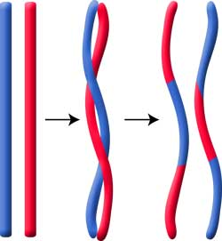
CROSSING OVER
Homologous chromosomes exchange parts of their DNA
Creates variation in gametes
Homologous Chromosomes – a chromosome pair, one inherited from the mother and one from the father, containing genes for the SAME trait or characteristic.

Slide 15
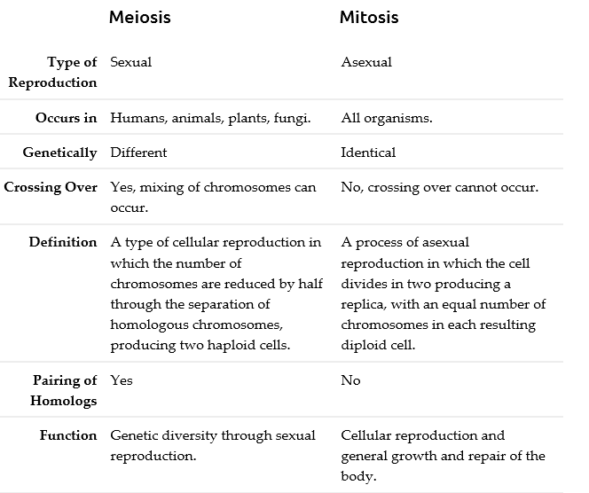
MITOSIS AND MEIOSIS

Slide 16
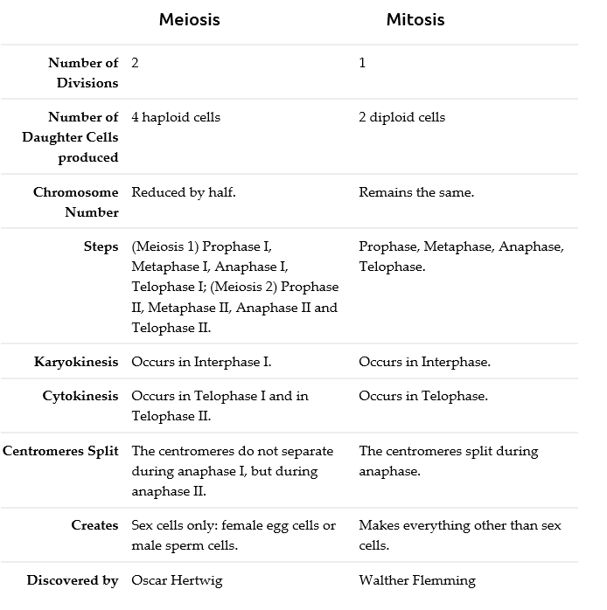
MITOSIS AND MEIOSIS

Slide 17
ASEXUAL VS. SEXUAL
REPRODUCTION
Asexual
One parent
Identical offspring
Variation only thru mutations
Examples: budding, fragmentation, fission
Sexual
Two parents
Offspring different from parents
More variation
Fertilization (fusion of gametes)

Slide 18
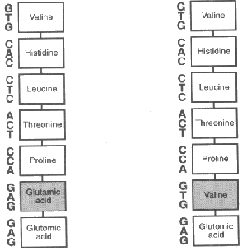
MUTATIONS
Change in DNA code – nucleotide sequence .
May cause a change in protein produced.
NOT always harmful.
May occur in somatic cells (aren’t passed to offspring)
May occur in gametes (eggs and sperm) and be passed to offspring
Sickle Cell Mutation

Slide 19
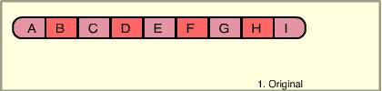
MUTATIONS
CHROMOSOMAL - May Involve:
  Changing the structure of a chromosome
  The loss or gain of part of a chromosome
  Five types exist:
  Deletion
  Duplication
  Inversion
  Translocation
  Nondisjunction

Slide 20
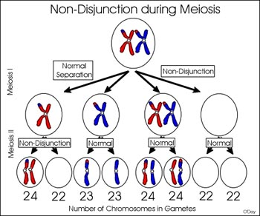
NONDISJUNCTION
Homologous chromosomes fail to separate during meiosis
Can lead to Down Syndrome, Turners Syndrome, and Klinefelters Syndrome

Slide 21

MUTATIONS
GENE MUTATIONS – aka point mutations.
Change in the nucleotide sequence of DNA.
May only involve a single nucleotide or may be due to copying errors, chemicals, viruses, etc.
Types:
  Point Mutations
  Substitutions
  Insertions
  Deletions
  Frameshift

Slide 22
MUTAGENS
Many mutations happen spontaneously when DNA is replicating.
Some mutations can occur when DNA is exposed to mutagenic factors such as x-rays, UV radiation, and chemicals.

Slide 23
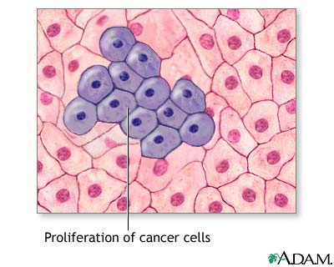
CANCER
Error in cell growth with causes uncontrolled cell growth.
Has environment and genetic variables.

Slide 24
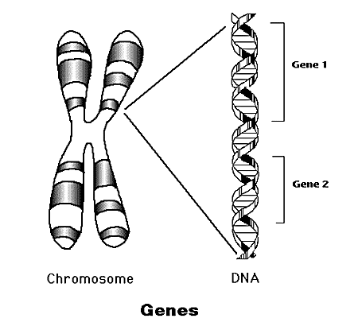
INHERITANCE
Traits are specific characteristics inherited from parents.
Genes are the factors that determine traits.
The different forms of a gene are called alleles.

Slide 25
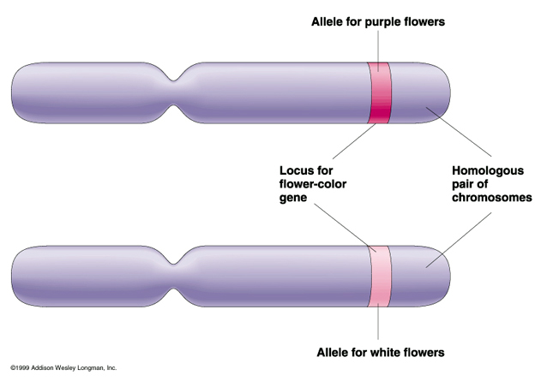
DOMINANT/RECESSIVE ALLELES
Dominant alleles are expressed, if present, and recessive are hidden

Slide 26
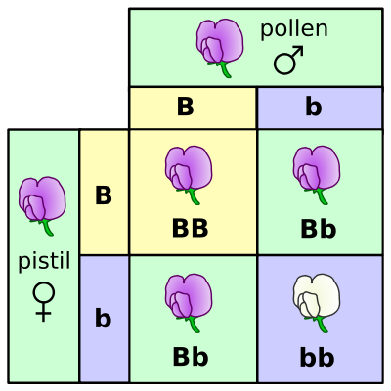
GENOTYPE actual alleles an individual has for a trait
Homozygous
Both alleles are the same
Ex. BB or bb
Heterozygous
Both alleles are different
Ex. Bb

Slide 27
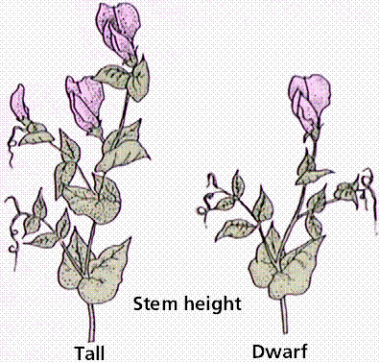
PHENOTYPE
The actual characteristic displayed by the individual (ex. brown eyes, Hemophiliac)

Slide 28
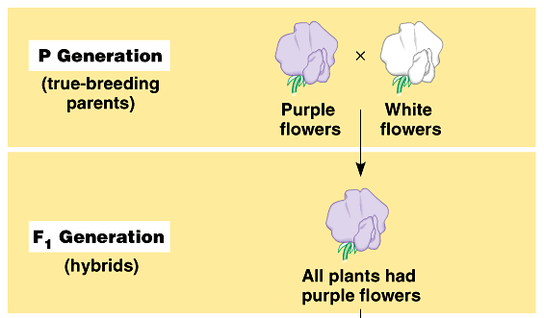
LAW OF DOMINANCE
One trait is covered up by another trait.
In the monohybrid cross (mating of two organisms that differ in only one character), one version disappeared.
What happens when the F1’s are crossed?

Slide 29
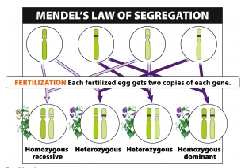
LAW OF SEGREGATION
Two alleles separate during gamete formation.

Slide 30
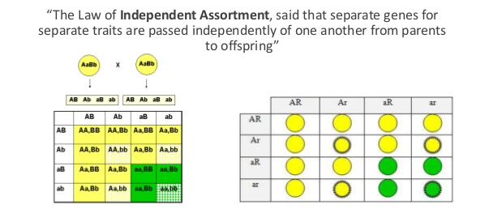
LAW OF INDEPENDENT ASSORTMENT
Each pair of alleles segregates independently of other pairs of alleles.

Slide 31
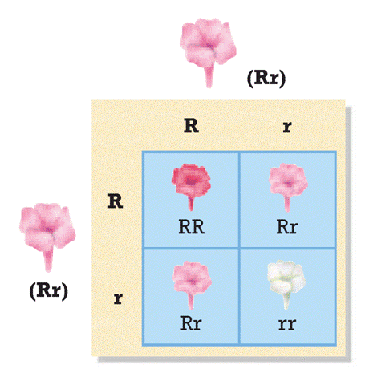
INCOMPLETE DOMINANCE
Heterozygote shows a blending of the dominant and recessive phenotypes.

Slide 32
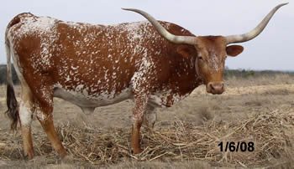
CODOMINANCE
Heterozygote expresses BOTH dominant and recessive traits
Ex. Roan animals

Slide 33
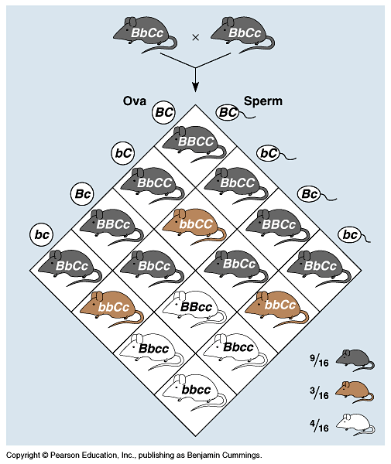
POLYGENIC TRAITS
Traits are influenced by more than one gene.
Ex. skin color

Slide 34
MULTIPLE ALLELES
More than two alleles for a trait (an individual still only inherits two).
Ex. Blood Type (I^{A},I^{B}, i)
type A = I^{A}I^{A} or I^{A}i
type B = I^{B}I^{B} or I^{B}i
type AB= I^{A}I^{B}
type O = ii

Slide 35
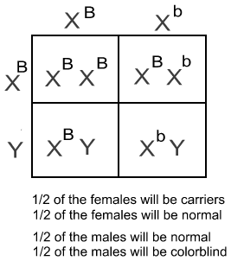
SEX LINKED TRAITS
Sex Chromosomes
  Female = XX
  Male = XY
Sex linked traits are carried on the X chromosome
Ex. Hemophilia, red-green colorblindness

Slide 36
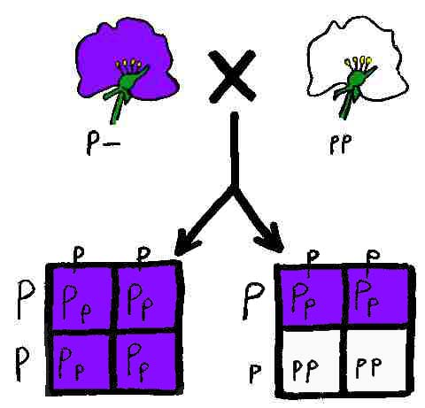
TEST CROSS
used to determine the phenotype of an unknown dominant individual
uses a homozygous recessive individual as the “test”

Slide 37
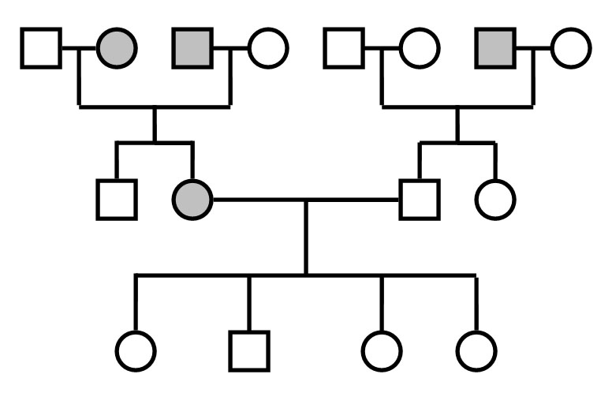
PEDIGREE
similar to a family tree
Shows pattern of inheritance of a specific trait through a family

Slide 38
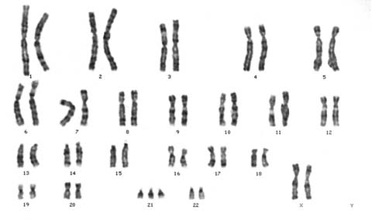
KARYOTYPE
Picture of someone's chromosomes
Can detect chromosomal disorders
Ex. Down Syndrome, Klinefelter’s Syndrome, and Turners Syndrome

Slide 39
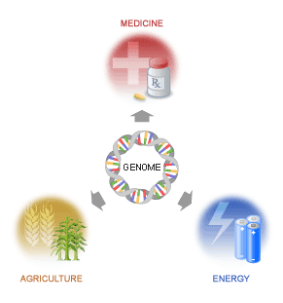
HUMAN GENOME PROJECT
Sequencing of human DNA
Being used to develop gene therapies

Slide 40
DNA FINGERPRINTING
How it Works:
Extract DNA
Cut DNA
Run a gel electrophoresis

Slide 41
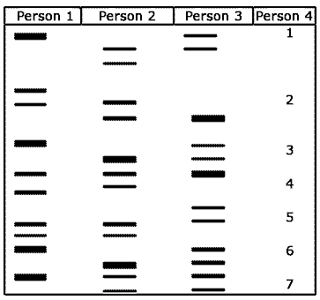
GEL ELECTROPHORESIS
Technique used to separate molecules (DNA or proteins) based on their size
Sometimes called a DNA fingerprint
Used to analyze and compare DNA

Slide 42
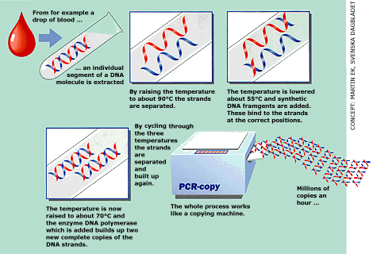
COPYING DNA
Polymerase Chain Reaction
Also called PCR.
A method to replicate DNA fragments to rapidly amplify DNA samples.

Slide 43
GENETIC ENGINEERING
The process of changing the genetic makeup of an organism to introduce a desirable trait.
Genes are transferred from one species into another species resulting in a transgenic organism that contains recombinant DNA.
OR a gene is modified and inserted into an organism of the same species.

Slide 44
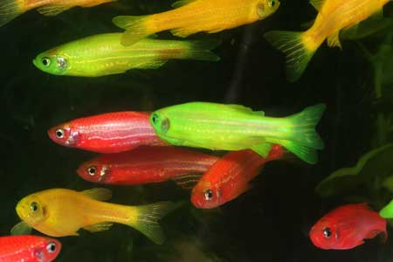
TRANSGENIC ORGANISM
An organism with a gene from another source
used to improve food supply, research, and healthcare

Slide 45
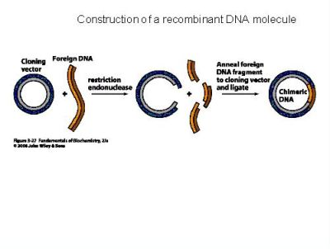
RECOMBINANT DNA
Cell with DNA from another source
Bacteria used to produce human insulin
Human gene inserted into bacterial plasmid

Slide 46
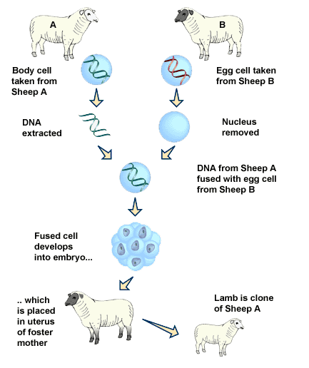
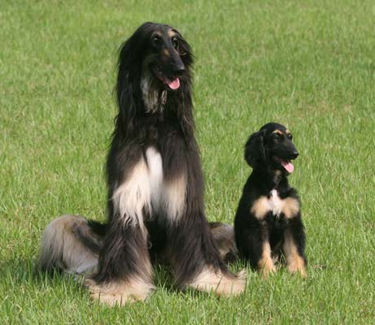
CLONING
Clone- a member of a group of genetically identical cells.
An organism made from one cell of another organism.
A genetically identical copy.

Slide 47
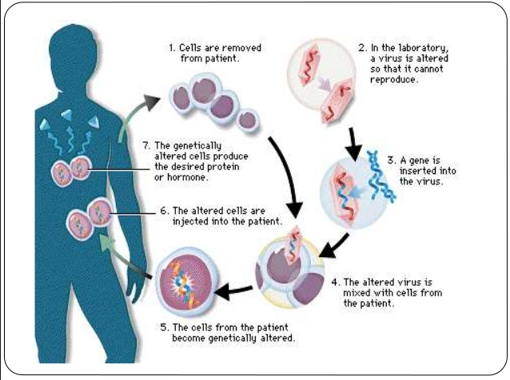
GENE THERAPY

Slide 48
GENE SPLICING
Gene splicing involves cutting out part of the DNA in a gene and adding new DNA in its place.
The process is entirely chemical.
A specific enzyme will split apart a specific strand of DNA leaving behind a gap in the genetic code. New DNA can then be added in this gap.
Once the new DNA is in place, the function of the gene changes.

Slide 49
BENEFITS
Transgenic plants
help farmers grow crops more efficiently and with less impact on the environment.
Transgenic animals
widely used in medical research – as sources of medically valued proteins or pharmacologicals.
food animals are being altered to be more nutritious, disease resistant, or easier to raise.

Slide 50
TO DO
Complete Page Three and Four for tomorrow.

