Slide 1
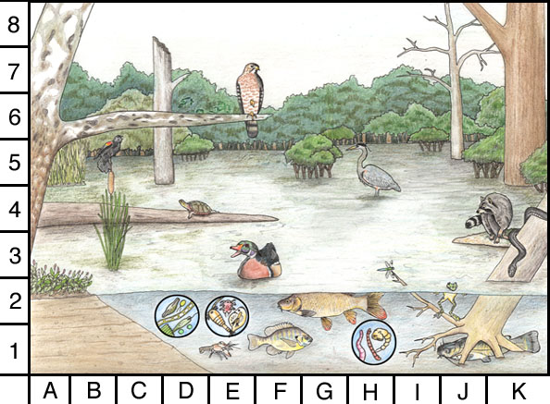
ECOSYSTEM
Collection of abiotic (nonlivng) and biotic (living) factors in an area
Together they influence growth, survival, and productivity of an organism

Slide 2
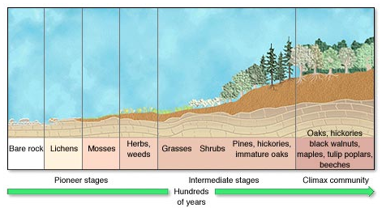
ECOSYSTEM
Primary Succession

Slide 3
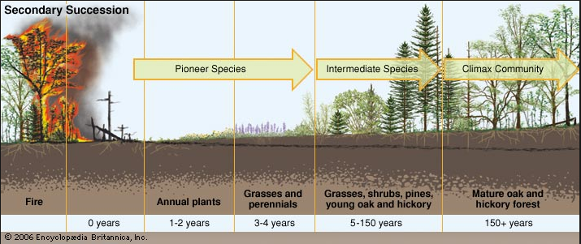
ECOSYSTEM
Secondary Succession

Slide 4

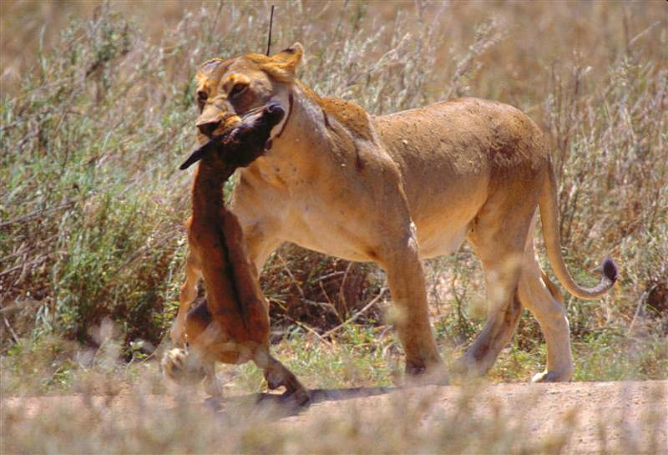
AUTOTROPH VS. HETEROTROPH
Obtain energy from the environment
Photosynthesis or chemosynthesis
“Producers”
Obtain energy from other living things
“Consumers”

Slide 5
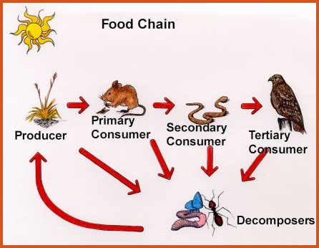
ECOSYSTEM
    A food chain is a sequence in which energy is transferred from one organism to the next as each organism eats another organism.

Slide 6
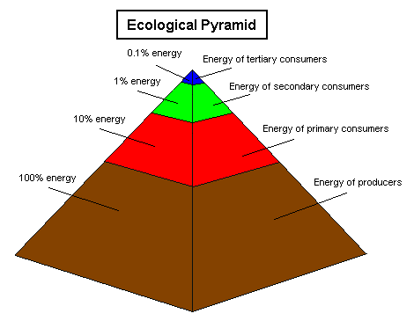
ECOSYSTEM
Steps in a food chain/web
Energy passes from one organism to another.
It takes a large number of producers to support a small number of primary consumers.
About 10% of the energy at one level passes to the next

Slide 7
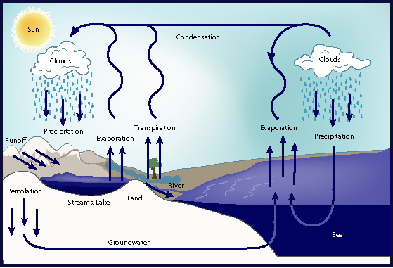
ECOSYSTEM
WATER CYCLE

Slide 8
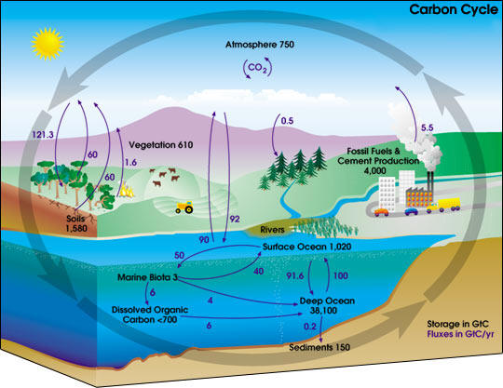
ECOSYSTEM
CARBON CYCLE

Slide 9
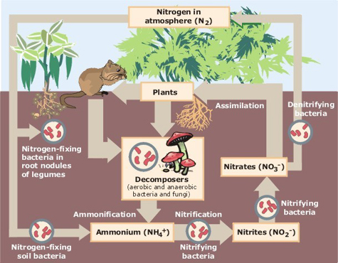
ECOSYSTEM
NITROGEN CYCLE

Slide 10
ENVIRONMENTAL ISSUES
Land Resources – Soil can be permanently damaged if it is mismanaged.
Soil erosion - occurs when the surface soil wears away by water or wind.
Desertification - occurs in dry climates, when a combination of farming, overgrazing and drought has turned once productive areas into deserts.
Deforestation - occurs when forests are cut down and lead to severe erosion as soil is exposed to heavy rains.

Slide 11
ENVIRONMENTAL ISSUES
Water Resources
Overfishing occurs when fish stocks are being harvested faster than they can reproduce.
Pollutants such as chemicals, waste and sewage enter the water cycle and contaminate water.
Air Resources
Smog – mixture of chemicals that create a haze in the atmosphere.
Acid Rain - Burning of fossil fuels release acidic gases containing nitrogen and sulfur compounds into the atmosphere.

Slide 12
ENVIRONMENTAL ISSUES
BIODIVERSITY
refers to the number of different species in a given area.
KEYSTONE SPECIES
are critical to the functioning of an ecosystem. These species control the population size of organisms in lower tropic levels.

Slide 13
ENVIRONMENTAL ISSUES
THREATS TO BIODIVERSITY
Endangered species – A species that is likely to become extinct if protective measures are not taken immediately.
Threatened species – A species that has a declining population and that is likely to become endangered if it is not protected.
Extinct species - A species of plant or animal that is no longer living.

Slide 14
ENVIRONMENTAL ISSUES
Habitat Destruction and Fragmentation –Humans destroy and fragment the habitats of other species. Natural habitats are destroyed and the remaining pieces of habitat contain fewer species and less diversity.
Invasive Species – A non-indigenous species is introduced into a particular region and can threaten native species that have no natural defenses against them.
Excessive Hunting, Harvesting and Poaching – Many countries now have laws to regulate hunting, fishing, harvesting and trade of wildlife.

Slide 15
ENVIRONMENTAL ISSUES
Pollution – Chemicals used by humans are making their way into food webs around the world. The long-term effects may not be clear until after many years of use (i.e. DDT and the bald eagle).
Biological magnification (accumulation) occurs when toxic substances enter the food chain. Concentrations of harmful substances increase in organisms at higher trophic levels in the chain or web. (DDT &and the bald eagle).

Slide 16
GLOBAL WARMING
Ozone
The ozone contains a layer of ozone gas (O₃) in the upper atmosphere of Earth.
It is naturally occurring and absorbs much of the ultraviolet (UV) radiation emitted by the sun from reaching Earth’s surface.
Ozone depletion is caused by chlorofluorocarbons (CFCs).

Slide 17
GLOBAL WARMING
Greenhouse Effect
The Greenhouse Effect is a natural process in which atmospheric gases absorb thermal radiation (heat).
Greenhouse gases regulate our climate by trapping heat and keeping Earth warm enough to sustain life.
The main greenhouse gases are Carbon Dioxide (CO₂), Methane (CH₄) and Nitrous Oxide (N₂O).

Slide 18
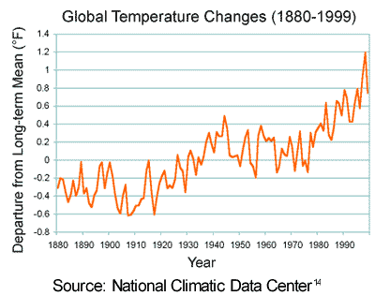
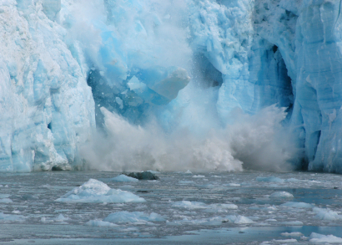
GLOBAL WARMING
Increase in the average temperature of the earth
Caused by the release of too much CO2 into the atmosphere which amplifies the greenhouse effect
Burning of fossil fuels, volcanic eruptions

Slide 19
GLOBAL WARMING
Humans accelerate this natural process by creating more greenhouse gases in the atmosphere through activities such as:
Ultimately, more greenhouse gases mean more infrared radiation trapped which gradually increases the temperature of the Earth’s surface.

Slide 20
GLOBAL WARMING
IMPACTS OF GLOBAL WARMING:
Ice sheets and glaciers are melting worldwide, especially at the Earth’s poles.
Ecosystems will change—some species will move farther north or become more successful; others won’t be able to move and could become extinct.
Sea level rise became faster over the last century.
Precipitation has increased across the globe, on average.
Floods and droughts will become more common.
Less fresh water will be available.
Hurricanes and other storms are likely to become stronger.
Species that depend on one another may become out of sync. For example, plants could bloom earlier than their pollinating insects become active.
Some diseases will spread such as malaria carried by mosquitoes.

Slide 21
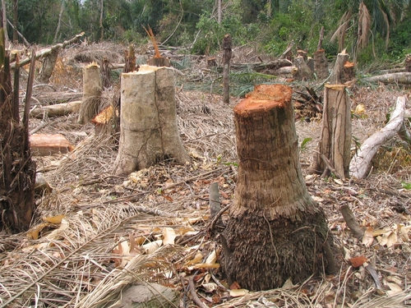
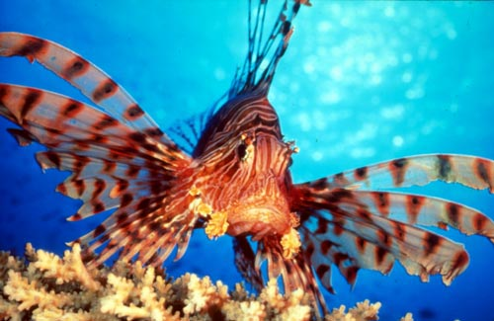

HUMAN IMPACTS
Positive
Negative
Reforestation
Cover Cropping
Recycling
Sustainable practice
Acid Rain
Deforestation
Habitat Destruction
Invasive Species
Ozone depletion from the release of CFCs

Slide 22
TO DO
Back side of Ecology handout.
GOOD LUCK ON YOUR EOC!!!

