Slide 1
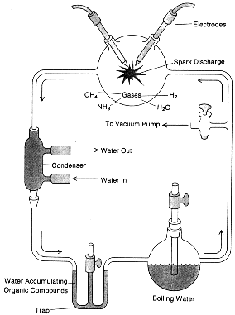
ORIGIN OF LIFE
Abiotic Earth LACKED Oxygen
Early organisms anaerobic prokaryotes
Miller and Urey
Experiment recreating
The abiotic atomospere

Slide 2
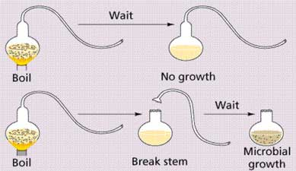
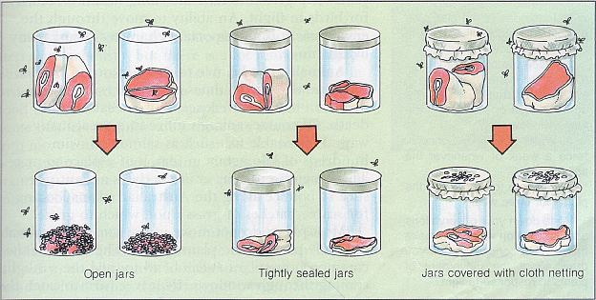
ABIOGENESIS
BIOGENESIS
Living from non-living or spontaneous generation
Disproved by Redi and Pasteur’s experiments
Living from Living

Slide 3
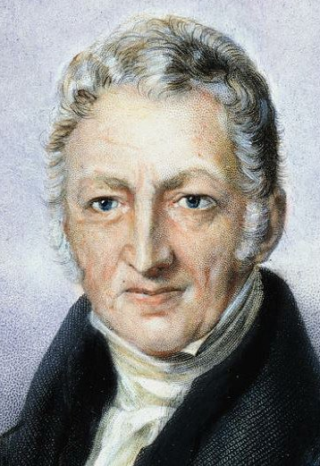
POPULATION GROWTH
Thomas Malthus
Observed babies being born faster than people were dying.
Predicts that human populations outgrow food supply. Death and famine are inevitable.

Slide 4
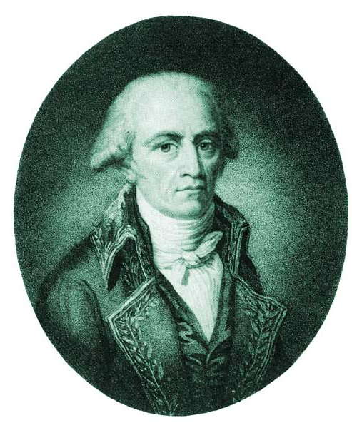
LAMARCK
Jean-Baptiste Lamarck
One of first scientists to understand that change occurs over time.
Called it Inheritance of Acquired Characteristics - organisms changed due to the demands of their environment.
Over time this led to new species.

Slide 5
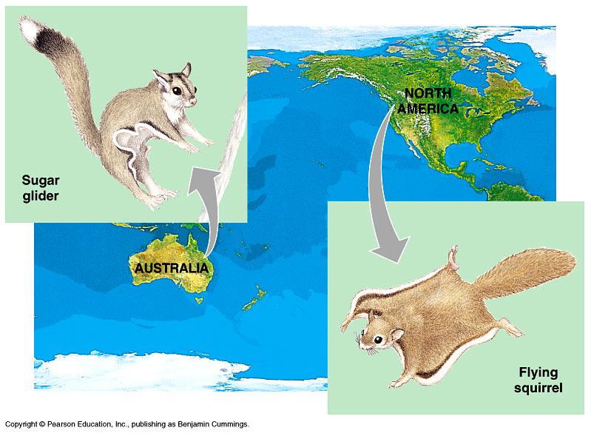
DARWIN
Patterns of diversity were shown.
Unique adaptations in organisms.
Species not evenly distributed
    Australia-kangaroos, but no rabbits
    S. America-Llamas

Slide 6
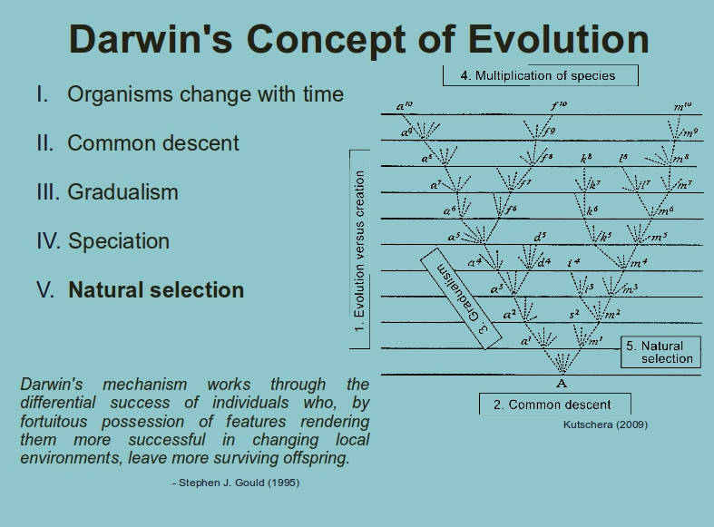

Slide 7
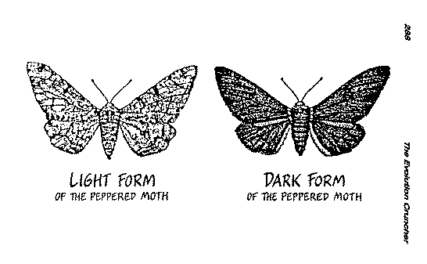
NATURAL SELECTION
Theory of Evolution
Fit organisms survive, reproduce, and pass on traits
Requirements:
Variation
Competition

Slide 8
NATURAL SELECTION
mechanism for evolution
Natural Variations (differences among individuals) exist in all organisms.
These variations are inherited and are called adaptations.
So adaptations are inherited traits.

Slide 9
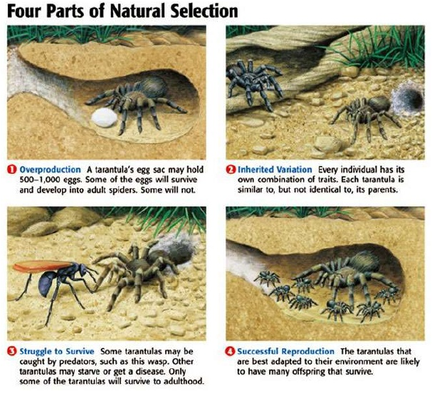

Slide 10
NATURAL SELECTION
ADAPTATIONS that are more favorable become more prevalent within the population.
These traits will be passed onto the next generation.
The GENE POOL of a population changes in favor of the “FITTEST” phenotype and genotype.

Slide 11
NATURAL SELECTION
Individuals compete for resources.
ONLY the best suited organisms to the environment will survive and reproduce.
“Survival of the Fittest” - Some phenotypes are better than others when it comes to competing for resources.

Slide 12
NATURAL SELECTION
The more “FIT” phenotype (best fitness) will survive and have the possibility of passing its alleles to the next generation.
Organisms with traits that don’t help them survive will die and will NOT be able to pass these traits on.
So the frequency of these “BAD” traits will decrease.

Slide 13
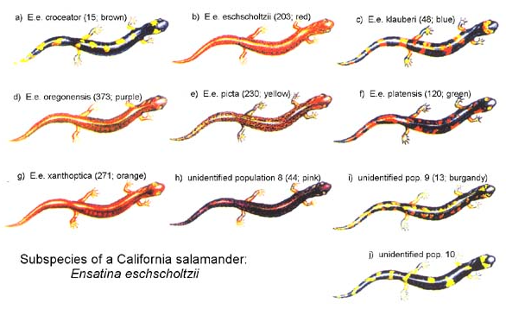
SPECIATION
Formation of a new species (group of organisms that can reproduce fertile offspring) needs:
1. Available niche
2. Genetic Isolation
3. Time

Slide 14
SPECIATION
SPECIATION - produces a NEW species
gene flow between two population is interrupted
genetic differences gradually accumulate between the two populations
reproductive isolation evolves as a consequence of this divergence

Slide 15
MECHANISMS
MECHANISMS leading to speciation:
Geographic Isolation
- Separated by bodies of water or mountains.
Temporal Isolation
- Reproduction takes place at different times of the year
Behavioral Isolation
- Populations are capable of interbreeding, but have different courtship rituals or other type of behavior.

Slide 16
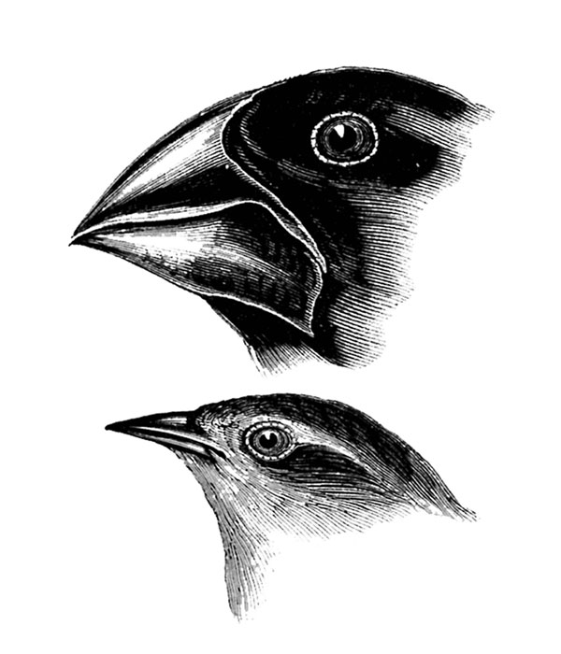
ADAPTATIONS
Trait that increases survival.
For Example,
  Beaks that make it easier to eat insects
  Bright flowers to attract pollinators
  Vascular tissue in plants to adapt to life on land

Slide 17
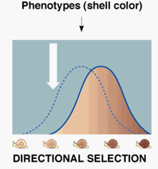
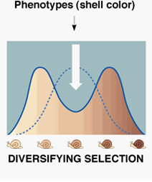
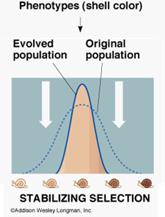
TYPES OF SELECTION
A. Directional Selection – natural selection favors one extreme
B. Diversifying (Disruptive) Selection – natural selection favors the extremes
C. Stabilizing Selection – natural selection favors the middle

Slide 18
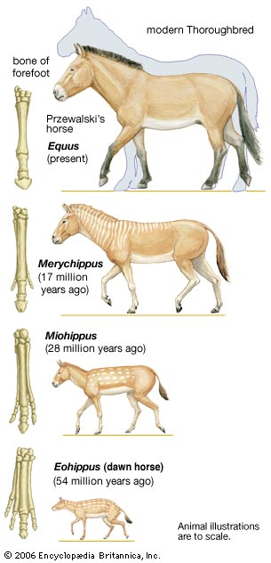
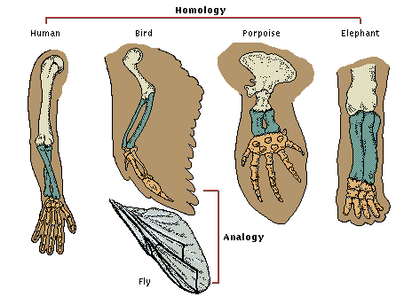
EVIDENCE FOR EVOLUTION
Fossil Record
Biochemical Similarities
Shared anatomical structures

Slide 19
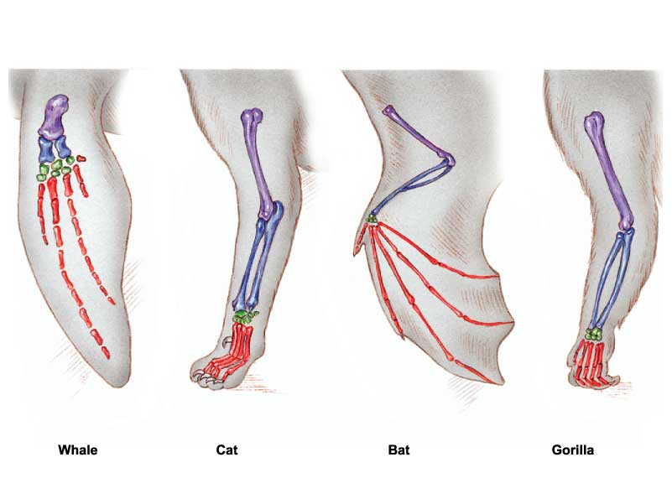
HOMOLOGOUS
structures have different mature forms, but developed from the same embryonic tissue.
Organisms have descended from a common ancestor.

Slide 20
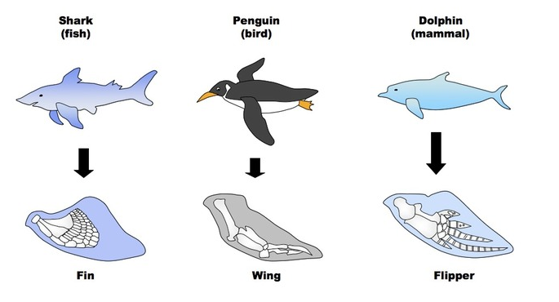
ANALOGOUS
Structures have similar function and superficial appearance, but different anatomy.
Similarities are due to environmental pressures, but do not demonstrate common ancestry.

Slide 21
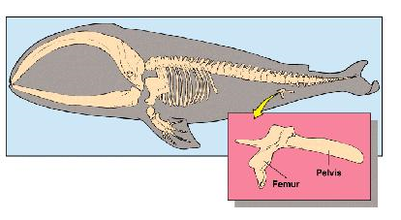
VESTIGIAL
Organs that are reduced in size. They are traces of homologous organs in other species.
Structures have no current function, but can provide information about ancestors.

Slide 22
FOSSILS
Darwin saw fossils as a record of the history of life on Earth.
By comparing fossils from older rock layers with fossils from younger layers, scientists could document that life on Earth has changed over time.
Through the examination of sedimentary rock strata (layers), fossils have been used to trace the history of modern life.

Slide 23
ADAPTIVE RADIATION
The evolution of many diversely adapted species from a common ancestor.
Usually occurs when a population colonizes an area of diverse geographic or ecological conditions.
Many species become so different that the possibility of cross breeding is no longer possible due to the accumulation of genetic changes.

Slide 24
EMBRYONIC DEVELOPMENT
The same groups of embryonic cells develop in similar patterns to produce the tissues and organs of all vertebrates.
This shows a common ancestor.

Slide 25
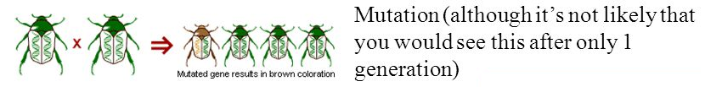
MECHANISMS
a. Genetic Mutations
A mutation is an error in the replication of a nucleotide sequence provides the genetic variation that evolution acts on.
Some “green genes” randomly mutated to “brown genes” (mutations alone cannot account for a big change in allele frequency).
Mutations can be transmitted in gametes to offspring, and immediately affect the composition of the gene pool.

Slide 26
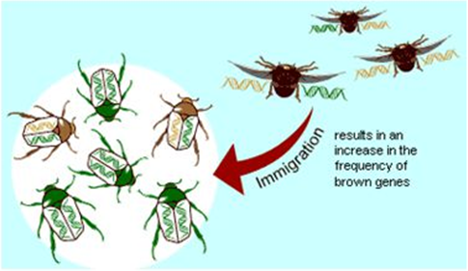
MECHANISMS
Gene Flow
Genes from one population are incorporated into a different population.
Some beetles with brown genes immigrated from another population or some beetles carrying green genes emigrated.

Slide 27
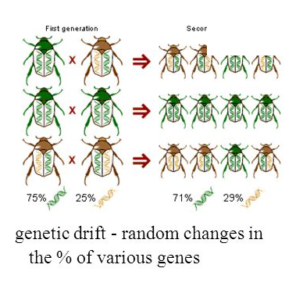
MECHANISMS
Genetic Drift
Genetic drift = the alteration of the gene pool of a small population due to chance.
It is random changes in the frequency of alleles within a population.

Slide 28
MECHANISMS
Natural Selection
Differential success in reproduction based on heritable traits results in selected alleles being passed to relatively more offspring (Darwinian inheritance).
The only agent that results in adaptation to environment.
Beetles with brown genes escaped predation and survived to reproduce more frequently than beetles with green genes, so that more brown genes were passed to the next generation.

Slide 29
DIVERGENT EVOLUTION
Divergent evolution is the process of two or more related species becoming more and more dissimilar.
Organisms, who share a common ancestry, have evolved into different organisms.
They diverge because they are adapted by different environments.

Slide 30
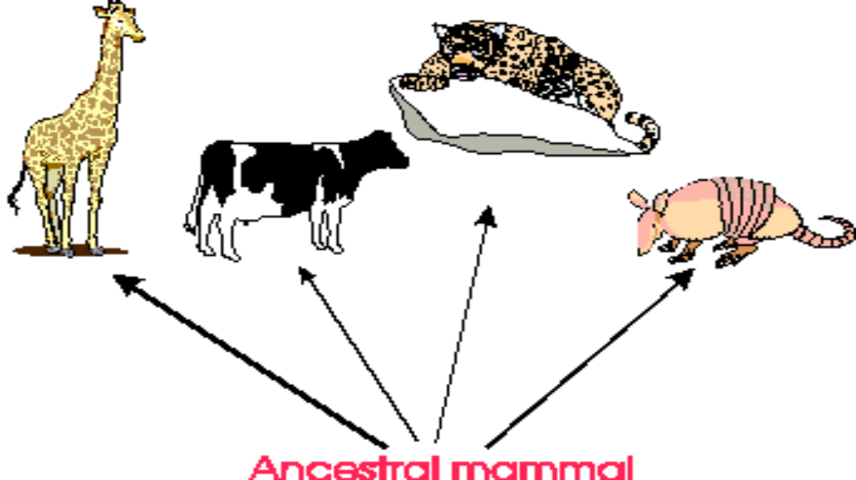
DIVERGENT EVOLUTION

Slide 31
CONVERGENT EVOLUTION
Convergent evolution is the emergence of biological structures or species that exhibit similar function and appearance but that evolved differently.
result of geographic isolation and niches to be filled.
process by which different species evolve similar structures or adaptations to similar (but different) environments.

Slide 32
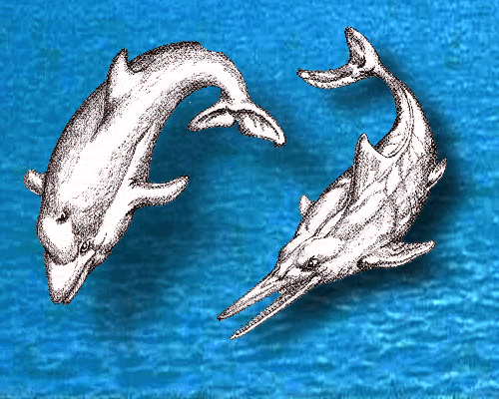
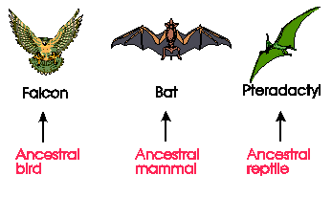
CONVERGENT EVOLUTION

Slide 33
COEVOLUTION
Co-Evolution is the joint change of two or more species in close interaction.
Example - Bumblebees and the flowers they pollinate have coevolved so that both have become dependent on each other for survival.

Slide 34
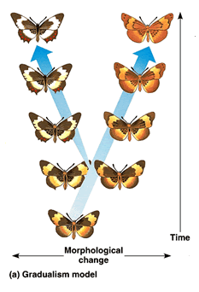
GRADUALISM
Very gradually, over a long time, the population changes. Change is slow, constant, and consistent.

Slide 35
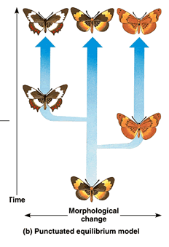
PUNCTUATED EQUILIBRIUM
The species changes very rapidly over a few generations, then settles down again to a period of little change.

