Slide 1

BINOMIAL NOMENCLATURE
Two word naming system
Scientific name
Uses Genus and Species names
Example: Dogs: Canis familiaris

Slide 2
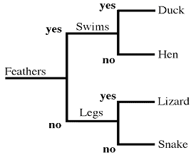
DICHOTOMOUS KEYS
Used to identify organisms
Paired set of questions with two choices

Slide 3
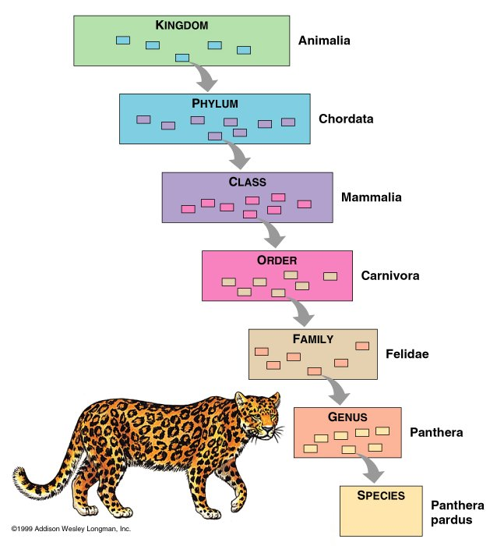
LEVELS OF ORGANIZATION
DOMAIN - Eukarya

Slide 4
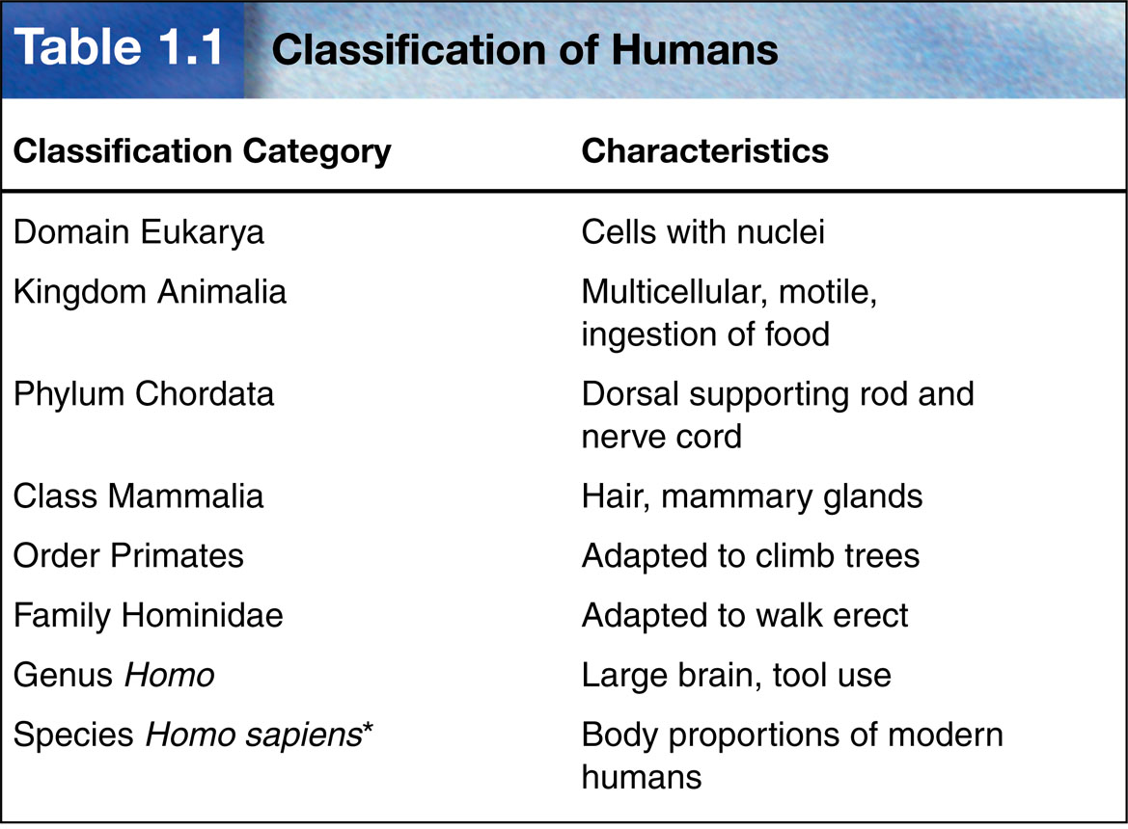

Slide 5
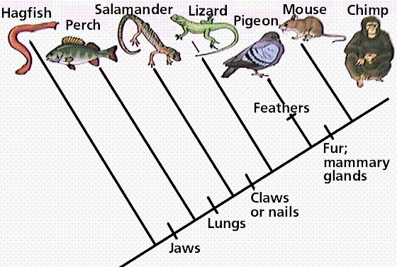
PHYLOGENIC TREE

Slide 6
DOMAINS
Broadest, most inclusive taxon
Three domains
Archaea and Eubacteria are unicellular prokaryotes (no nucleus or membrane-bound organelles)
Eukarya are more complex and have a nucleus and membrane-bound organelles

Slide 7
DOMAINS
Domains | ARCHAE
Kingdoms | ARCHAEBACTERIA
Cell Type – Prokaryote or Eukaryote | PROKARYOTE
# of cells – Unicellular or Multicellular or Both | UNICELLULAR
Cell Structure – Cell wall composition | CELL WALL WITH no PEPTIDOGLYCAN
Nutrition – Autotroph or Heterotroph or Both | BOTH

Slide 8
DOMAINS
Domains | BACTERIA
Kingdoms | EUBACTERIA
Cell Type – Prokaryote or Eukaryote | PROKARYOTE
# of cells – Unicellular or Multicellular or Both | UNICELLULAR
Cell Structure – Cell wall composition | CELL WALL WITH PEPTIDOGLYCAN
Nutrition – Autotroph or Heterotroph or Both | BOTH

Slide 9
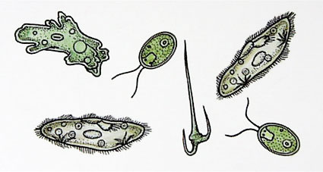
PROTISTS
Unicellular Eukaryotes
Can be autotrophic or heterotrophic
Reproduce mostly asexually

Slide 10
DOMAINS
Domains | EUKARYA
Kingdoms | PROTIST
Cell Type – Prokaryote or Eukaryote | EUKARYOTE
# of cells – Unicellular or Multicellular or Both | MOSTLY UNICELLULAR
Cell Structure – Cell wall composition | CELL WALL WITH CELLULOSE
Nutrition – Autotroph or Heterotroph or Both | BOTH

Slide 11
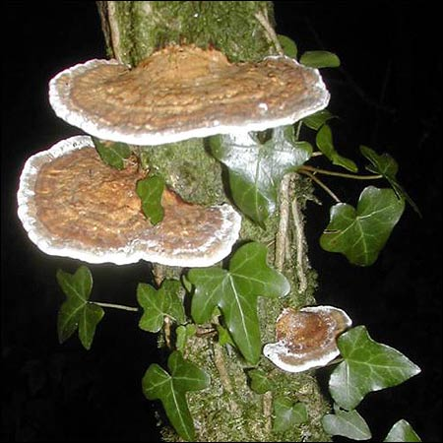
FUNGI
Multicellular eukaryotes
(yeast are the only unicellular fungi)
Heterotrophs
Reproduce asexually and sexually

Slide 12
DOMAINS
Domains | EUKARYA
Kingdoms | FUNGI
Cell Type – Prokaryote or Eukaryote | EUKARYOTE
# of cells – Unicellular or Multicellular or Both | MULTICELLULAR EXCEPT ONE
Cell Structure – Cell wall composition | CELL WALL CONTAIN CHITIN
Nutrition – Autotroph or Heterotroph or Both | HETEROTROPHS

Slide 13
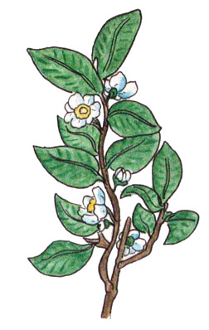
PLANTS
Multicelluar eukaryotes
Autotrophs
Reproduce sexually and asexually

Slide 14
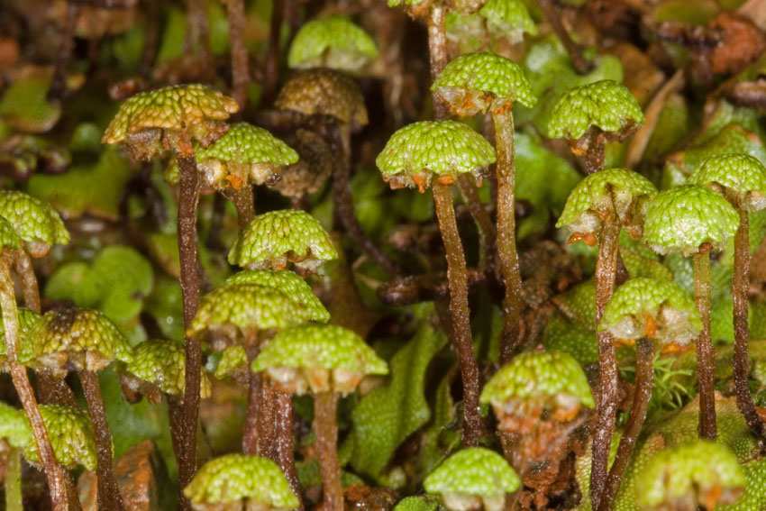
NON VASCULAR PLANTS
Also called Bryophytes
No true roots or vascular tissue causing them to be small in size
Must live in moist environments
Reproduce with spores
Ex. Mosses, liverworts

Slide 15
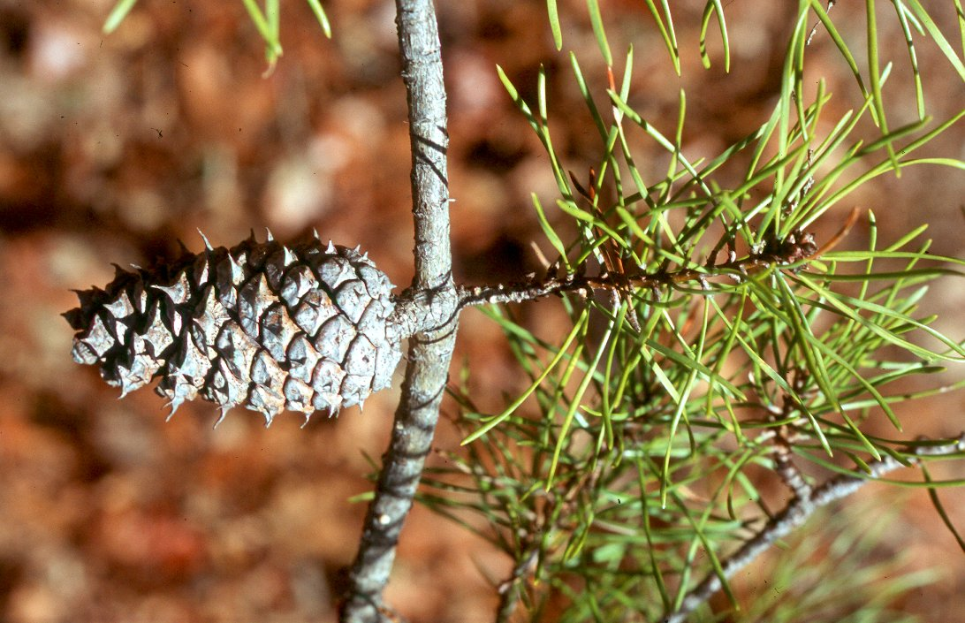
GYMNOSPERMS
Non-flowering vascular plants
Reproduce with
cones that contain seeds
Ex. Conifers (pine trees)

Slide 16
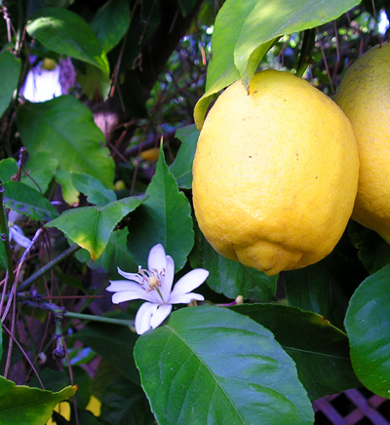
ANGIOSPERMS
Flowering vascular plants
Flower is main reproductive organ
Seeds are enclosed within a fruit
Ex. Deciduous plants

Slide 17
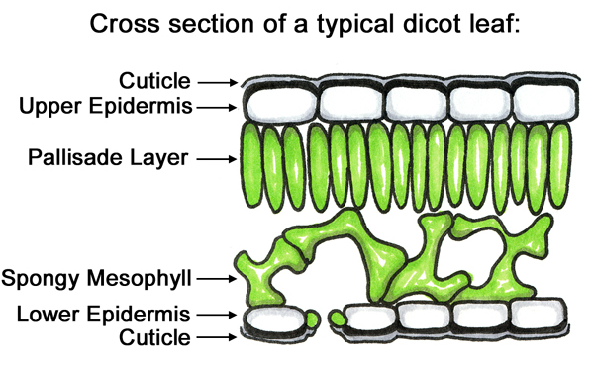
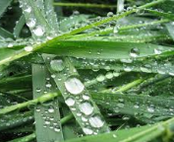
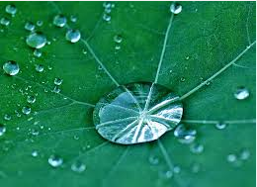
ADAPTATIONS
To prevent desiccation, many plants developed a cuticle (a thick, waxy, watertight barrier) that covers the plant and prevents loss of moisture to the air.

Slide 18
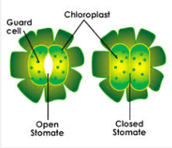
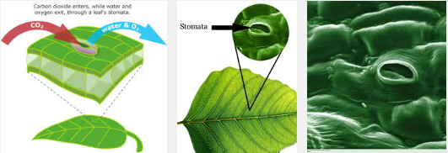
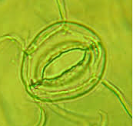
ADAPTATIONS
The stomata are openings in the cuticle that allow for gas exchange and transpiration of water as the plant photosynthesis.

Slide 19
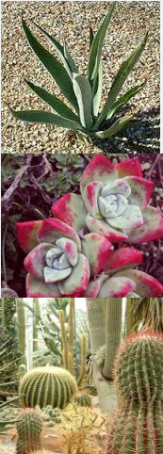
ADAPTATIONS
- DESERT
SUCCULENTS store water in their stems and leaves.
Some plants have no leaves or leaves that only grow after it rains – do photosynthesis in their green stems.
Long roots spread out wide or go deep.
Leaves with hair help shade the plant, reducing water loss.
Some leaves turn during the day to expose a minimum surface area to the heat.
Grow slowly – uses less water.

Slide 20
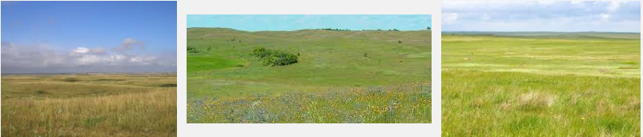
ADAPTATIONS
- GRASSLAND
Roots extend deep into the ground to absorb as much moisture as they can.
Prairie grasses have narrow leaves which slow water loss.

Slide 21
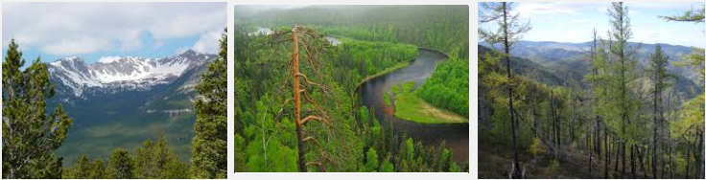
ADAPTATIONS
- TAIGA
Many trees have needle-like leaves whose shape reduced water loss
Waxy coating on leaves prevents evaporation

Slide 22
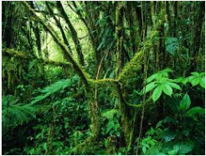
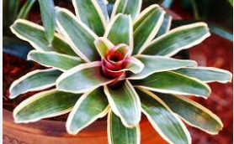
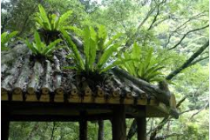
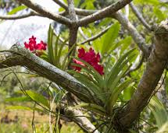
ADAPTATIONS– TROPICAL RAIN FOREST
Drip tips and waxy surfaces allow water to run off to discourage growth of bacteria and fungi.
Smooth bark or waxy flowers speed the run-off of water.
Many bromeliads are epiphytes (plant that live on other plants).

Slide 23
ADAPTATIONS
Growth Adjustment
Gravitropism or Geotropism– a growth response to gravitational forces.
Phototropism— when stems/leaves adjust the direction of growth in response to light
Thigmotropism— plants shift a direction of growth as they contact objects

Slide 24
ADAPTATIONS
Hormones
  Auxin - hormone responsible for regulating phototropism in a plant by stimulating the elongation of cells and helps promote the growth of fruit.
  Abscisic Acid - inhibits plant growth during times of stress such as cold temperature or drought.
  Gibberellins - growth hormones that cause plants to grow taller and increase the rate of seed germination and bud development.

Slide 25
DOMAINS
Domains | EUKARYA
Kingdoms | PLANT
Cell Type – Prokaryote or Eukaryote | EUKARYOTE
# of cells – Unicellular or Multicellular or Both | MULTICELLULAR
Cell Structure – Cell wall composition | CELL WALL MADE WITH CELLULOSE
Nutrition – Autotroph or Heterotroph or Both | AUTOTROPHS

Slide 26
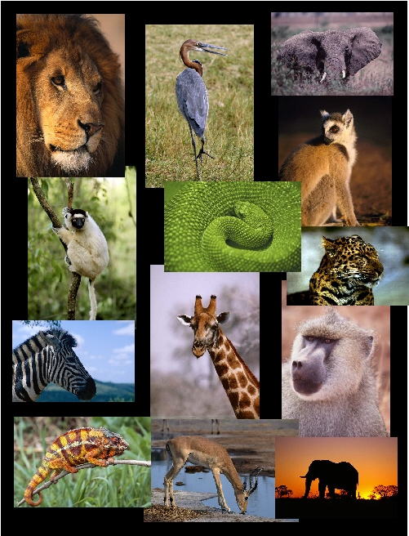
ANIMALS
Multicellular eukaryotes
Heterotrophs
Reproduce sexually and asexually

Slide 27
DOMAINS
Domains | EUKARYA
Kingdoms | ANIMALS
Cell Type – Prokaryote or Eukaryote | EUKARYOTE
# of cells – Unicellular or Multicellular or Both | MULTICELLULAR
Cell Structure – Cell wall composition | NO CELL WALL
Nutrition – Autotroph or Heterotroph or Both | HETEROTROPHS

Slide 28
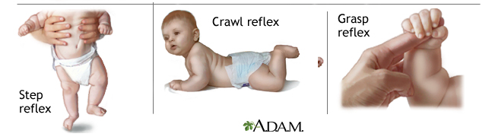
INNATE BEHAVIOR
Reflexes
Automatic response that requires no thinking at all.
a simple, inborn, automatic response by a part of the body to a stimulus.
Reflexes help animals respond quickly to a stimulus, thus protecting them from harm.

Slide 29
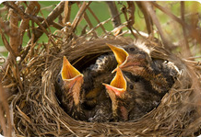
INNATE BEHAVIOR
Instincts
something which is engrained into that animal when it is still developing and hasn't even been born yet.
Instinct is thought to be hereditary, passed on from the parents.

Slide 30
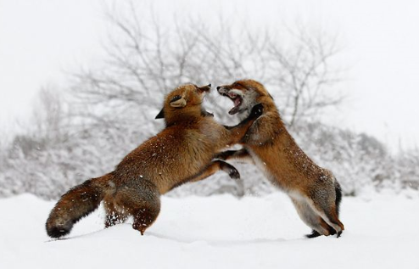
INNATE BEHAVIOR
Territoriality
Animals that have territories will defend their space against others in their species or (sometimes) against other species.

Slide 31
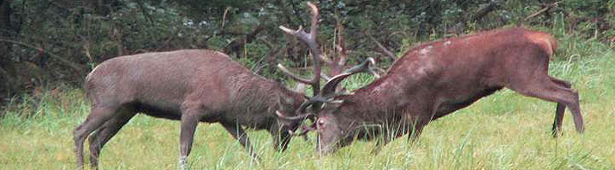
INNATE BEHAVIOR
Aggression
A threatening behavior that one animal uses to gain control over another.
Used to fend off predators and competitors
Used to protect young and food sources.

Slide 32
INNATE BEHAVIOR
Submission
The weaker animal
involves an individual indicating by an act or posture that it will not challenge a dominant individual in a social group.
Helps maintain a social group hierarchy.

Slide 33
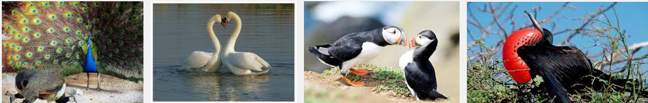
INNATE BEHAVIOR
Courtship
To find a mate
Courtship behavior helps many animals identify healthy mates.
Animal sends out stimuli in order to attract a member of the opposite sex.

Slide 34
INNATE BEHAVIOR
Behavior Cycles
Many animals respond to periodic changes in the environment with daily or seasonal cycles of behavior.
circadian rhythm – occur in daily patterns; uses external cues; important in the feeding and sleeping patterns of all animals

Slide 35
INNATE BEHAVIOR
Migration
– periodic movement from one place to another and then back again.
Uses geographical clues
Uses the Earth’s magnetic field
Can be triggered by hormones

Slide 36
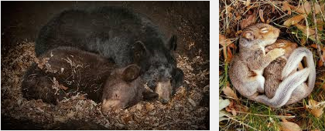
INNATE BEHAVIOR
Behavior Cycles
Hibernation
dormancy during winter;
characterized by low body temperature, slow breathing and heart rate, and low metabolic rate;
reducing the need for food
Can be caused by temperature change or day length change.

Slide 37
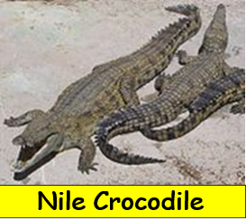
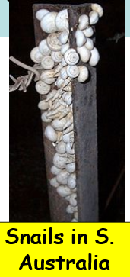
INNATE BEHAVIOR
Behavior Cycles
Estivation
dormancy during summer;
animals slow their activity for the hot, dry summer months.

Slide 38
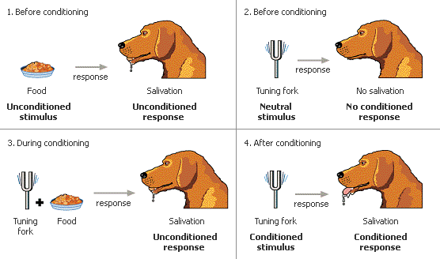
LEARNED BEHAVIOR
Behavior an animal acquires during its lifetime
Includes
  Habituation
  Conditioning
  Trial and error

Slide 39
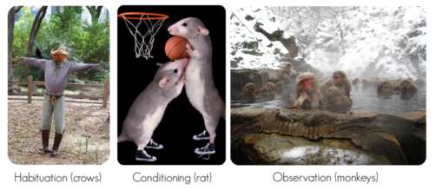
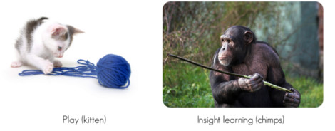
LEARNED BEHAVIOR
Allows animals to adapt!
these behaviors are acquired or learned over time.
Organisms can alter their behaviors as a result of experience.
A result of previous experiences.

Slide 40
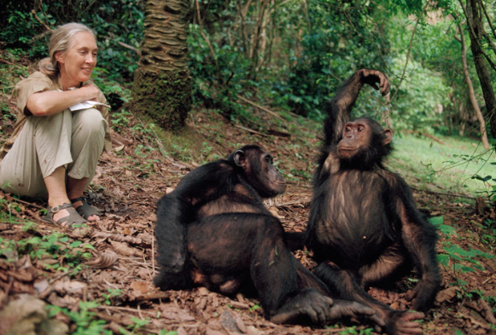
LEARNED BEHAVIOR
  Habituation
  organism decreases or stops its response to a repetitive stimulus that neither rewards nor harms the animal
  The simplest type of learning.
  By ignoring the stimulus, animals can spend their time and energy more efficiently.

Slide 41
LEARNED BEHAVIOR
Imprinting
when an organism forms an attachment to an object or other organism after birth and copies it.
For example, sparrows have an innate ability to recognize their own species’ song. To sing the complete version, the young birds must first hear it sung by the adults.

Slide 42
ADAPTATIONS FOR DEFENSE
Mechanical defense
occurs when an animal uses its physical structures such as claws, tusks, stingers and shells.
Is incorporated into the physical structure of the organism.
Other examples of mechanical defense include camouflage, cryptic coloration, disruptive coloration, counter shading, etc.

Slide 43
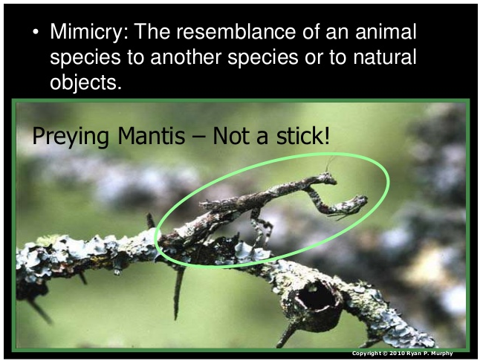
MIMICRY

Slide 44
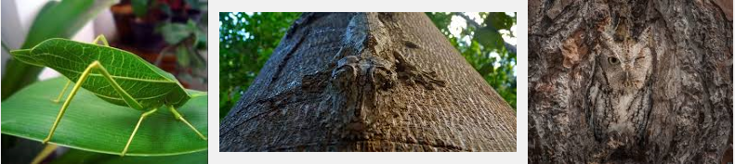
CAMOUFLAGE
Use of a color from an animal’s surroundings.

Slide 45
ADAPTATIONS FOR DEFENSE
Chemical defense occurs when the animal produces stinging sensations, paralysis, poisoning, or just a bad taste
Most common in insects, but the skunk is a particularly dramatic mammalian example. Another example includes the bombardier beetle which can accurately shoot a predator with a stream of boiling poison.
The most poisonous animal on earth is the 2 inch long (5cm) golden poison dart frog. It has enough venom to kill 10 adult humans or 20,000 mice.

Slide 46
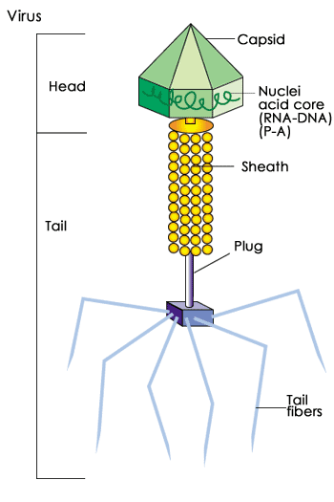
VIRUSES
Not considered living things
Pathogens that can mutate to resist vaccines
Ex. HIV, Influenza,
Smallpox

Slide 47
VIRUSES
VIRUS
Viruses are nonliving particles that can only reproduce within a HOST CELL (living cell).
Incapable of reproducing independently.
Do not grow.
Do not have homeostasis.
Do not metabolize.
Can crystallize.

Slide 48
VIRUSES
Structure and Function
  Nucleic Acid – DNA or RNA
  Capsid - protein coat surrounding nucleic acid; arrangement determines shape; contains special sites on its protein surface that allow the virus to attach and penetrate the host cell membrane
  Envelope - membrane surrounding the capsid; not found in all viruses; helps the virus enter cells. Made up of proteins, lipids, and glycoproteins.

Slide 49
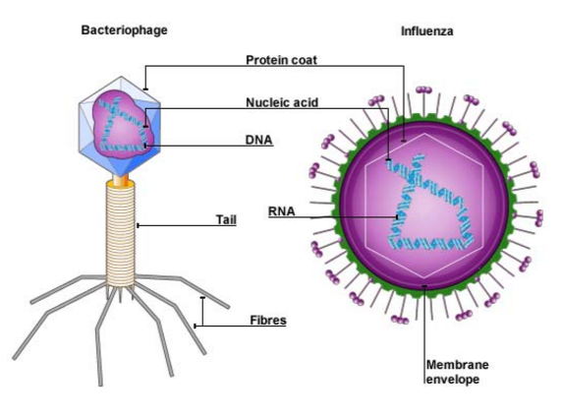
VIRUSES
VIRUS
Structure and Function

Slide 50
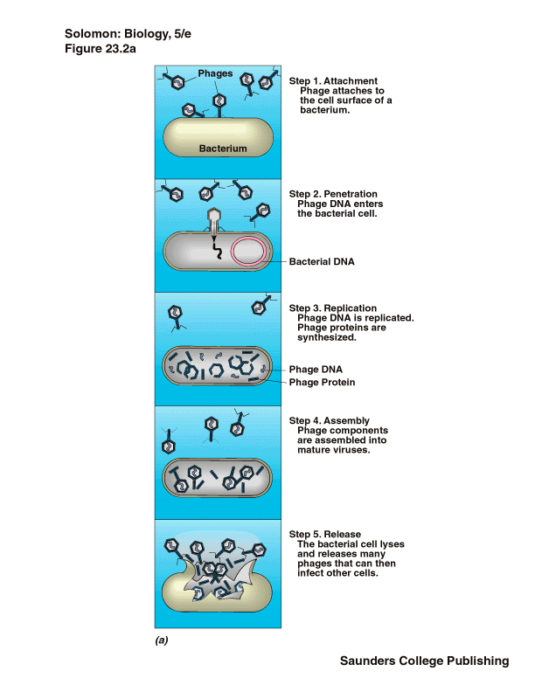
VIRUSES
VIRUS
Replication
LYTIC CYCLE
Attach
Entry
Replication
Assembly
Release

Slide 51
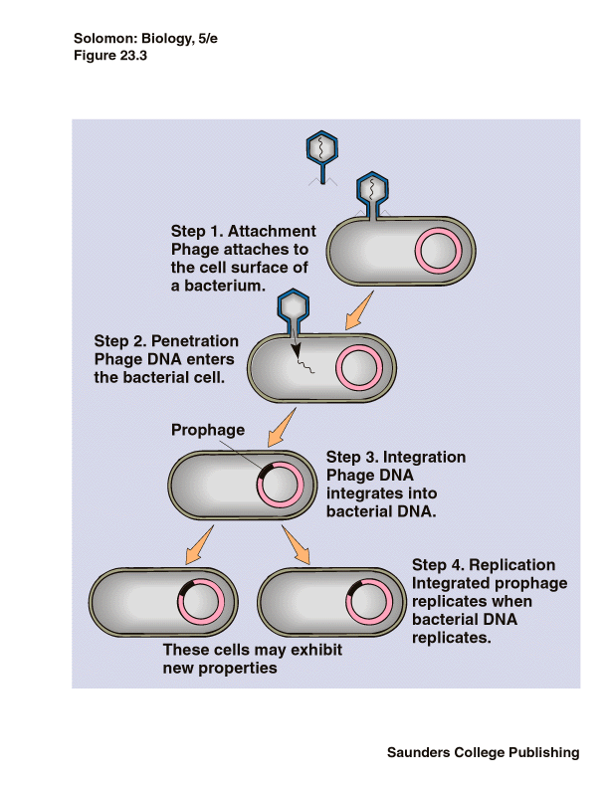
VIRUSES
VIRUS
Replication
  Lysogenic Cycle
Attach
Entry
Integration
Replication

Slide 52
VIRUSES
VIRUS
Antiviral drugs – treat symptoms or suppress the virus.
Your immune system has to kill the virus.
Vaccine – preparation of weakened or killed virus/viral particle; stimulates immune system to prevent infection by “teaching” it to recognize virus

Slide 53
VIRUSES
VIRUS
Oncogenic viruses – cause cancer; genes disrupt cell cycle.
Retrovirus – contains RNA; produces a DNA copy of the viral RNA and inserts viral DNA into host cell.
Prion – protein particle with no nucleic acid; accumulation of proteins in an area and kills cells.
Viroid - small naked single-stranded RNA molecules that cause plant diseases.

