Slide 1
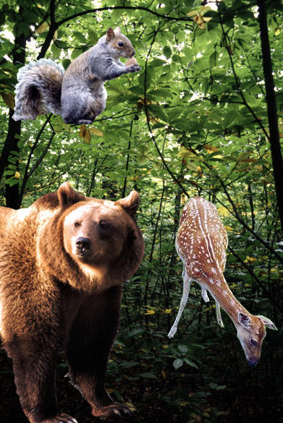
ECOLOGY
The environment is composed of two factors:
Biotic factors - are the living and once living parts of an environment (plants, animals, dead organisms).
Abiotic factors- are the never living parts of the environment (i.e. air, water, rocks, sand, light, and temperature).
Notes:
When I say environment you think what—weather. Well Ok but it it much more than that

Slide 2
Biosphere
Biome
Ecosystem
Community
Population
Organism
Notes:
Just like with classification, ecology is hierarchal. Each level builds on itself and they fit together like nesting boxes.

Slide 3
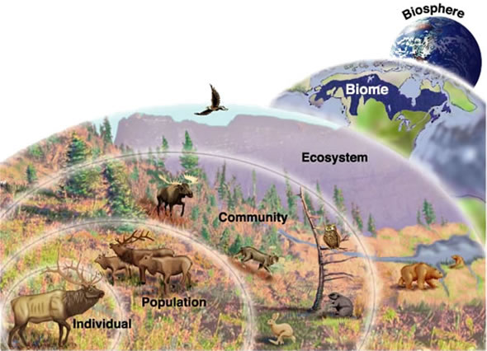

Slide 4
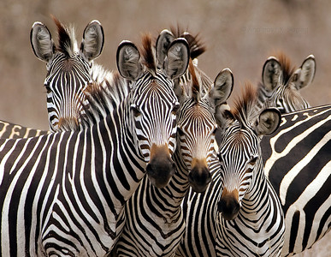
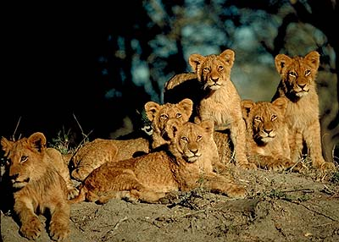
POPULATION
All members of the same species that LIVE in the same place at the same time.
Produce fertile offspring
Compete with each other for resources (food, mates, shelter, etc.)
Notes:
The next level is a population. A population consists of a single species living together and breeding. Give me an example of a population. Ex. large mouth bass living in Lake Meade. Beetles living under the same log. Here we have salmon spwning and two bears fishing.

Slide 5
HABITAT VS. NICHE
Habitat- the place in which an organism lives out its life
Niche - the role a species plays in a community; its total way of life
Notes:
Although several species may share a habitat they each have their own niche. A niche is a very narrow range where a species fits within a habitat.

Slide 6
HABITAT VS. NICHE
Example:
A tree frog in a Brazilian rainforest can only survive if temperatures and humidity stay within a certain range. It also needs access to a certain amount and type of food. It must avoid becoming food for predators.
The sum of these conditions is the frog’s niche.

Slide 7
POPULATION
All members of the same species that live in the same place at the same time.
Produce fertile offspring
Compete with each other for resources (food, mates, shelter, etc.)
Four variables influence/govern population size:
1. Births
2. Deaths
3. Immigration
4. Emigration.
rate = (b - d) + (i - e)

Slide 8
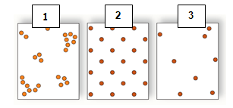
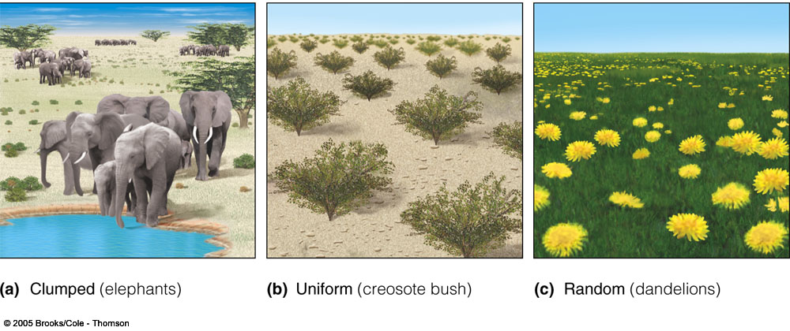

POPULATION
Population Density
  Clumped
  Uniform
  Random

Slide 9
POPULATION
Populations usually stay about the same size from year to year.
A species’ biotic potential is the fastest rate at which its population can reproduce.
This rate is limited by an organism’s reproductive potential which is the maximum number of offspring that each member of the population can produce.

Slide 10
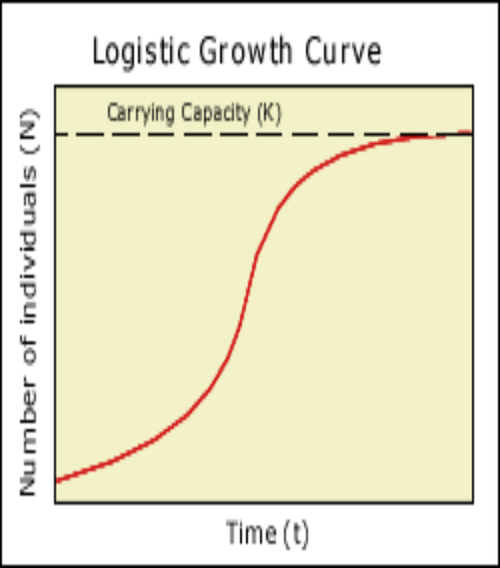
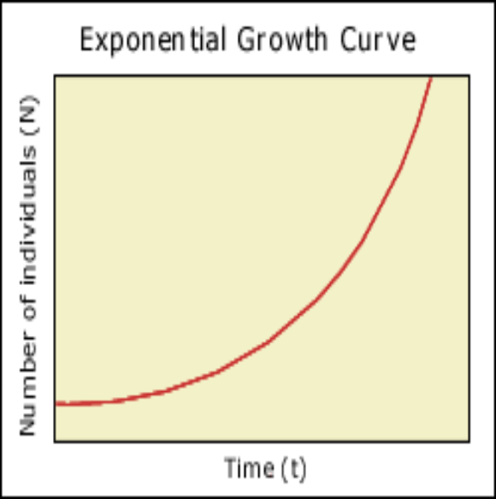
POPULATION
  Exponential Growth
    Define - Populations rapidly increase due to an abundance of resources. There are UNLIMITED resources.
  Logistic Growth
    populations are limited by environmental factors and tend to attain equilibrium in size which is determined by available resources.

Slide 11
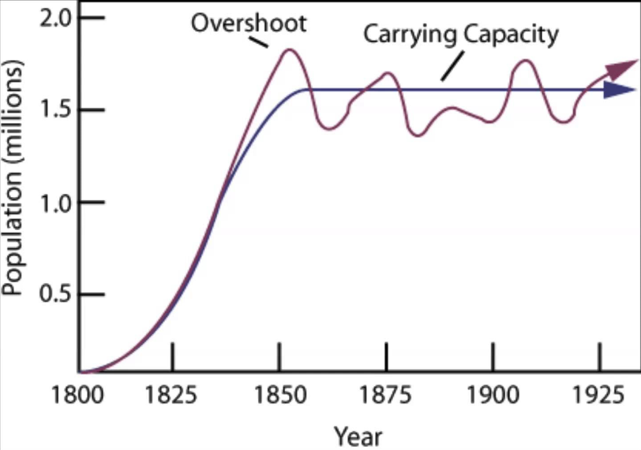
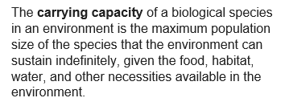
POPULATION
Carrying Capacity

Slide 12
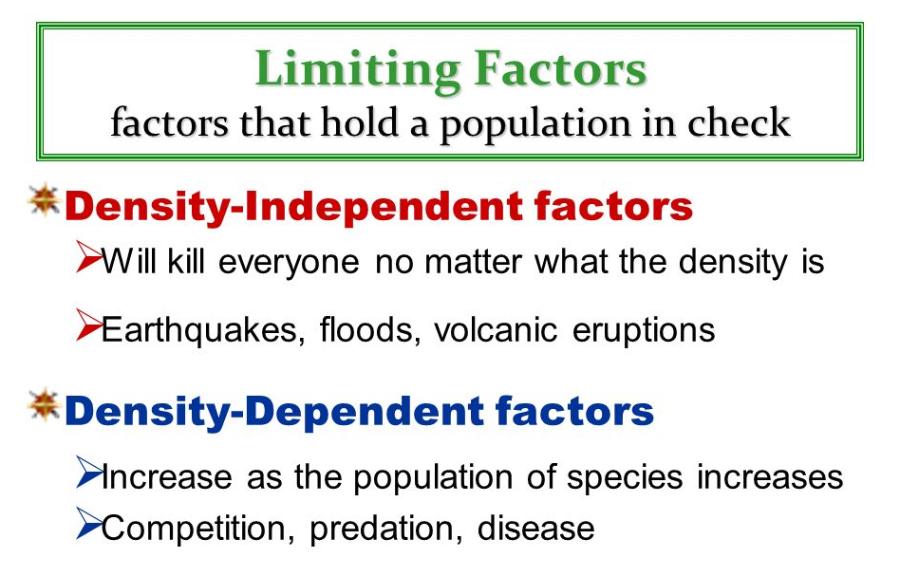
POPULATION

Slide 13
COMMUNITY
A group of various species that live in the same place and interact with each other.
Several interacting populations that inhabit a common environment and are interdependent.
It is only made of biotic components.
Notes:
Next level is a community which is several populations living together and depending on each other. What does interdependent mean? An example of a community is shown here with the bear and the salmon. They both live in a common environment and the bear needs the fish for food? How does the salmon need the bear?

Slide 14
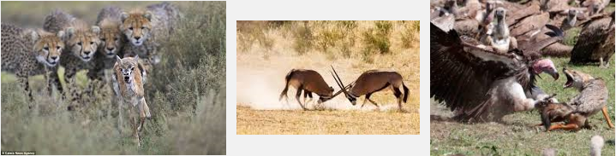
COMMUNITY
Competition
A relationship in which different individuals or populations attempt to use the same limited resources.
Each individual has less access to the resource and is harmed by the competition.

Slide 15
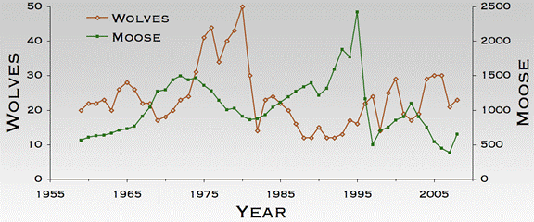
COMMUNITY
Predation
The act of one organism (predator) feeding on another organism (prey).

Slide 16
COMMUNITY
Symbiosis
A relationship in which two species live in close association.
These species may evolve adaptations that reduce the harm or improve the benefit of the relationship.
Three Types:
  Mutualism (+,+); Parasitism (+,-); Commensalism (+, o)

Slide 17
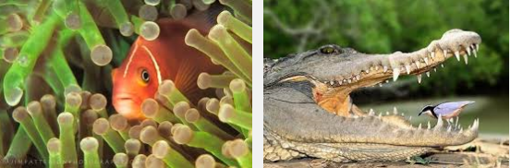
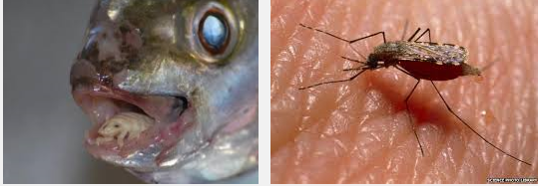
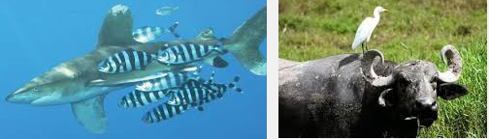
Parasitism – An organism that lives in or on another organism (host) and feeds on it. Parasites usually do not kill their hosts, but weakens or develops a disease.
Mutualism – Two species provide a benefit and depend on each other for survival.
Commensalism – A relationship in which one species benefits and the other species is neither harmed nor helped.

Slide 18
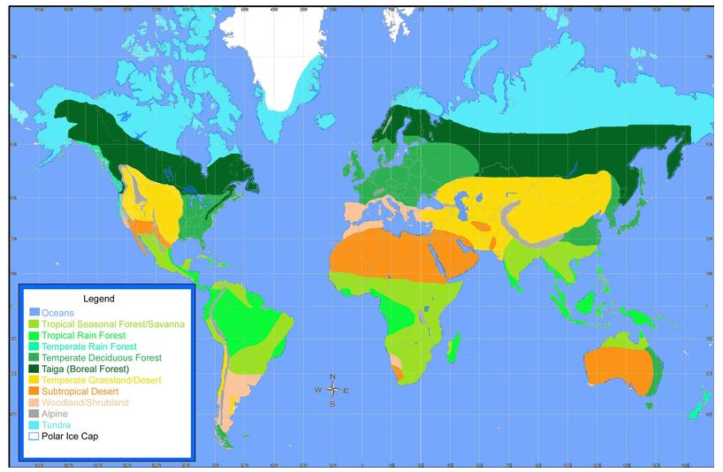
BIOME
Are large climatic regions that contain a number of smaller ecosystems. Biomes may exist in more than one location and are distinguished by plants and animals.

Slide 19
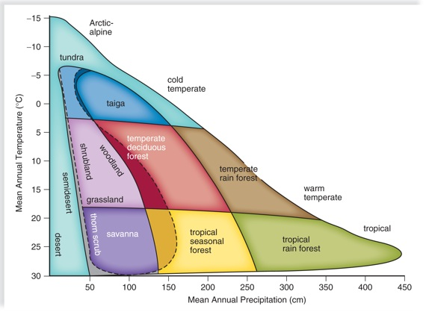
TERRESTRIAL BIOMES

Slide 20
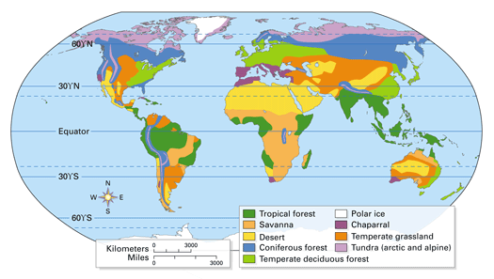
TERRESTRIAL BIOMES

Slide 21
TROPICAL RAIN FOREST
Found near the equator in Africa, South America, Australia, and the Pacific Islands
The most widespread biome
Greatest diversity of plants, animals, and other organisms.
200 to 225 cm precipitation yearly
Hot and humid all year
Temperatures are fairly constant - 25ºC
Soil is nutrient poor and acidic.

Slide 22
TROPICAL RAIN FOREST
A rain forest may contain more than 700 species of trees and over 1000 species of flowering plants.
Plant Adaptations:
Drip tips, waxy cuticle, shallow roots, buttresses, climbing vines, epiphytes
Animal Adaptations:
Some animals never touch the ground, opposable thumbs to holding vines and limbs

Slide 23
TEMPERATE DECIDUOUS FOREST
Found in Europe, the Eastern part of the United States, and China
Found between 30ºN - 50ºN latitudes
75 to 150 cm precipitation yearly
Wide range of temperatures with four seasons
Below freezing in winter to 30ºC in summer

Slide 24
Temperate Deciduous Forest
the growing seasons lasting only 4 to 6 months. Plants are adapted to survive seasonal changes.
Trees are predominately are broad, flat leaf which drop during the fall.
Soil is rich in nutrients.
Animal usually hibernate or migrate during the winter months.

Slide 25
TAIGA OR CONIFEROUS FOREST
Found in parts of Canada, Alaska, and Russia.
World’s largest land biome.
Latitudes between 50ºN and 60ºN.
Winters are long and cold (6-10 months).
Average temperatures are below freezing.
35 to 40 cm of precipitation yearly (mostly snow).

Slide 26
TAIGA
Plant Adaptations:
Mostly conifers trees grow which have needle-like leaves and seeds that develop in cones.
The shape of the leaves and their cuticle prevents the tree from losing too much water especially important when ground is frozen and the roots cannot replace lost water by absorbing more from the soil.
Animal Adaptations:
Migration, hibernation, heavy summer and fall feeding.

Slide 27
GRASSLAND / SAVANNA
Grassland found in Africa, western India, northern Australia and South America.
A tropical or temperate biome that is dominated by grasses, shrubs and small trees.
Because most rain falls during the wet season, plants must be able to survive prolonged periods without water.

Slide 28
GRASSLAND / SAVANNA
Plant Adaptations:
During the dry season, plants lose their leaves or die down to the ground.
Many plants have horizontal root systems so they can draw water from a larger area.
Most plants have vertical leaves to reduce water loss and thorns to keep herbivores away.
The soil is rich and fertile.
The grass has extensive root systems, called sod.
Animal Adaptations:
Grazing herbivores have adopted a migratory way of life and follow the rains.
Many animals give birth during the rainy season when food is abundant and the young are more likely to survive.

Slide 29
DESERT
The driest biome on Earth – found on every continent.
Extreme temperatures- Very hot during the day and cool at night.
Even in hot deserts near the equator, there is little insulating moisture in the air - the temperature may go from 40ºC in the day to near freezing at night.
Very little rainfall - less than 25 cm precipitation yearly

Slide 30
DESERT
Plant Adaptations:
Succulents are plants that have thick, fleshy stems and leaves and their leaves have a waxy coating that prevents water loss.
Sharp spines protect the plants from animals.
Animal Adaptations:
Reptiles have thick, scaly skin that prevents water loss and amphibians survive summers by estivating – burying themselves in the ground and sleeping during the dry season.
Most desert animals are nocturnal which means they are active mainly at night when the air is cooler.

Slide 31
TUNDRA
Found in parts of Canada, Alaska, and Siberia.
Found at latitudes around the North Pole; northern arctic regions.
Less than 25 cm precipitation yearly
Very cold year round (-40ºC in winter)
Very cold year round (-40ºC in winter)
Winter lasts 6 to 9 months with no daylight
Summer is short and cold with 24 hours of sunlight a day

Slide 32
TUNDRA
Plant Adaptations:
Moss and lichen which can grow without soil cover vast areas of rock.
The soil is thin, so plants have wide, shallow roots to anchor them against the icy winds.
Most plants are short and grow close to the ground to avoid wind and help absorb heat from the sunlit soil during the summer.
Animal Adaptations:
Some animals burrow underground during the winter, but are still active.
Many animals that live in the tundra year-round lose their brown fur and grow white fur to camouflage them in the winter snow.
These animals are also extremely well insulated.
Many animals of the tundra migrate there during the short summer.

Slide 33
FRESHWATER
RIVERS
  The faster the water flows, the greater the amount of dissolved oxygen in it.
  Faster water flows = increased oxygen
At its headwaters, a river is usually cold, full of oxygen and runs swiftly through a shallow riverbed.
As the river flows down a mountain, it becomes warmer, wider, slower, contains more vegetation and less oxygen.

Slide 34
FRESHWATER
Ponds
  Small, shallow bodies of water
  Sunlight penetrates all the way to the bottom
  Most completely filled with plant material
  Very high amount of nutrients
Lakes
  Larger and deeper than ponds
  Plant growth is limited to the shoreline
  Sunlight does NOT penetrate to the bottom= no plants after a certain depth!

Slide 35
FRESHWATER
Freshwater Wetlands
Land is covered with freshwater for at least part of the year such as marshes and swamps.
Most freshwater wetlands in the U.S. are located in the Southeast.
Wetlands act as filters because they absorb and remove pollutants from the water that flows through them.
They control flooding by absorbing extra water when rivers overflow.
Many game fish use wetlands for feeding and spawning. These areas provide habitats for wildlife.

Slide 36
SALTWATER
Coastal Wetlands
  Area where a river meets an ocean
  Mix of salt and freshwater
  Located near coastlines, border land
  Extremely fertile
  Nutrient levels are higher than both salt and freshwater.
Coastal wetlands provide habitat and nesting areas for fish and other wildlife.
Coastal wetlands absorb excess rain, protect areas from flooding, filter out pollutants and sediments and provide a recreational area for humans.

Slide 37
SALTWATER
Salt Marshes
In estuaries, where river deposit their load of mineral-rich mud, salt marshes form.
The marsh supports a community of clams, fish and aquatic birds.
It serves as a nursery for many species.
It absorbs pollutants and protects inland areas.

Slide 38
SALTWATER
Coral Reefs
Reefs are limestone ridges built by tiny coral animals called polyps and the algae that live inside them.
Thousands of species live in the reefs making it one of the most diverse ecosystems.
Reefs are found in shallow, clear tropical seas.

Slide 39
SALTWATER
Oceans
  Can be divided into 2 main life zones
    1. Photic zone- sunlight penetrates
    2. Aphotic zone- NO sunlight
    Much of ocean’s life is concentrated in the shallow, coastal waters (photo zone) where sunlight penetrates to the bottom and rivers wash nutrients from the land.

