Slide 1
DO NOW
Pick up worksheet packet.
Get out notes….last three pages go with this unit.
Get out a new EOC daily sheet.

Slide 2
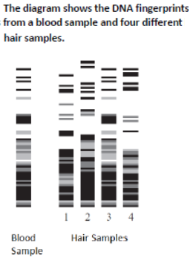
EOC BIOLOGY BIO13
Based on the DNA fingerprints, which hair sample came from the same organism as the blood sample.
Hair Sample 1
Hair Sample 2
Hair Sample 3
Hair Sample 4

Slide 3
EOC BIOLOGY BIO13
C. Hair Sample 3. The pattern of dark and light bands in this hair sample exactly matched the pattern in the blood sample.
Choices A, B, and D are incorrect because each of these hair samples has a different patterns of dark and light bands that does not match the pattern in the hair sample.

Slide 4
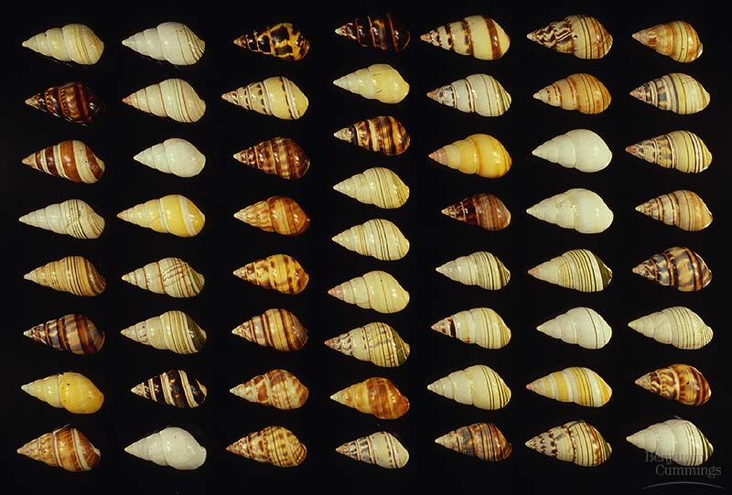
PROCESS OF EVOLUTION

Slide 5
EVOLUTION
We are going to look at the processes of evolution:
MACROEVOLUTION
large scale evolutionary change
AND
MICROEVOLUTION
evolution that occurs within a population.

Slide 6

MACROEVOLUTION
Macroevolution is evolution on a scale of separated gene pools.
Is it large scales evolutionary change.
Macroevolutionary studies focus on change that occurs at or above the level of species, in contrast with microevolution, which refers to smaller evolutionary changes (typically described as changes in allele frequencies) within a species or population.

Slide 7
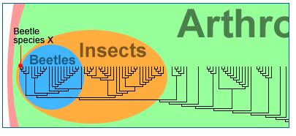
MACROEVOLUTION
Microevolution Macroevolution

Slide 8
MACROEVOLUTION
Macroevolution encompasses the grandest trends and transformations in evolution, such as the origin of mammals and the radiation of flowering plants.
Macroevolutionary patterns are generally what we see when we look at the large-scale history of life.
It is not necessarily easy to "see" this history; there are no firsthand accounts to be read.
Instead, we reconstruct the history of life using all available evidence: geology, fossils, and living organisms.

Slide 9
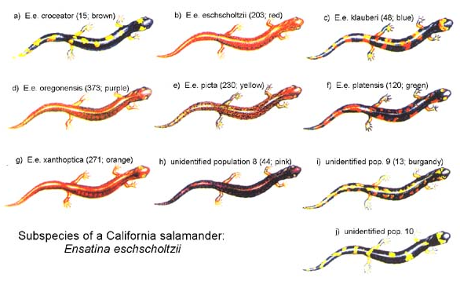
SPECIATION
Formation of a new species (group of organisms that can reproduce fertile offspring) needs:
1. Available niche
2. Genetic Isolation
3. Time

Slide 10
MACROEVOLUTION
SPECIATION - produces a NEW species
gene flow between two population is interrupted
genetic differences gradually accumulate between the two populations
reproductive isolation evolves as a consequence of this divergence

Slide 11
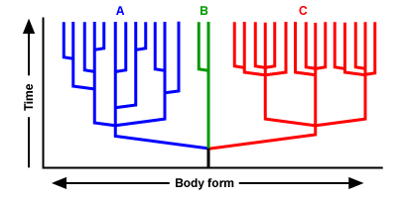
MACROEVOLUTION
Lots f splitting along the way
Only one split
Lots of splitting at the same time.

Slide 12
MACROEVOLUTION
MECHANISMS leading to speciation:
Geographic Isolation
- Separated by bodies of water or mountains.
Temporal Isolation
- Reproduction takes place at different times of the year
Behavioral Isolation
- Populations are capable of interbreeding, but have different courtship rituals or other type of behavior.

Slide 13
MACROEVOLUTION
Geographic Isolation example
Some fruit fly larvae were washed up on an island, and speciation starts because populations were prevented from interbreeding by geographic isolation.
Scientists think that geographic isolation is a common way for the process of speciation to begin: rivers change course, mountains rise, continents drift, organisms migrate, and what was once a continuous population is divided into two or more smaller populations.

Slide 14
MACROEVOLUTION
Temporal Isolation example
There is reproductive isolation due to differences in the mating season in the toad species Bufo americanus and Bufo fowleri.
The members of these species can be successfully crossed in the laboratory.
However, mating does not occur in the wild even though the geographical distribution of the two species overlaps. B. americanus mates in early summer and B. fowleri in late summer.

Slide 15
MACROEVOLUTION
Behavioral Isolation example
Bowerbirds construct elaborate bowers and decorate them with different colors in order to woo females.
If two species in the beginning stages of differentiation evolve differences in this mating ritual, it might permanently isolate them and complete the process of speciation.

