Slide 1
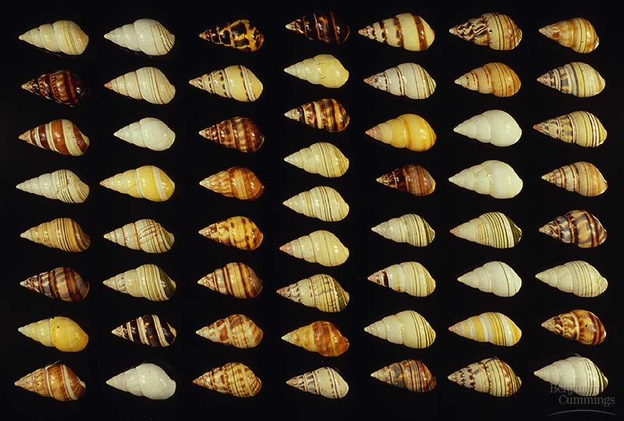
PROCESS OF EVOLUTION

Slide 2
EVOLUTION
We are going to look at the processes of evolution:
MACROEVOLUTION
large scale evolutionary change
AND
MICROEVOLUTION
evolution that occurs within a population.

Slide 3
START WITH MICROEVOULTION
Watch: Mechanisms of Evolution

Slide 4
MODERN THEORY
Today’s theory on evolution
Recognizes that GENES are responsible for the inheritance of characteristics.
Recognizes that POPULATIONS, not individuals, evolve due to natural selection and genetic drift.
Recognizes that SPECIATION usually is due to the gradual accumulation of small genetic changes.

Slide 5
SPECIES AND POPULATIONS
Population - a localized group of individuals of the same species.
Species - a group of populations whose individuals have the ability to breed and produce fertile offspring.
Individuals near a population center are, on average, more closely related to one another than to members of other populations.

Slide 6
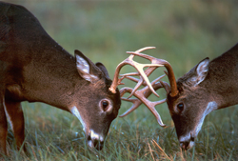
POPULATIONS
A group of the same species living in an area.
No two individuals are exactly alike due to variations.
More fit individuals survive and pass on their traits.

Slide 7
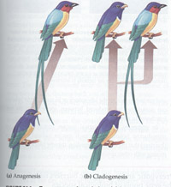
SPECIATION
Formation of new species.
One species may split into two or more species.
A species may evolve into a new species.
Requires very long periods of time.

Slide 8
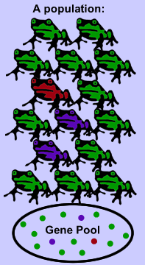
THE GENE POOL
Members of a species can interbreed and produce fertile offspring.
Species have a shared gene pool.
Gene pool – all of the alleles of all individuals in a population.

Slide 9
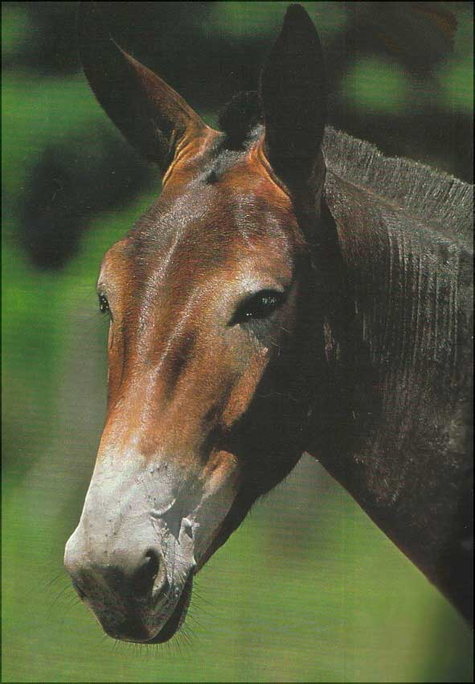
THE GENE POOL
Different species do NOT exchange genes by interbreeding.
Different species that interbreed often produce sterile or less viable offspring, e.g. Mule.

Slide 10
THE GENE POOL
A population’s gene pool is the total of all genes in the population at any one time.
If all members of a population are homozygous for a particular allele, then the allele is fixed in the gene pool.

Slide 11
MICROEVOLUTION
MICROEVOLUTION refers to evolution that occurs within a population.
Changes occur in gene pools due to genetic mutation, gene flow, genetic drift, and natural selection.
Gene pool changes cause more VARIATION in individuals in the population.
Example: Bacteria becoming unaffected by antibiotics (resistant).

Slide 12
MICROEVOLUTION
Microevolution refers to changes in allele frequencies in a gene pool from generation to generation. Represents a gradual change in a population.
Mechanisms of Microevolution:
Genetic Mutations
Gene Flow
Genetic Drift
Natural Selection

Slide 13
MICROEVOLUTION
Mechanisms of evolution – leading to changes in allele frequencies!!!
Imagine that you observe an increase in the frequency of brown coloration genes and a decrease in the frequency of green coloration genes in a beetle population. Any combination of the mechanisms might be responsible for the pattern.

Slide 14
GENETIC MUTATIONS
A mutation is an error in the replication of a nucleotide sequence provides the genetic variation that evolution acts on.
Some “green genes” randomly mutated to “brown genes” (mutations alone cannot account for a big change in allele frequency).
Mutations can be transmitted in gametes to offspring, and immediately affect the composition of the gene pool.

Slide 15
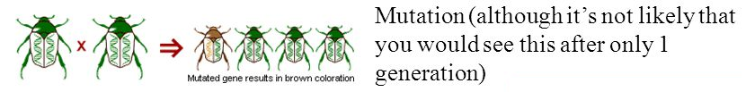
GENETIC MUTATIONS
- The original source of variation.

Slide 16
GENE FLOW
GENE FLOW: Genes from one population are incorporated into a different population.
Some beetles with brown genes immigrated from another population or some beetles carrying green genes emigrated.
Migration into or out of a population may be responsible for a marked change in allele frequencies (the proportion of members carrying a particular variant of a gene).

Slide 17
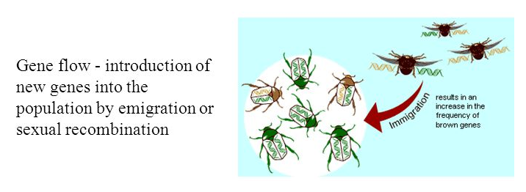
GENE FLOW

Slide 18
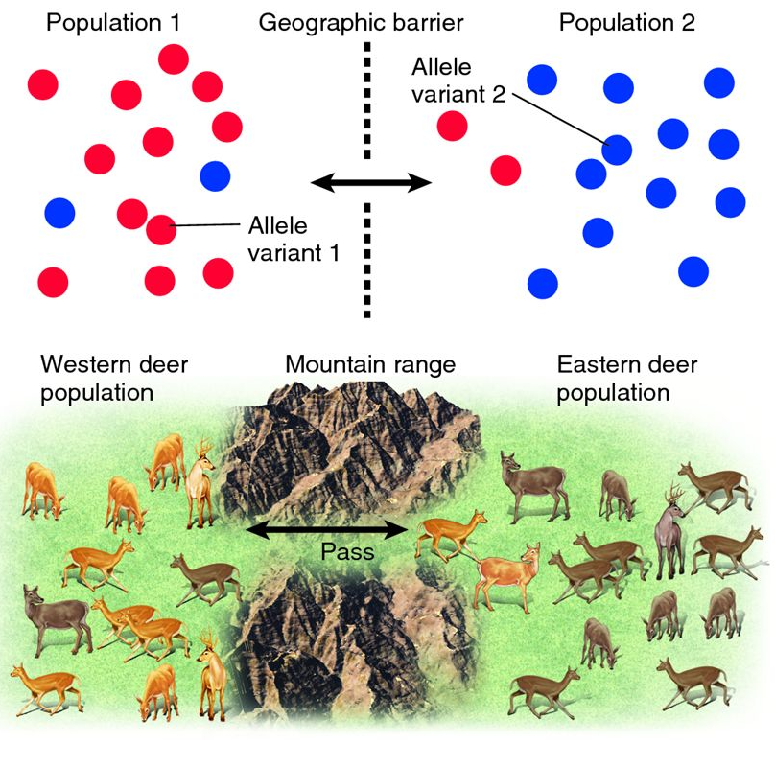
GENE FLOW

