Slide 1
MICROEVOLUTION
Microevolution refers to changes in allele frequencies in a gene pool from generation to generation. Represents a gradual change in a population.
Mechanisms of Microevolution:
Genetic Mutations
Gene Flow
Genetic Drift
Natural Selection

Slide 2
GENETIC DRIFT
Genetic drift = the alteration of the gene pool of a small population due to chance.
It is random changes in the frequency of alleles within a population.
When the beetles reproduced, just by chance more brown genes than green genes ended up in the offspring. Easier to recognize and has a greater effect in a small population.

Slide 3
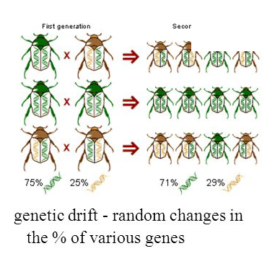
GENETIC DRIFT

Slide 4
GENETIC DRIFT
Two factors may cause genetic drift:
Bottleneck effect may lead to reduced genetic variability following some large disturbance that removes a large portion of the population. The surviving population often does not represent the allele frequency in the original population.
Founder effect may lead to reduced variability when a few individuals from a large population colonize an isolated habitat.

Slide 5
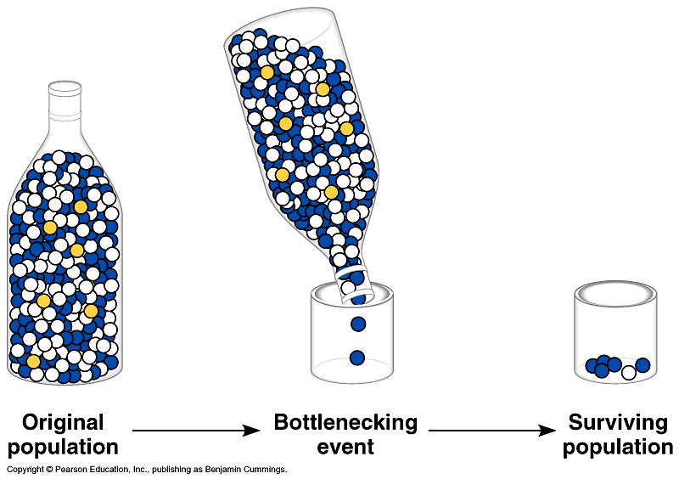

Slide 6
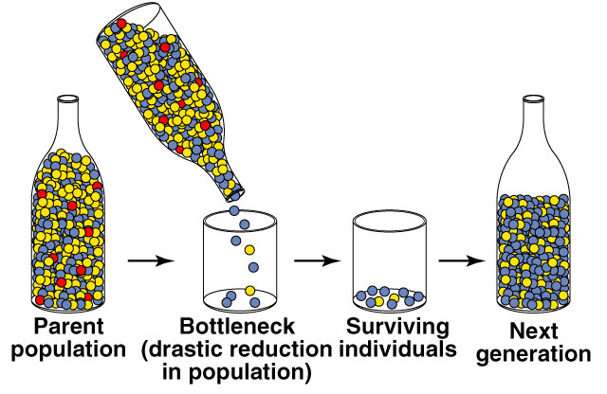
GENETIC DRIFT-BOTTLENECK EFFECT

Slide 7
NATURAL SELECTION
Differential survival and/or reproduction of organisms that differ in one or more characteristics.
Differential success in reproduction based on heritable traits results in selected alleles being passed to relatively more offspring (Darwinian inheritance).
The only agent that results in adaptation to environment.
Beetles with brown genes escaped predation and survived to reproduce more frequently than beetles with green genes, so that more brown genes were passed to the next generation.

Slide 8
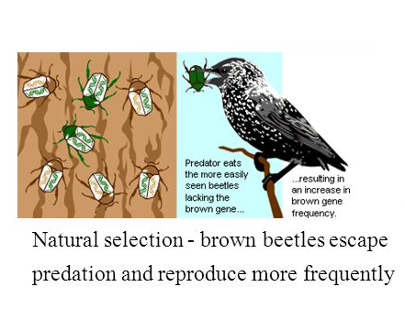
NATURAL SELECTION

Slide 9
NATURAL SELECTION
Natural selection does not produce perfect organisms
a. Evolution is limited by historical constraints (e.g., humans have back problems because our ancestors were 4-legged).
b. Adaptations are compromises. (Humans are athletic due to flexible limbs, which often dislocate or suffer torn ligaments.)
c. Not all evolution is adaptive. Chance probably plays a huge role in evolution and not all changes are for the best.
d. Selection edits existing variations. New alleles cannot arise as needed, but most develop from what already is present.

Slide 10
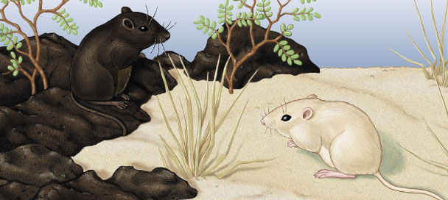
NATURAL SELECTION
Selection pressures:
  avoiding predators
  matching climatic condition
  pesticide resistance

Slide 11
GENETIC DRIFT SIMULATION
To complete the manual version of the Genetic Drift Simulation you need:
the Worm Worksheet
colored pencils in 5 different colors.

Slide 12
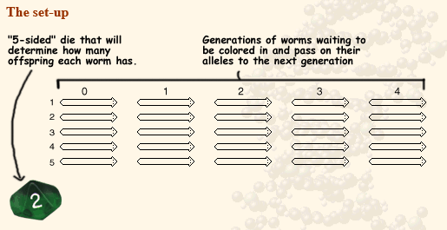
GENETIC DRIFT SIMULATION

Slide 13
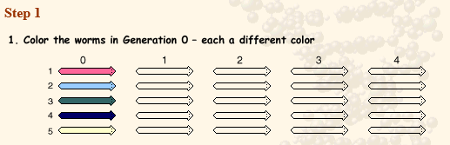
GENETIC DRIFT SIMULATION

Slide 14
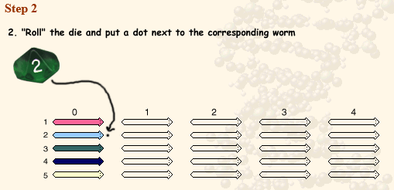
GENETIC DRIFT SIMULATION

Slide 15
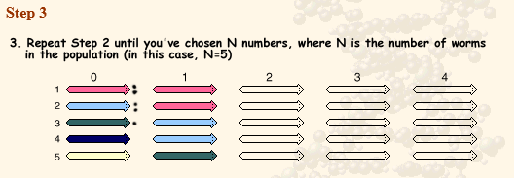
GENETIC DRIFT SIMULATION

Slide 16
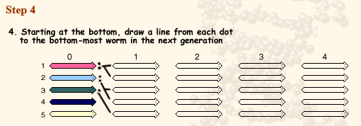
GENETIC DRIFT SIMULATION

Slide 17
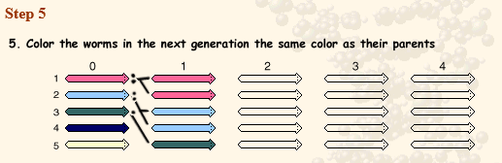
GENETIC DRIFT SIMULATION

Slide 18
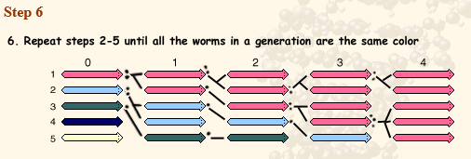
GENETIC DRIFT SIMULATION

