Slide 1
PATTERNS OF EVOLUTION
Divergent Evolution
Convergent Evolution
CoEvolution

Slide 2
DIVERGENT EVOLUTION
Divergent evolution is the process of two or more related species becoming more and more dissimilar.
Organisms, who share a common ancestry, have evolved into different organisms.
They diverge because they are adapted by different environments.
Over millions of years, related species become dissimilar as they adjust to their environment.

Slide 3
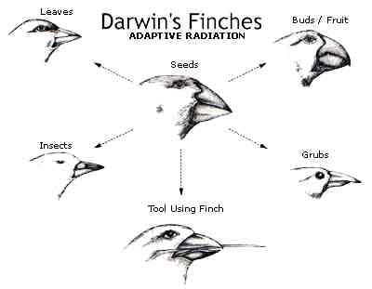
DIVERGENT EVOLUTION
Darwin’s finches went through adaptive radiation - process by which ancestral species evolve into a number of different species.

Slide 4
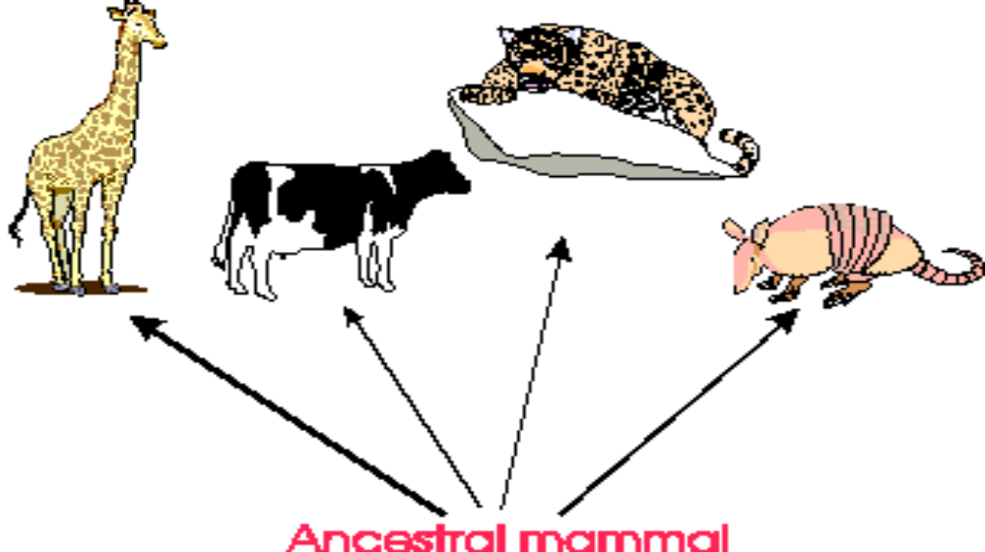
DIVERGENT EVOLUTION

Slide 5
CONVERGENT EVOLUTION
Convergent evolution is the emergence of biological structures or species that exhibit similar function and appearance but that evolved through widely different evolutionary pathways.
result of geographic isolation and niches to be filled.
process by which different species evolve similar structures or adaptations to similar (but different) environments.

Slide 6
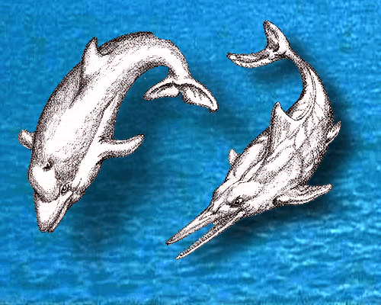
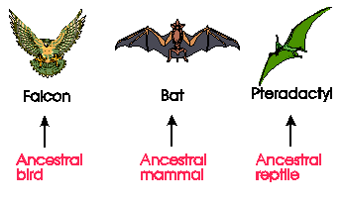
CONVERGENT EVOLUTION

Slide 7
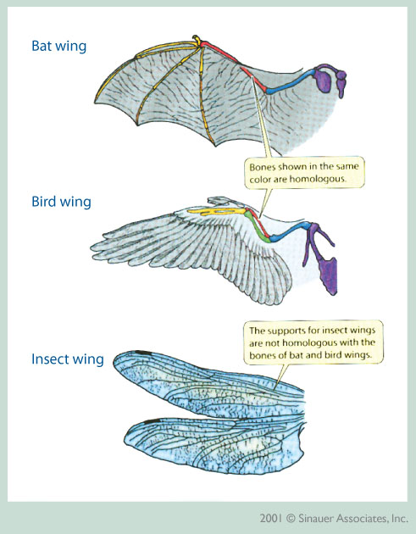
CONVERGENT EVOLUTION

Slide 8
CONVERGENT EVOLUTION
Darwin ran into several situations where he found many organisms on different continents that looked alike and shared many similarities.
However, after closer study he discovered that while they look similar they were in fact unrelated.
The similarities evolved due to exposure to similar environmental pressures.

Slide 9
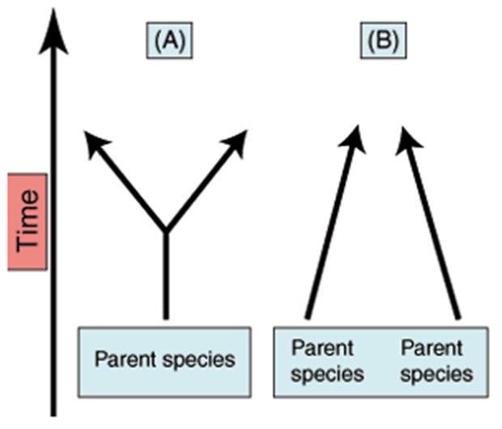
EVOLUTION
Which is Divergent and which is Convergent Evolution?

Slide 10
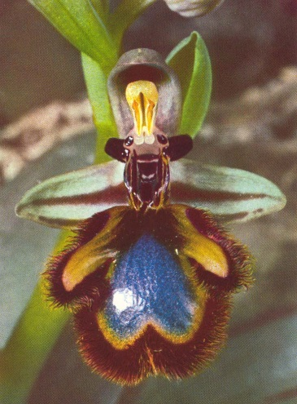
COEVOLUTION
Co-Evolution is the joint change of two or more species in close interaction.
Example - Bumblebees and the flowers they pollinate have coevolved so that both have become dependent on each other for survival.
When two different organisms change in response to each other
Evolution of Camouflage

