Slide 1
RATES OF EVOLUTION
Gradualism and punctuated equilibrium are two ways in which the evolution of a species can occur.
A species can evolve by only one of these, or by both.
Scientists think that species with a shorter evolution evolved mostly by punctuated equilibrium, and those with a longer evolution evolved mostly by gradualism.

Slide 2
GRADUALISM
Gradualism – organisms descend from a common ancestor slowly over a long period of time.
Over a short period of time it is hard to notice.
Small variations that fit an organism slightly better to its environment are selected for: a few more individuals with more of the helpful trait survive, and a few more with less of the helpful trait die.

Slide 3
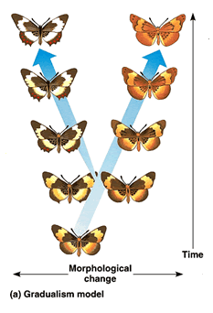
GRADUALISM
Very gradually, over a long time, the population changes. Change is slow, constant, and consistent.

Slide 4
PUNCTUATED EQUILIBRIUM
Punctuated Equilibrium – new species appear suddenly after long periods of little change.
In punctuated equilibrium, change comes in spurts. There is a period of very little change, and then one or a few huge changes occur, often through mutations in the genes of a few individuals.

Slide 5
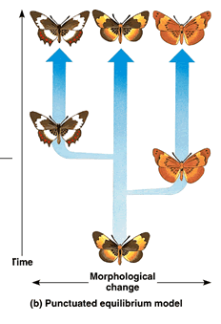
PUNCTUATED EQUILIBRIUM
The species changes very rapidly over a few generations, then settles down again to a period of little change.

Slide 6
EXAMPLE ONE
A population of a particular organism would be living, dying, and getting fossilized every few hundred thousand years. Little observable evolution seems to be occurring judging from these fossils. Then, a drop in sea level forms a lake and isolates a small number of the population of organism from the rest of the population. The small, isolated population experiences strong selection and rapid change because of the novel environment and small population size. The environment in the newly formed lake exerts new selection pressures on the isolated organism. Also, their small population size means that genetic drift influences their evolution. Type of Evolution Rate?

Slide 7
EXAMPLE TWO
A population of a particular organism would be living, dying, and getting fossilized every few hundred thousand years. Little observable evolution seems to be occurring judging from these fossils. Type of Evolution Rate?

