Slide 1
GEOGRAPHIC DISTRIBUTION
Darwin’s theory was that many species now living had each descended from a common ancestor.
While many of these newer species shared similarities, they had each adapted to their new environments
This results in adaptive radiation.

Slide 2
ADAPTIVE RADIATION
The evolution of many diversely adapted species from a common ancestor.
Usually occurs when a population colonizes an area of diverse geographic or ecological conditions.
Many species become so different that the possibility of cross breeding is no longer possible due to the accumulation of genetic changes.

Slide 3
ADAPTIVE RADIATION
Starting with a recent single ancestor, this process results in the speciation and phenotypic adaptation of an array of species exhibiting different morphological and physiological traits with which they can exploit a range of divergent environments.

Slide 4
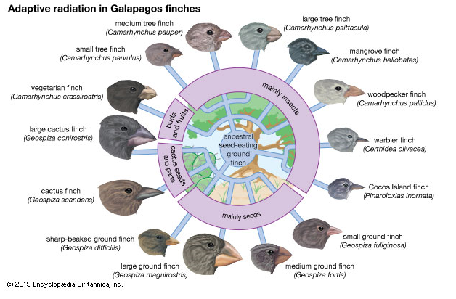
ADAPTIVE RADIATION

Slide 5
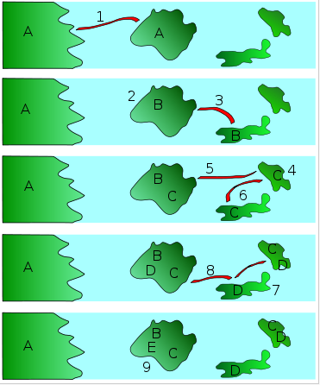
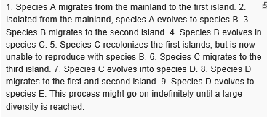
ADAPTIVE RADIATION

Slide 6
SIMILARITIES IN EARLY DEVELOPMENT
The same groups of embryonic cells develop in similar patterns to produce the tissues and organs of all vertebrates.

Slide 7
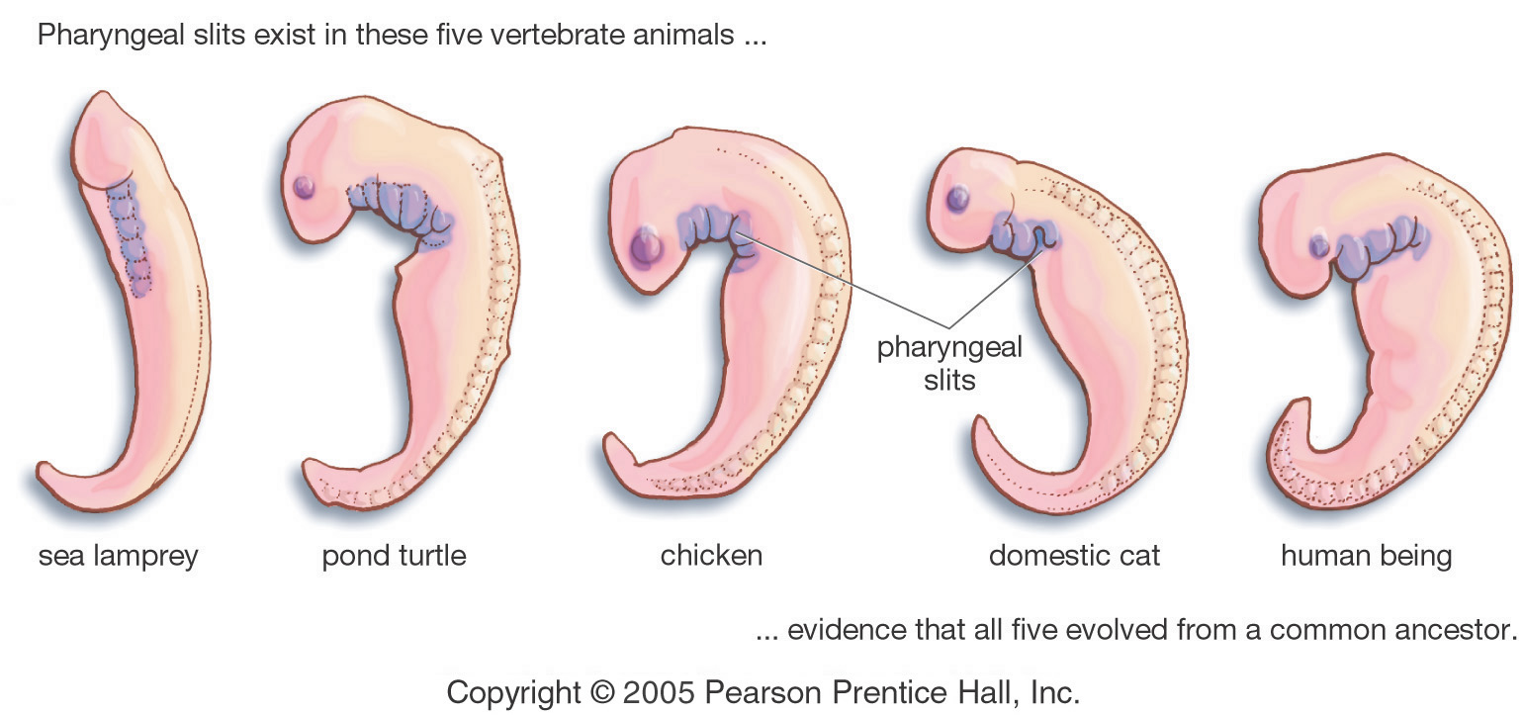
SIMILARITIES IN EARLY DEVELOPMENT
Evidence for Evolution - Comparative Embryology

Slide 8
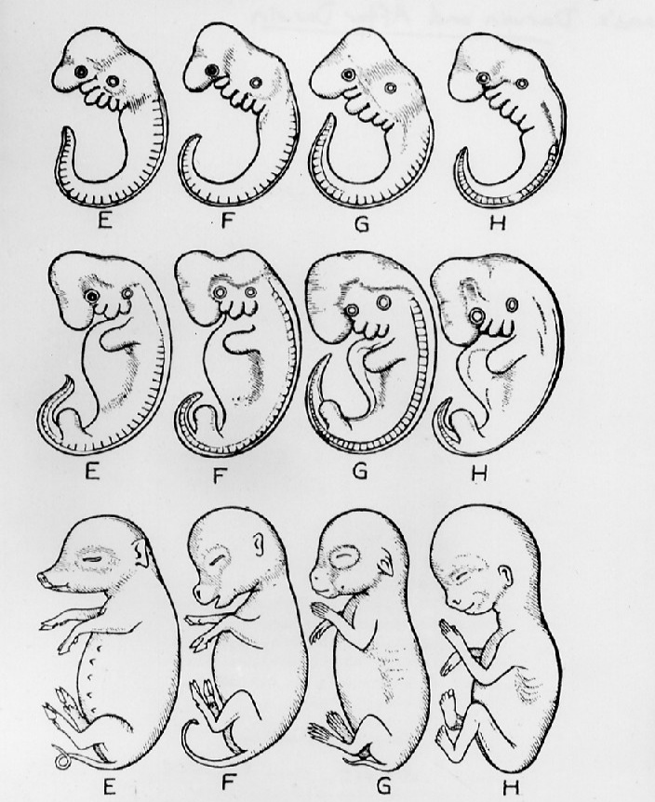
SIMILARITIES IN EARLY DEVELOPMENT
E = HOG
F = CALF
G = RABBIT
H = HUMAN

Slide 9
